Slide 1
Did Henry VII Invent the War of the Roses?
HIST 1016
11/19/14

Slide 2
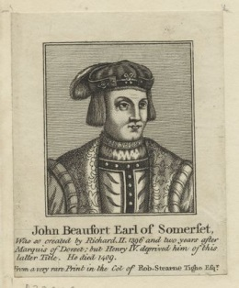
The Lancasters, Beauforts, and Tudors
1373 – John of Gaunt
fathers illegitimate son, John
Beaufort, with Katherine Swynford
1396 – John of Gaunt marries Swynford
Papal bull recognizes the
Beauforts as legitimate children
1397 – Act of Parliament
recognizes Beauforts as legitimate children
Henry IV – recognizes Beaufort
half-brother as legitimate
Include proviso, cannot inherit
throne

Slide 3
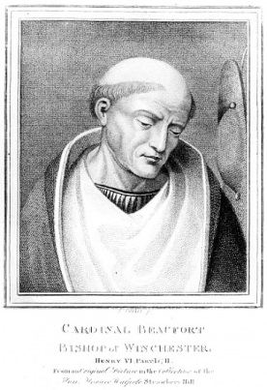
The Lancasters, Beauforts, and Tudors
1397 – John Beaufort named
Earl of Sommerset
After 1399 – Beauforts are
Lancaster loyalists
Sons include Edmund, Duke
of Sommerset, killed at the
First Battle of St. Albans
Brother, Henry Beaufort =
Cardinal Beaufort, advisor to
Henry VI, Joan of Arc’s trial

Slide 4
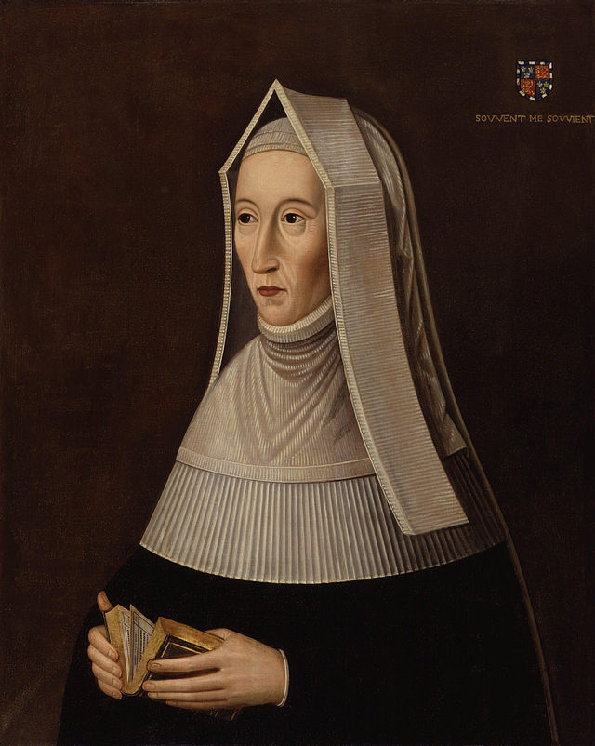
The Lancasters, Beauforts, and Tudors
Margaret Beaufort, John
Beaufort’s granddaughter
Inherits father’s lands and
titles at age 1
1455 - at age 12, married to
Edmund Tudor (24), Welsh
noble, son of Owen Tudor and
Henry V’s widow Catherine
1456 – Edmund dies in a Yorkist
prison
Margaret left widowed and
pregnant at 13

Slide 5
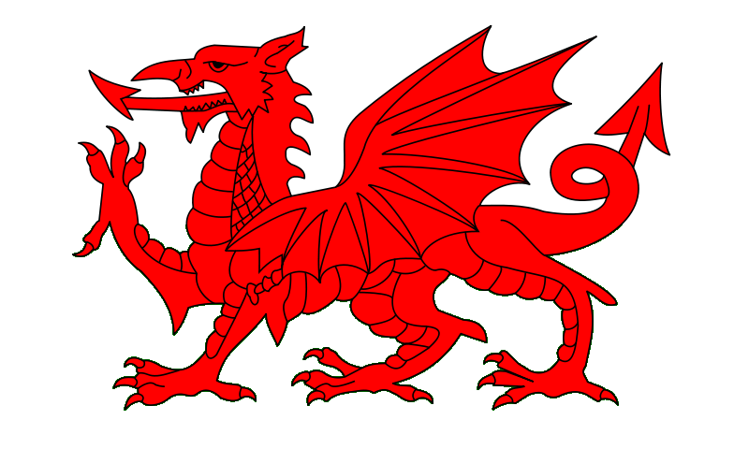
The Lancasters, Beauforts, and Tudors
1457 – Henry Tudor born
Lancaster + Welsh nobility?
Tudors claim descent from Cadwaladr, last legendary British King
Welsh aristocrats who side with Owain Glyndwr against Henry IV
Henry V’s reconciliation
brought Owen Tudor
into Lancaster court
Y Mab Darogan – The
Prophesized Son

Slide 6

Tudors and the War of the Roses
1457 – Margaret and Henry at Pembroke Castle with Henry’s uncle Jasper Tudor
1461 – Jasper goes into exile
Pembroke falls to William Herbert, with Margaret and Henry
1469 – Warwick switches to Lancasters
Jasper returns to England
and takes Henry to court
1471 – York’s victory
send Jasper and Henry to
Brittany

Slide 7
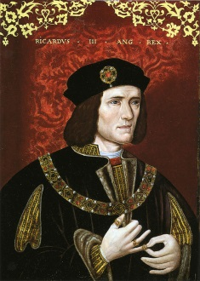
Richard III (r. 1483-1485)
Best known for purge of
Woodvilles and Princes in the Tower
Focus on Commoners
Court of Requests – court of
grievances for people without legal
representation
Bail reform – protect suspected felons
and prevent property seizure
Lift and ban restrictions on printing
and sale of books
Written Laws and Statutes translated
from French to English
College of Arms – register of heraldry
and genealogical research

Slide 8
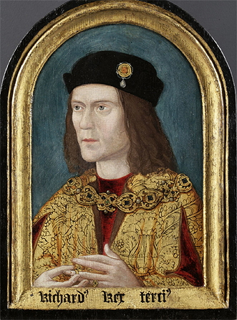
Buckingham’s Rebellion (1483)
May be a misnomer
Supporters of Edward IV
rise up against Richard
The murder of Edward V
becomes public
Richard’s ally, the Duke of
Buckingham, raises an army
against him
Buckingham married to a
Woodville…
After the Princes in the Tower,
who’s next in line?

Slide 9
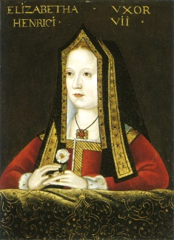
Buckingham’s Rebellion
It’s Henry Tudor!
Buckingham’s plan –
marry Henry to Edward IV’s
eldest daughter Elizabeth
Lancaster + York = Tudor
Storms prevent Henry’s
arrival in England
Richard defeats Buckingham
1484 – Plan to marry Richard III
to Elizabeth
Richard’s supporters are
anti-Woodville

Slide 10
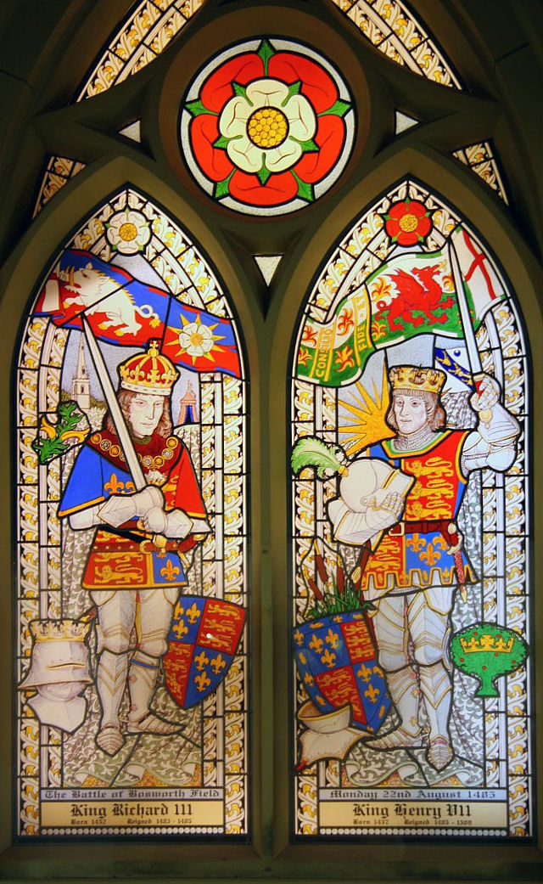
Battle of Bosworth Field (1485)
France finances a second
invasion by Henry
5,000 Lancaster/Tudor forces vs.
8,000 Yorkist
Was Richard betrayed by Baron
Stanley, Margaret Beaufort’s new
husband?
Richard attempts to kill Henry
directly (comes within a swords
length)
Instead Richard killed (last English
king to die in battle)

Slide 11
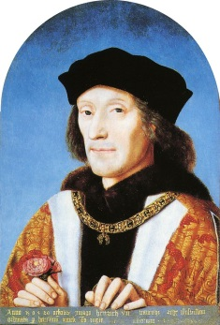
Henry VII (r. 1485-1509)
Marriage to Elizabeth of York
Repeal of Titulus Regius
Retroactively declared king the
day before Bosworth Field
Why does it matter?
Bonds – written contracts of
loyalty with monetary penalties
Recognisances – formal
acknowledgements of debts to the
crown
Bans on livery – retainers wearing
a lord’s badge and uniform

Slide 12
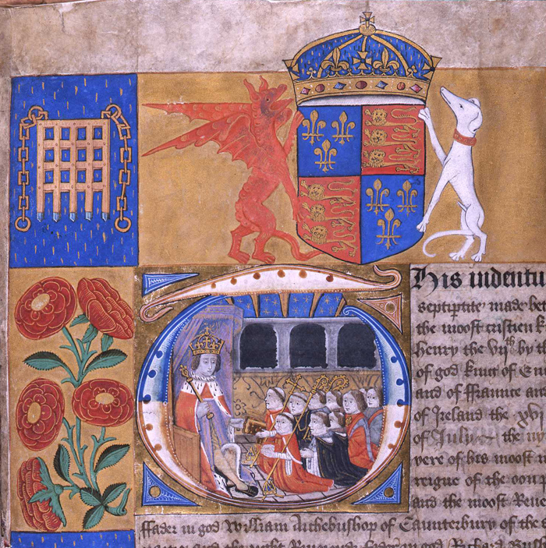
Henry VII and Control of the Nobility
Limits on maintenance – the number of male servants a lord may employ… Why?
King’s Council/Privy Council –
  Advisors with both advisory and executive abilities
  Taken from Parliament, clergy,
  military, judges, and diplomats
Court of the Star Chamber –
  Secret court where nobility
  could be tried by Privy Council
  No witnesses present
Justices of the Peace –
  representatives in every
  shire/county
  guarantee laws are enforced
  Rotated annually

Slide 13
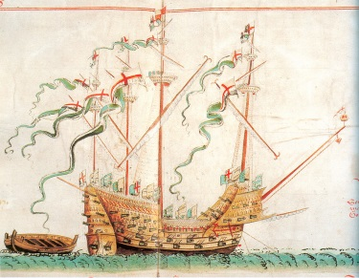
Henry VII and Economic Reform
Stability in the treasury
“Morton’s Fork” and tax collection
1490 – Treaty of Medina del Campo – diplomatic marriage with Spain (including 200,000 crown dowry) and free trade
1492 – Peace of Étaples –
France pays England
50,000 crowns per year
1496 – political concessions
for opening trade with the
Netherlands
Expansion of navy

Slide 14
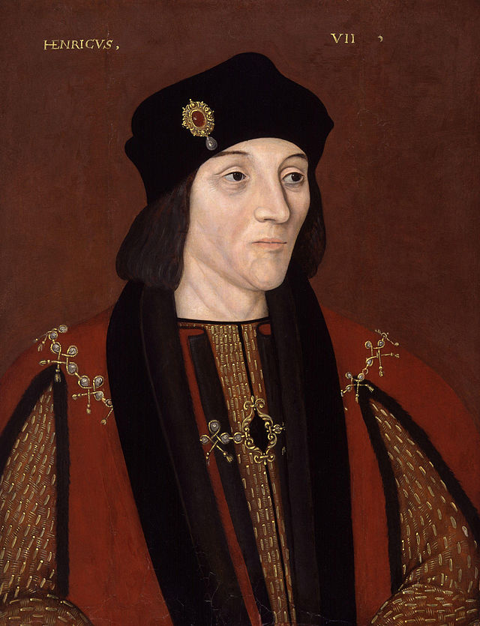
Henry VII
End of Plantagenets,
beginning of the Tudors
1502 – Arthur Tudor,
Henry’s air dies
  Five months after marrying
  Catherine of Aragon
  Attempts to marry
  Catherine to Henry or his son
1503 – Queen Elizabeth dies
in childbirth
1509 – Henry VII dies
Henry VIII (r. 1509-1547) –
Only legitimate son to survive his
father

Slide 15

The Tudor Rose

Slide 16
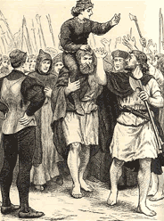
Rivals to the Tudors
Beginning a new dynasty should clear away past claims to the throne
Union of Lancaster and York should satisfy major claimants
Yorkist revolts in 1486, 1487, 1490
Lambert Simnel – impersonated the
imprisoned Duke of Warwick, son of
Clarence
Perkin Warbeck – impersonated Richard,
Duke of York, younger Prince of the Tower,
invaded England in 1491, 1495, 1496, and
1497
Forgiveness of nobles who would take
oaths and bonds

Slide 17
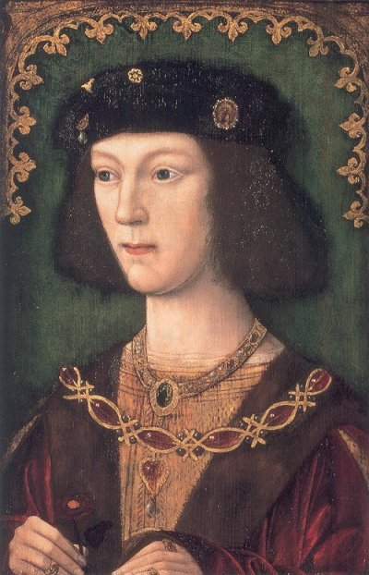
Henry VIII
Charged with preserving Tudor
dynasty
Marriage to Catherine of Aragon
The King’s Great Matter
  No legitimate sons
  A daughter, Mary, too young to
  produce a grandson
  Henry FitzRoy, Duke of Richmond
  Second Succession Act
  Annul marriage to Catherine
Papal authority and the English
Reformation

Slide 18
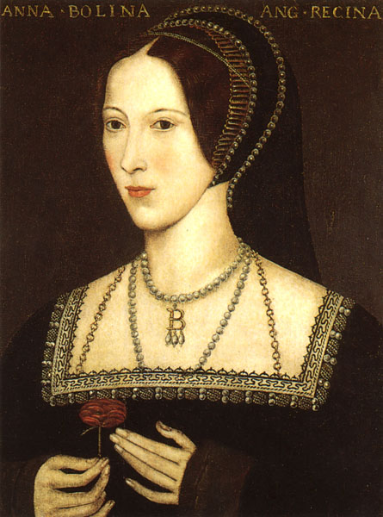
Henry VIII
1527 – argument for annulment
presented to Pope Clement VII
1531 – Catherine banished
from court
Strained relationships with
Charles V, Holy Roman Emperor,
King of Spain, and Catherine’s
nephew
1532 – marriage to Anne Boleyn
1534 – Act of Supremacy and the
Church of England

Slide 19
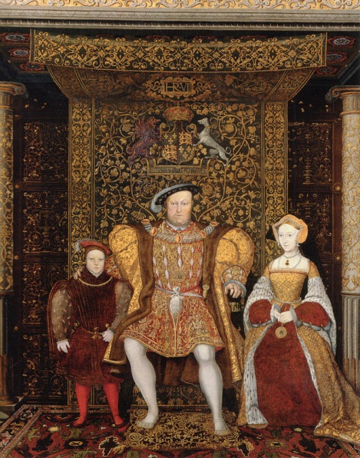
Henry VIII
1536 – Catherine of Aragon
dies
Henry orders a celebration
  Injured in a joust
  Queen Anne miscarries a
  son
Moves against Boleyn family
Anne accused of adultery and
treason and executed
Marriage to Jane Seymour
1537 – Prince Edward born
Jane dies shortly after

Slide 20
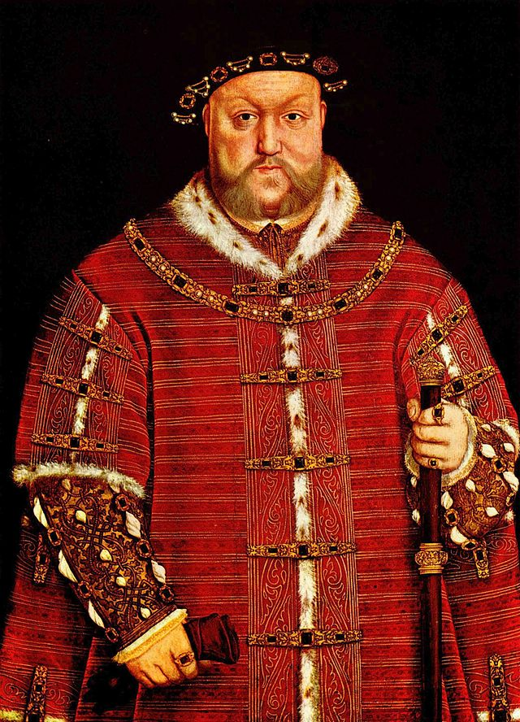
Henry VIII
Second Act of Succession –
delegitimizes previous
children
Continued marriages to
secure succession
Anne of Cleaves – 1540 (six
months)
Catherine Howard – 1540-1542
  Executed for adultery
Catherine Parr – 1544-1547
1547 – Henry VIII dies

Slide 21
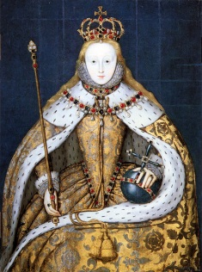
The Tudors after Henry VIII
Edward VI (r. 1547-1553)
  Died heirless at the age of
  15
Mary I (r. 1553-1558)
  Daughter of Henry and
  Catherine of Aragon
  “Bloody Mary”
  Married Philip II of Spain
  Died heirless
Elizabeth I (r. 1558-1603)
  Daughter of Henry and Anne
  Boleyn
  “Virgin Queen”

Slide 22
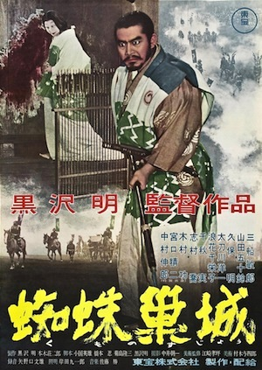
Akira Kurosawa’s Throne of Blood (1957)
Shakespeare’s Macbeth set
in Japan
Sengoku or Warring States
Period (ca. 1467-1603)
Emperor – Shogun – daimyo
– samurai
Plot: Washizu and Miki are
samurai commanders serving
the daimyo Tsuzuki. Returning
from battle, they receive a
prophecy from a spirit about their
futures…

