Slide 1
Richard III and the Tudors
HIST 1016
11/17/14

Slide 2
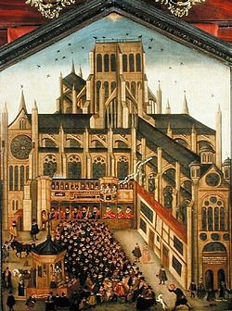
York vs. Queen Margaret
St. Albans was an act of treason, but…
Fears of turning into out
right war
Who is heir to Henry VI? York
or the infant Edward?
Margaret keeps Henry away
from London
1456 – York removed as Lord
Protector
Warwick as champion of merchants
Neville-Percy feud and blood feuds
over St. Albans
1458 – Love Day procession

Slide 3
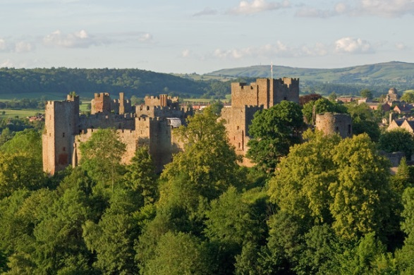
Ludlow Castle
Built for strategic control of Welsh borders
1425 – Richard, Duke of York inherited castle from maternal uncle
1459 – York calls his supporters to gather at Ludlow
Battle of Blore Heath
  Earl of Salisbury attacked when marching to Ludlow
  Queen Margaret
  building personal army,
  swan emblems
  Salisbury routs the
  Lancasters
  ~3,000 dead

Slide 4
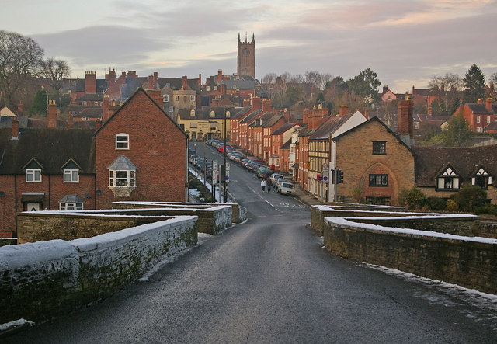
Reversals of Fortune
Who is York against? King Henry or his evil councilors
Battle of Ludford Bridge
  York attempts to march on London
  Large Lancaster force with Henry VI
  Defections from Yorkist forces
York flees to Ireland
Salisbury, Warwick, and
Edward, Earl of March flee to
Calais
Naval attacks on England

Slide 5
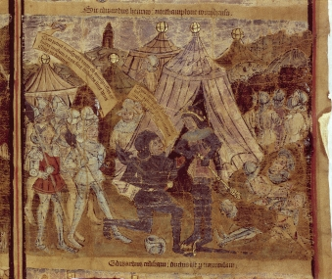
The Madness of Henry VI
Parliament of Devils – York, Salisbury, and Warwick declared traitors
Large support in London and Kent
1460 – Cross the English Channel
Battle of Northampton
  Defections from king’s
  troops
  Henry abandoned in tent
  Second mental breakdown
  Henry as prisoner of Yorkists

Slide 6
The Meaning of York’s Revolt
York attempts to claim the throne
Model of Henry IV
Presentation of genealogical claim to throne
Parliament votes in favor of Henry VI
Acts of Accord – York recognized as Henry’s heir and Protector of the Realm

Slide 7
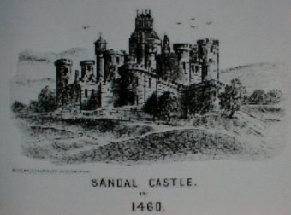
Queen Margaret and the Battle of Wakefield
Margaret and six year old son Edward flee to Scotland
Betrothal to Scottish princess for army
Battle of Wakefield (Dec. 30, 1460)
  Yorkists attack Lancaster forces in north
  Total Lancaster victory
  York killed in battle
  Salisbury and York’s
  second son captured and
  executed
Edward, Earl of March,
claims his father’s titles

Slide 8

Lancaster Violence and Yorkist Propaganda
Margaret relies on looting to pay army
Edward and the parhelion sunrise
  Battle of Mortimer’s Cross (1461)
  Vision of three suns
  Represents himself
  and his two surviving
  brothers
  Yorkist victory
Warwick spreads
stories of looting
Defections to York,
refusal to supply Lancaster

Slide 9
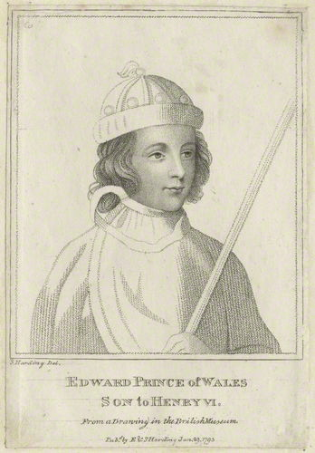
Second Battle of St. Albans (1461)
Warwick attempts to
block Lancasters from London
Flanking maneuver results
in Lancaster victory
Henry VI with Warwick, left
behind in route
Knights who guarded Henry
executed
Queen Margaret, Prince
Edward, and chivalry
London locks its gates against
Lancasters

Slide 10
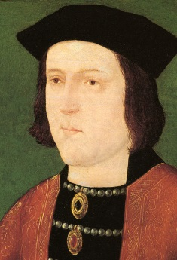
King Edward IV (r. 1461-1470, 1471-1483)
Edward and Warwick rally in
London
Bishop of London asks for the will
of the people - “King Edward!”
Parliament supports Edward
Why move to depose Henry now?
Battle of Towton
  Agreement to settle issue once and
  for all
  No quarter offered, no quarter given
  ~80,000 participants
  20,000 killed
  Henry, Margaret, and Prince Edward flee
  to Scotland

Slide 11
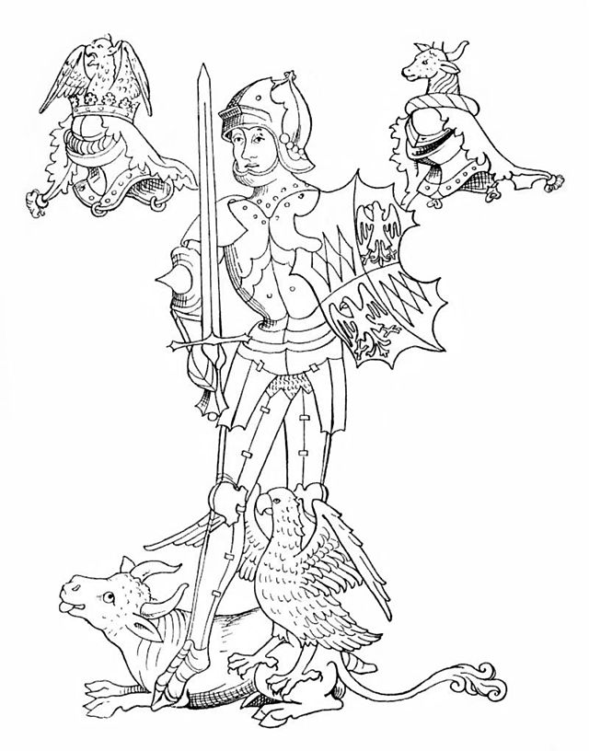
Edward and the Kingmaker
Continued conflicts with
Lancasters in north until
1464
1465 – Henry VI captured
and imprisoned
Peace agreement with
Scotland sends Margaret
and Edward to France
Warwick the Kingmaker rules
through Edward
Warwick attempts to marry
Edward to French princess

Slide 12
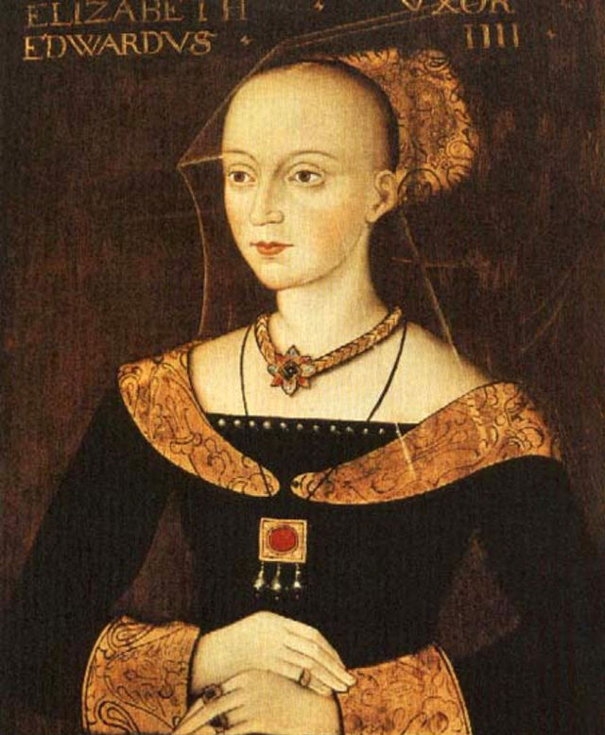
Edward and Elizabeth Woodville
Elizabeth Woodville –
minor noble, widow of Sir
John Grey (a Lancaster
supporter), with two children
1464 – Edward secretly
marries Elizabeth
Undermining Warwick’s plans
“He must know she was no
wife for a prince such as himself”
12 siblings of Elizabeth marry
into noble families
Love, lust, or political
calculation?

Slide 13
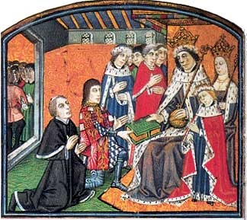
Warwick vs. Edward
Nevilles vs. Woodvilles for offices
Alliance w/ Burgundy vs. alliance w/ France
Reluctance to marry Edward’s brothers to Warwick’s daughters
Is it easier to be Kingmaker
than rule?
Warwick blamed for high
taxes and periods of
lawlessness
Tradition of blaming advisors

Slide 14
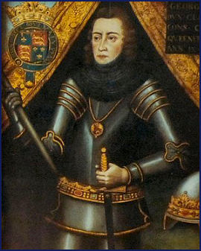
Warwick’s Rebellion
Alliance between Warwick and Edward’s brother, the Duke of Clarence
1469 – Battle of Edgecote
Moor
  Warwick and Clarence raise an
  army
  Defeat and capture Edward
  Warwick has two kings
Breakdown of England
Feuds among noble families
Resurgence of Lancaster rebellions

Slide 15
Warwick’s Rebellion
No move to remove Edward, rule through Edward
Rebellions make Edward more important
Troubles in Lincolnshire
  Were Warwick and Clarence the instigators
  Warwick and Clarence declared traitors
In France, Warwick allies with Louis XI and Margaret of Anjou

Slide 16
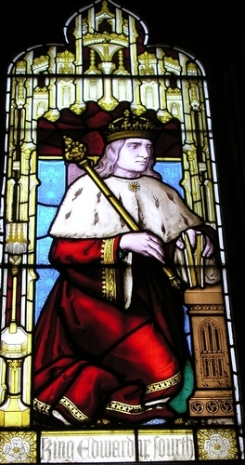
Warwick’s Rebellion
1470 – Warwick invades
England with French army
Edward flees to Burgundy
Henry VI restored as king
Lancasters demand return of
confiscated property
Louis XI expects Warwick to
invade Burgundy
Instead, Edward invades England

Slide 17
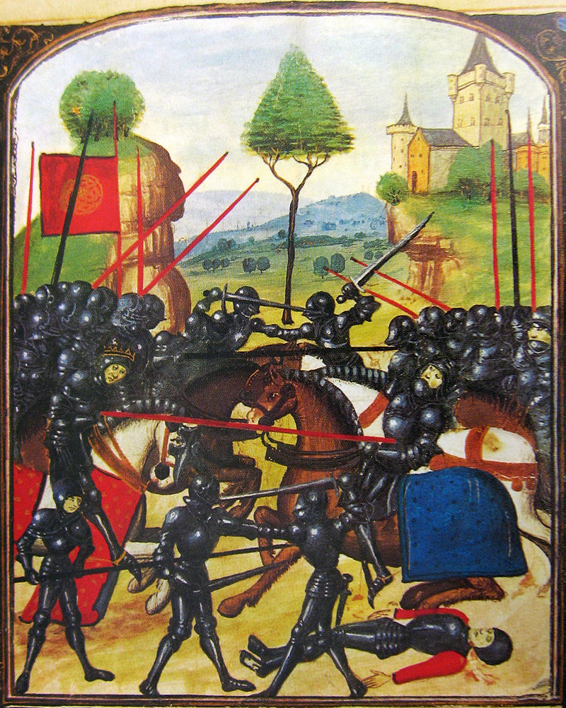
Edward’s Return
1471 – Edward returns to
England demanding the
title Duke of York
Claims loyalty to Henry
Clarence abandons
Warwick for Edward along
with ever fickle nobility
Battle of Barnet
  Thick fog and betrayal
  Warwick killed

Slide 18
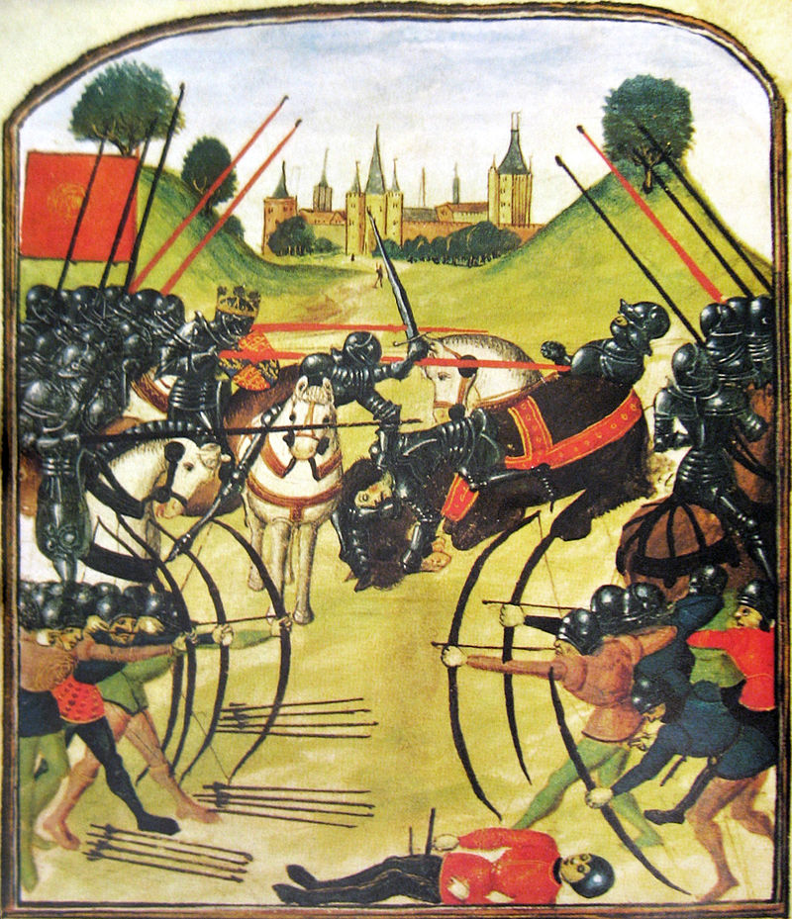
Battle of Tewkesbury
Margaret and Prince Edward attempt to join Lancaster forces in Wales
Gloucester refuses passage
across the River Severn
Battle of Tewkesbury
  Lancaster forces destroyed
  Prince Edward killed
Heirless, Henry VI killed in
Tower of London
Edward IV uncontested king

Slide 19


Is this the end?

Slide 20
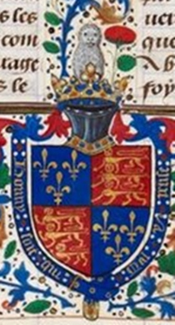
Modus et ordo
Method and Order
Edward brings stability after
decades of conflict
Heavy investment in London
merchant corporations
Duchy of Lancaster as crown lands
Reform at the Exchequer – make
sure lords are paying their due
Make crown lands profitable

Slide 21
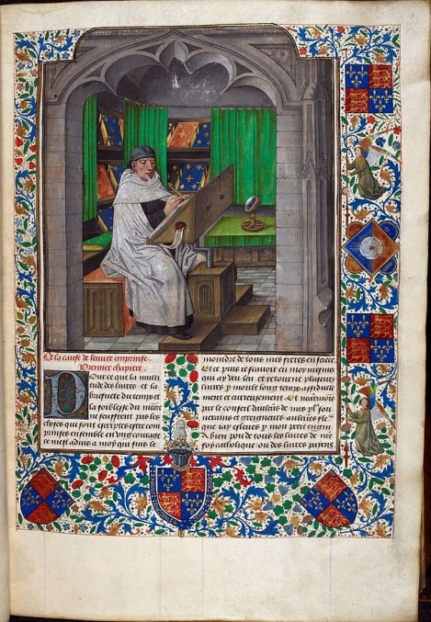
The Court of Edward
Used wealth to express
legitimacy
“the most splendid in all
Christendom”
Interest in scholarship
Commissioned large
library
Foundation of the Royal
Collection of Manuscripts at
the British Library

Slide 22
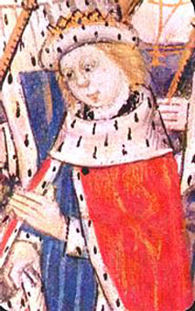
Edward V (r. 1483)
Richard, Duke of Gloucester,
youngest brother of Edward, and
William Hastings become
governors of north and midlands
Clarence estranged from
Edward and executed in 1478
1483 – Edward dies after a
short illness
Makes final change to will,
making Richard Lord Protector over
his 12 year old son Edward V

Slide 23
Richard and the Woodvilles
Parvenus – up-start who has not gained social acceptance
Are Woodvilles parvenus?
Edward V living as steward under Anthony Woodville, Earl Rivers
Richard, Hastings, and the Duke of Buckingham gather an army
Hastings and Buckingham intercept Rivers with Edward V
Were the Woodvilles planning to assassinate Richard?

Slide 24
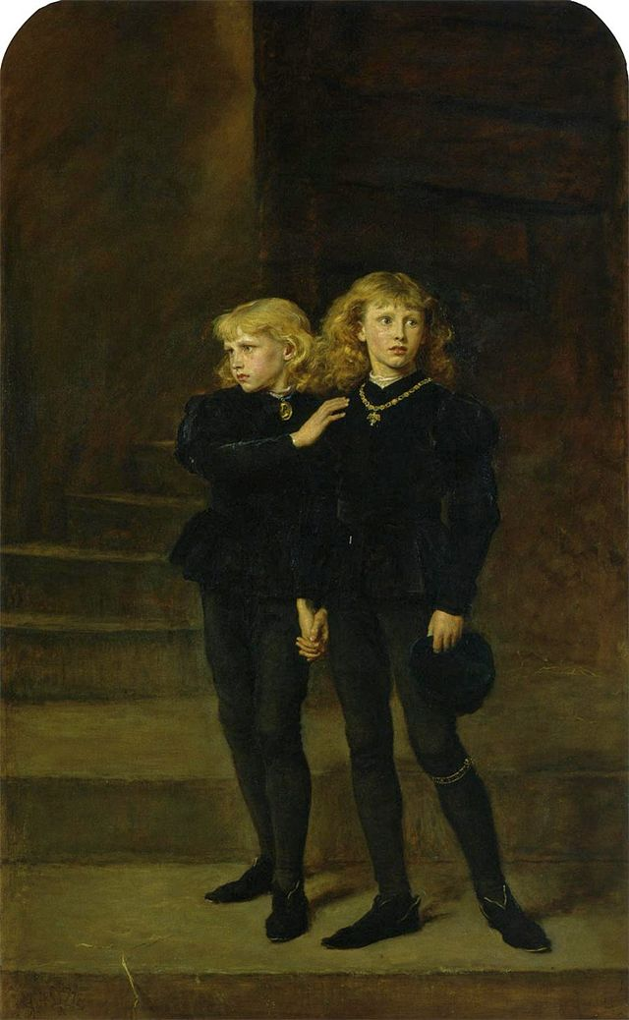
The Princes in the Tower
Edward locked in the Tower of
London
Queen Elizabeth and children
hide in Westminster Abbey
Archbishop of Canterbury
convinces Elizabeth to give up
youngest son
Richard declares Edward and
Elizabeth’s marriage illegal and their
children illegitimate
Titulus Regius – Parliament names
Richard III king

