Slide 1
Popular Revolt and the Claims of York
HIST 1016
11/12/14

Slide 2
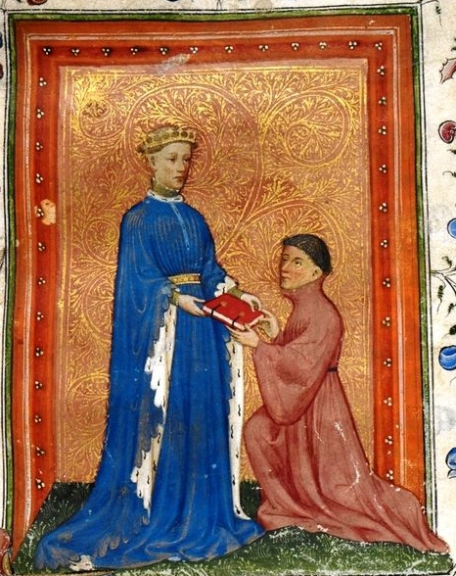
Henry V (r. 1413-1422)
Son of Henry IV
During his father’s reign
  Prince of Wales, Duke of
  Lancaster, Duke of Cornwall,
  Earl of Chester, Duke of Aquitaine
  Military command in
  Wales against Glyndwr,
  Battle of Shrewsbury against
  Percys (Harry Hotspur)
1410-1411 – while father is
ill, Henry takes control of
government for 18 months

Slide 3
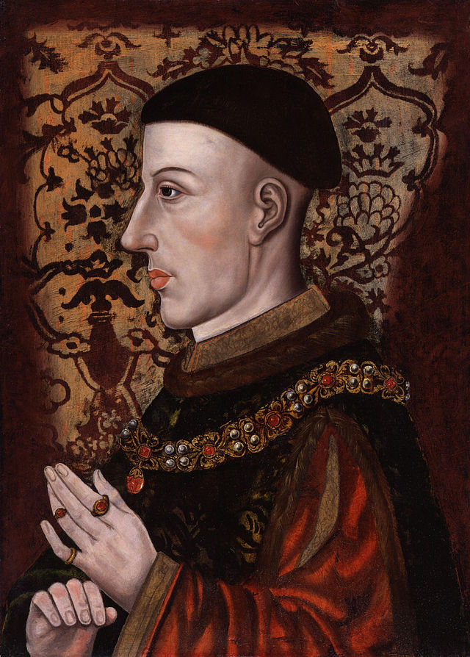
Henry V
1413 – Henry succeeds
his father after his death
Promoted English unity
Restored titles and lands
to rivals of his father
First king to promote
English language and use it
himself
Military success = happy
subjects

Slide 4
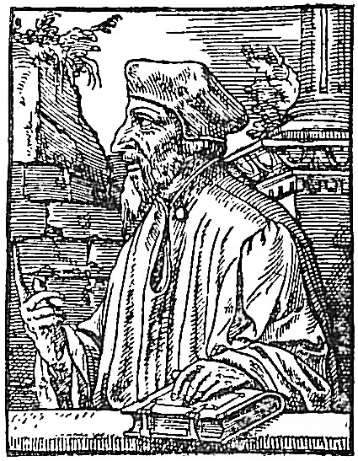
Lollardy
John Wycliffe (d. 1384) – English preacher and reformer
Anti-clerical, Bible centered
Accompanies translation of
Bible
Often incorporated into
political revolts
Precursor to Protestant
Reformation
1401 – Outlaw the translation
of the Bible, burn heretics

Slide 5
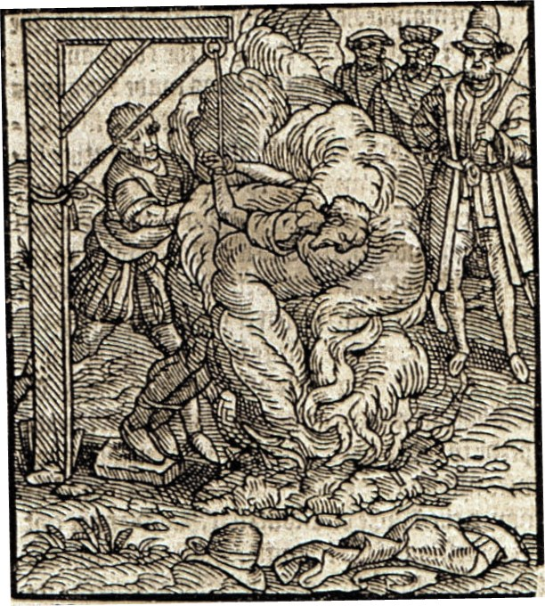
Henry and John Oldcastle
Sire John Oldcastle – English knight and friend of Henry
1410 – Oldcastle arrested
over Lollard heresy
Henry protects his friend,
but Oldcastle refuses to
repent
1413 – Oldcastle escapes
and becomes head of Lollardy
rebellion
1417 – Oldcastle captured
and burnt at the stake
Falstaff of Shakespeare

Slide 6
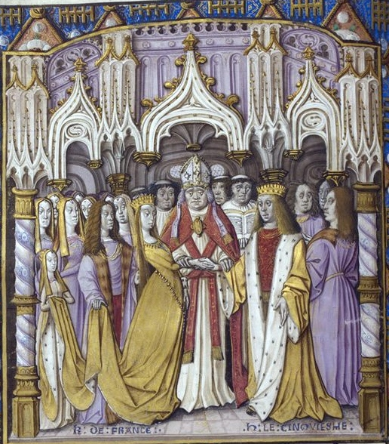
Henry and France
Reassert Edward III’s claim to France
1415 – Henry campaigns in France
Battle of Agincourt – Oct. 25
  English victory
  Execution of all prisoners
Treaty of Canterbury (1416) –
Holy Roman Emperor Sigismund
recognizes Henry’s claims
Treaty of Troyes (1420) –
Henry will marry Charles VI’s
daughter and become his heir

Slide 7
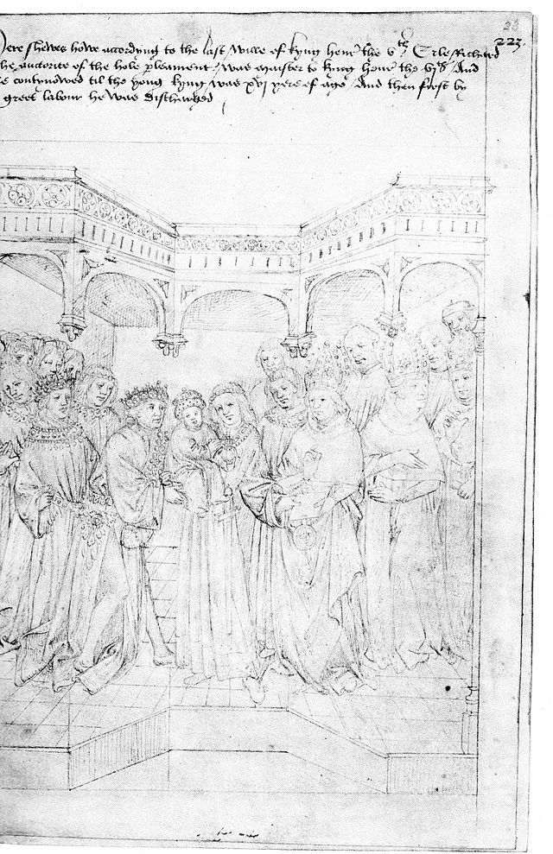
Henry VI (r. 1422-1461, 1470-1471)
1422 – Henry V dies while
on campaign in France
Henry VI – only heir is nine
months old
Charles VI dies weeks later
and Henry VI becomes king of France
John, Duke of Bedford – brother
of Henry V acts as regent, focused
on France
Humphrey, Duke of Gloucester –
brother of Henry V acts as lord
protector

Slide 8
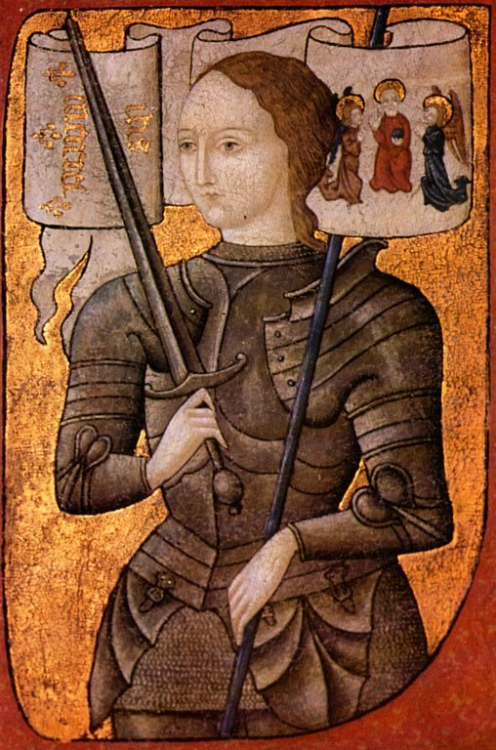
Charles VII and Joan of Arc
Charles VII (r. 1422-1461) –
son of Charles VI and contender
to French throne
Joan of Arc – peasant girl
receives visions instructing her
to support Charles VII
Is the Hundred Years’ War a
holy war?
Siege of Orleans (1429) – relief
shortly after Joan’s arrival
Coronation of Charles VII

Slide 9
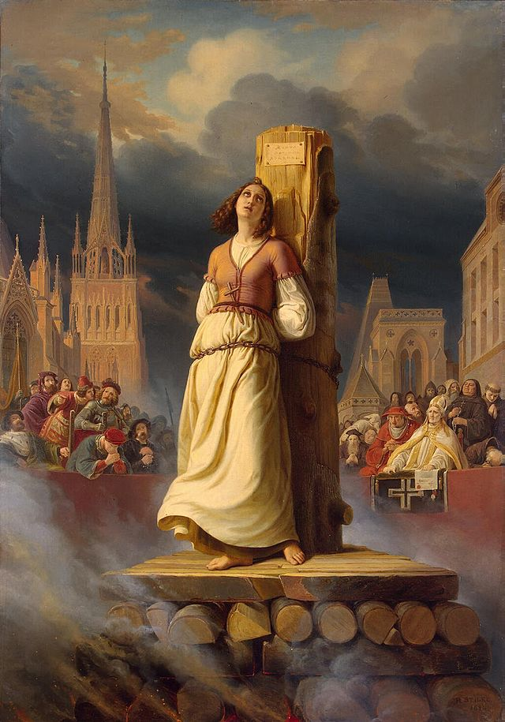
Trial of Joan of Arc
1430 – captured by
English
John of Bedford leads trial
of heresy
Entirely pro-English, no
French representatives
Cross-dressing charge
1431 – found guilty and
burned at the stake

Slide 10
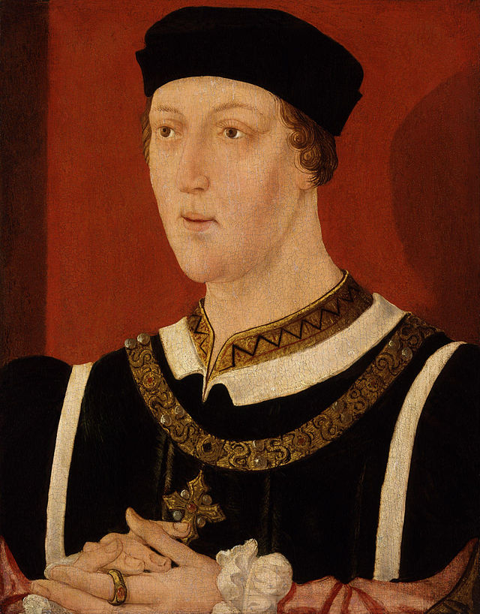
Henry VI
1435 – John of Bedford dies
1437 – Henry comes of
age (16)
Remembered as peaceful
and studious
Pushes peace policy with France
Split among advisors
  Doves – Cardinal Beaufort and
  William de la Pole, Earl of Suffolk
  Hawks – Humphrey, Duke of
  Gloucester and Richard, Duke of
  York

Slide 11
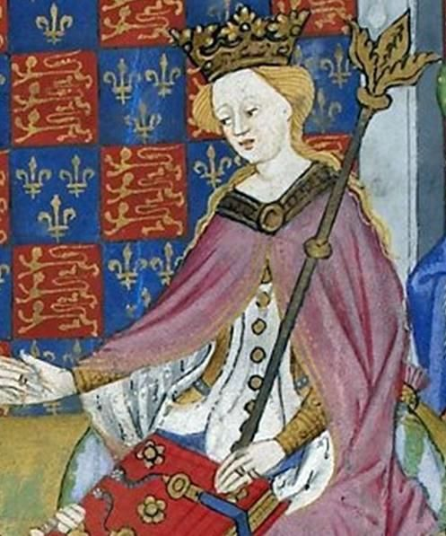
The Court of Henry VI
1445 – marries Charles VII’s niece, Margaret of Anjou
Returns Maine and Anjou
to France
1447 – Humphrey, Duke of
Gloucester arrested for treason,
dies in prison
Richard, Duke of York exiled to
Ireland
William, Earl of Suffolk and
Edmund, Earl of Somerset elevated
to Dukes
Public opinion with York

Slide 12
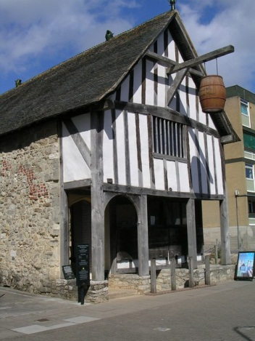
The Great Slump
ca. 1440-1480 – pan-European recession
Shortage of silver bullion = shortage of coin and credit
Protectionist economic policies
London as center of foreign trade
1429 – foreigners buyers of
English wool forced to pay 1/3rd in
bullion or foreign currency
1435-1439 – Burgundian
blockade

Slide 13
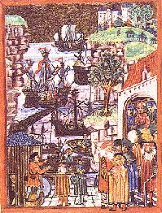
The Great Slump
1440-1447 – Hosting statute
War with France = loss of trade
Anti-piracy measures anger
Hanseatic League
Discourages foreign trade
Bans on English goods in
northern Germany
Ripple effect throughout economy
Correlation between political unrest
and wool industry
Is this the government’s fault?

Slide 14
Popular Revolt
Loss of Normandy and raids on English coast
Soldiers not receiving payment or supplies
Crown lands given to Henry and Margaret’s favorites
1450 – Suffolk impeached by the House of Commons
Henry sends Suffolk into exile, but his ship was captured and Suffolk beheaded
Body discovered on the shores of Dover

Slide 15
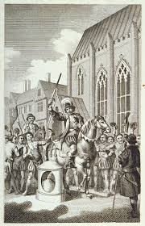
Jack Cade Rebellion
Jack Cade, commoner, aka –
Jack Mortimer
Fear in Kent over reprisals for
Suffolk
“The Complaint of the Poor
Commons of Kent” or “The
Proclamation of Grievances”
May 1450 – 5,000 commoners
march on London
Ambushes and surprising victories
July 1450 – Cade declares himself
mayor of London

Slide 16
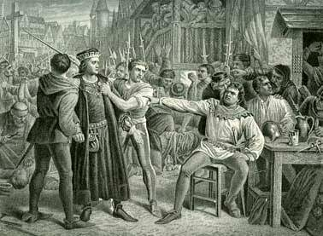
Jack Cade Rebellion
Henry VI flees London
Show trials of advisors accused of treason
James Fiennes, 1st Baron Saye and Sele and Lord High Treasurer imprisoned and executed with son-in-law
Drunken looting turns
opinions of Londoners
July 8 – Battle between
Londoners and Cade on
London Bridge
John Kemp, Archbishop
and Lord Chancellor, offers
pardons

Slide 17
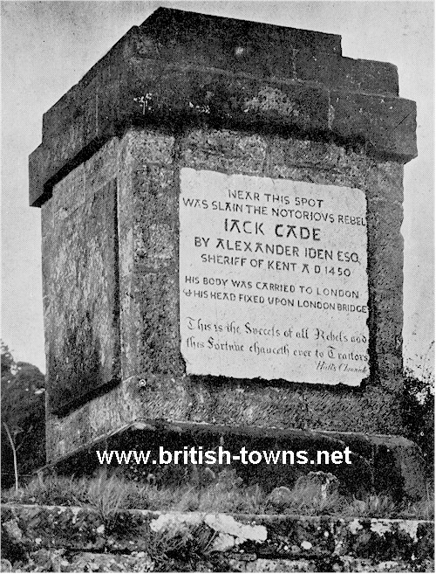
Jack Cade Rebellion
“Writ and Proclamation by
the King for the Taking of Cade”
Pardons are voided (not
approved by Parliament)
Reward given for Cade, dead
or alive
July 12 – Cade is mortally
wounded in a struggle
Cade’s body is put on trial and
beheaded
All rebels ordered arrested and tried
Further rebellions in Sussex and
elsewhere

Slide 18
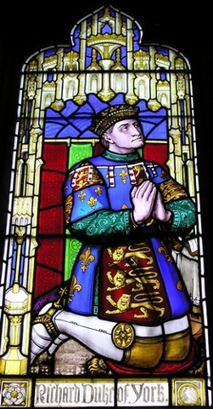
Richard, Duke of York
House of York – descendants of
Edward III’s fourth son
Also his second son through marriage
Sept. 1450 – York returns from his
exile in Ireland
Gathers supporters and marches on
London
Reformer – better government and
prosecution of traitors who had lost northern
France
Rivalry with the Duke of Somerset
Campaign to be named Henry’s heir
1452 – forced to swear oath of allegiance

Slide 19
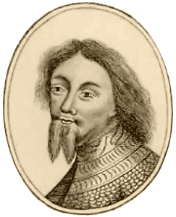
Richard, Protector of the Realm
Battle of Castillon (1453) – English lose last territories in France
End of the Hundred Years’ War
Henry VI has a mental
breakdown
Son, Edward, born shortly after
Great Council called
York elected Protector of the
Realm and Chief Councilor
Duke of Somerset imprisoned

Slide 20
Percy-Neville Feud
Rival noble families in northern England
Henry VI and Somerset support Percy
York supports Neville
  Married to a Neville
Richard Neville, 5th Earl of Salisbury – named Chancellor by York
Neville is York’s greatest ally among nobility

Slide 21
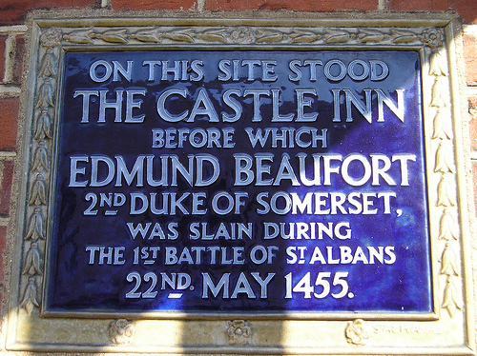
St. Albans and the Beginning of the War of the Roses
1455 – Henry VI recovers
Somerset released from prison and York removed from office
Somerset calls Great Council away from London
York, Salisbury, and Salisbury’s son, Warwick, raise an
army and march on London
First Battle of St. Albans –
Somerset killed, Henry
captured, York named Lord
Protector

Slide 22
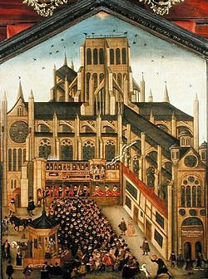
York vs. Queen Margaret
St. Albans was an act of treason, but…
Fears of turning into out
right war
Who is heir to Henry VI? York
or the infant Edward?
Margaret keeps Henry away
from London
1456 – York removed as Lord
Protector
Warwick as champion of merchants
Neville-Percy feud and blood feuds
over St. Albans
1458 – Love Day procession

