Slide 1
The People’s Democratic Party of Afghanistan
HIST 3035
11/10/14

Slide 2
Modernization and Foreign Investment
Lessons learned, can’t raise taxes without upsetting traditional power centers.
Shift to direct taxation on exports.
Means you must build an export economy.
Cotton in Kunduz, karakul lambskin, fruits, grain, and opium
Still largely a subsistence economy…

Slide 3
Enter the Rentier State
Afghans generally nervous about outside influence, but need foreign investment.
Limit influence of British and Soviet Union
WWI – Seek German and Ottoman assistance
WWII – Seek German and Japanese assistance
Neither of these pan out…

Slide 4
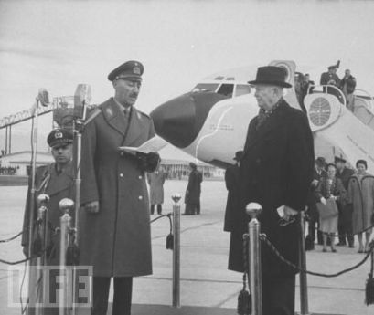
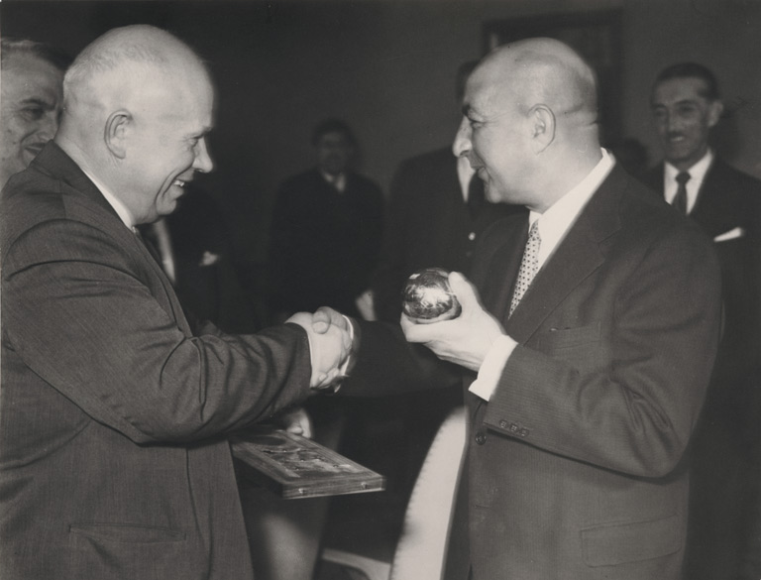
Afghanistan and the Cold War
1950’s-1970’s: approximately
$2 billion enter Afghanistan from
US and Soviet Union
Makes Kabul a cosmopolitan city
filled with foreign advisors,
diplomats, and businessmen.
Benefits Kabul and other urban
centers first.
Little offered by Afghanistan in
return…
  Put down basmachi in the north
  Tone down the Pashtunistan rhetoric

Slide 5
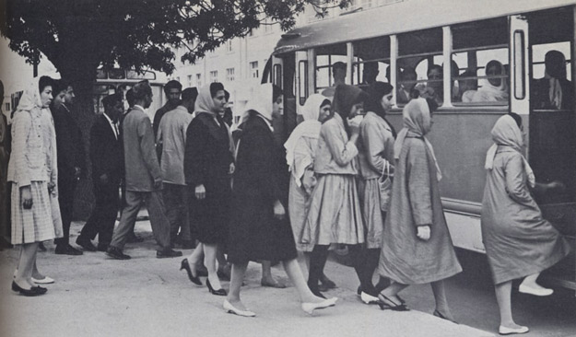
Kabul and Afghanistan

Slide 6
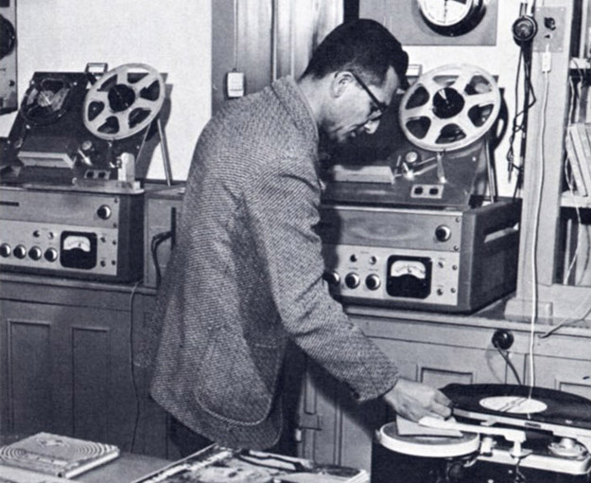
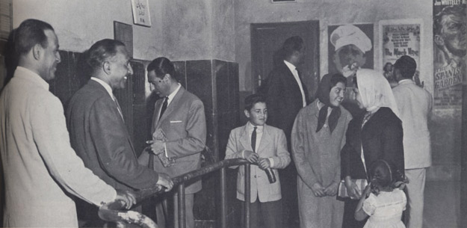
Forging a National Identity

Slide 7
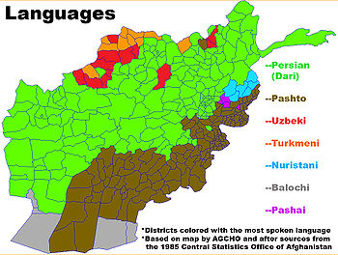
Still rather Pashtu Centered

Slide 8
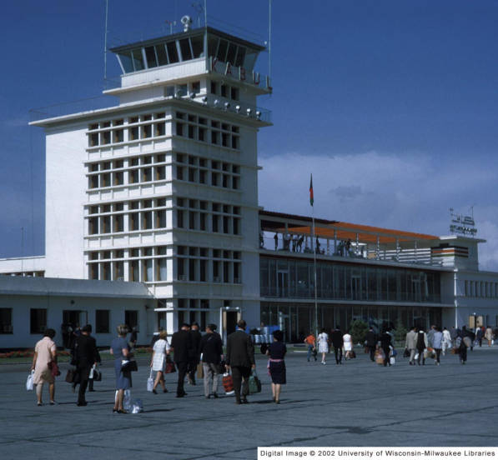
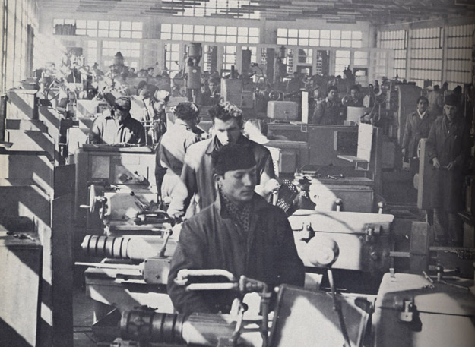
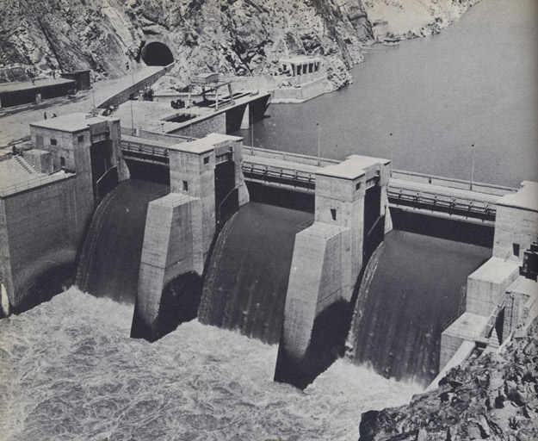
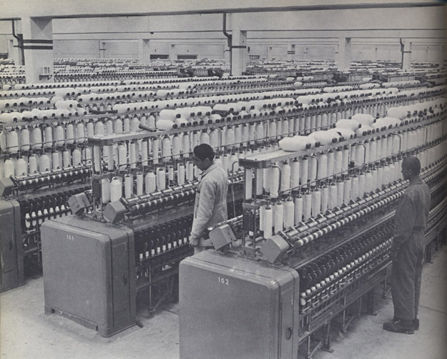
Modernization and Foreign Investment

Slide 9
Cold War and Education
Kabul University: Western European and American faculty
Kabul Polytechnic: Soviet faculty
al-Azhar
By 1979: 1,000,000+ students in primary school, 136,000 in secondary school, and 23,000 enrolled in university
Creates a growing educated elite.

Slide 10
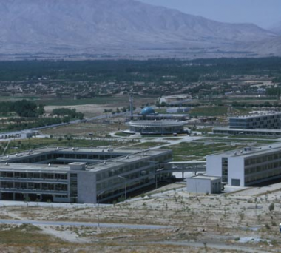
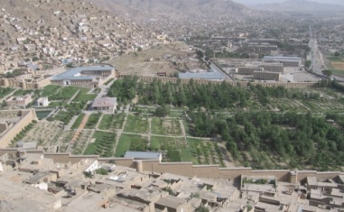
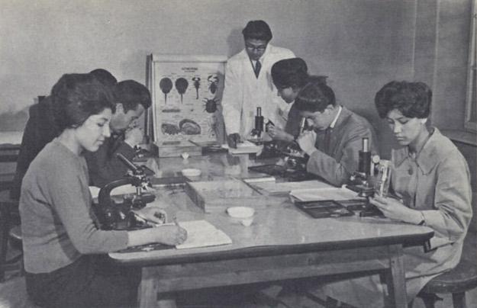
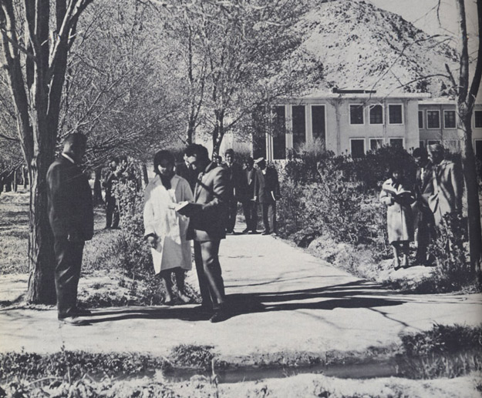
Cold War and Education

Slide 11
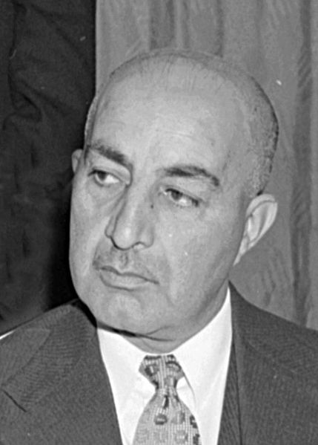
Education and Modernization
Increased education creates
constituency for secularization and
liberalization.
Daud Khan: cousin of Zahir Shah,
becomes Prime Minister in 1953
1964: New constitution
  Bans members of the royal family
  from government office
  Recognizes Dari and Pashtun as
  national languages
  Women’s suffrage

Slide 12
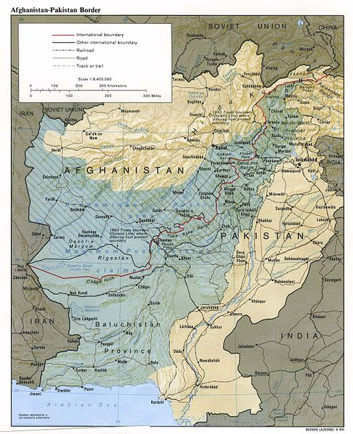
Pashtunistan
1949: Parliament denounces Durrand Line
1978: Pashtunistan Day a
national holiday
Kabul Times glorifies Pashtun
leaders in Pakistan
Push back from non-Pashtuns
Problems of interference in
Pakistani politics
1960’s: US backs out of
supporting Afghanistan

Slide 13
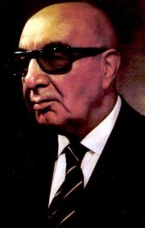
Republican Coup
1973: Daud Khan overthrows
Zahir Shah
Zahir Shah in Rome for
medical treatment
Coup supporters include
leftists and the military,
especially university grads
Unmet expectations of 1964
constitution meet Soviet
influence

Slide 14
Prelude to the People’s Democratic Party of Afghanistan
1948: Formation of a parliament spawns a variety of political parties (Marxist, nationalist, Islamist, democratic, etc.)
Calls for shift from monarchy to liberal democracy
1953: Prime Minister Daud Khan leads government repression of parties
Ban political parties, close newspapers, etc.

Slide 15
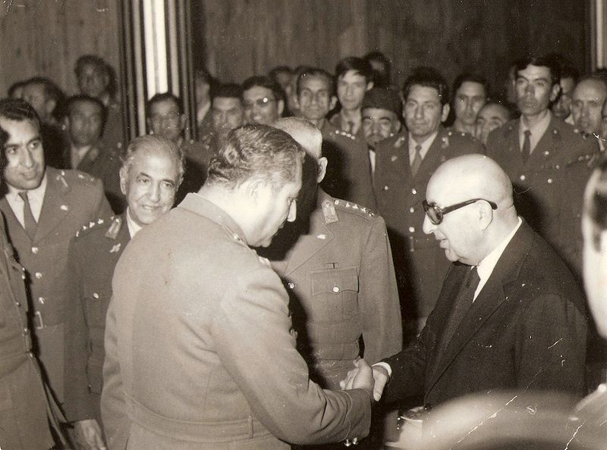
Republic of Afghanistan
Response to rapid development
Supported by leftist political parties and the military
Development had raised expectations for public
services,
infrastructure,
and standard
of living
Growing number of
unemployed
college
graduates (a
blocked elite)

Slide 16
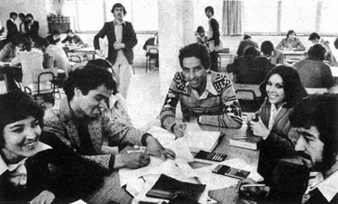
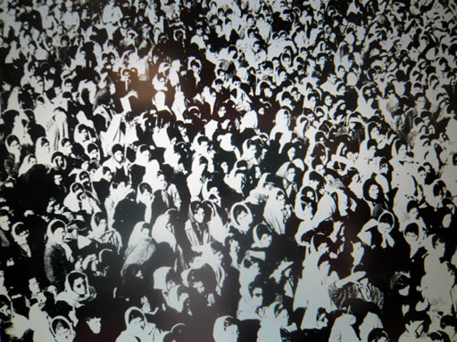
Kabul University
Crucible of students, new ideas,
and new opportunities
Islamists: Muslim Youth
Organization (1973, later
Jamiat-i-Islami)
  Inspired by Muslim Brotherhood
  Members include Burhanaddin
  Rabbani (President of Afghanistan)
  Faculty sponsors include Ghulam
  Rasul Sayyaf and Gulbuddin
  Hekmatyar (President of
  Afghanistan and currently wanted
  by US)

Slide 17
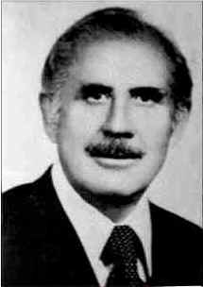
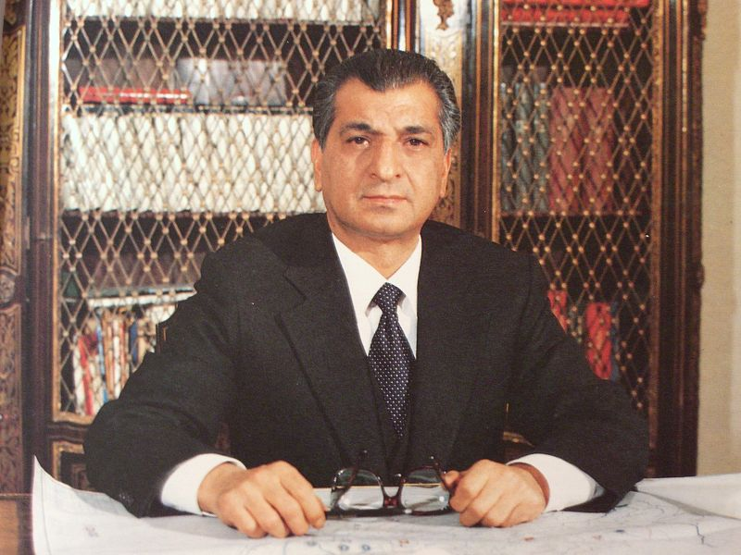
People’s Democratic Party of Afghanistan
1965: Formed by Nur Muhammad
Taraki and Barbak Karmal (both
presidents of the Democratic
Republic of Afghanistan)
1967: PDPA splits
  Khalq (masses): Ghilzai
  Pashtuns in the military, led
  by Taraki and Hafizullah
  Amin
  Parcham (banner): Kabul centric,
  bureaucracy and educational
  institutions, led by Karmal

Slide 18

Khalq and Parcham
Both Marxist and Pro-Soviet
Khalq: Favors revolution to bring quick path to socialism
Parcham: Favors slow reform through cooperation with existing system

Slide 19
Islamists and PDPA
Both Kabul centered, growing out of student movements
Neither have large base of support
Neither interested in support outside of Kabul
PDPA ~18,000 members before 1978, only 1/3rd “active”
Islamists do not attract many mullahs, Sufis, or other mainstream religious figures

Slide 20
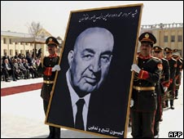
PDPA and Daud Khan
PDPA “junior” partners in
Republican Coup
Parchamis given
bureaucratic positions and
rural governorships
Khalqis less inclined to
participate in non-socialist government
By 1975, Daud purges Parchamis from government, outlaws PDPA
1975: Islamist uprisings, fail to gain support, crushed, excuse to arrest mainstream Islamists

Slide 21
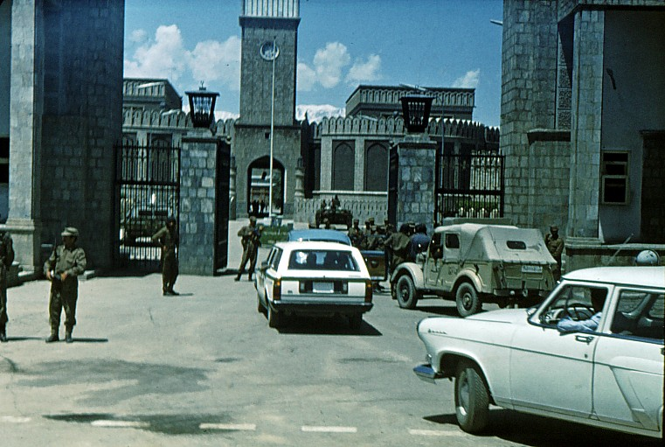
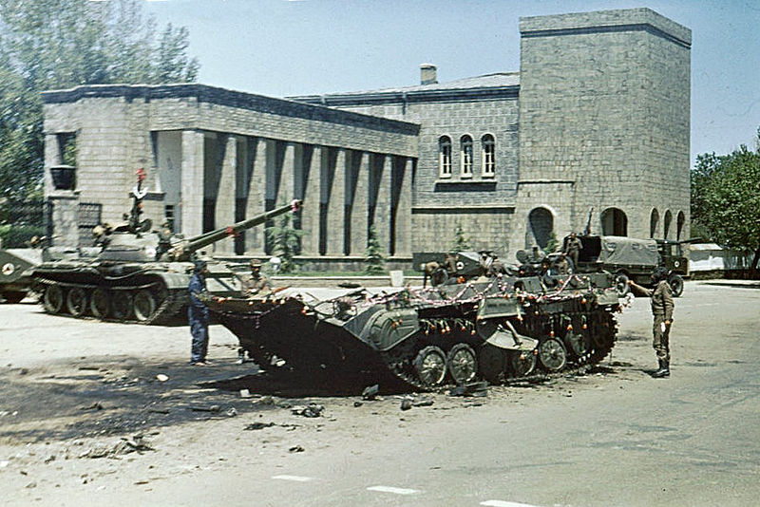
Saur Revolution (April 27, 1978)
Rumors that Daud
assassinated a prominent
Parchami leader led to
widespread
demonstrations.
Daud ordered the arrest of
all PDPA leadership
Khalqi faction puts junior
military officers into action.
Storm the Presidential Palace,
kill Daud and most of his
family

Slide 22
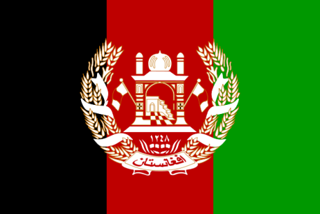



Khalqis and Radical Reforms
Transform Afghanistan through radical changes to land tenure, education, women’s rights, and family law.
Target land owners, older military elites, Islamic leaders, and even Parchamis
Replace Islamic rhetoric with Marxist rhetoric
Why would this trouble the Soviet Union?

