Slide 1
The Musahiban Dynasty:
Debating the Future of Afghanistan

Slide 2
From Abdur Rahman to the Musahiban…
Major issues…
1) Geopolitics and foreign interests, the legacy of Gandemak
2) Developing national(ist) identity, Afghanistan is Kabul
3) Debates over culture and religion, the identity of Afghanistan and the Afghan state

Slide 3
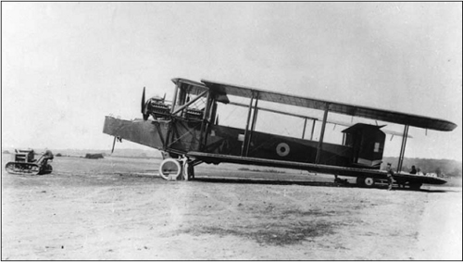
Geopolitics: The Third Anglo-Afghan War
May 6 – Aug. 8, 1919
Amanullah pushes independence from British
Afghanistan attacks through Khyber Pass
Ends with RAF bombing Kabul
Total British victory,
except…
Peace treaty gives
Afghanistan right
to control
foreign relations

Slide 4
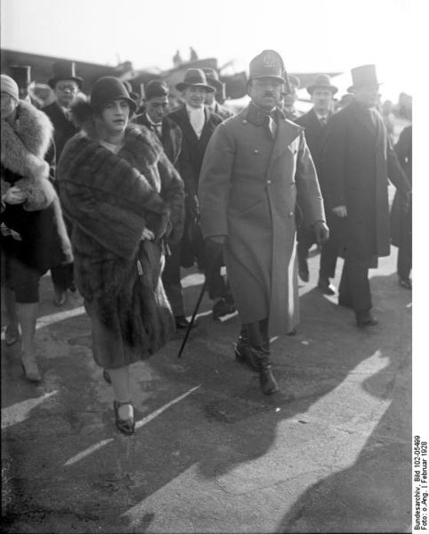
Third Anglo-Afghan War, Aftermath
Occasion of Afghan
Independence Day
Joins League of Nations
Afghanistan attempts to
find allies far
removed from local
geopolitics.
1927: Amanullah travels
to Turkey, Iran,
Western Europe
Queen Soraya and Amanullah in Germany

Slide 5
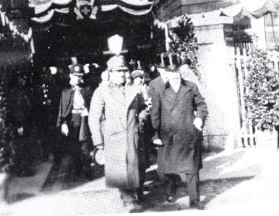
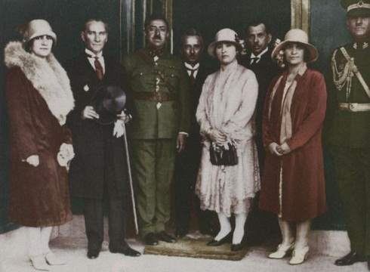
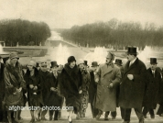
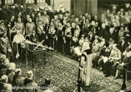
Amanullah’s World Tour

Slide 6
Afghanistan is Kabul
Pushes Afghan national identity, conceived in and enforced from Kabul
1923: First written constitution
  Civil Rights for all Afghans
  Elected legislature
  Make state interactions transparent and standardized
Remove tribal elders from military recruitment process
Ends state subsidies for tribal elders and junior members of the Muhammadzai clan
1928: National bank and currency, the afghani

Slide 7
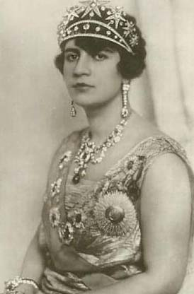
Culture and Religion
Attempt to put Afghanistan
at the forefront of
modernization and
reform in the Muslim
world.
Western dress for men in
Kabul
New schools, coed w/ secular
curriculum
Veiling no longer required by
law.

Slide 8
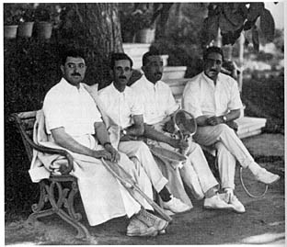
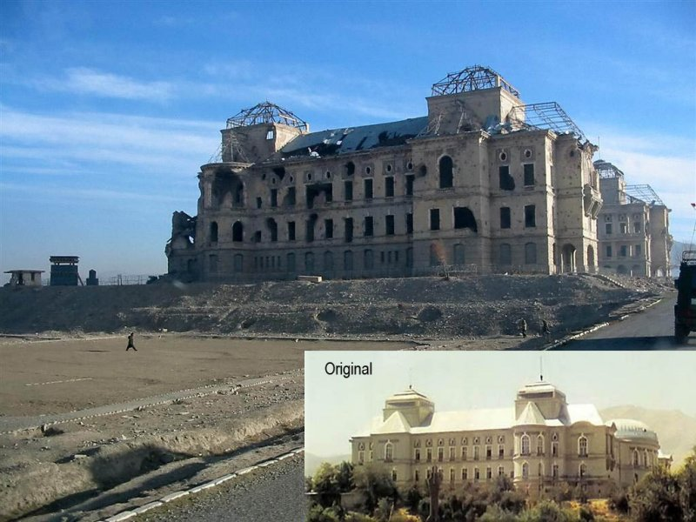
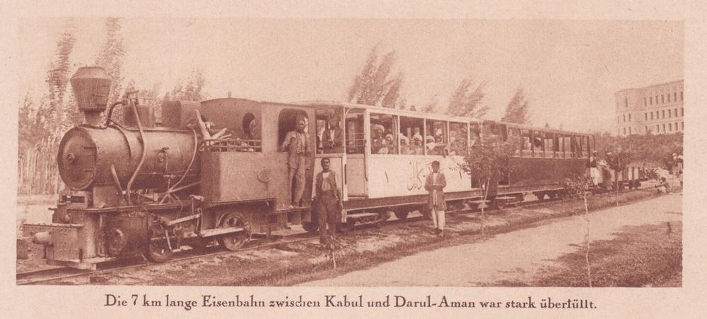
Darulaman

Slide 9
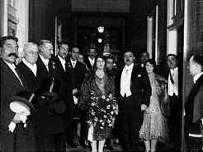
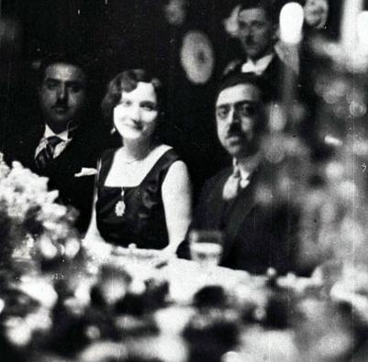
Amanullah and Soraya

Slide 10
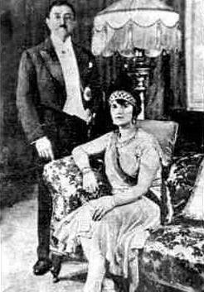
Culture and Religion
Cultural changes become
symbolic of Kabul
centralization, especially
reform of marriage laws
Most reforms only
effected in Kabul
itself
Still attracts opposition
from traditional
power bases

Slide 11
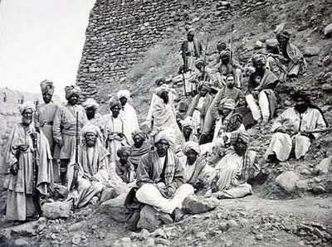
1924 Khost Rebellion

Slide 12
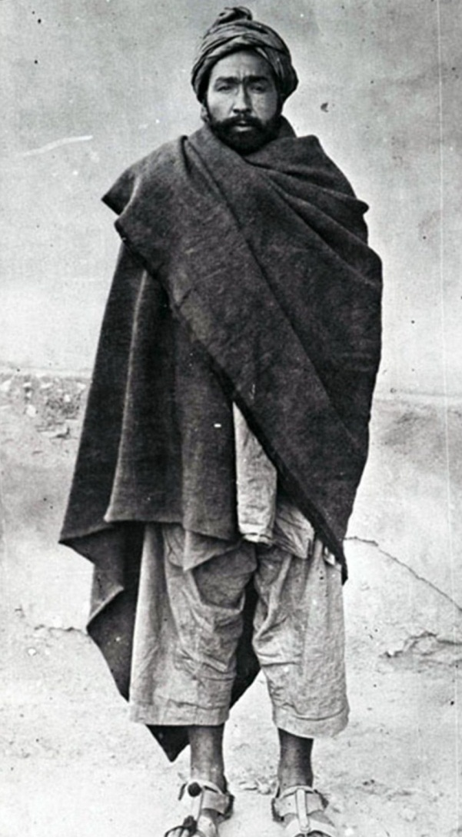
Habibullah Kalakani (r. Jan. – Oct. 1929)

Slide 13
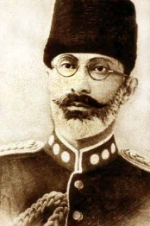
Musahiban Dynasty
Muhammadzai Pashtuns
retake power after nine
months
Muhammad Nadir Shah
(1929-1933)
Undoes all of Amanullah’s
reforms
1931: New constitution
  Parliament replaced by
  loya jirga
  Increases size and scope of army

Slide 14
Kabul and Afghanistan
1933: Nadir Shah assassinated by a college student
Demonstrates the constituency for Amanullah’s reforms
  Young
  Urban
  Educated
  Kabul-centric
If you’re going to be overthrown whether you reform or not, what’s a shah to do?

Slide 15
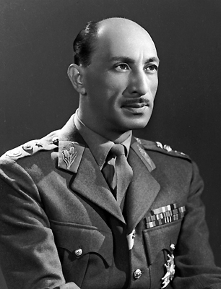
Muhammad Zahir Shah (r. 1933-1973)
Comes to power at age
19
Leaves his uncles holding
real power
Focus on modernization
of infrastructure
Modernization will lead
to centralization and
reform

Slide 16
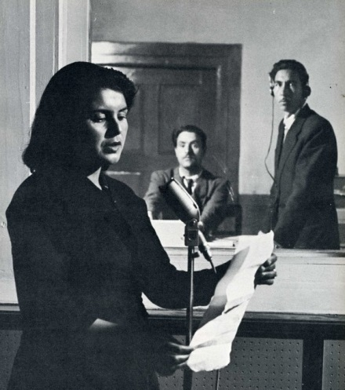
Forging a National Identity
Create a Kabul
centered national identity
which combines Pashtun
and Tajik elements
Radio Kabul/Afghanistan
(the news from Kabul)
National Museum
National Afghan Music
(mixing Tajik/Persian poetry
with Pashtun rhythms and
melodies)
National Buzkashi

Slide 17
Still rather Pashtu Centered
Pashtu control of government power (but not bureaucracy)
1937: Pashtu Academy founded to create new Pashtu words
1938: Pashtu becomes official language of Afghanistan
Limits of government power: Dari still dominates in Kabul and the north
1960’s: Dari allowed for government business
1964: Recognizes Dari and Pashtu as state languages

