Slide 1
The Conquest of China
HIST 1016
10/20/14

Slide 2
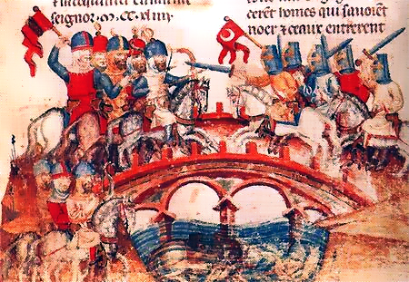
Invasion of Europe
1240 – invasion from three directions
Poland – The Battle of Legnica (April 9, 1241)
  Mongol victory over Crusader orders
Hungary – The Battle of Mohi (April 11, 1241)
  Up to 40% of Hungary’s population killed
Croatia – Allies of Hungary
Why no further?
Dec. 11, 1241 – Ögedei
Khan dies
1241-1246 – conflict
between Batu and Güyük

Slide 3
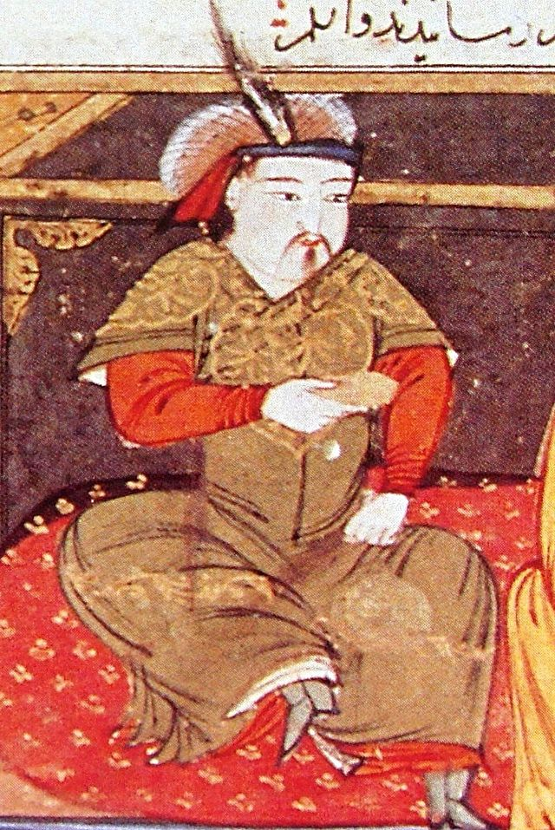
Il-khans (1256-1335)
1219-1256 – Starting with
Khwarzmshahs, Mongols raid
across Central Asia, Persia, Iraq,
and Anatolia
Möngke Khan (r. 1251-1259):
Son of Tolui, Great Khagan
1255 – Orders establishment
of Mongol rule as far as Egypt
Hülegü Khan (r. 1256-1265):
Brother of Möngke and first
Il-Khan

Slide 4
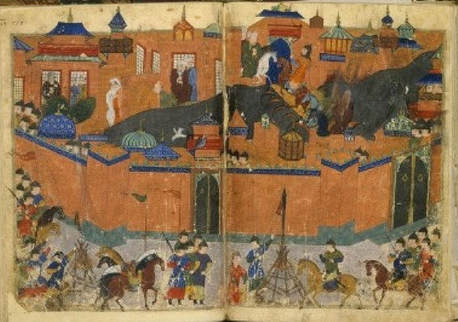
Il-Khans and the Changing Face of the Middle East
1251 – Possible assassination attempt of Möngke
1256 – Destruction of Assassin fortress in Alamut
1258 – Siege of Baghdad
al-Musta’sim
(r. 1242-1258): Last
`Abbasid Caliph
Is it bad luck to shed
royal blood?
Siege of Baghdad in contemporary
manuscript.

Slide 5
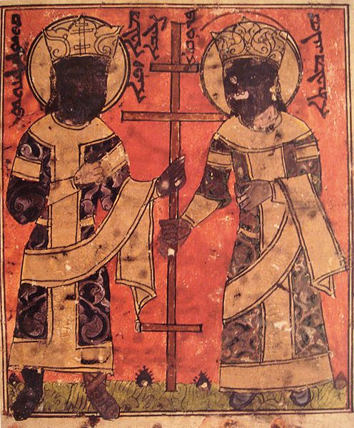
The Battle of Ayn Jalut
Il-Khans and Christian vassals
1260 – Conquest of Aleppo
and Damascus
Last Ayyubid ruler, al-Nasir
Yusuf, killed
Threats sent to Mamluk Egypt
Möngke dies
Mamluks take advantage
Sept. 3, 1260 – Mamluks defeat
Il-Khans in Palestine
Hulagu and Doquz-Qatun (wife) as
Constantine and Helen in Syriac Bible

Slide 6
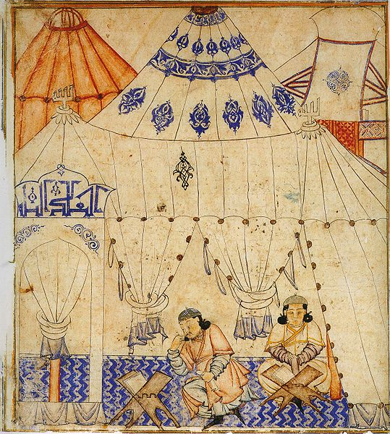
Il-Khans and Islam
Rivalry with Golden Horde
vs. control of population
Buddhism, Christianity,
and local minorities
Il-Khans and the Crusades
Mahmud Ghazan
(r. 1295-1304): converts to
Islam
Is conversion sincere or
attempt to secure local
support?
Ghazan studies the Quran

Slide 7
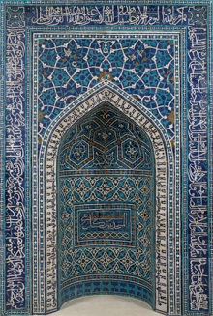
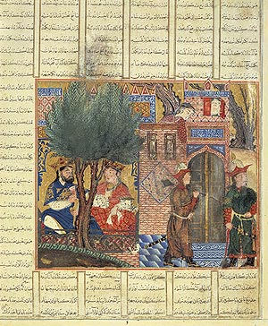
Il-Khanid Art

Slide 8
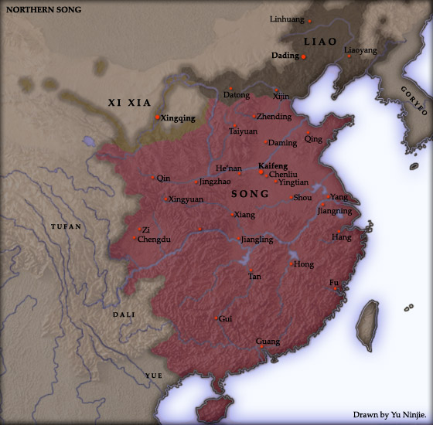
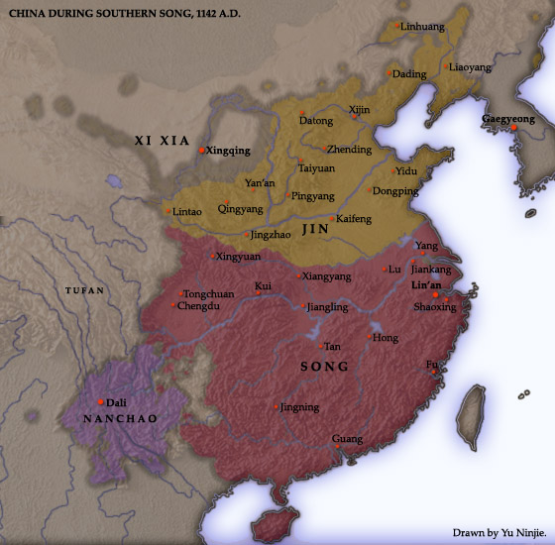
Song Dynasty
r. 960-1279
1115: Song use Jin (Chin) to remove Liao (Khitan, related to Mongols)
1127: Jin attack Chang’an and capture the emperor
Beginning of Southern Song
1211-1234: Mongols overthrow Jin

Slide 9
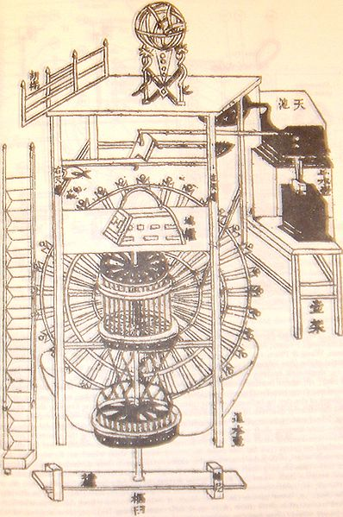
Song Science
Mathematics
Navigation
Astronomy
First portable compass

Slide 10
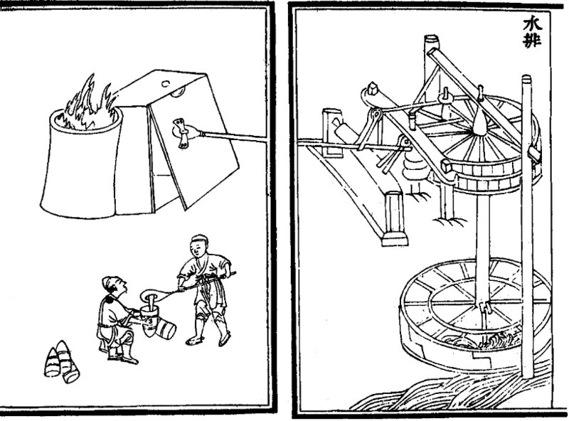
Metallurgy

Slide 11
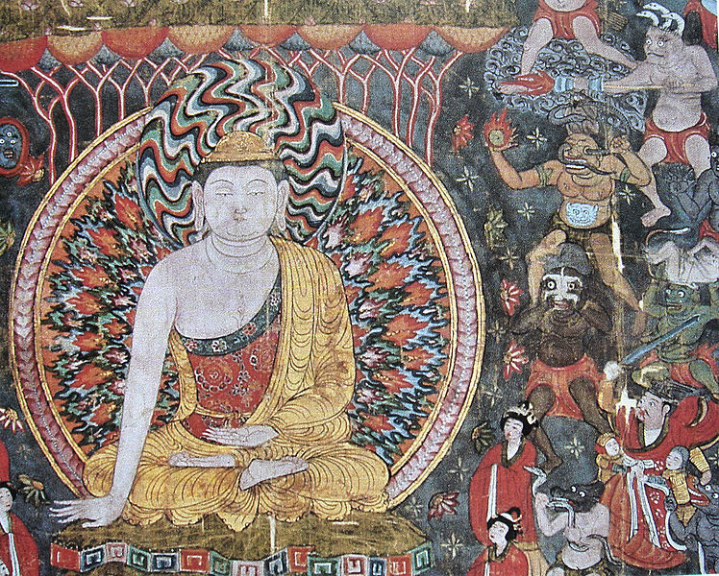
Gunpowder

Slide 12
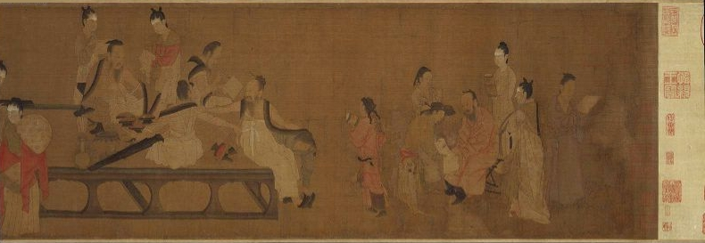
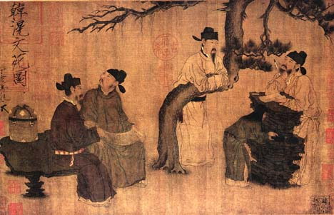
Song Bureaucratic Culture
Emphasized bureaucracy over military
Neo-Confucianism
Bureaucratic examinations
Replace recommendations
Emphasis on Confucian Classics
Emphasizes loyalty to the Song

Slide 13
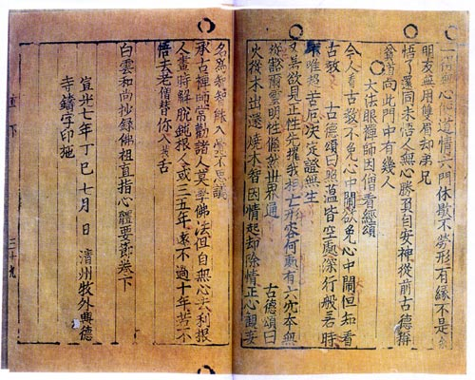
Moveable Type Printing

Slide 14
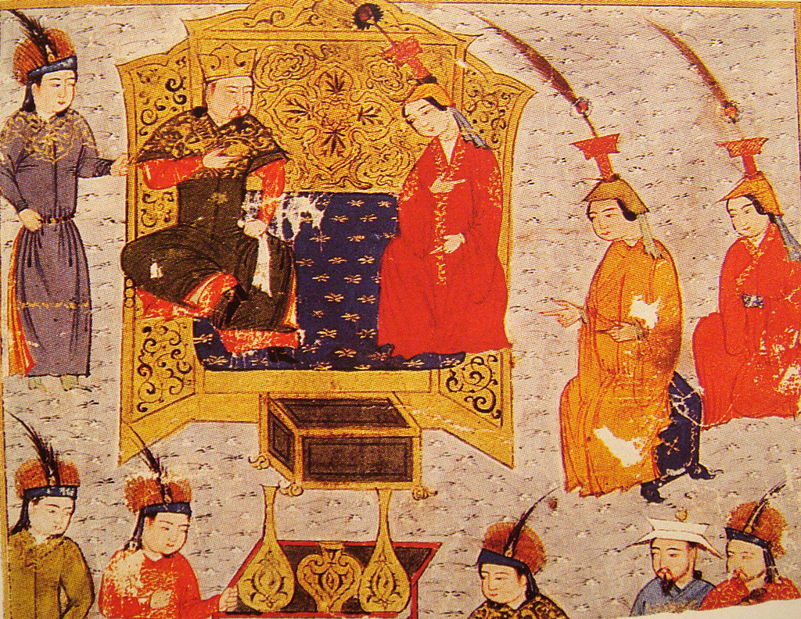
Rise of the Toluids
Khubilai Khan (r. 1260-1294): Son of Tolui and Sorghaghtani Beki
On Tolui’s death (1236) Sorghaghtani demands lands for herself and sons in Northern China
Base for Toluid faction
1241: Ögedei Khan
dies
Güyük Khan and his
mother Törgene
Sorghaghtani Beki and Tolui

Slide 15
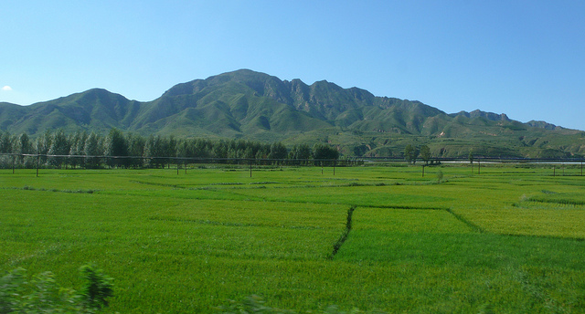
Sorghaghtani, Khubilai, and Northern China
Sorghaghtani rules through local advisors
  Light taxes that promote stability
At first, Khubilai rules from Mongolia
  Tax collectors abuse local population
  Leave for Song lands
Mix of Buddhist and Confucian Chinese,
Christian, and Uighur
advisors
Wealth of Northern
China buys influence
Landscape of Hopei province

Slide 16
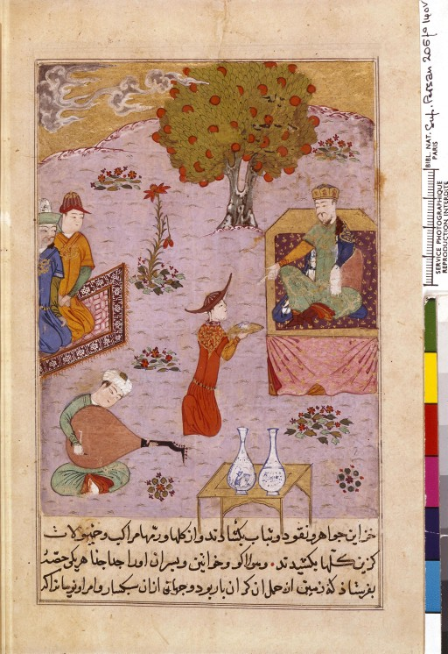
Rise of the Toluids
Güyük Khan and Törgene
not well liked
  Question of succession
  Abusive taxation
Alliance between
Sorghaghtani and Batu (of the
Golden Horde)
1247: Güyük plans to attack
Batu
Sorghaghtani warns Batu
Güyük dies

Slide 17
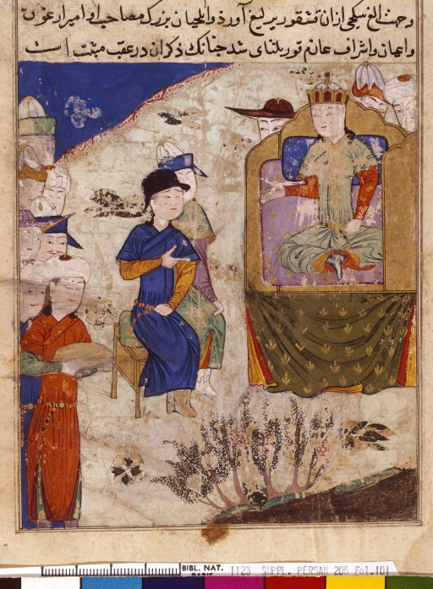
Rise of the Toluids
Batu – eldest of Chinggis
Khan’s grandsons
Sorghaghtani – wealthiest
of Mongol nobility
1251 – khuriltai elects
Sorghaghtani’s son Möngke
Khan khagan
Civil war between descendants of
Jochi and Tolui vs. descendants of
Chaghadai and Ögödei
Möngke purges Chaghadai and
Ögödei nobility

Slide 18
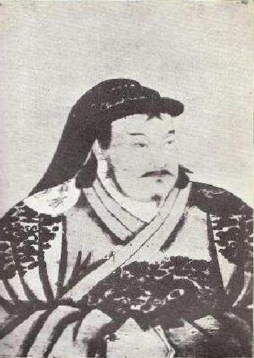
Rise of the Toluids
Möngke orders brothers to lead
new campaigns
Hülegü Khan and the Il-Khans in
Middle East
Khubilai Khan and the Ta-Li
Campaign
  Ta-Li (Dali Kingdom) –
  non-Chinese (Bai) kingdom
  Border between China and
  South Asia
  First major campaign
  Promise no pillaging or slaughter
  if Ta-Li surrenders
Early portrait of Khubilai Khan

