Slide 1
The Mongol Empires and the Pax Mongolica
HIST 1016
10/15/14

Slide 2
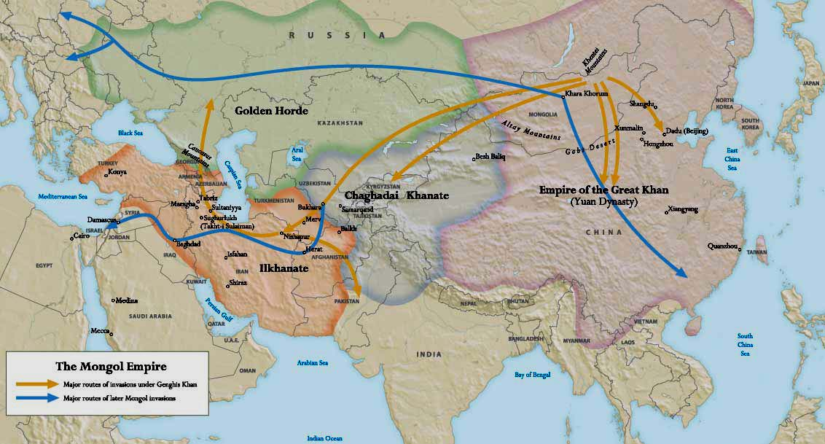
The Mongol Empire

Slide 3
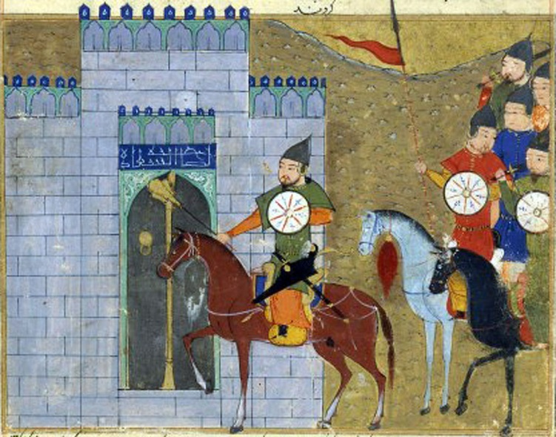
Order of Mongol Conquests
Unification of steppe (1206-1218)
Hsi Hsia (Tanguts) (1209)
  Finally eliminated in 1223
Chin Empire (1211-1234)
  1215: Fall of Peking
  (Beijing)
4) Khwarzmshahs
(1218-1230)
5) Caucuses and Russia
(1230’s)
Chinggiz Khan enters Beijing, by an Afghan
painter

Slide 4
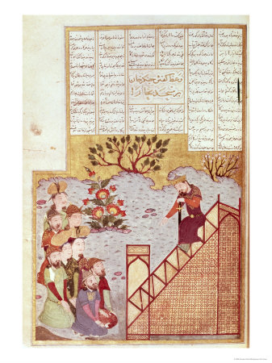
Mongol Success
Alliances and diplomacy
Coalition army
Steppe and Silk Road
“Calculated
Frightfulness”
Can nomads govern
a sedentary population?
Destruction of
agricultural base
Chinggiz Khan from a Persian perspective

Slide 5
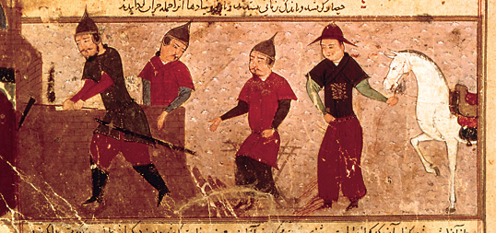
The Mongol Empires
1227 – Chinggiz Khan dies
Division of territory among sons
  Jochi (d. 1226) – The Golden Horde (given to Orda and Batu)
  Chagatai (d. 1242) – Chagatai Khanate
  Ögedei (d. 1241) – Khagan or Great Khan
  Tolui (d. 1232) – Mongolia
Ulus – inherit army
rather than territory
Kurultai – gathering
to acknowledge
Khagan
Chinggiz Khan w/ Chagatai, Ögedei,
and Tolui

Slide 6
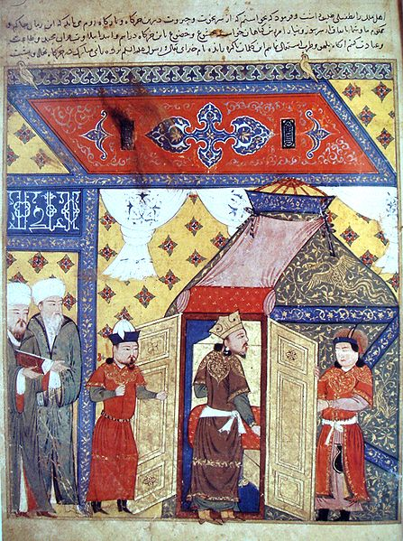
Mongol Empire and Pax Mongolica
No unified culture or
social structure
Mongols more likely to
convert
Many Mongol Empires
Patronage of artists and
craftsmen
Steppe Diplomacy in
the City
Son-in-law States

Slide 7
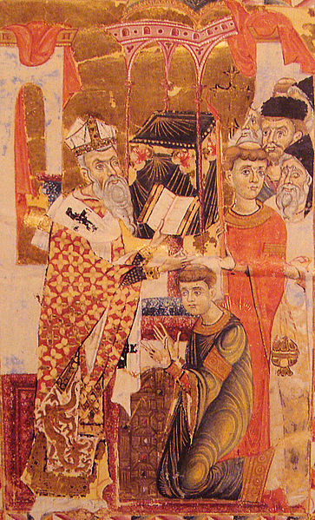
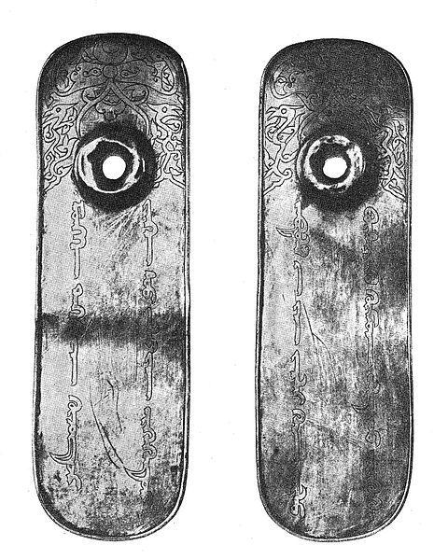
Pax Mongolica
Paisa - passport

Slide 8
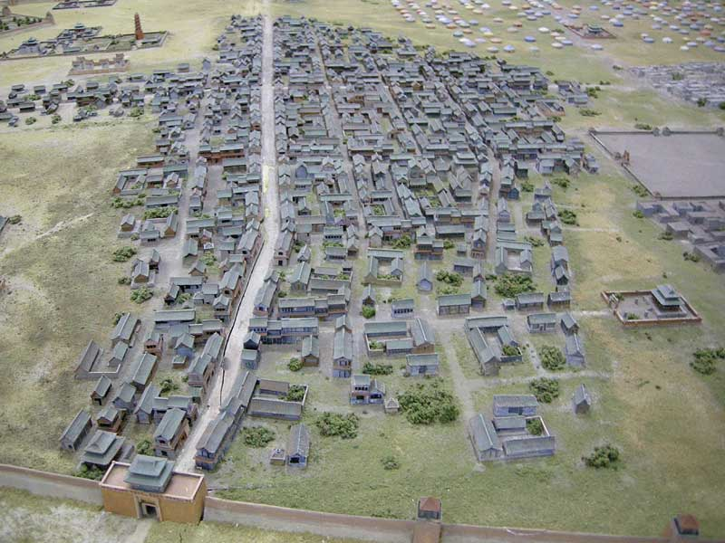
Karakorum
“Black Tent”
Cosmopolitan
yurt city?
Captured
artisans
Guillaume
Boucher

Slide 9
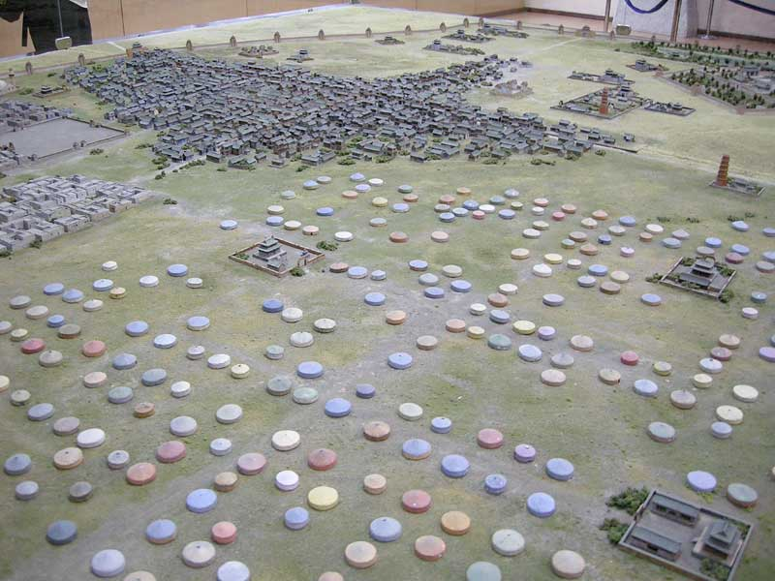
Yurt in the City

Slide 10
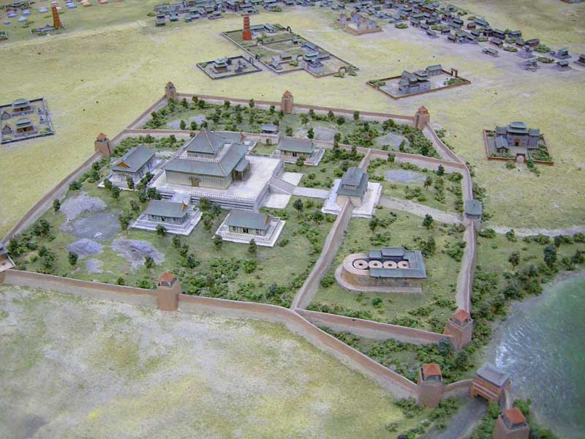
Karakorum Buddhist Temple

Slide 11
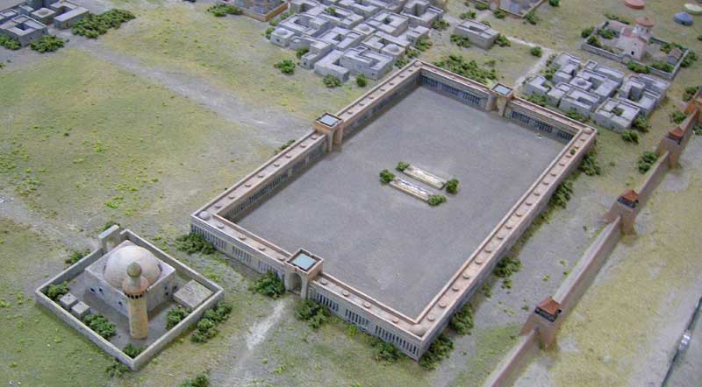
Karakorum Mosque and Caravanserai

Slide 12
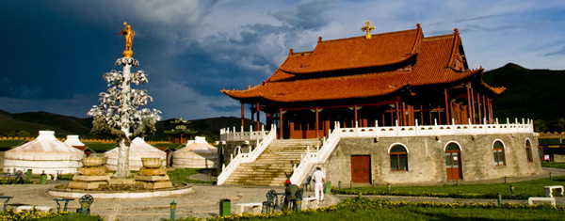
Modern Reconstruction of the Silver Tree of Guillaume Boucher

Slide 13
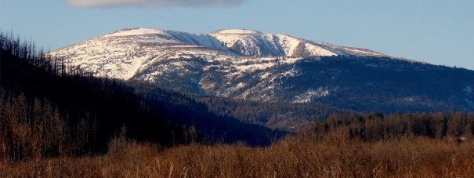
Mongols and Conquered Cultures
Are the Mongols tolerant of others?
Tengrism – shamanistic tradition focused on Tengri, the sky
Focus on sacred spaces, mostly in the steppe
Interactions with Nestorian Christianity, Islam, and Buddhism
Syncretism
The sacred mountain of
Burkhan Khaldun

Slide 14
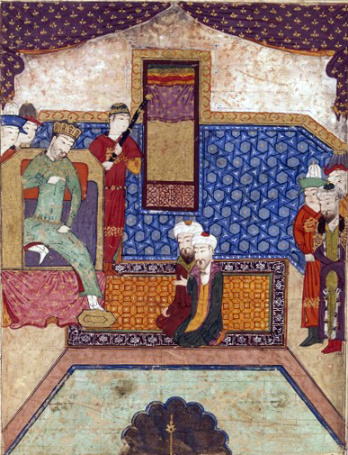
Mongols and Conquered Cultures
Invitation for religious
scholars to attend Mongol
court
Are the Mongols serious
about conversion?
Are the Mongols Prester John?
Güyük Khan (r. 1246-1248)
and Pope Innocent IV
Conversion is expedient
  Golden Horde, the Qipchaqs,
  and Islam
Güyük Khan interrogates Muslim scholars

Slide 15
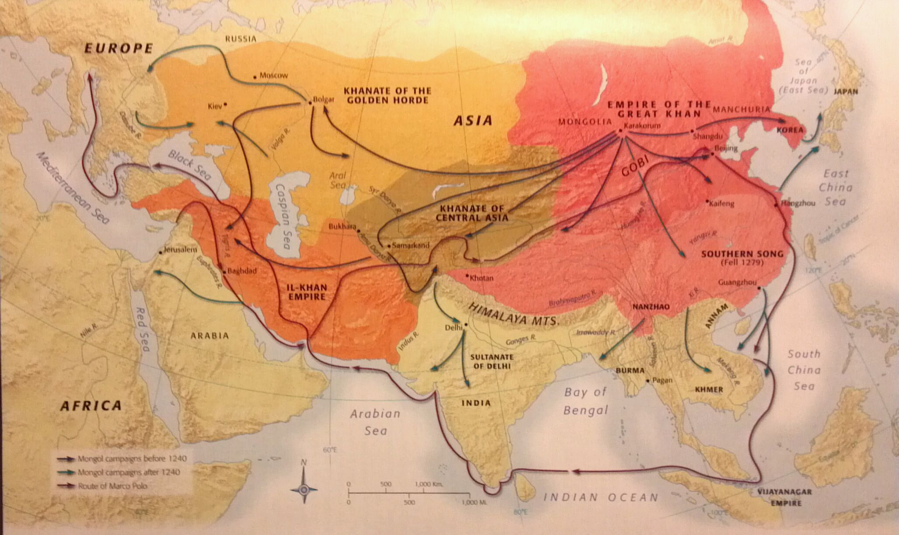
Expansion and the Mongol Khanates

Slide 16
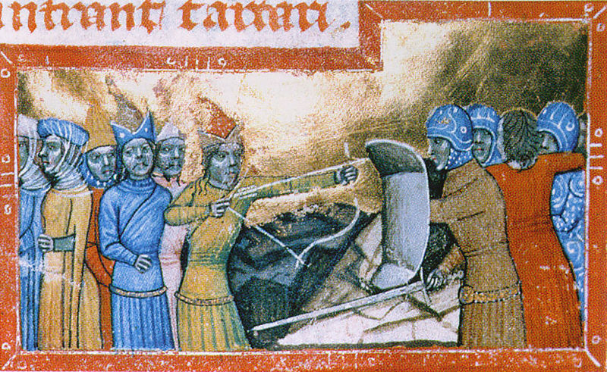
Khanate of the Golden Horde (1230’s-1502)
Kievian Russia and the Qipchaq Steppe
Vikings, German Crusaders, and Mongols
The Mongol Yoke
Alliances with
local princes

Slide 17
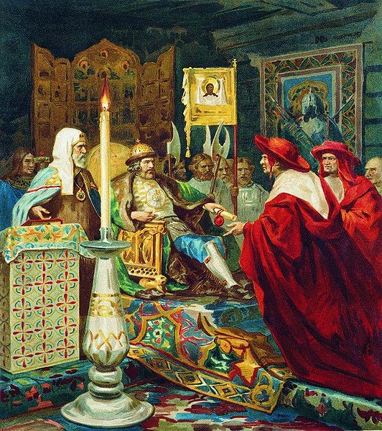
Alexander Nevskii (1220-1263)
Prince of Novgorod
1242 – Battle on the
Ice
Allies with Mongols
Moves power
towards Novgord and
Moscow

