Slide 1
Chinggis Khan
HIST 1016
10/13/14

Slide 2
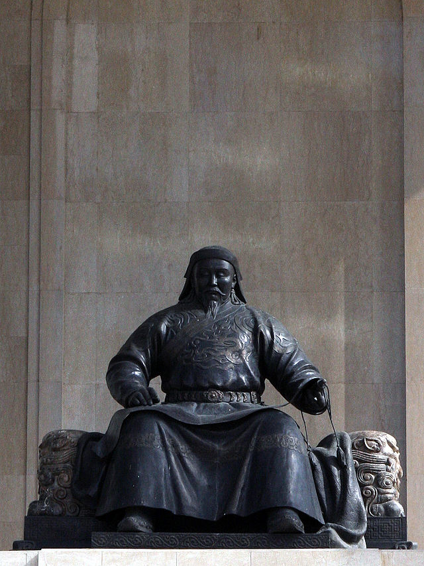
Khubilai Khan
(r. 1260-1294)

Slide 3
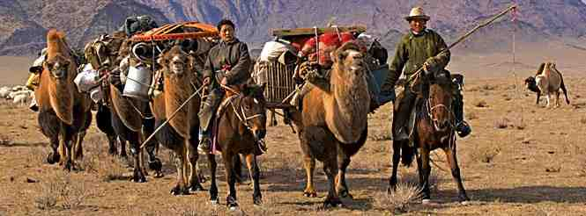
What is a nomad? What is a pastoralist?

Slide 4
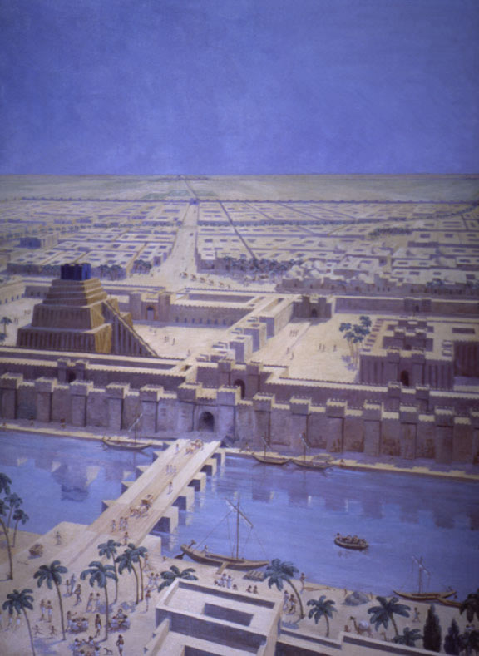
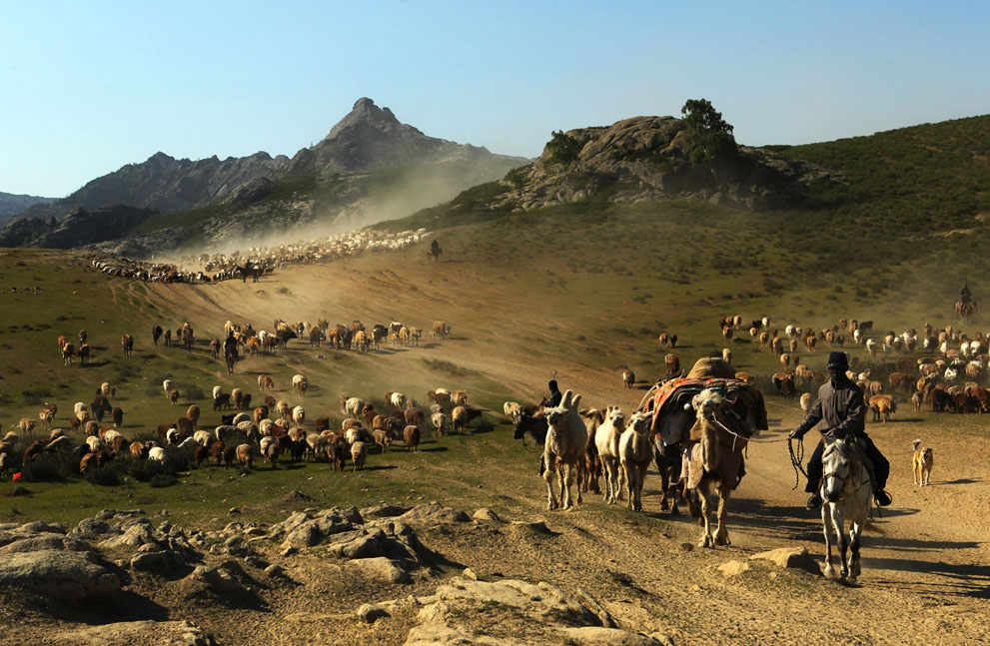
Which Came First,
Cities or Nomads?

Slide 5
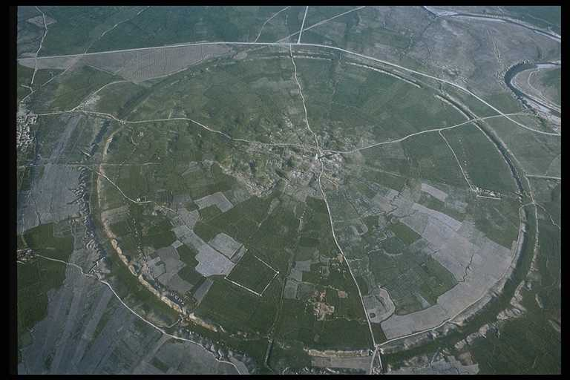
Cities and Nomads

Slide 6
Trade or Raid
Semi-pastoralist – sedentary part of the year to farm
Nomads need products of sedentary agriculture
  Grains, cotton, manufactured goods, etc.
Sedentary societies need products of nomads
  Meat, leather, wool, felt, etc.
Sedentary society is stronger = trade
Nomadic society is stronger = raid

Slide 7
Conical Clan Genealogy
Clan Ancestor
Ancestor of Lineage I
Ancestor of Local Lineage A
Ancestor of Local Lineage B
Ancestor of Lineage II
Ancestor of Local Lineage C
Ancestor of Local Lineage D
Present Lineage Chief a
Present Lineage Chief b
Present Lineage Chief c
Present Lineage chief D
Leftmost person of each generation is patriarch with authority over all others.
Rightmost person of each generation is inferior to all others.
After Marshall D. Sahlins, Tribesmen, (1968), p. 25 and Rudi P. Lindner, “What Was a Nomadic
Tribe?,” (1982), p. 692.

Slide 8
Is this how a real nomadic tribe works?
Is the eldest son of the eldest son always the patriarch?
Is the eldest son of the eldest son always the most successful, fit for rule?
What if the patriarch has no sons?
Does a young patriarch really hold authority over his uncles?

Slide 9
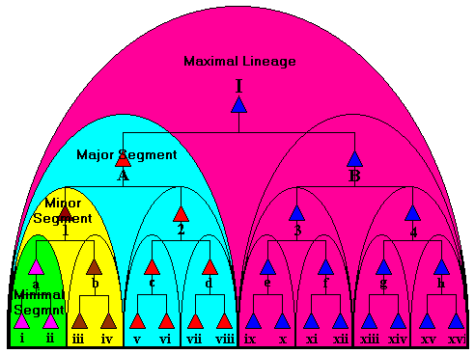
Segmentary Clan Genealogy

Slide 10
Segmentary Clan Genealogy
I against my brothers…
My brothers and I against our cousins…
My cousins, my brothers, and I against our neighbors…
My neighbors, my cousins, my brothers, and I against the world…

Slide 11
Is this how a real nomadic tribe works?
My cousin and I against my brother…
Genealogical proximity vs. economic and political potential
In either case, how do we fit in…
  Daughters?
  Sons-in-law?
  Their families?
  Clients?

Slide 12
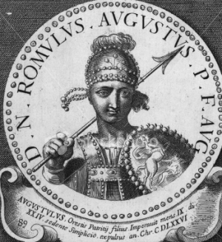
Come with us and eat salmon!
Tribal genealogy isn’t all in the genes
Success attracts supporters
  Orestes the Hun
Tribalism and
Ethno-Genesis
(Bloody) Tannistry & the
Conical Clan
The last Western Roman Emperor, Romulus Augustulus.
His dad had been a Hun… for a little while.

Slide 13
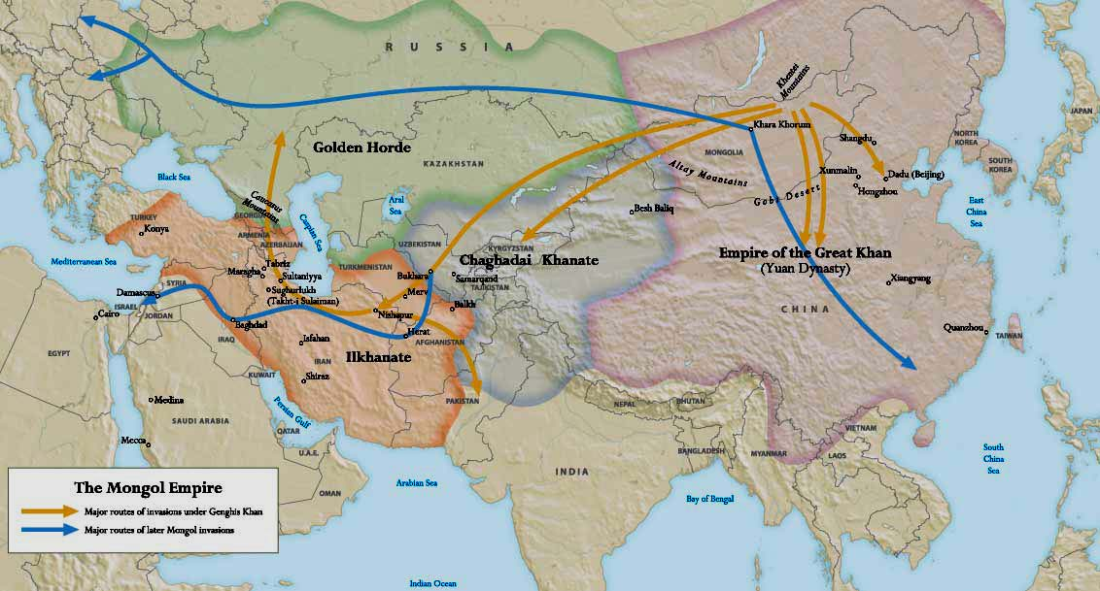
The Mongol Empire

Slide 14
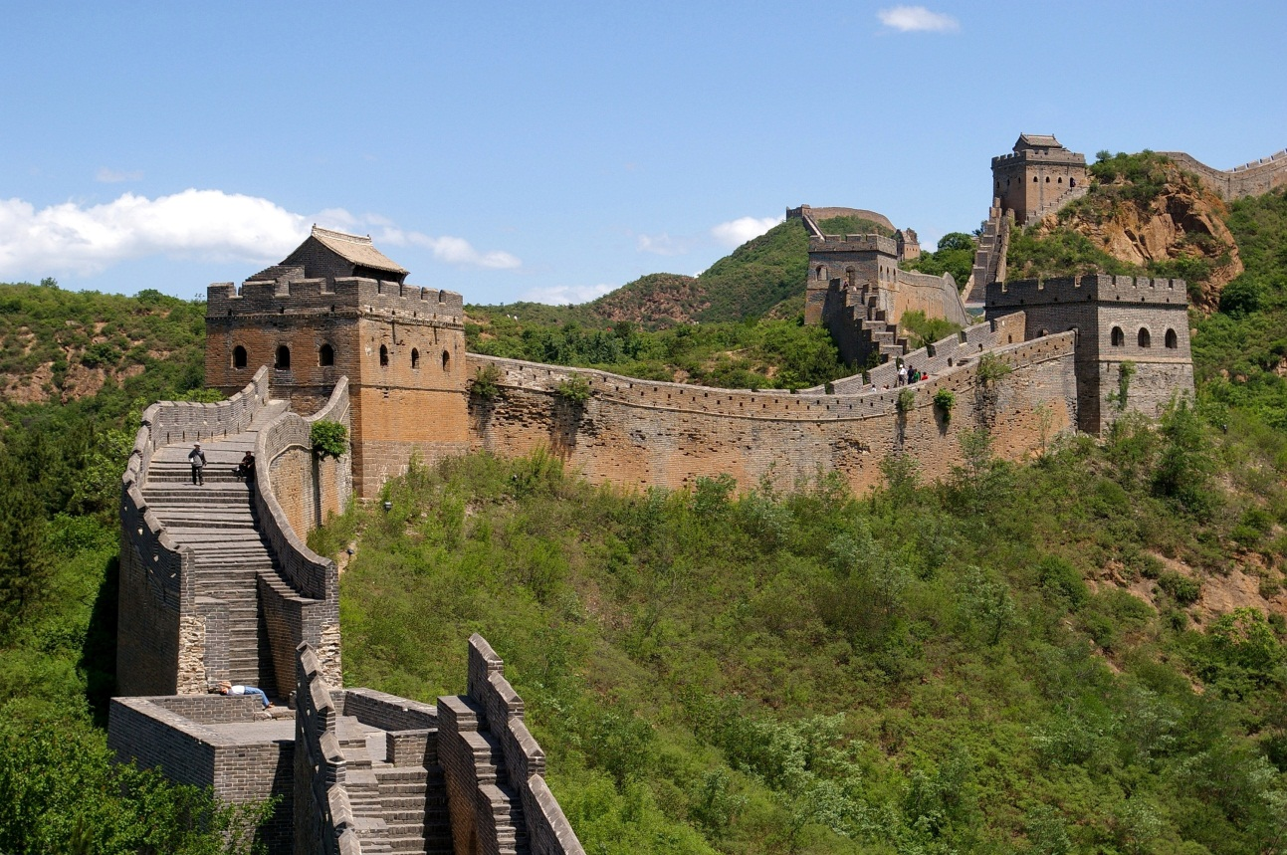
Ethno-genesis on the Steppe
Political pressures
  Nomads are pests
  Strong state
  pushes back
  The Great Wall
  The Conquest
  Dynasties and steppe
  rivalries
Ecological pressures
  Drought
  “Little Ice Ages”
  Constant search for greener pastures

Slide 15
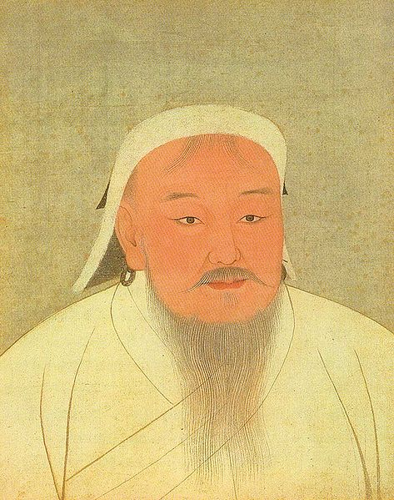
Chinggis Khan (r. 1206-1227)
Temujin – born 1162
Father dies, exiled from clan
Alliances
Diplomatic marriages
Master of steppe diplomacy
  Identities are fluid
  Violence only justified when
  pacts are broken
  He with the largest alliance, wins

Slide 16

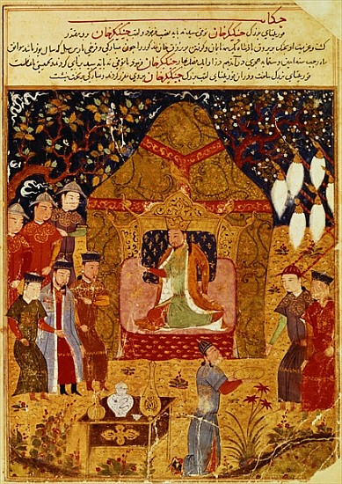
Universal Khan
New steppe confederacy –
The Mongols!
Khuriltai
1206 – Chinggis Khan
Karakorum – capital
Yurt
Equality among Mongol
aristocracy
Merit based appointments –
Ulus
Mongol Script – Yassa Code

Slide 17
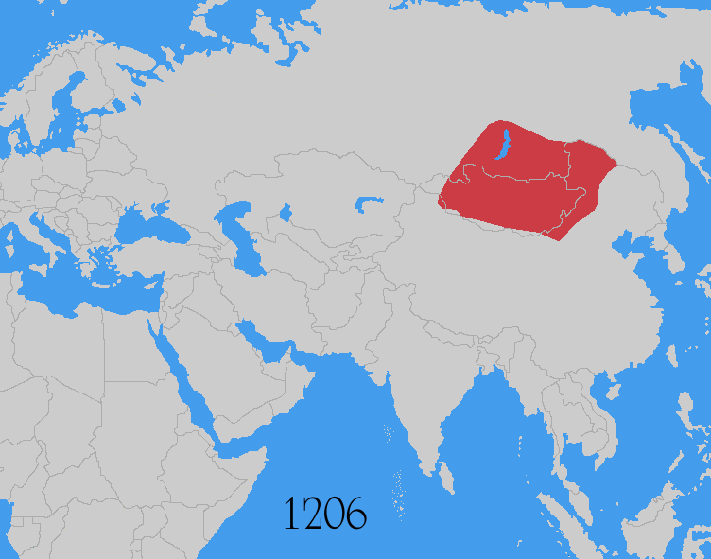
Mongol Expansion

Slide 18
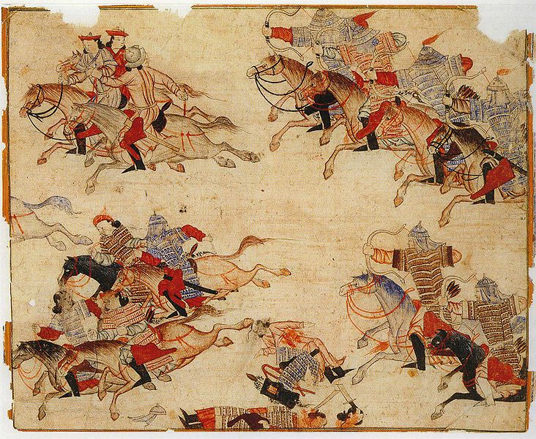
Ibn al-Athir (1160-1233)
Kurdish historian
Worked under Saladin
“The Complete
History”
Tatars – Turkic
people, fought
in the Mongol
army

Slide 19
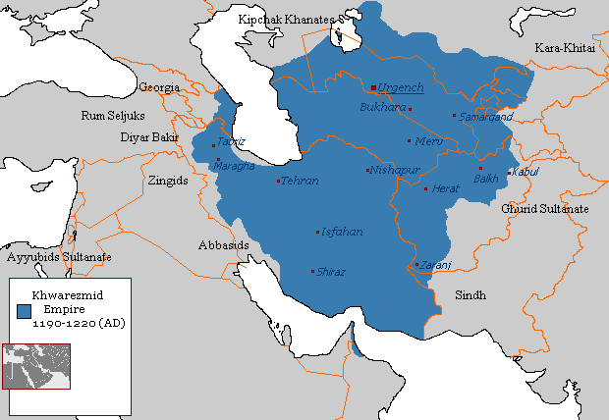
Khwarzmshahs and Otrar
By mid-12th century, Khwarzm independent
By early-13th century, control Iran and Central Asia
`Ala al-Din Muhammad II (r. 1200-1220)
1218 – trade delegation
from Mongols in Otrar
500 merchants held as
spies

Slide 20
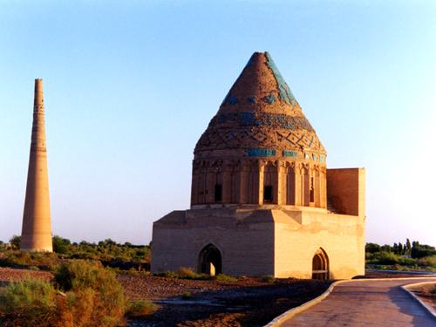
Khwarzmshahs and Otrar
Chingiz Khan sends ambassador
Inalchuq (Ghayir Khan) kills one ambassador
Kills the merchants and sells their goods
1219 – Chingiz Khan
invades Khwarzm
If Inalchuq loves silver
so much…
Palace of `Ala al-Din, Urgench, Turkmenistan

