Slide 1
Salah al-Din’s Legacy
HIST 1016
10/6/14

Slide 2
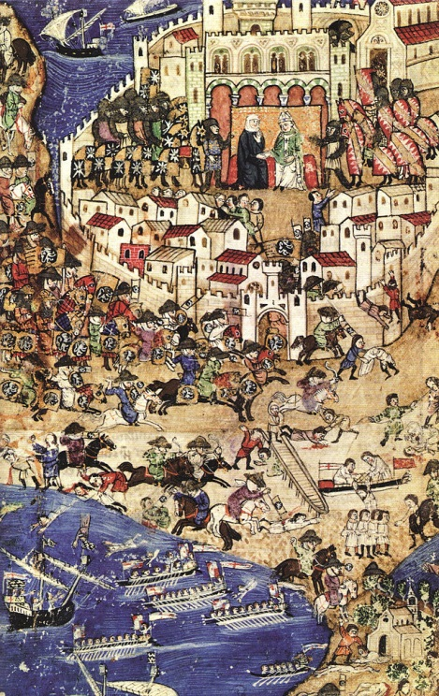
Crusading after Salah al-Din
Fourth Crusade (1202-1204):
Crusaders conquer Byzantine Empire
Fifth through Ninth Crusades:
Focus on Egypt, no crusader
victories
Crusading in France and Baltic
1244 – Jerusalem retaken by
Muslims
1291 – Acre falls to Muslims, end of
Crusading
1492 – End of Reconquista
Fall of Tripoli in 1289

Slide 3
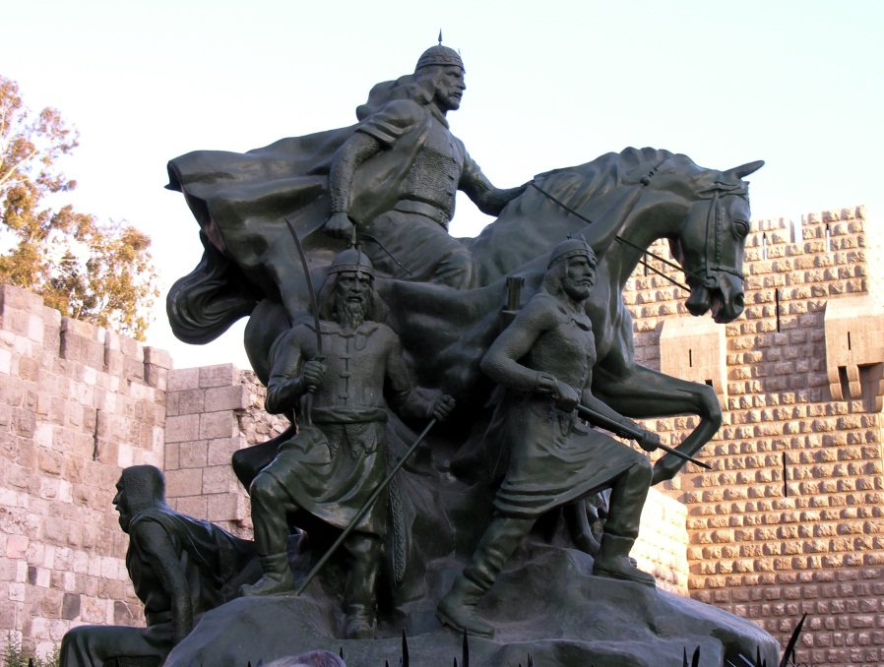
Memories of the Crusade
Crusades are formative to European history
Muslims didn’t much care…
Why not?
Why do they seem
to care so much
today?
Monument to Salah al-Din, Damascus

Slide 4
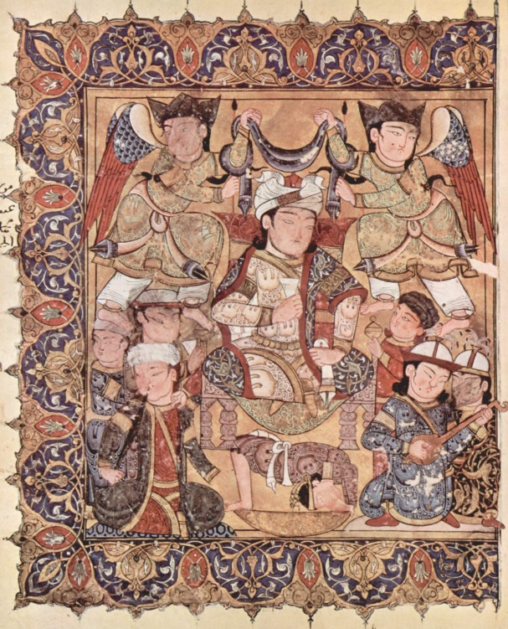
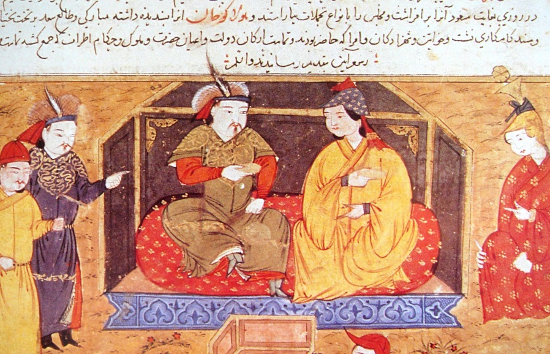
Crusades aren’t a big deal compared to…
The Mamluk Sultanate
  r. 1250-1517
  Ayyubid ghulams turned sultans
The Mongols
  Steppe nomads organized under
  Chingis (Genghis) Khan
  Ilkhanate (r. 1256-1335)
  Timurids (r. 1370-1507)
Mamluk Sultan Baybars and Ilkhan Hulagu Khan

Slide 5
Memories of Salah al-Din
Traits emphasized by both Christians and Muslims
Generosity
  Concern and care for others
  Gift giving
  Treatment of prisoners
  To the point of poverty
Learned
  Religious education
  Poetry
Ascetic life-style
Usurper of Nur al-Din’s inheritance

Slide 6
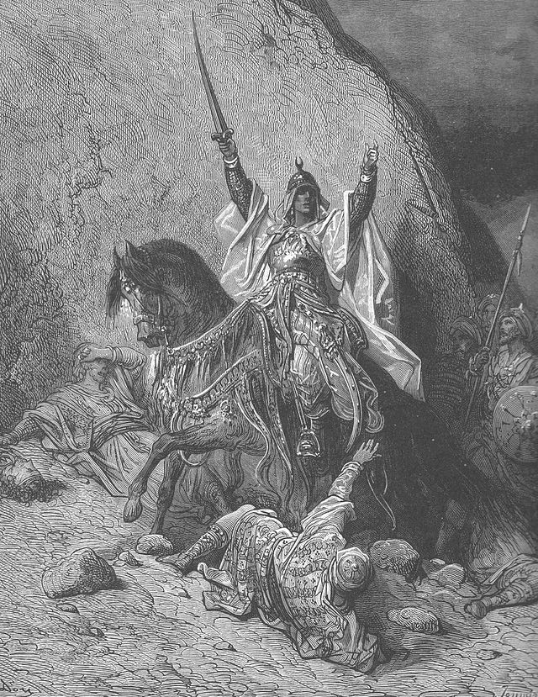
Salah al-Din in Europe
“Noble Heathen”
Perfect knight
  Dubbed a knight by a baron
  of the Kingdom of Jerusalem
Secret Christian?
  Christian mother
  Died a baptized Christian
Justifying his success?
Commentary on Christendom
Claims about Islam by church
leaders

Slide 7
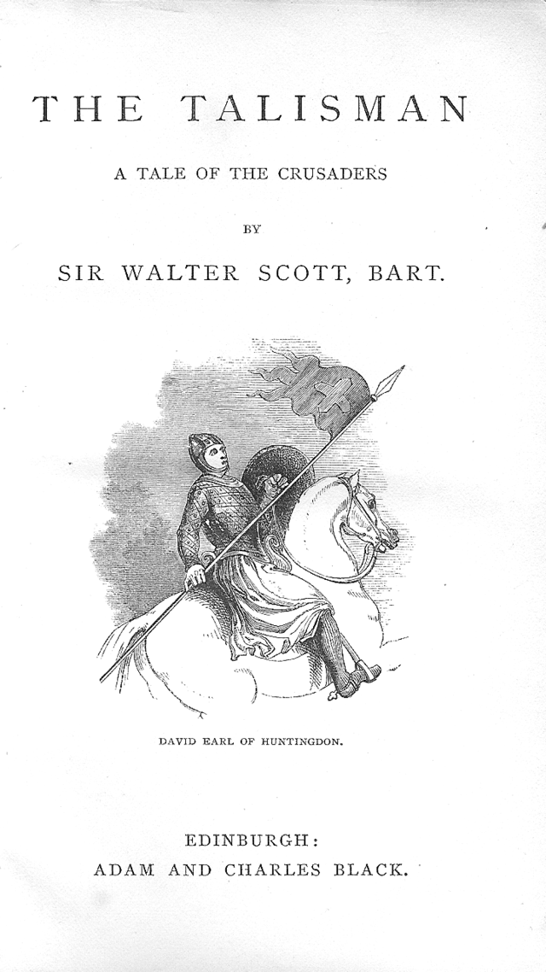
Salah al-Din in Europe
Dante – Salah al-Din in Limbo
Voltaire – Salah al-Din’s
clemency vs. Crusaders’ violence
Was Salah al-Din a tolerant
religious pluralist?
“Nathan the Wise” – Salah al-Din
as model of tolerance
Sir Walter Scott, The Talisman –
Salah al-Din and Richard the
Lionheart’s friendship

Slide 8
Salah al-Din in Europe
Amazed by Salah al-Din or confused about Islam
Religious tolerance and ahl al-kitab, dhimma
Can a Christian break an oath with a non-Christian?
Can a Muslim break an oath with a non-Muslim?
Diversity of Muslim legal opinions, one verse does not a decision make

Slide 9
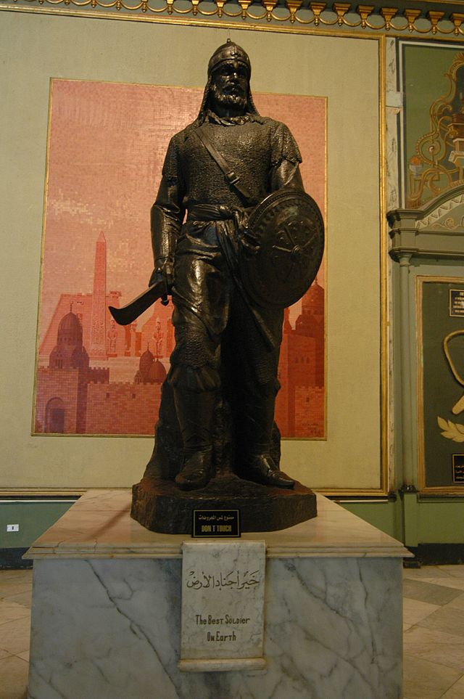
Salah al-Din in the Middle East
Eulogized by Baha al-Din,
Ibn al-Athir, and Usama
Ibn Munqidh
Model ruler for generosity
and piety
Brief rule of Ayyubid Empire
Salah al-Din and Crusades
not memorialized
Statue of Salah al-Din in Cairo

Slide 10
Salah al-Din in the Middle East
Revival due to colonialism
European interest in Crusade history
1898: German Emperor Wilhelm II repairs tomb of Salah al-Din
Salah al-Din as anti-colonial
Salah al-Din as Pan-Islamic hero
Salah al-Din as Arab hero?
Salah al-Din as Kurdish hero?

Slide 11
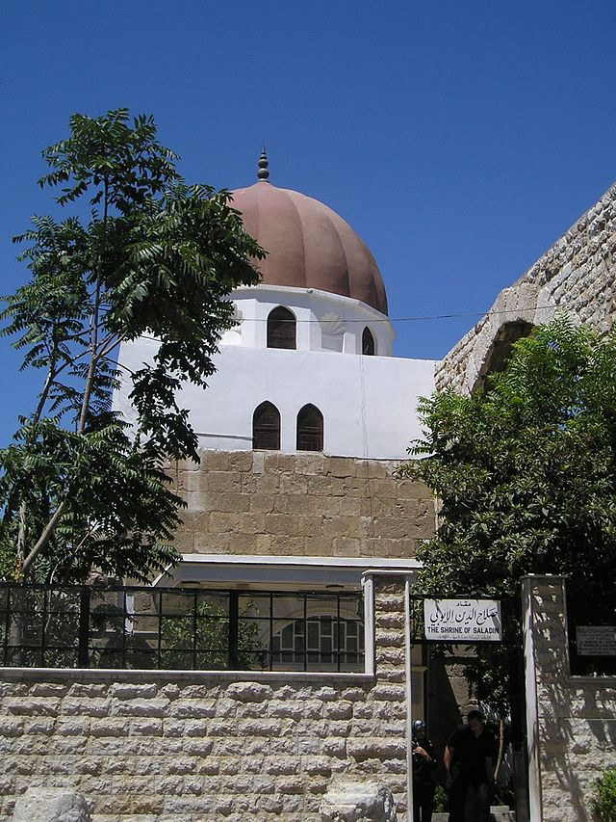
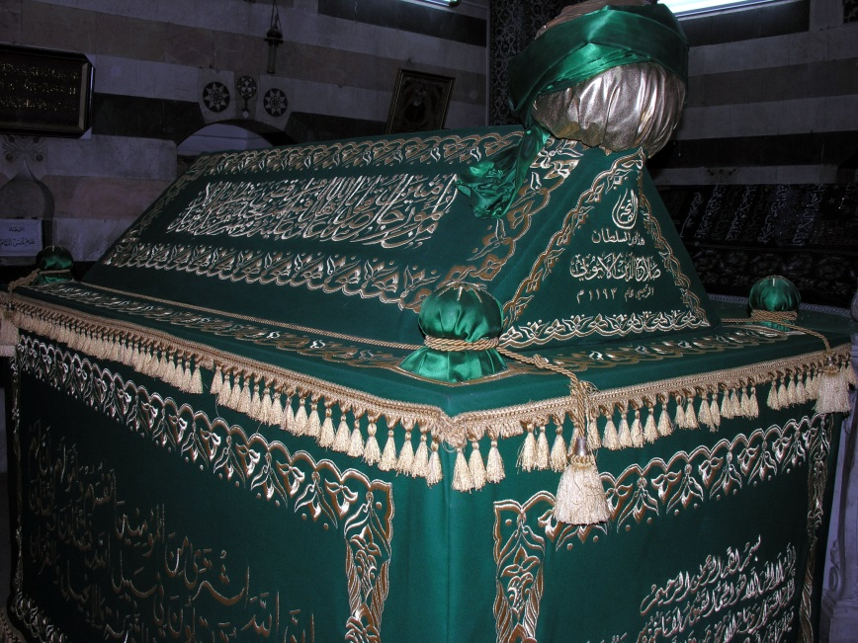
Mausoleum of Salah al-Din

Slide 12
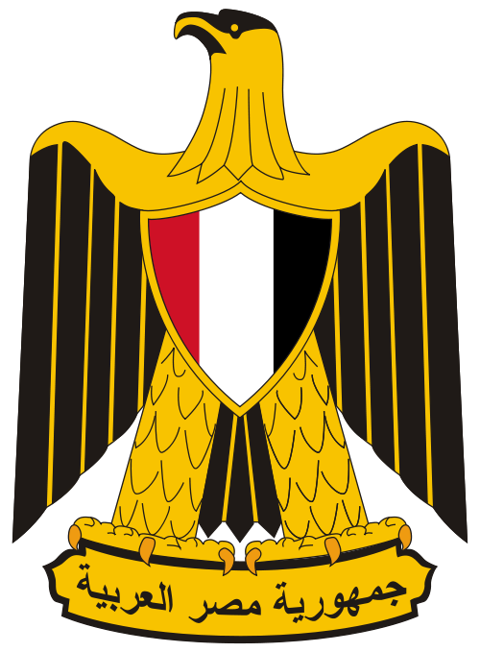

Salah al-Din and the Middle East
Salah al-Din as model ruler
Invoking national histories and
identities
But who’s history?
  Egypt – start of Salah al-Din’s career
  Syria – Salah al-Din’s greatest successes
  Iraq – Salah al-Din’s homeland
  Kurdistan – did being Kurdish mean the
  same thing in the 12th century?
  Palestine – conflict over Jerusalem
The eagle of Salah al-Din on Egyptian and Kurdish coats of arms

