Slide 1
Timurids

Slide 2
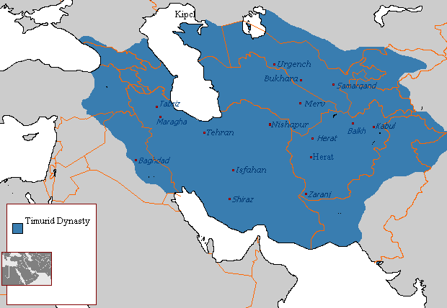
Timurids (r. 1370-1507)

Slide 3
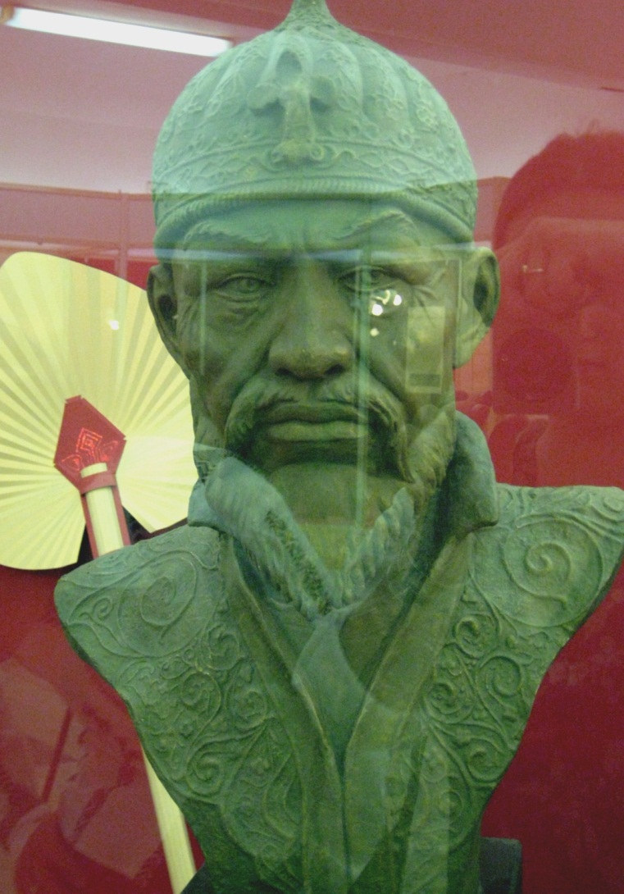
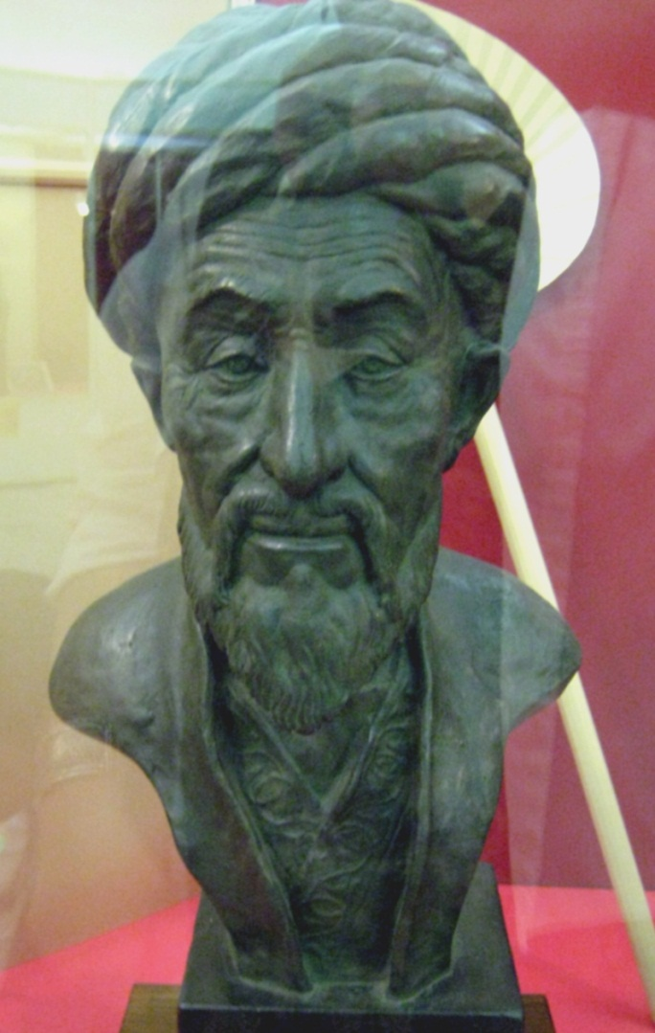
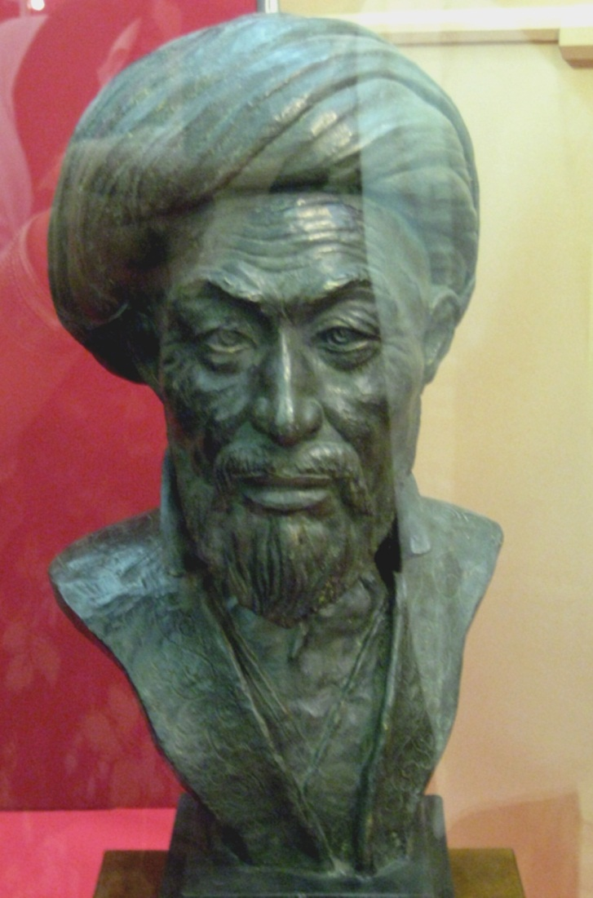
Timur (r. 1370-1405), Shah Rukh (1405-47), Ulugh Beg (1447-49)

Slide 4
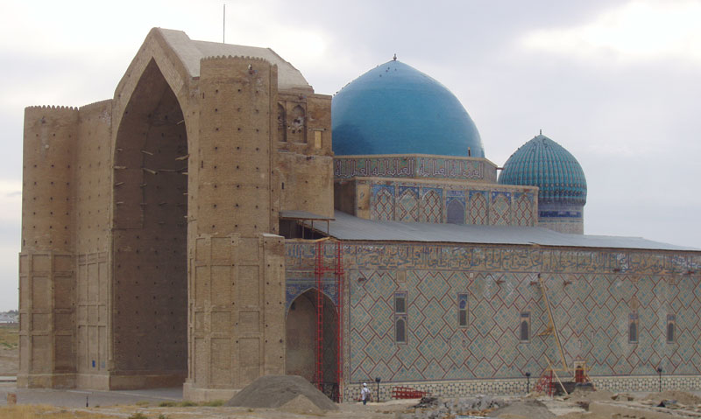
Mausoleum of Khoja Ahmend Yasawi, Turkistan, Kazakhstan

Slide 5
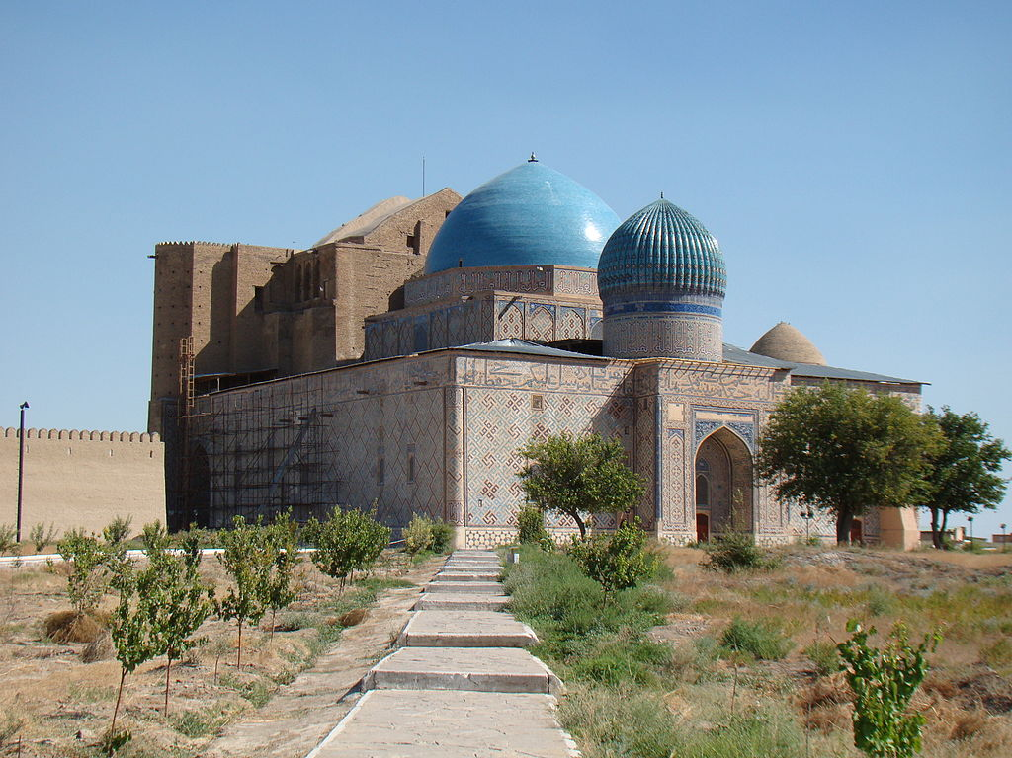
Mausoleum of Khoja Ahmend Yasawi, Turkistan, Kazakhstan

Slide 6
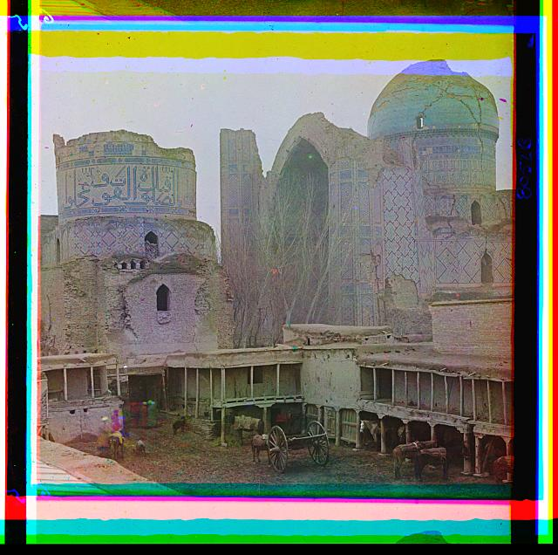
Bibi-Khanym Mosque, Samarqand

Slide 7
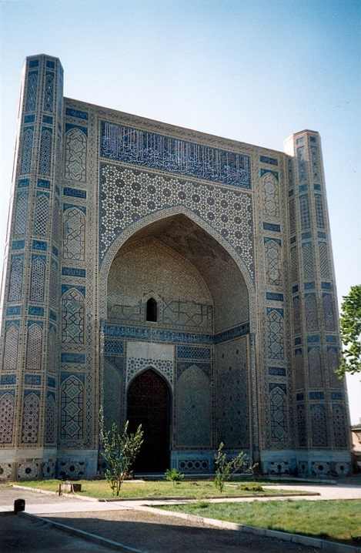
Bibi-Khanym
Mosque,
Samarqand

Slide 8
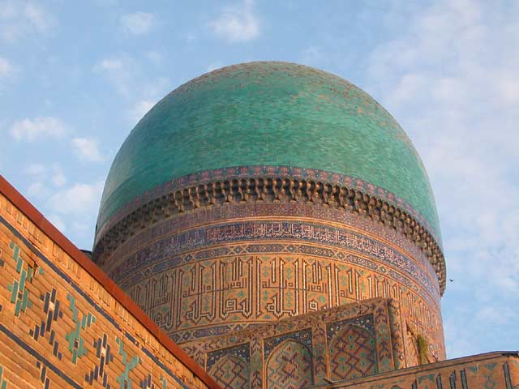
Bibi-Khanym Mosque, Samarqand

Slide 9
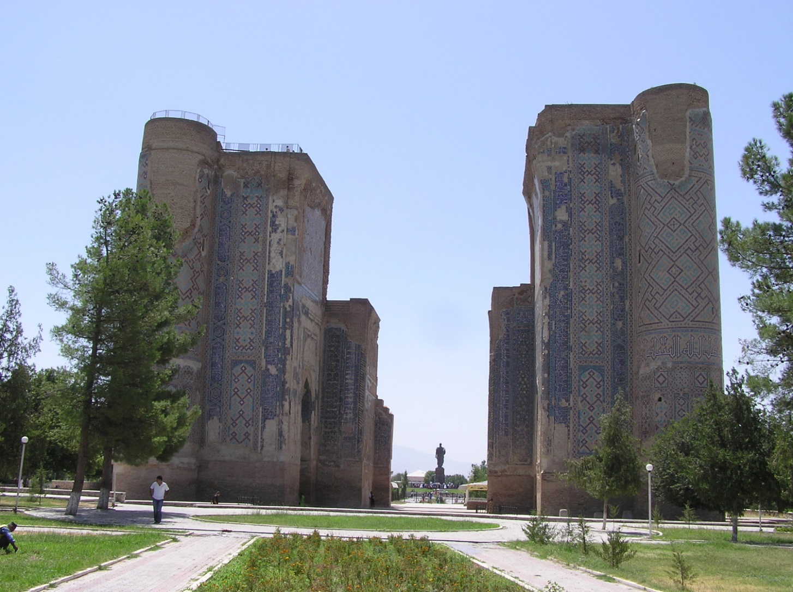
Aq Saray Palace, Shahrisabz, Uzbekistan

Slide 10
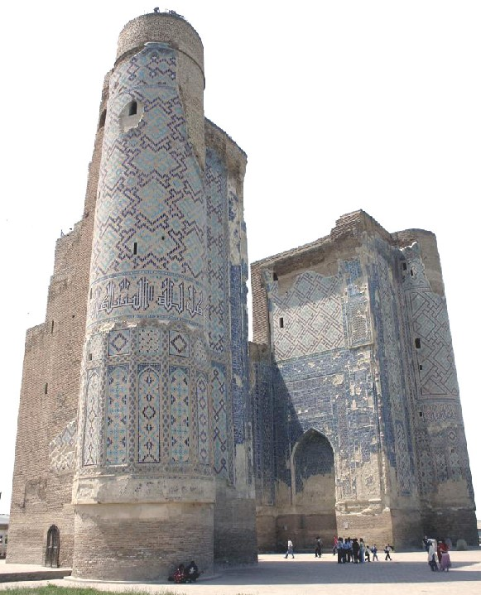
Aq Saray Palace,
Shahrisabz,
Uzbekistan

Slide 11
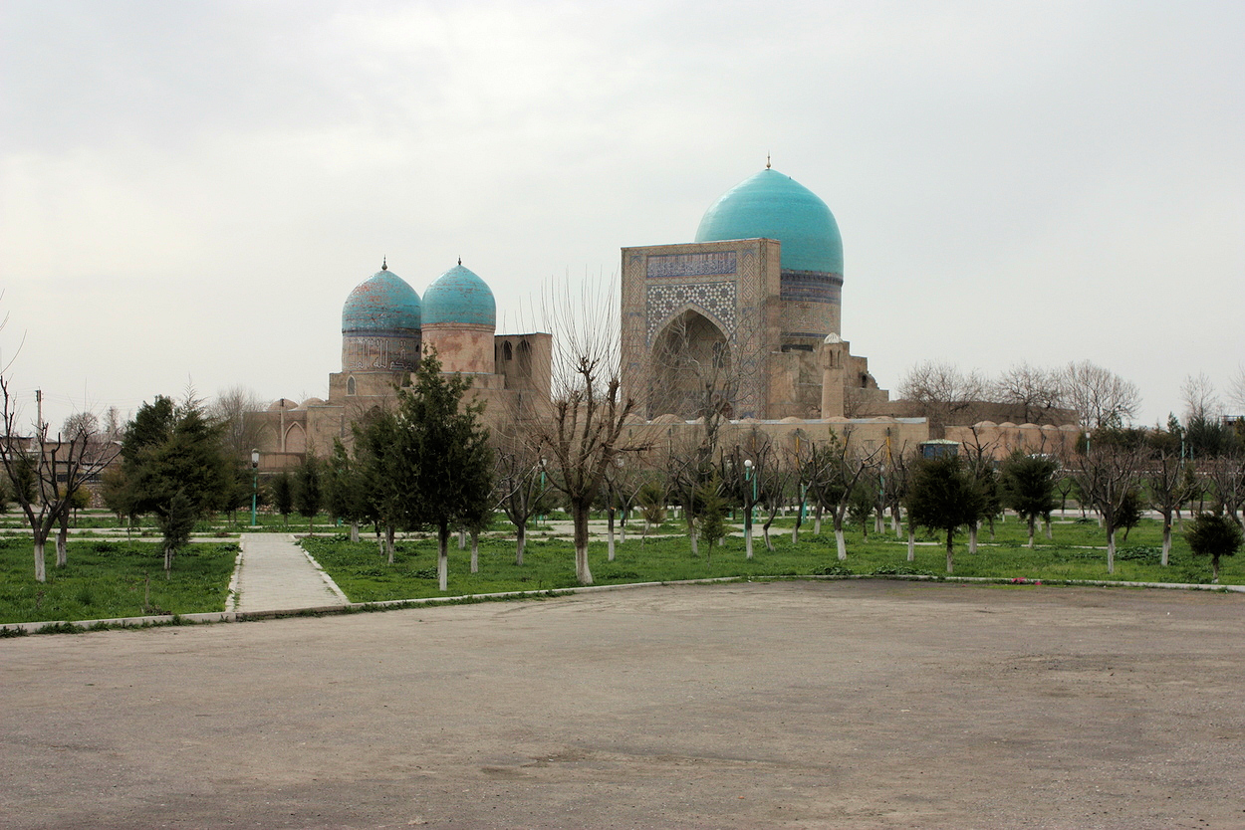
Kok Gumbaz Mosque and Dorut Tilovat Mausoleum, Shahrisabz

Slide 12
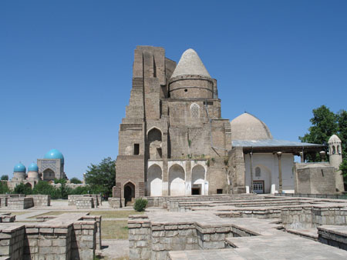
Dorus-Saodat, Shahrisabz

Slide 13
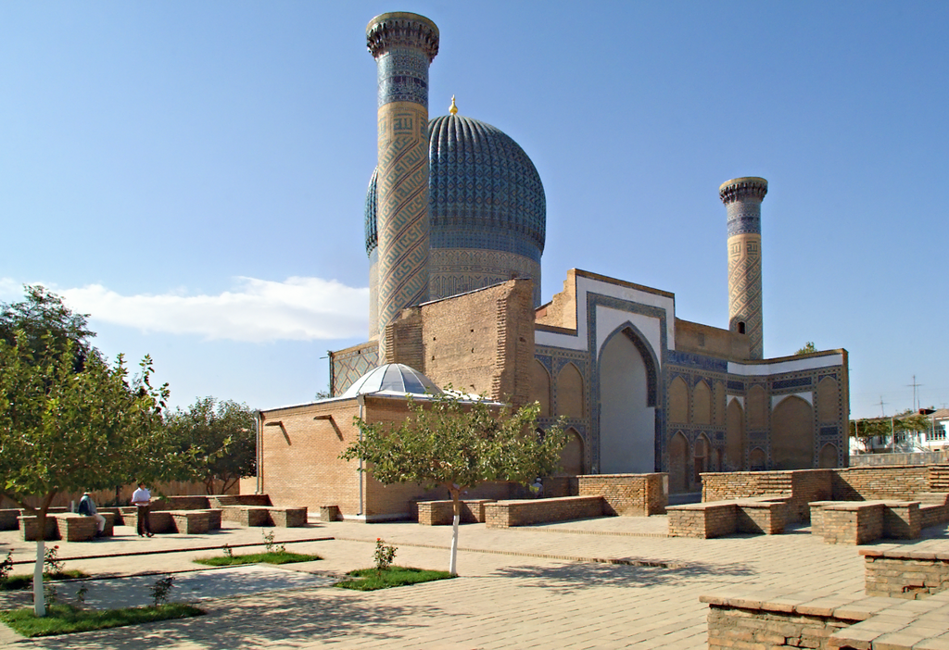
Gur-e Amir, Samarqand

Slide 14
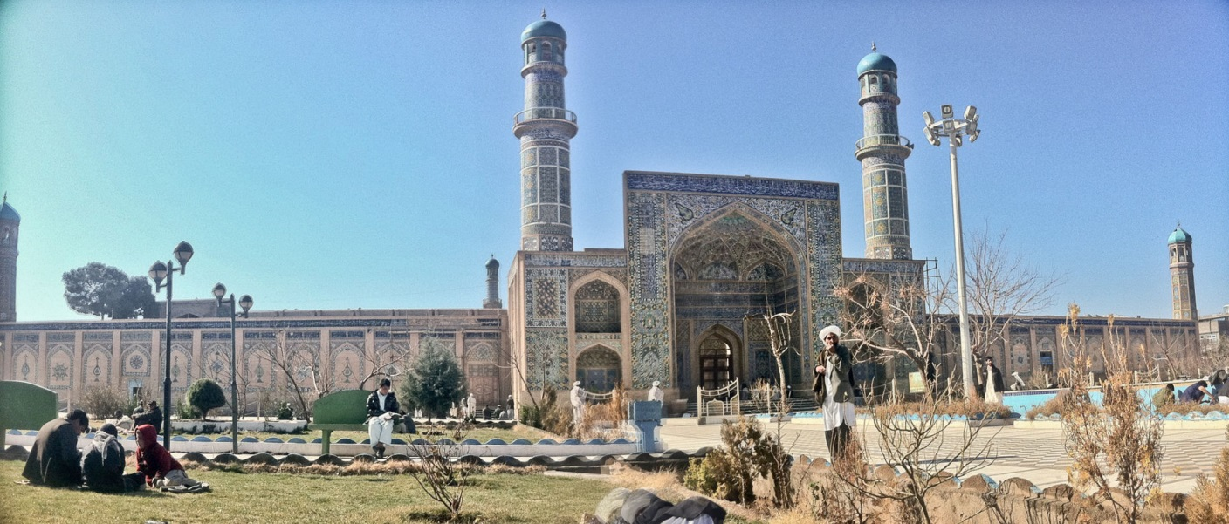
Friday Mosque, Herat

Slide 15
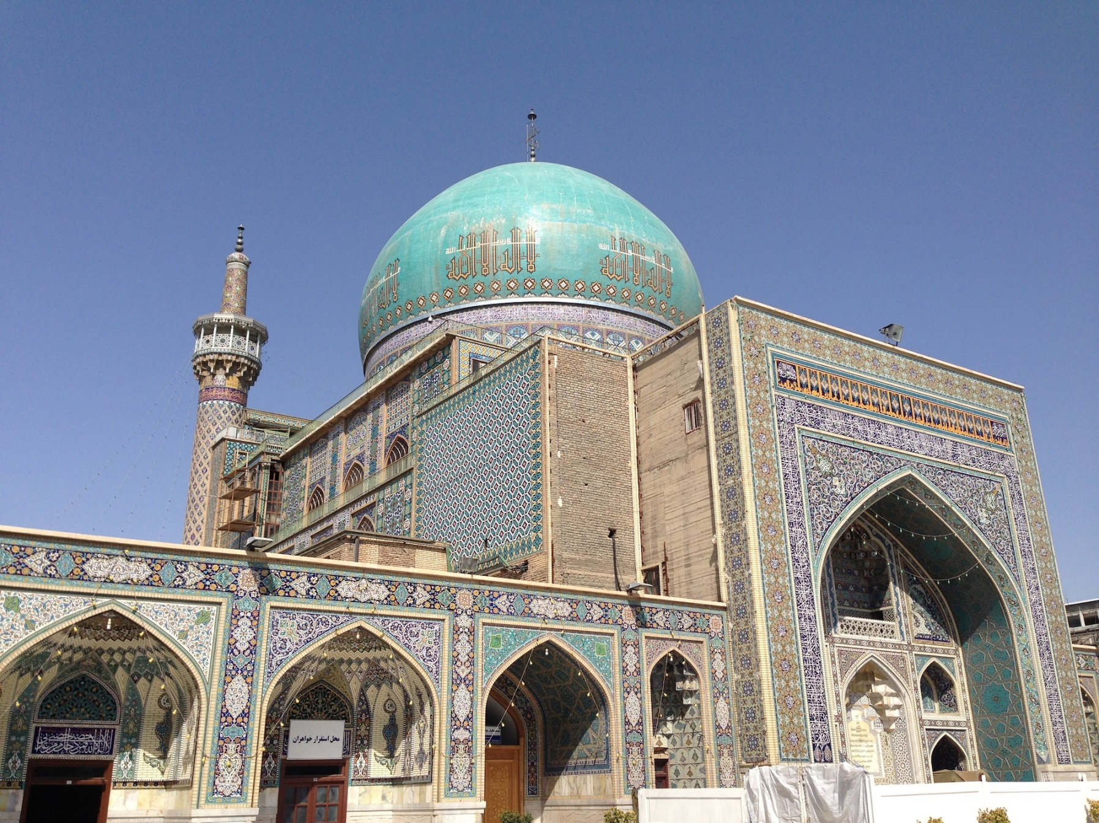
Goharshad Mosque, Mashhad

Slide 16
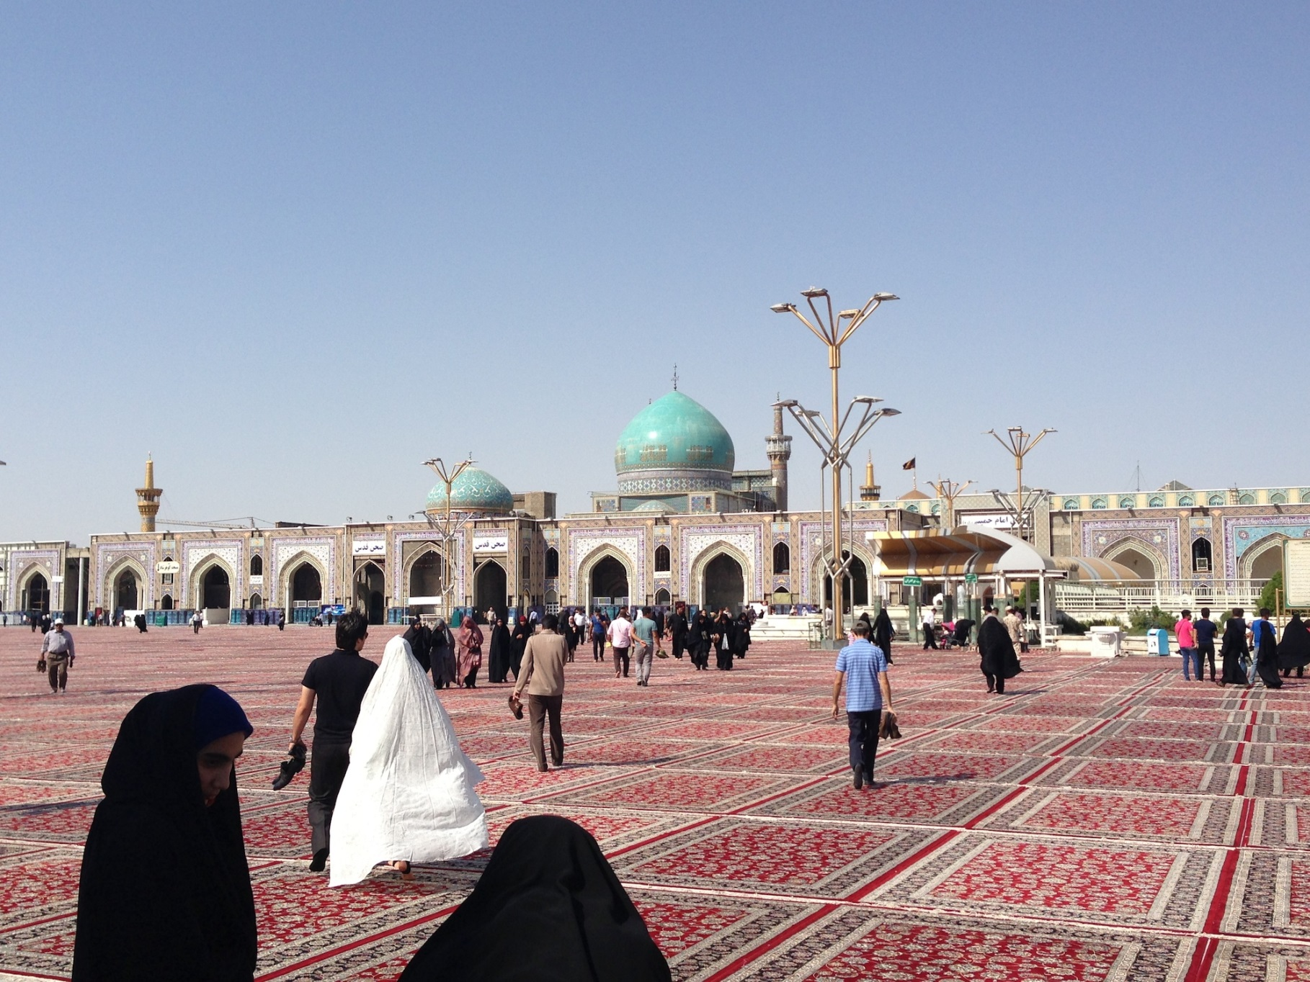
Goharshad Mosque, Mashhad

Slide 17
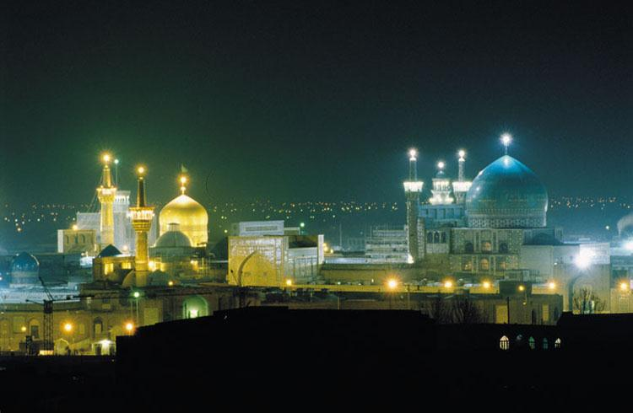
Gohar Shad Mosque, Mashhad

Slide 18
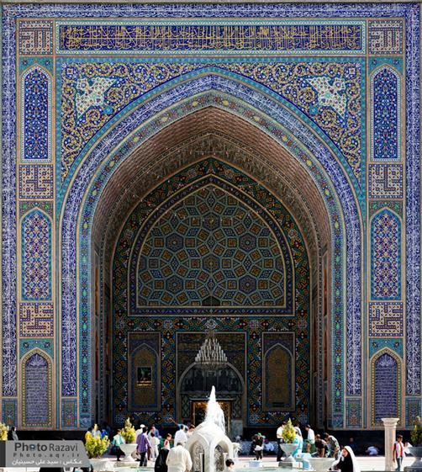
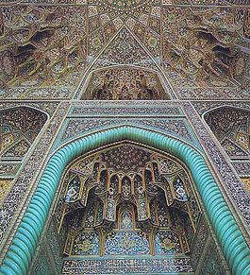
Gohar Shad Mosque, Mashhad

Slide 19
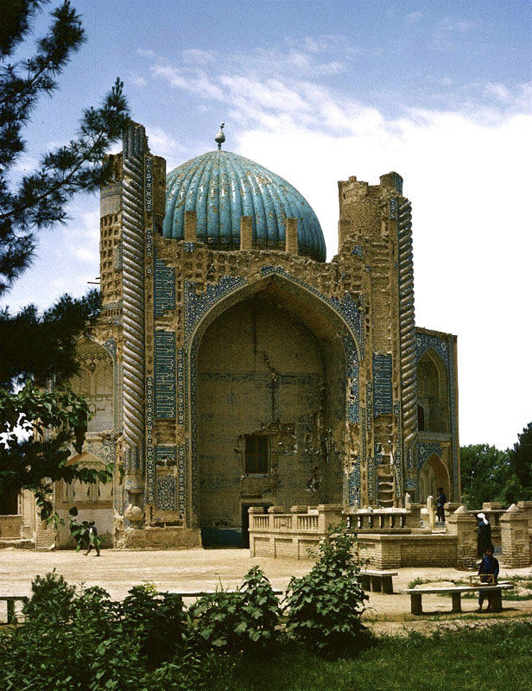
Green Mosque, Balkh

Slide 20
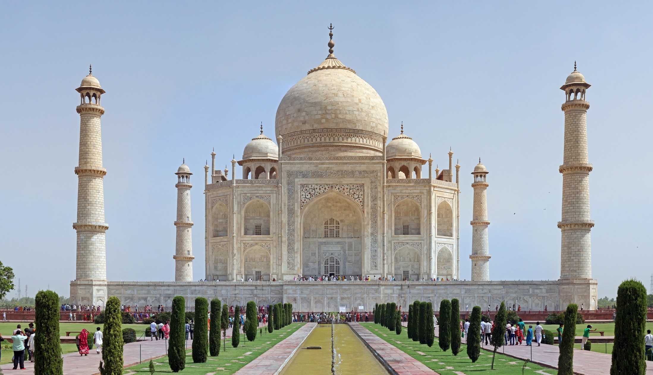
Taj Mahal, Agra

Slide 21
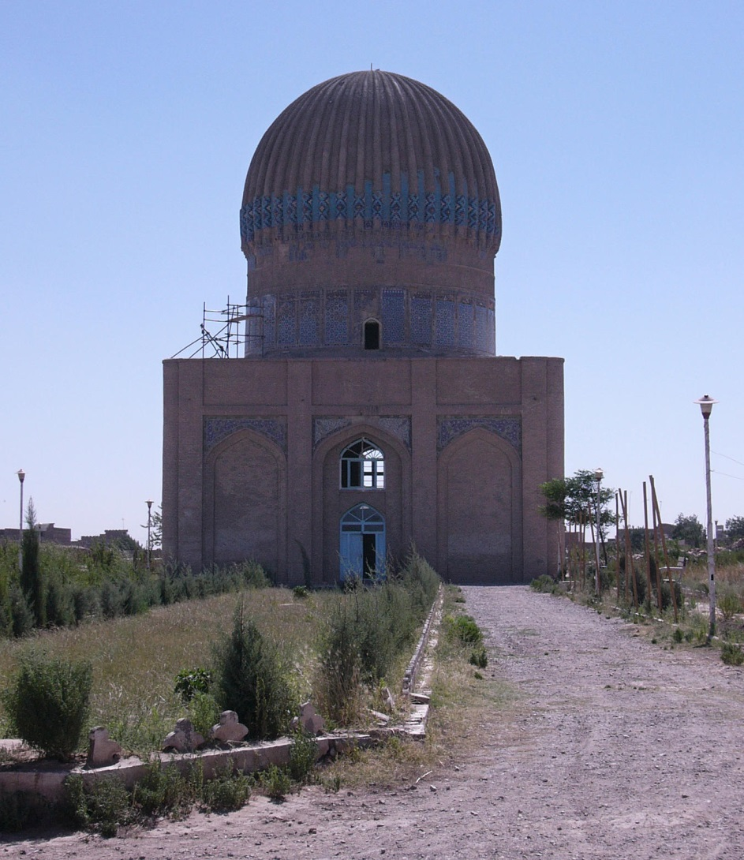
Gohar Shad Mausoleum, Herat

Slide 22
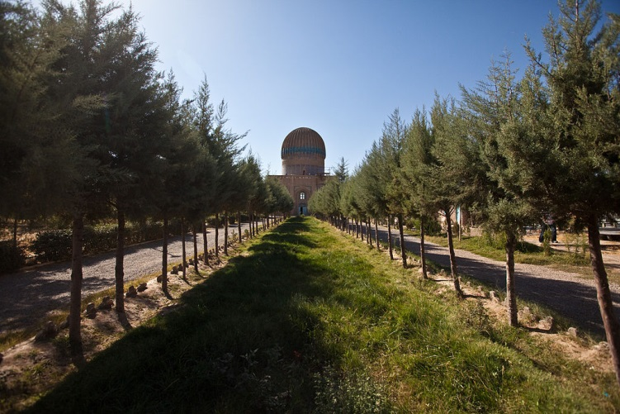
Gohar Shad Mausoleum, Herat

Slide 23
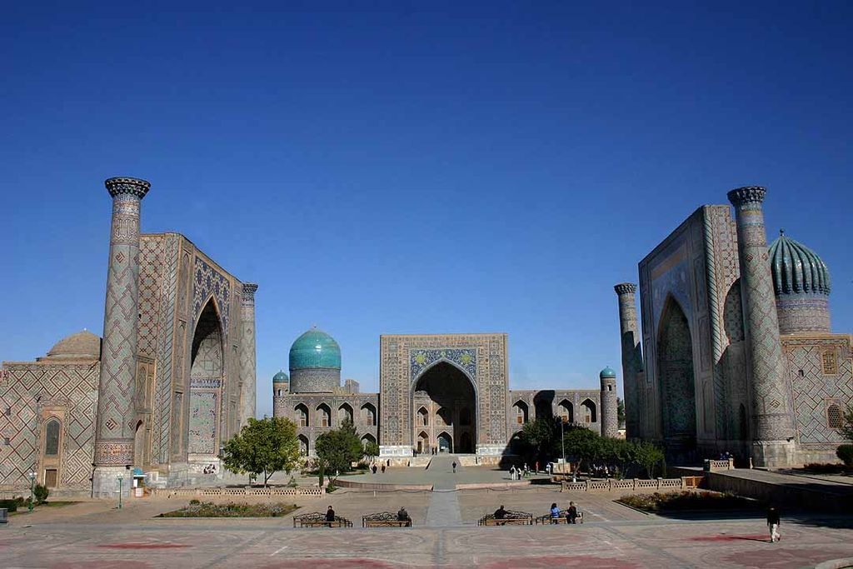
Registan, Samarqand

Slide 24
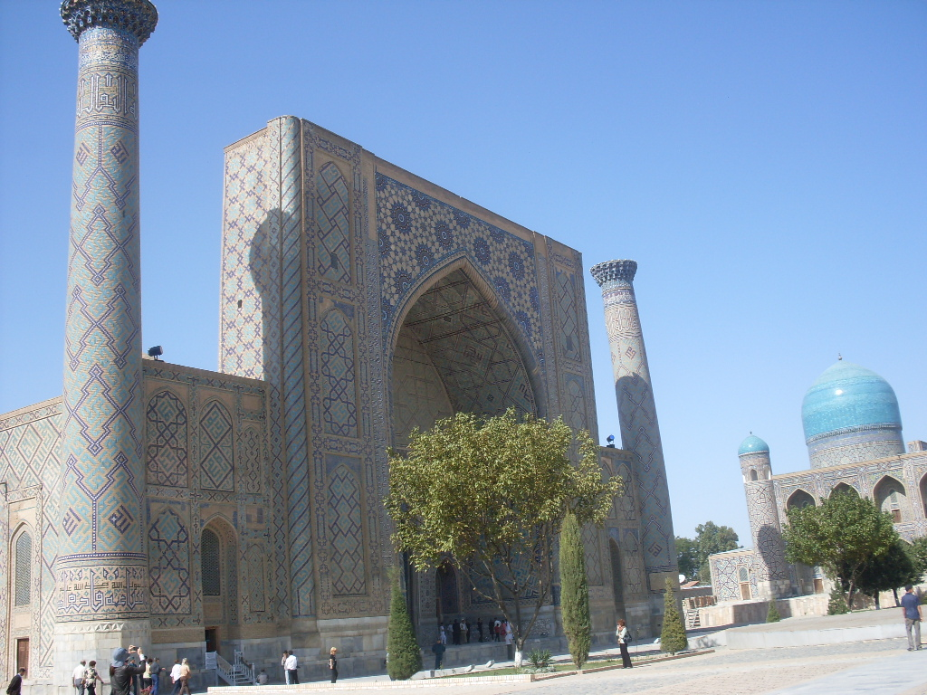
Ulugh Beg Madrasa, Samarqand

Slide 25
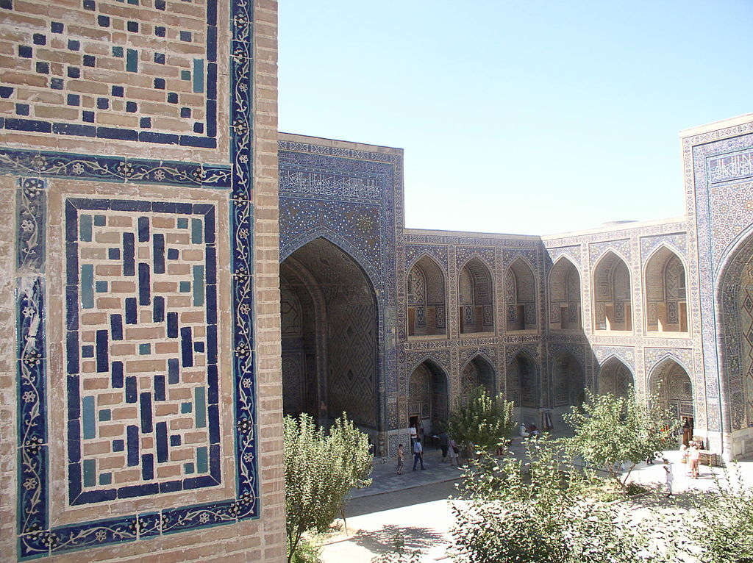
Ulugh Beg Madrasa, Samarqand

Slide 26
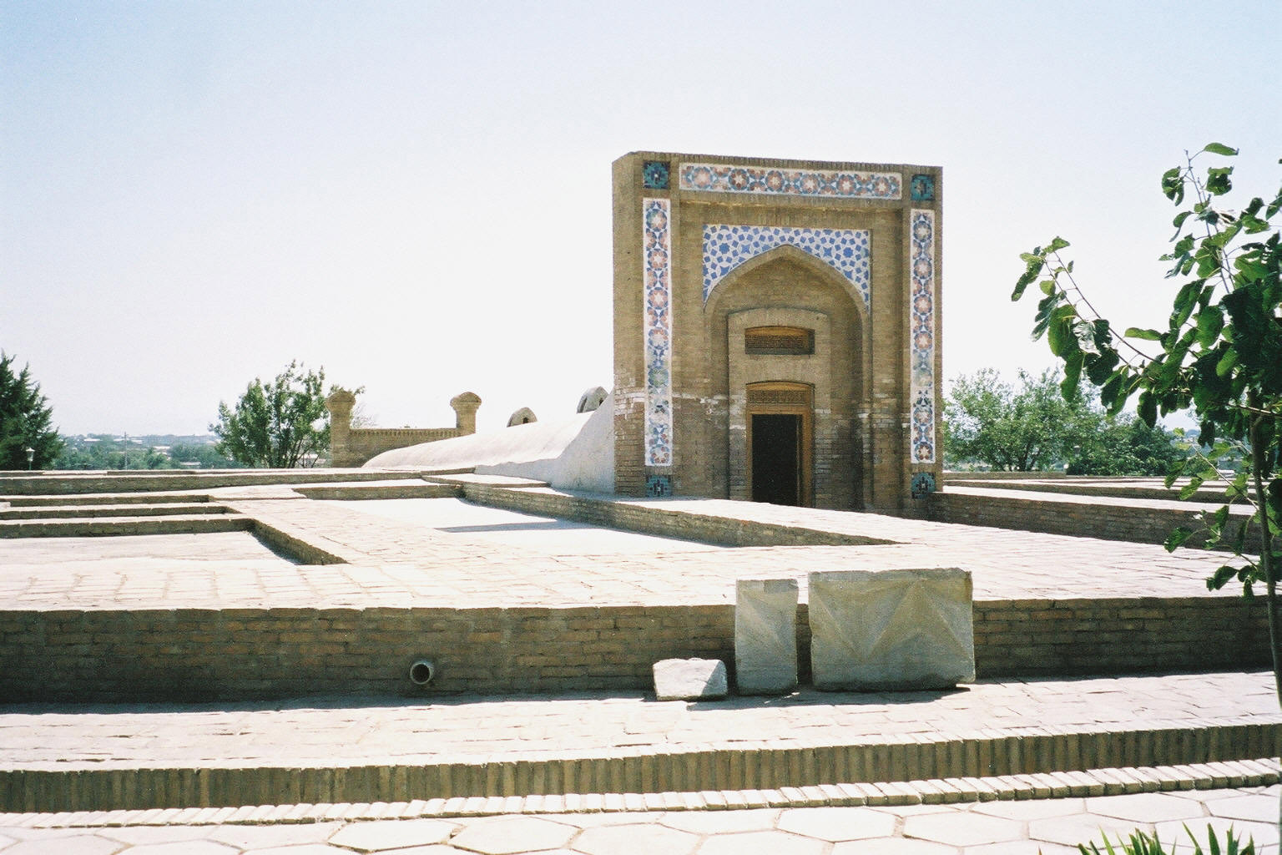
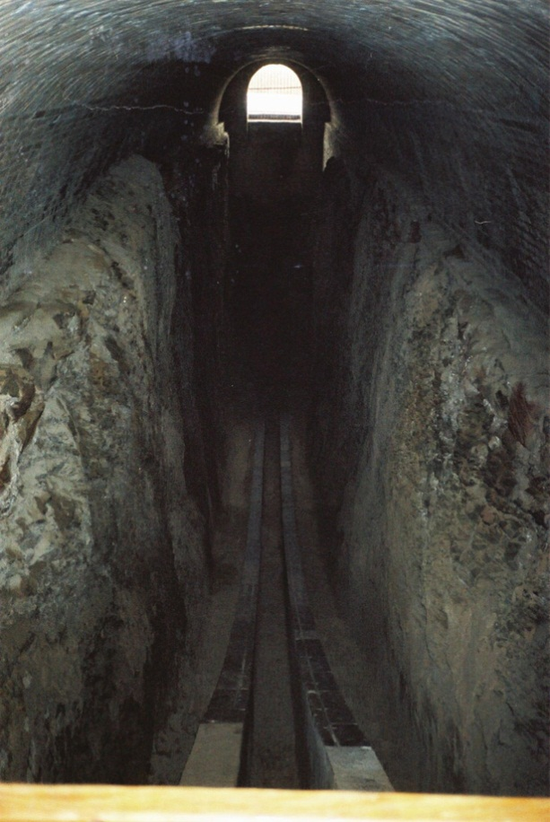
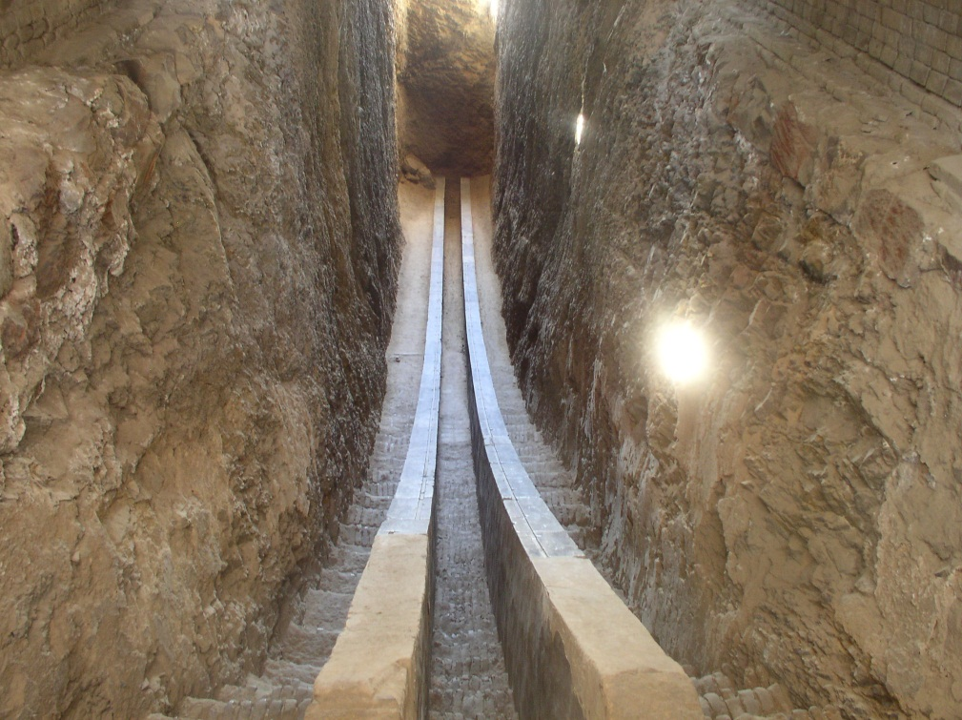
Ulugh Beg Observatory, Samarqand

Slide 27
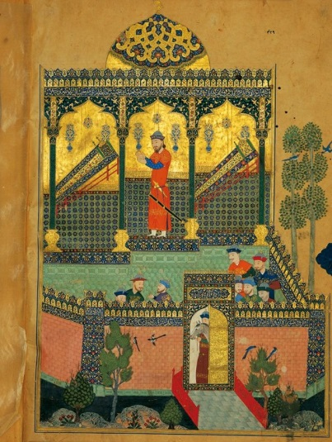
Baysongor b. Shahrukh Shahnameh

Slide 28
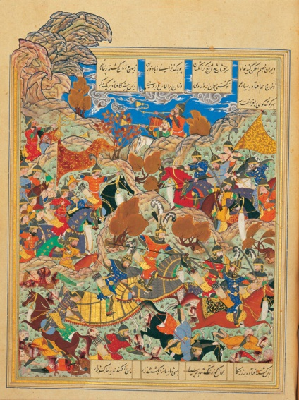
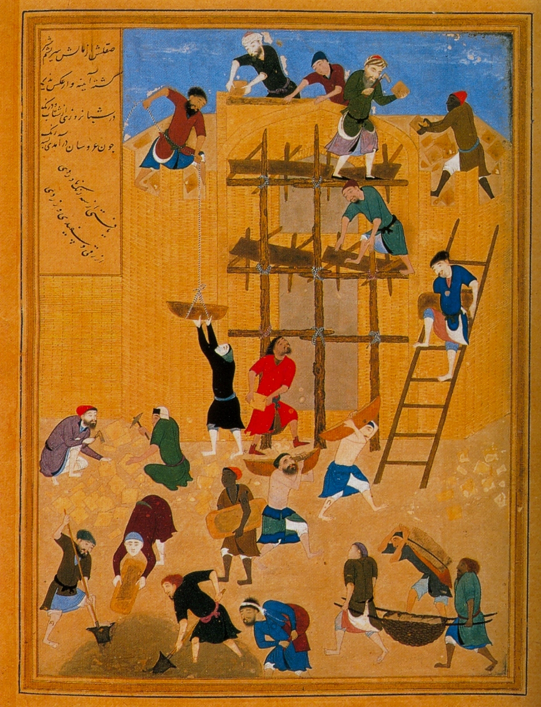
Behzad
Timur battling Mamluks of Egypt – construction of a castle at Khavarnaq

Slide 29
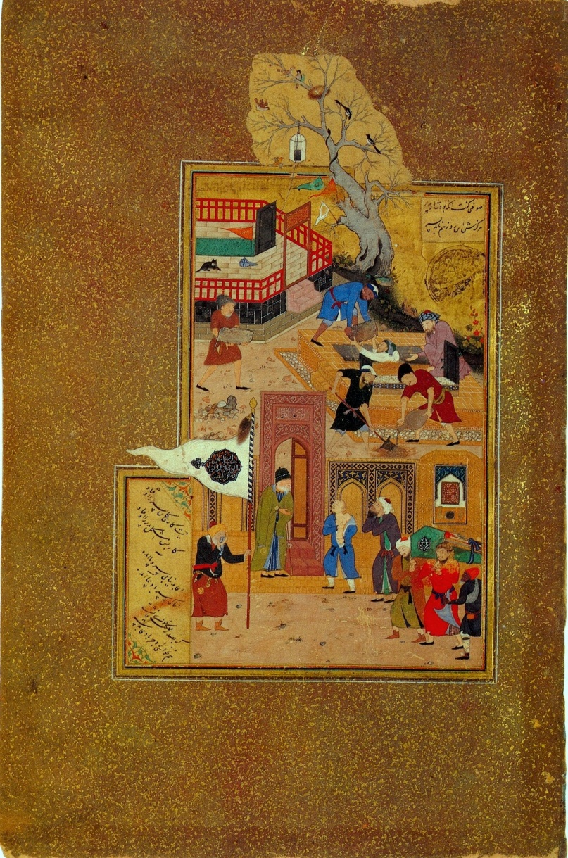
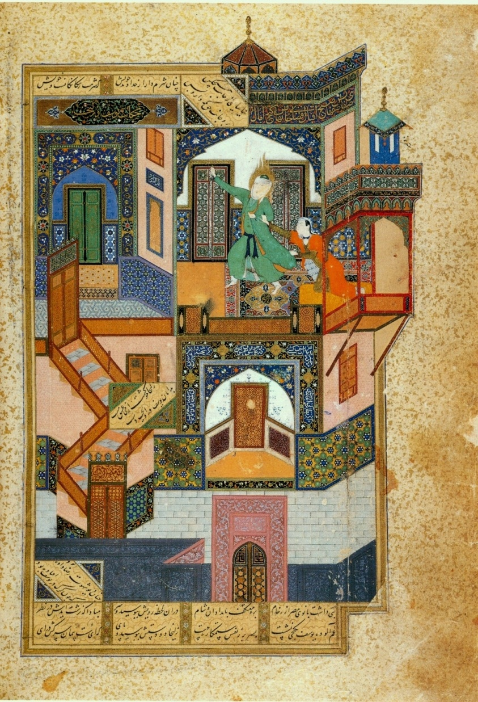
Behzad
Funeral of Attar of Nishapur – Yusef and Zuleykha

Slide 30
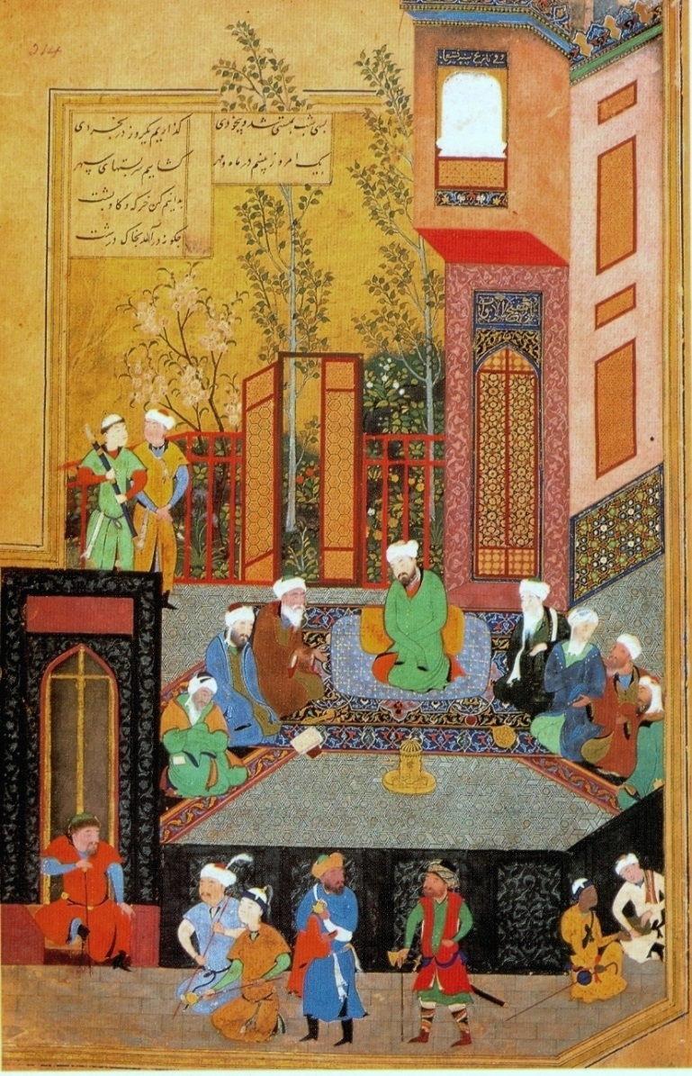
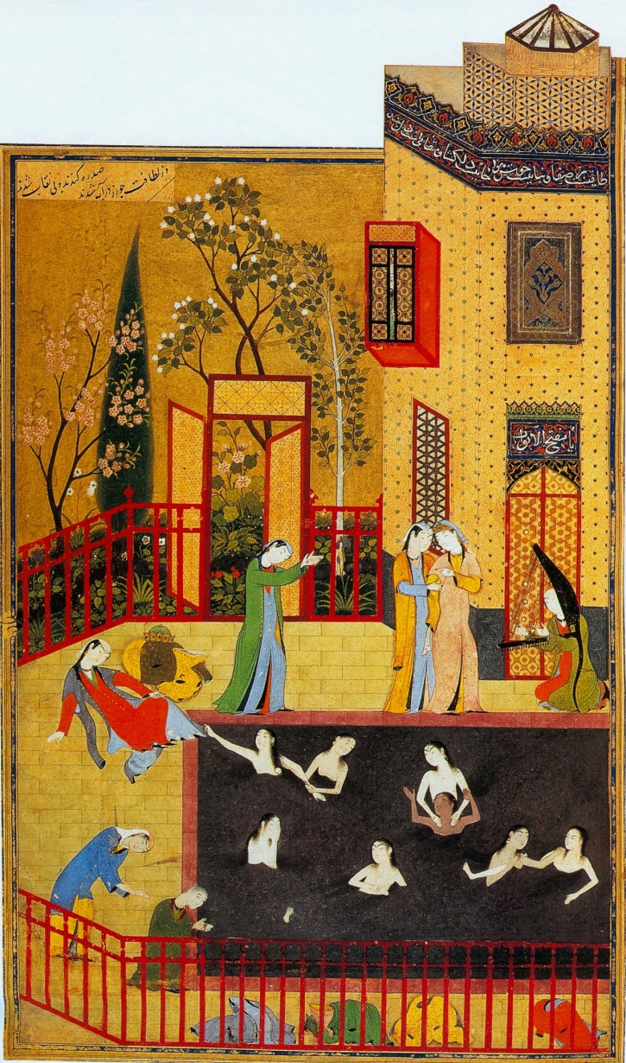
Behzad
Scenes from the Iskandernama

Slide 31
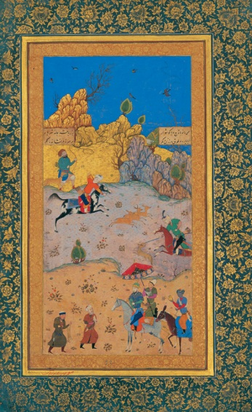
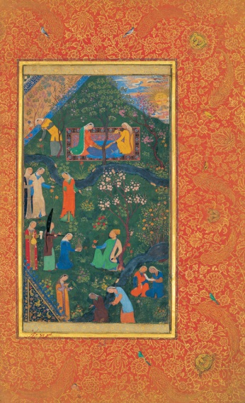
Hunting scene – Sultan Husayn Bayqara (r. 1470-1506)

