Slide 1
Salah al-Din: Freedom Fighter? Noble Heathen?
HIST 1016
10/1/14

Slide 2
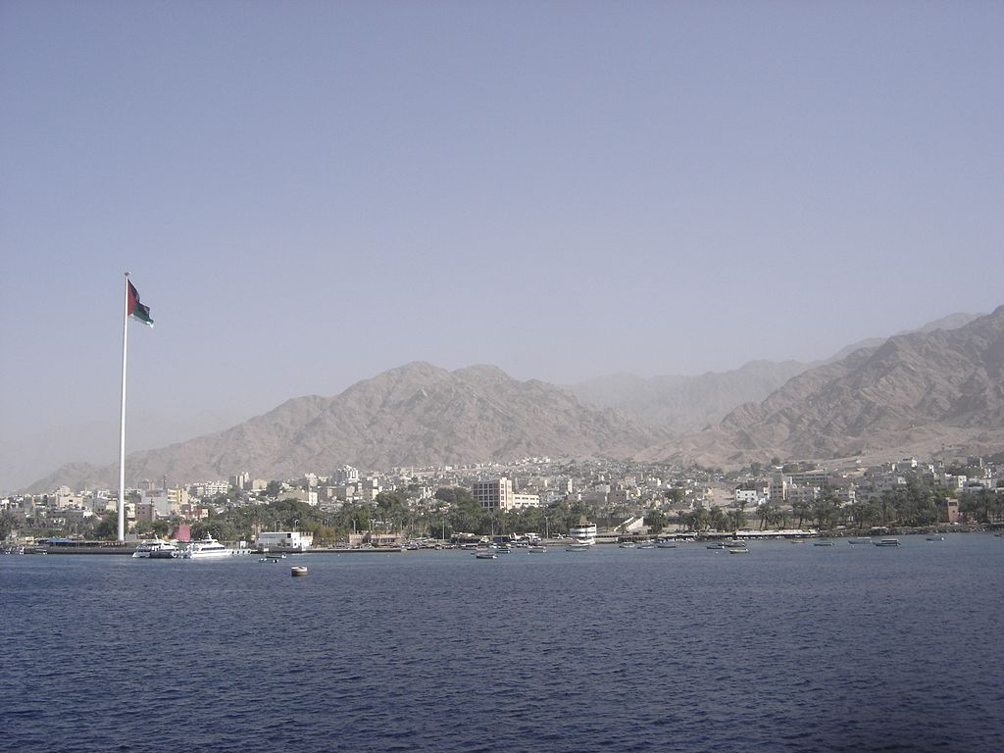
Salah al-Din and Nur al-Din
Salah al-Din the insolent
Light tax returns from Egypt
Failure to send troops for Nur al-Din’s campaigns
Independent
campaigns against
Kingdom of Jerusalem
Ayla (Aqaba, Jordan):
Access to Red Sea,
buffer between Egypt
and Syria

Slide 3
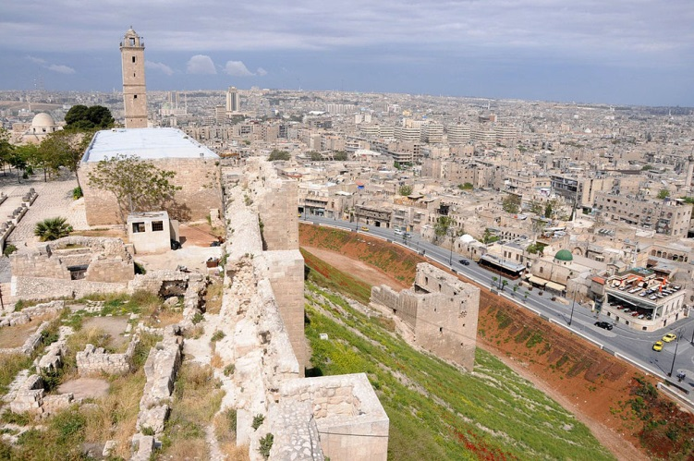
Salah al-Din (r. 1174-1193)
1174: Nur al-Din dies
Syria and Egypt go to his underage son, al-Salih Isma`il
Salah al-Din enters Damascus as al-Salih’s defender
al-Salih retreats to
Aleppo, allies with
Jerusalem
Salah al-Din uses this
as pretense to take lands
Aleppo, Syria

Slide 4
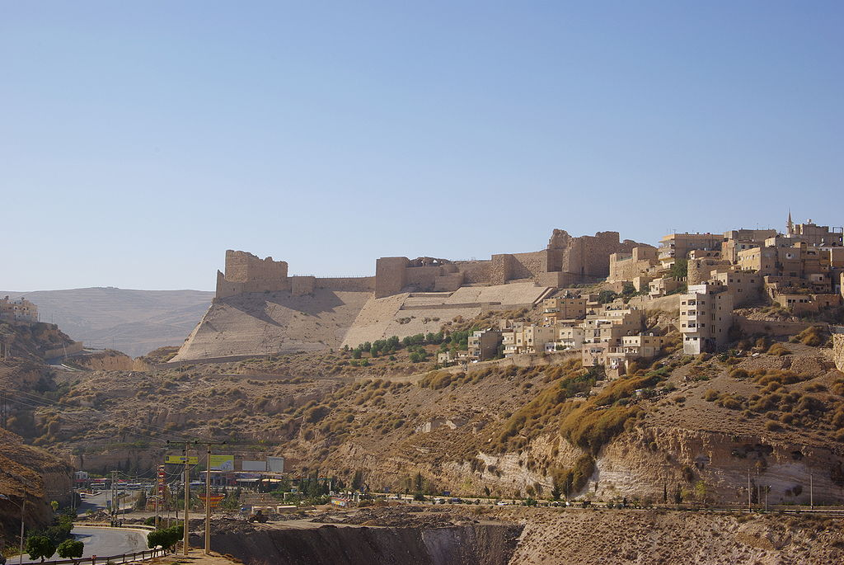
Salah al-Din the Counter Crusader
40 years of anti-Crusader rhetoric
Continued treaties with Jerusalem
Reynald of Châtillon: former prince of Antioch with aggressive personality
Campaigns into Arabia and Red Sea, threats on Medina
1186: Reynald
breaks truce to raid
Muslim caravans
Guy of Lusignan: King
of Jerusalem un-able/
willing to punish Reynald
Karak Castle, Jordan

Slide 5
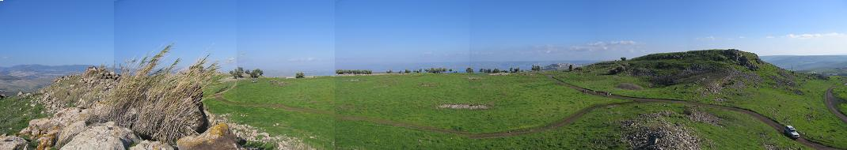
The Battle of Hattin
May, 1187: Salah al-Din takes force of 30,000 into Crusader territory
Kingdom of Jerusalem fields 20,000
  Brings a fragment of the True Cross
Crusaders lured by attack on Tiberius
Horns of Hattin
  Crusaders forced to camp without water
  Ambushed and destroyed

Slide 6
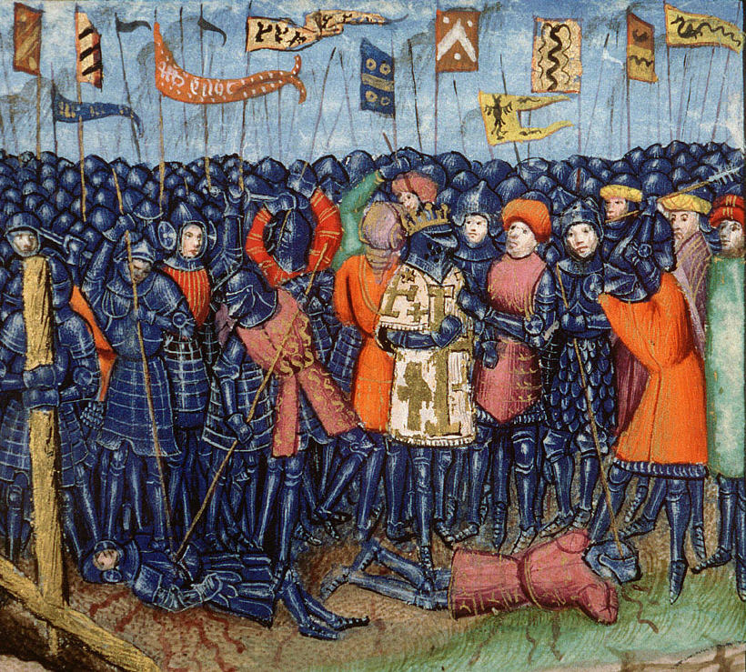
Aftermath of Hattin
Vast majority of crusader force killed or imprisoned
Reynald of Châtillon executed
Guy of Lusignan imprisoned
Leaves entire Kingdom of
Jerusalem defenseless
Salah al-Din claims all
Crusader territories except
a handful of castles
15th century representation of Hattin

Slide 7
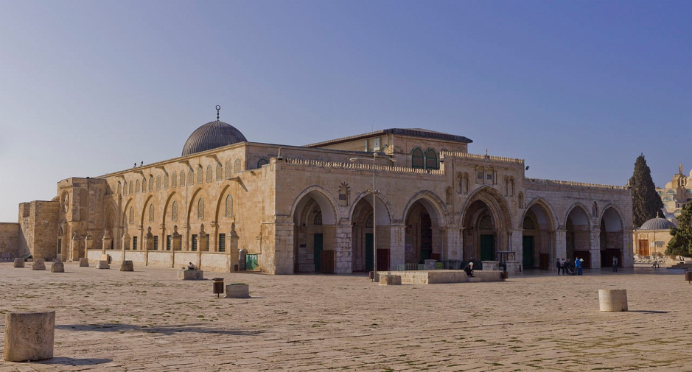
The Fall of Jerusalem
Oct. 2, 1187: After two week siege, Salah al-Din takes Jerusalem
Balian of Nablus: forced to knight noble boys of 16 and wealthy men
Threatens to kill everyone and destroy
holy sites
Population
ransomed
Rededication of
Muslim holy sites
al-Aqsa Mosque, Jerusalem

Slide 8
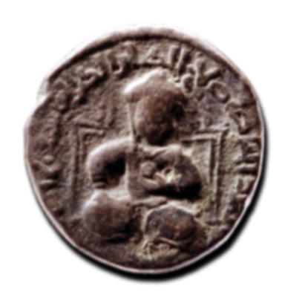
The Image of Salah al-Din
Contrast between Salah al-Din and First Crusade clear to all
Salah al-Din’s clemency vs. Crusaders’ bloodshed
Reinforced by Massacre of
Ayyadieh
Comes to define European
image of Salah al-Din
“Noble Heathen” –
Non-Christian, but model of
Christian values

Slide 9
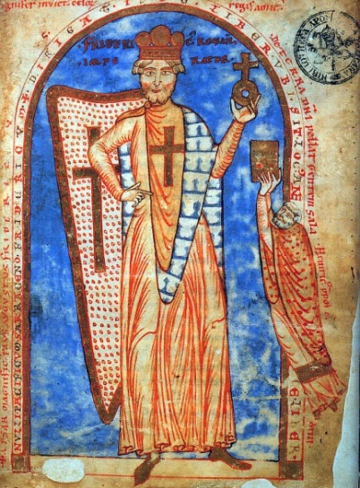
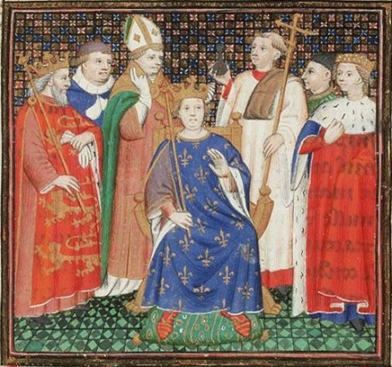
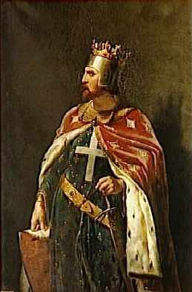
Third Crusade (1189-1192)
Response to fall of Jerusalem
God’s Punishment
Saladin Tax
European kings and unfulfilled vows
  Holy Roman Emperor Frederick
  Barbarossa
  French King Philip II Augustus
  English King Richard I the Lionheart
European politics prioritized

Slide 10
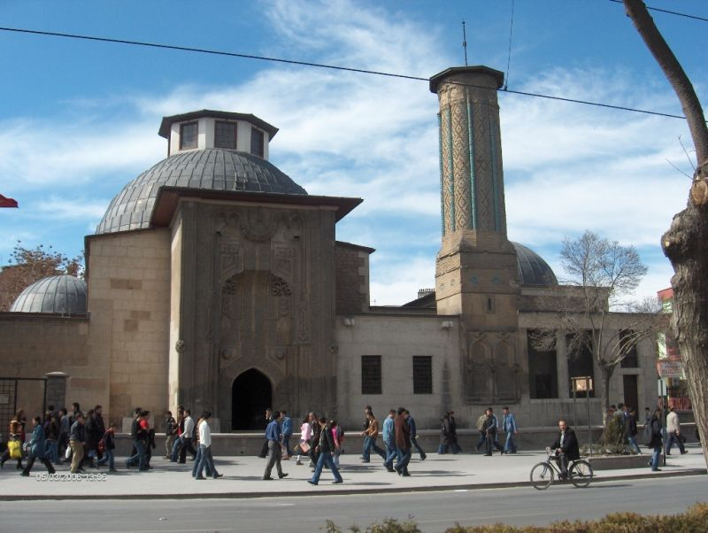
Third Crusade and Politics of the East
Byzantines and Salah al-Din
  Mosque in Constantinople
  Supervision of the Holy Sepulcher
Holy Roman Empire and the Sultans of Rum
  Free passage across Anatolia
  Qutb al-Din, Salah al-Din,
  and Konya
Iqta` and Salah al-Din’s
treasury
  How do you keep troops in
  the field?
Konya

Slide 11
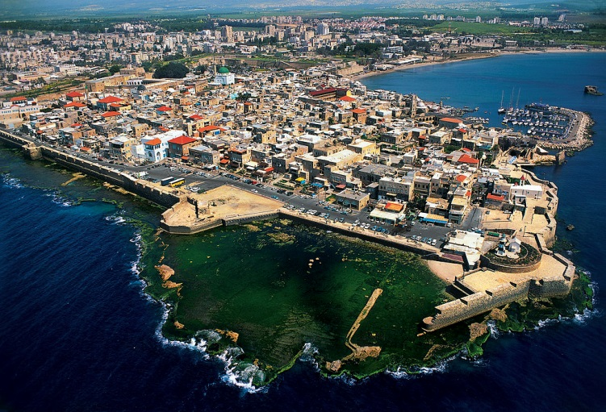
Siege of Acre (Aug. 28, 1189 – July 12, 1191)
Guy of Lusignan and Conrad of Montferrat in Tyre
New arrivals flock to Guy
Acre as planned base of operations
Flow of new arrivals
maintains siege
Negotiated surrender
Richard and the
Massacre of Ayyadieh

Slide 12
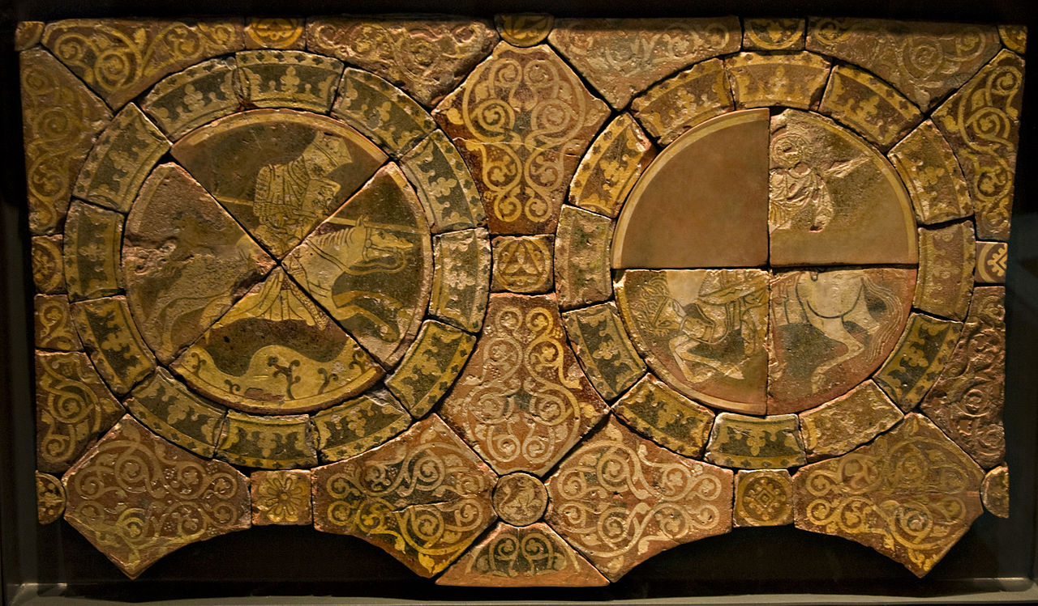
The Third Crusade
Richard the Lionheart left in charge
Muslim afraid to fight against him
Salah al-Din’s responses…
  Destroy defenses
  Fortify Jerusalem
Two failed attempts on
Jerusalem
Peace treaty
  Access for pilgrims and
  merchants
  Jaffa and Ascalon go to
  Salah al-Din
  The True Cross
Contemporary images of Richard and Salah al-Din

Slide 13
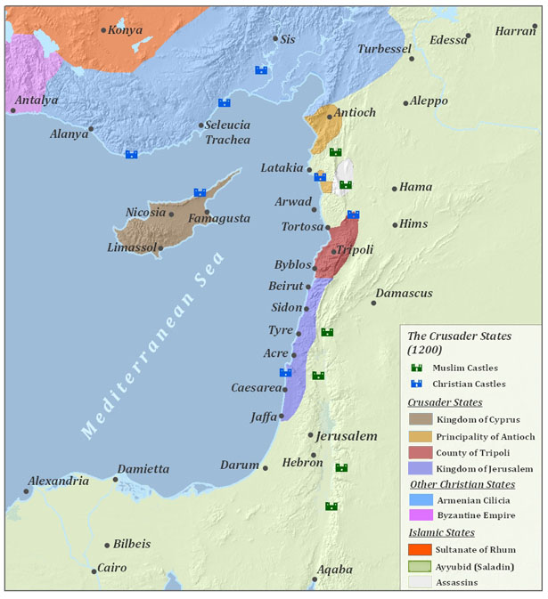
End of the Third Crusade

Slide 14
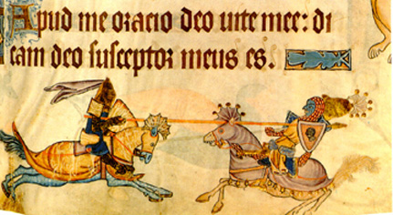
Richard and Salah al-Din
Remembered as respectful rivalry
Three year treaty, not end of fight
Oct., 1192 – Richard returns to England
Never enters Jerusalem
Salah al-Din as
model of chivalry
Virtuous pagan or
noble heathen
Richard and Salah al-Din in 14th century
manuscript

Slide 15
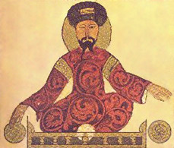
Death of Salah al-Din
Plans for pilgrimage
Settle local disputes
Feb., 1193 – Falls ill, fasting and prayer
Concern over succession
al-Afdal accepts oath of
loyalty
March 3, 1193 – Salah
al-Din dies

Slide 16
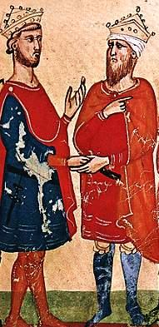
Ayyubid Dynasty (r. 1171-1341)
Preserve Salah al-Din’s Sultanate
Egypt as new economic center
Egypt as new focus of crusade
  1197, 1217, 1229, and 1249
Sixth Crusade (1228-1229)
  Holy Roman Emperor Frederick II
  Ayyubid Sultan al-Kamil
  Jerusalem given to Frederick by
  way of treaty
Frederick II and al-Kamil from 14th
century manuscript

