Slide 1
The Dissolution of the Caliphate
9/24/14
HIST 1016

Slide 2
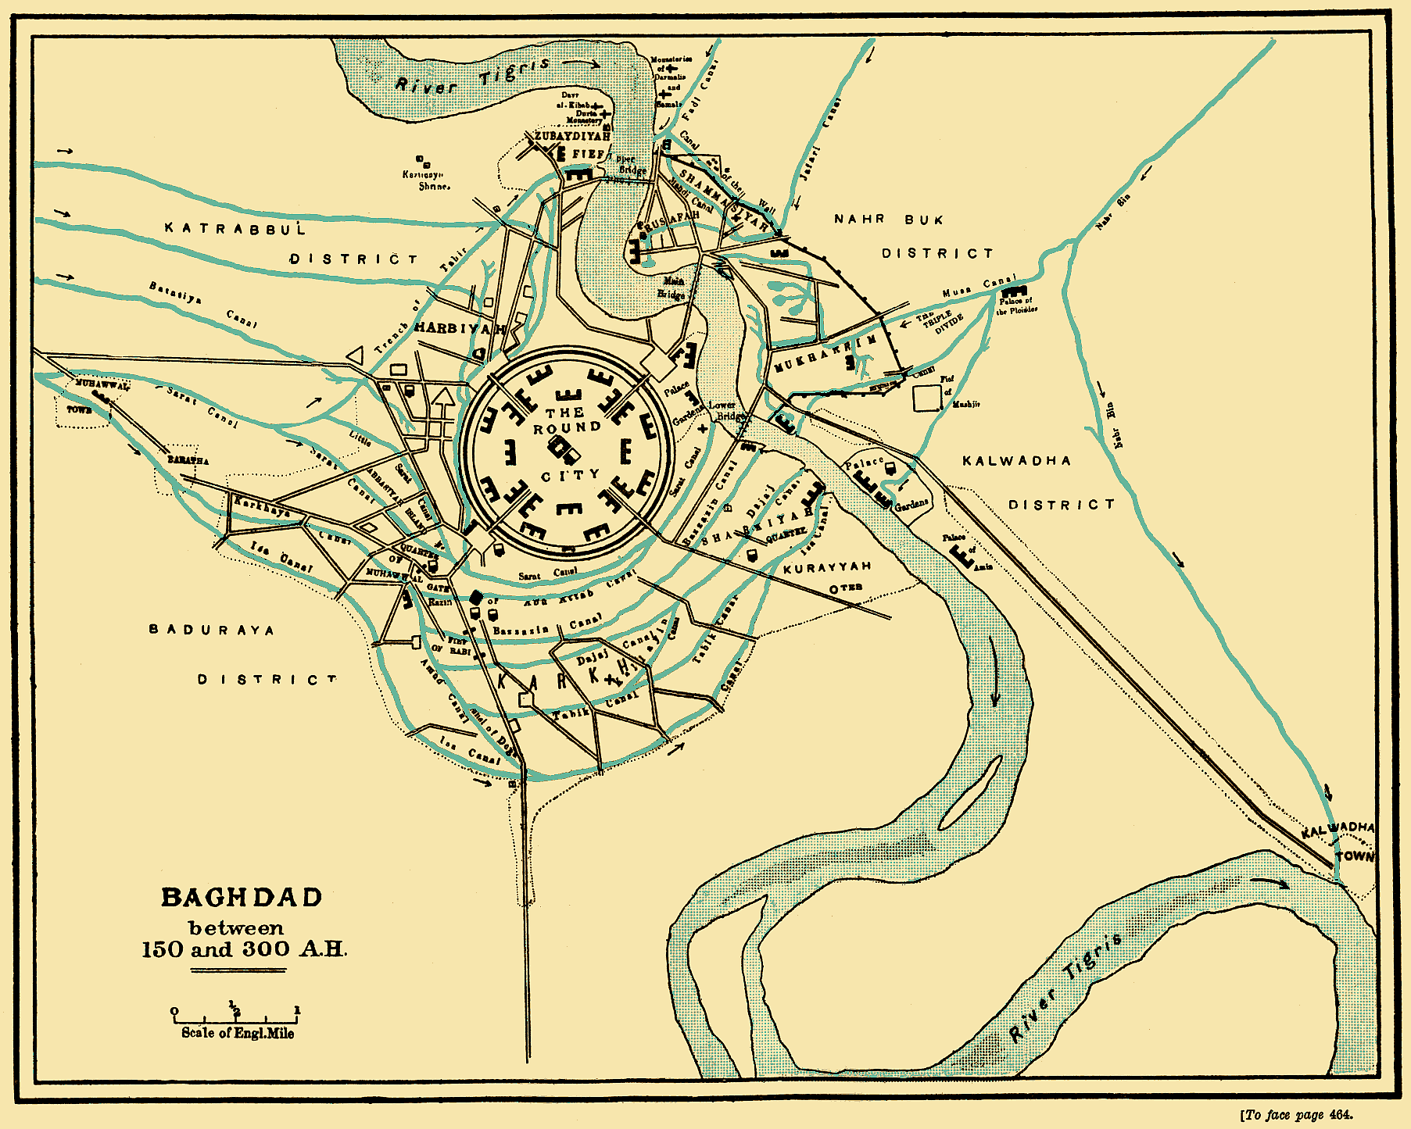
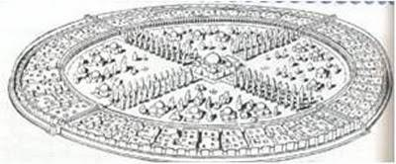
Baghdad as the Center of the World
750: `Abbasid Revolution
Baghdad – founded in 762
Cosmopolitan capital of `Abbasids
al-Yaqubi (d. 897/8)
Ibn al-Nadim (d. 998)
– al-Fihrist

Slide 3
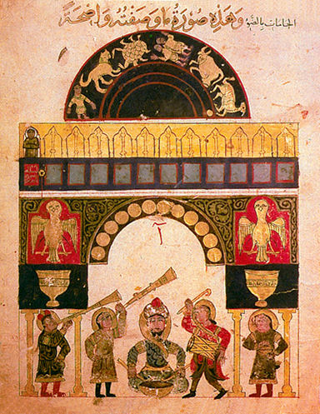
Don’t Forget: Harun al-Rashid

Slide 4
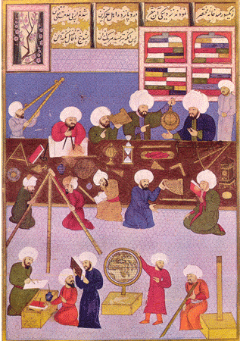
Arabic and the Translation Movement
Arabic and Islam
Arabic as lingua franca
Bayt al-Hikma: House of Wisdom
al-Ma’mun (r. 813-833)
Greek, Persian, and Indian texts
Islamic innovations

Slide 5
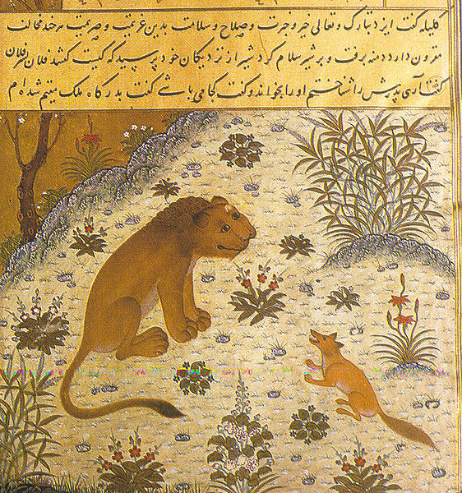
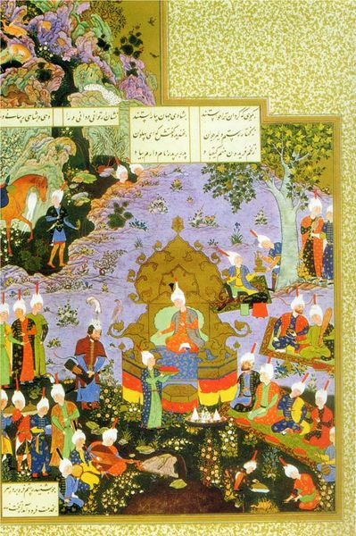
Kalila wa Dimna (Panchatantra)
1,001 Nights (Hazar Afsan, Jataka Tales)
Shahnameh

Slide 6
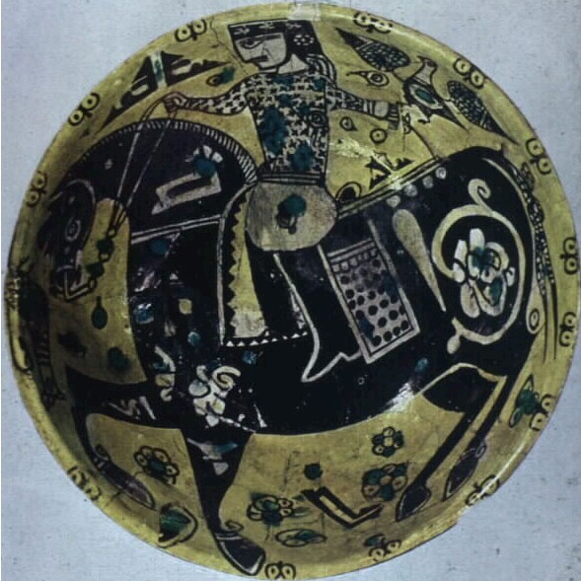
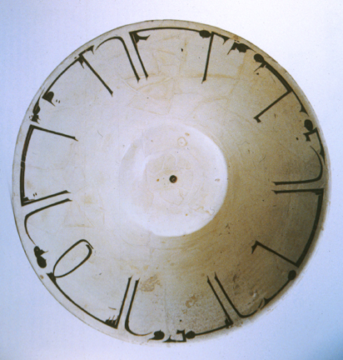
Nishapurware

Slide 7
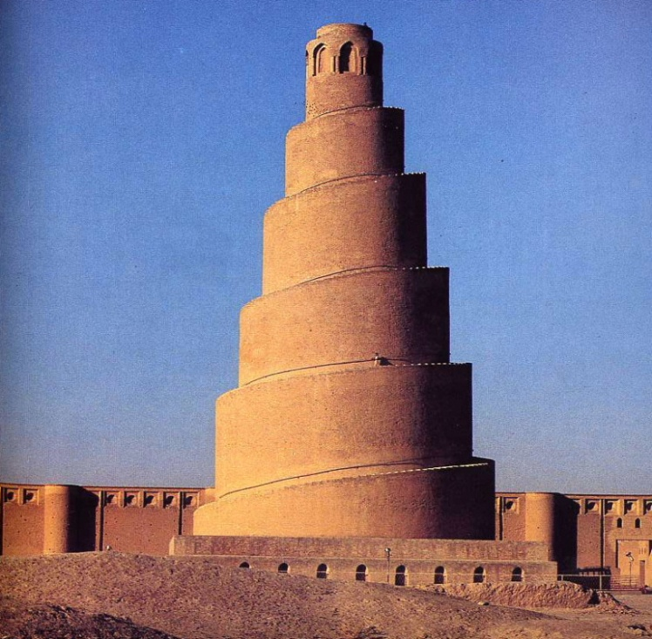
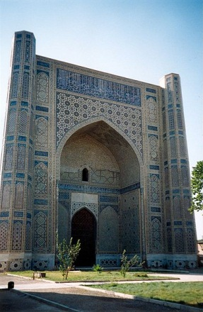
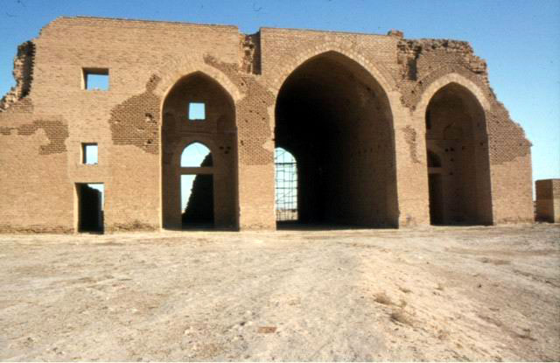

Slide 8
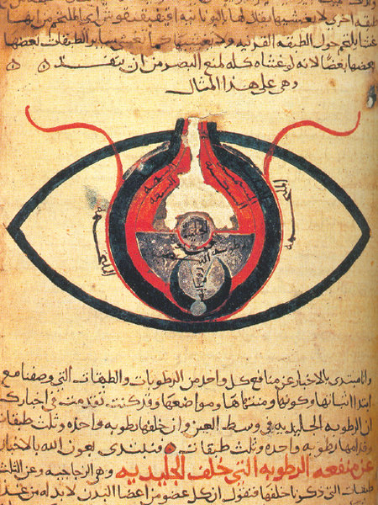
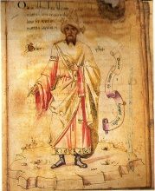
The Islamic Golden Age
Philosophy – Ibn Sina (Avicenna) (ca.
980-1037)
Mathematics - al-Khwarizmi (ca. 780 –
850)
Astronomy – al-Farghani (active 833 –
861)
Medicine – al-Razi (Rhazes) (865-925)
Chemistry – Jabir (Geber) (ca. 721 –
ca. 815)

Slide 9
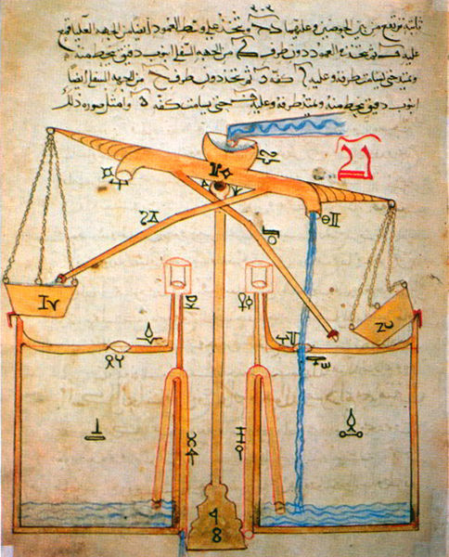
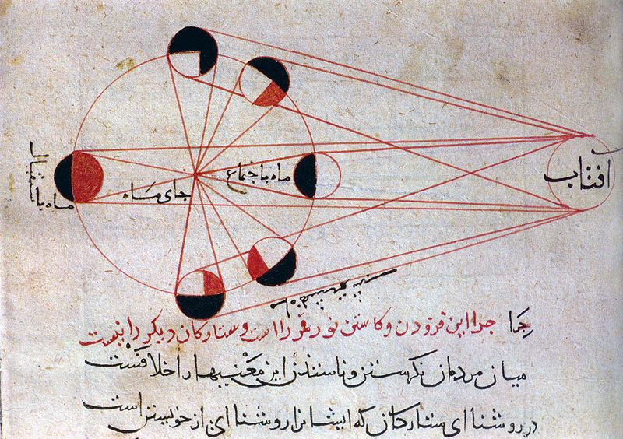

Slide 10
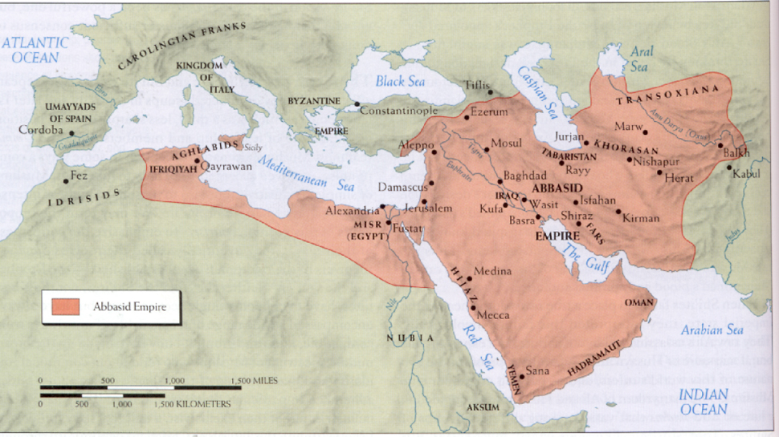
How do we go from this…

Slide 11
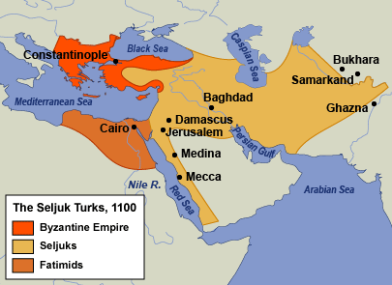
To this?

Slide 12
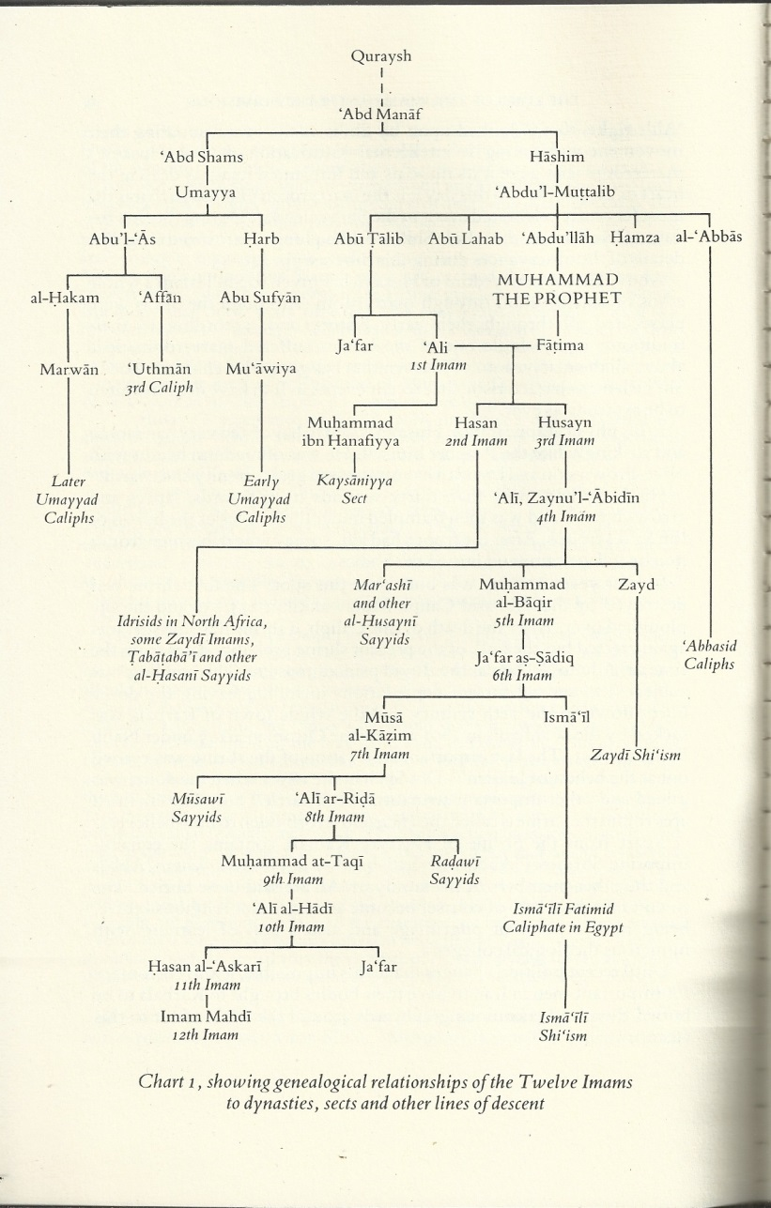
Step 1: Shi’ism and the Fatimids
Piety attached to loyalty to
`Ali and his descendants
Imam: True leader of the
Muslim community
Both political and religious
Who are the Imams and
what makes them special?

Slide 13
Isma`ili (Sevener) Shi’ism
765: Promotes Isma`il b. Ja`far over Musa al-Kazim as seventh Imam
Extreme messianism
Zahir and batin: literal and esoteric truths
Prophet and wasi: executer and interpreter of revelation
Cycles of seven prophets and seven wasi
Muhammad b. Isma`il to be the seventh prophet, will reveal truth and establish justice

Slide 14
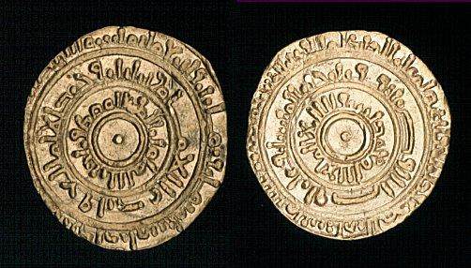
Isma`ili (Sevener) Shi’ism

Slide 15
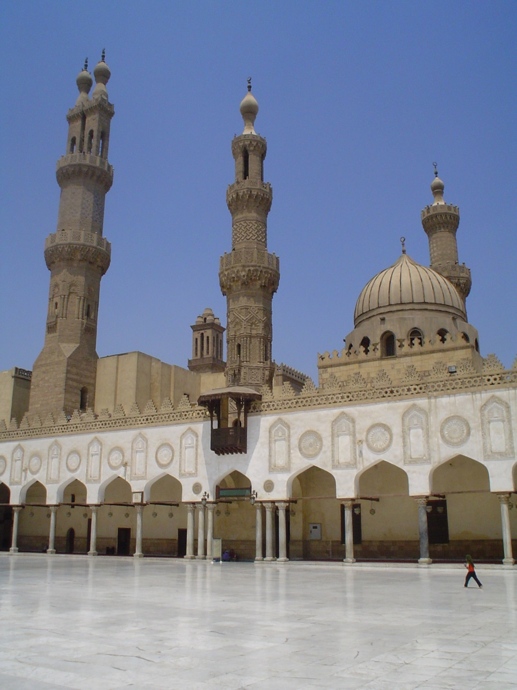
Fatimid Caliphate (r. 909-1171)
Isma`ili Shi’ite counter
caliphate
Founded in North Africa
by missionaries among
Berbers
Eventually spread to
Egypt and Syria
Establish rule of Isma`ili
Imams
969: Founded Cairo as capital

Slide 16
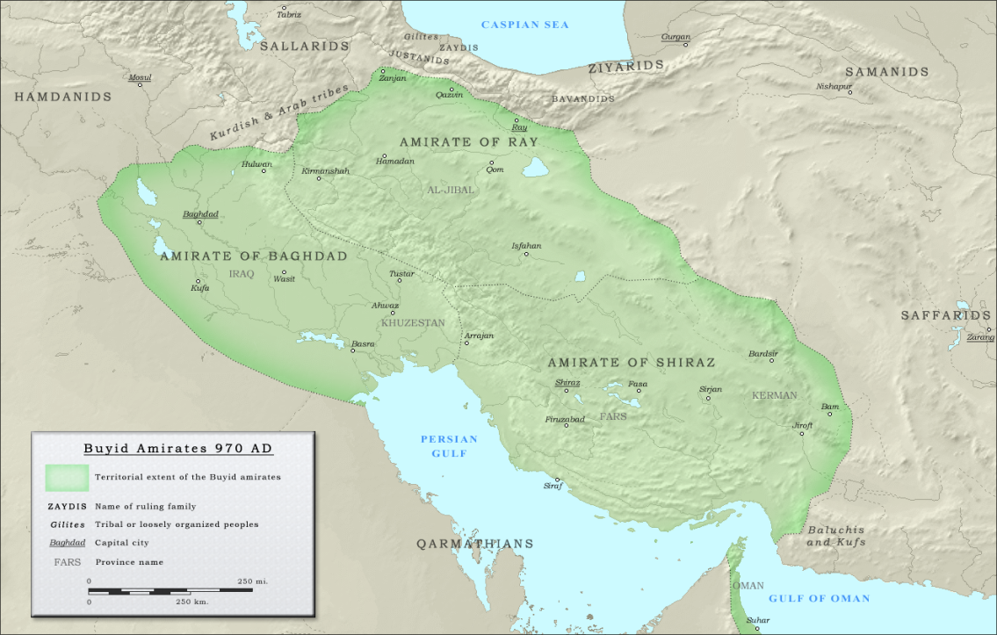
The Buwayhids (r. 934-1062)
Shi’ites from Daylam
Late 9th century – mercenaries
934 – Three brothers (`Ali, al-Hasan, and Ahmad
b. Buya) hired by local landowners to remove abusive governor in Fars
944 – March on
Baghdad
Amir al-umara’
Shi’ite commanders
of `Abbasid military?

Slide 17
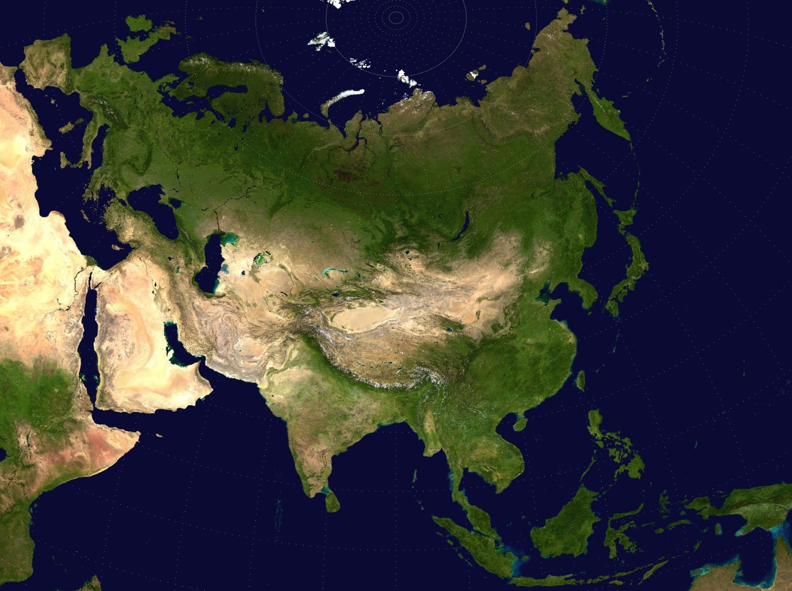
Step 2: The Steppe Turks

Slide 18
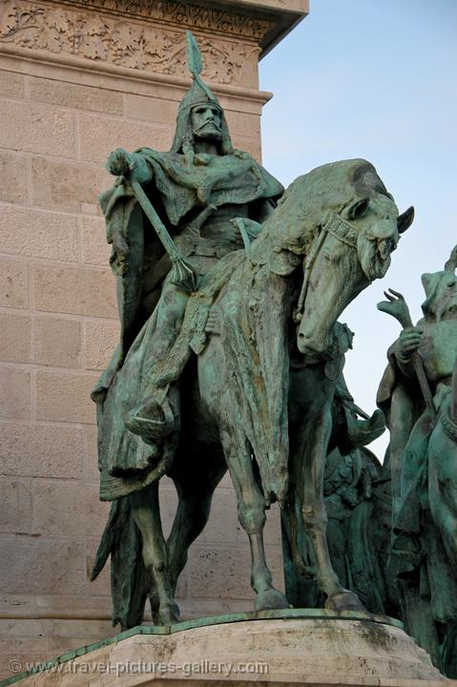
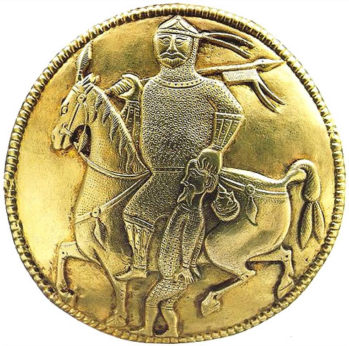
Don’t Forget: The Huns and the Avars

Slide 19
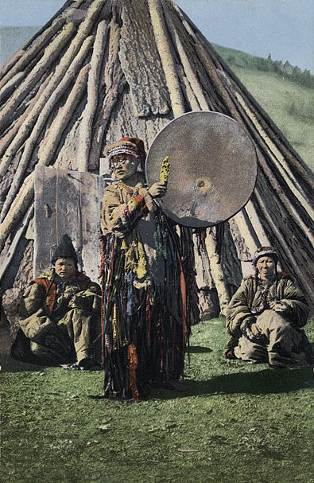
Turks and Islam
Paganism – living spirits inhabit all
objects animate and inanimate
Shamanism – shamans can interact
with spirits and travel in spiritual
realms
Nestorian Christianity, Buddhism,
and Manichaeism spread along Silk
Road
Mid-10th century – Islam expands
onto steppes
Lowers opposition to Turks
Turkic Shaman, Russian Empire, 1908

Slide 20
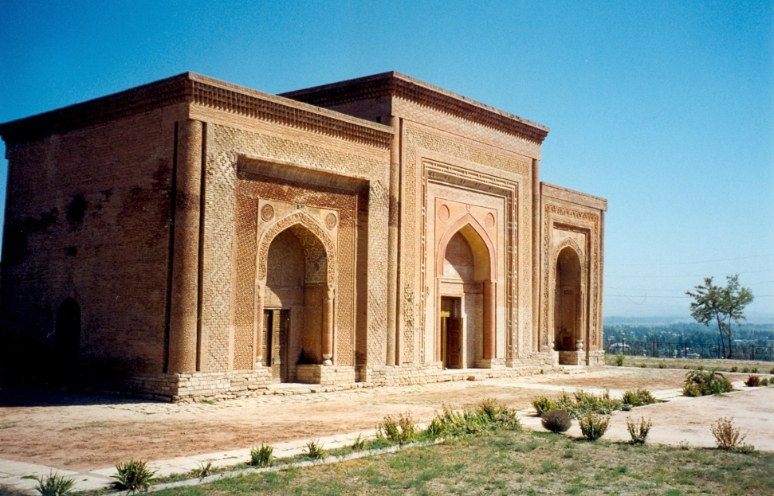
Turks in Islamic World
Turkish ghulams
Ghaznavids (962-1186)
  Ghulams of the Samanids
  Form independent dynasty in Afghanistan
Qarakhanids (992-1212)
  Muslim Qarluq Turks
  Conquer Samanid lands
  Welcomed as good
  Muslim rulers
Qarakhanid mausoleum in Uzgen, Kyrgyzstan

Slide 21
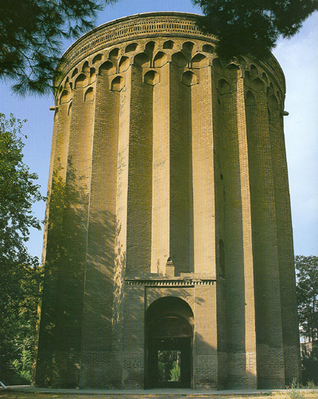
The Seljuqs
Oghuz Turks
Tughril Beg (r. 1016-1063) –
First Great Seljuq
1025 – cross Oxus River
into Khurasan
Was there a little Ice Age?
1040 – Battle of Dandanaqan
  Seljuqs defeat Ghaznavids for
  control of Khurasan
Begin war against Buywahids
Burj Tughril, tomb of Tughril Beg,
near Rayy, Iran

Slide 22
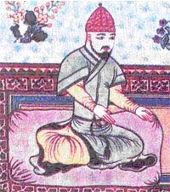
The Sunni Revival
Seljuqs become defenders of Sunni Islam
Byproduct of war with Buwayhids?
Employment of `ulama’ and sufis to justify rule
1055 – Invited into Baghdad to
rescue `Abbasids from
Buwayhids
Does not mean revival of
`Abbasid power
Tughril Beg

Slide 23
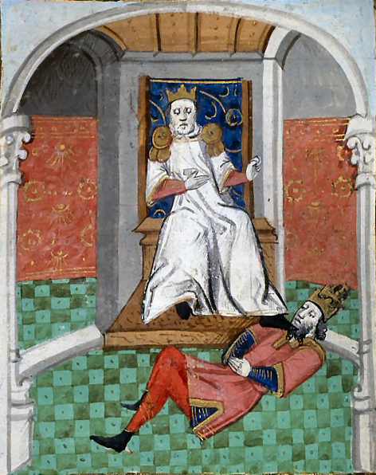
Wars with the Byzantine Empire
Aug. 26, 1071 – Battle of
Manzikert
Defeat of the Byzantine
Empire
Collapse of Byzantine-Muslim
frontier
Capture of Emperor
Romanos IV Diogenes
Begins Turkification of
Anatolia
15th century painting of Alp Arslan
humiliating Romanos IV

Slide 24
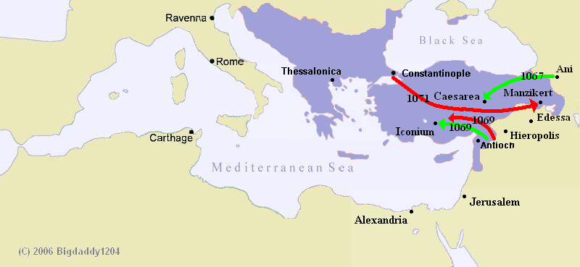
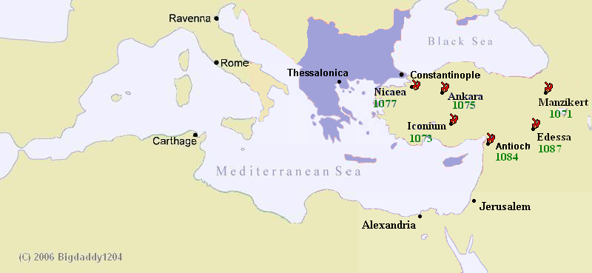

Slide 25
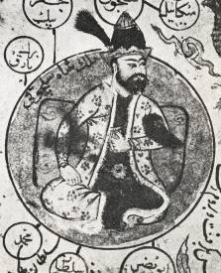
Malik Shah and Nizam al-Mulk
Nov. 25, 1072 – Alp Arslan
assassinated by captured Turkish rival
Malik Shah I (r. 1072-1092)
  Son of Alp Arslan
  Fights uncle, brother, and cousin for
  title
Nizam al-Mulk (d. 1092)
  Persian vizier of Malik Shah
  Real ruler of the Seljuq Empire for 20
  years
  Siyasatnama – Book of Government
  Nizamiyyah – universities to train administrators
Malik Shah I

Slide 26
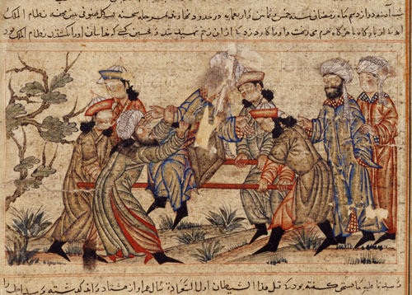
Seljuq Collapse
Oct. 14, 1092 – Nizam al-Mulk assassinated by the Assassins
Assassins (hashshashin) – Nizari Ismaili Shi’ites
who engaged in politically motivated murders
Or was it Malik Shah?
Malik Shah dies not
long after
Seljuq lands fall into chaos
Sons and grandsons fight
for control
14th century depiction of assassination of
Nizam al-Mulk

Slide 27
Seljuq Successor States
Sultans of Hamadan (western Persia)
Sultans of Kerman (southern Persia)
Sultans of Aleppo (northern Syria)
Sultans/Emirs of Damascus (southern Syria)
Sultans of Rum (Anatolia)
Each with smaller divisions!
And they are all fighting with each other!

Slide 28
Seljuq Titles
Sultan – authority
Great Seljuq – Sultan of Seljuq Empire
Beg or Bey – prince
Emir – military commander
Atabeg – regent and tutor

Slide 29
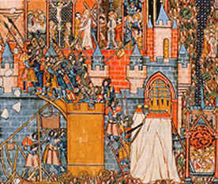
Enter the Crusaders
Crusades - A series of conflicts conducted by
Catholic Europeans against Muslims, pagans,
heretics, and excommunicates
beginning in 1095 and ending
in 1291 (even though the
crusading spirit lasted until
1798).
Crusading was a continuous
enterprise, but later historians
have numbered nine major
crusades between 1095 and 1291.

Slide 30
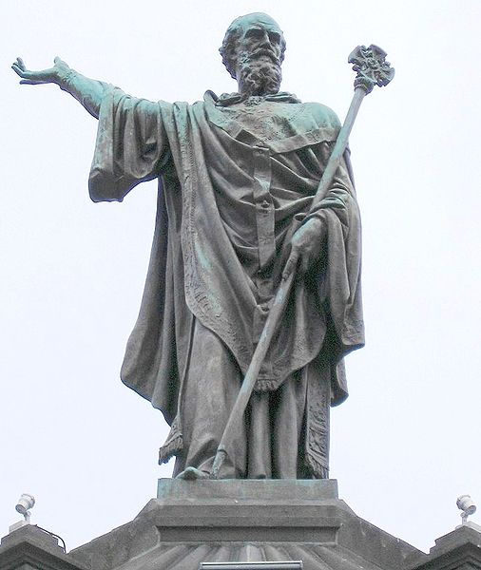
The Crusades
Urban II (r. 1088-1099)
Reform Pope
Peace and Truce of God
1095: Council of Claremont
Urban II calls for armed
pilgrimage to liberate the
Holy Land
Indulgences offered for
those who join.
Statue of Pope Urban II in Claremont

