Slide 1
The Rise of Islam
9/22/14
HIST 1016

Slide 2
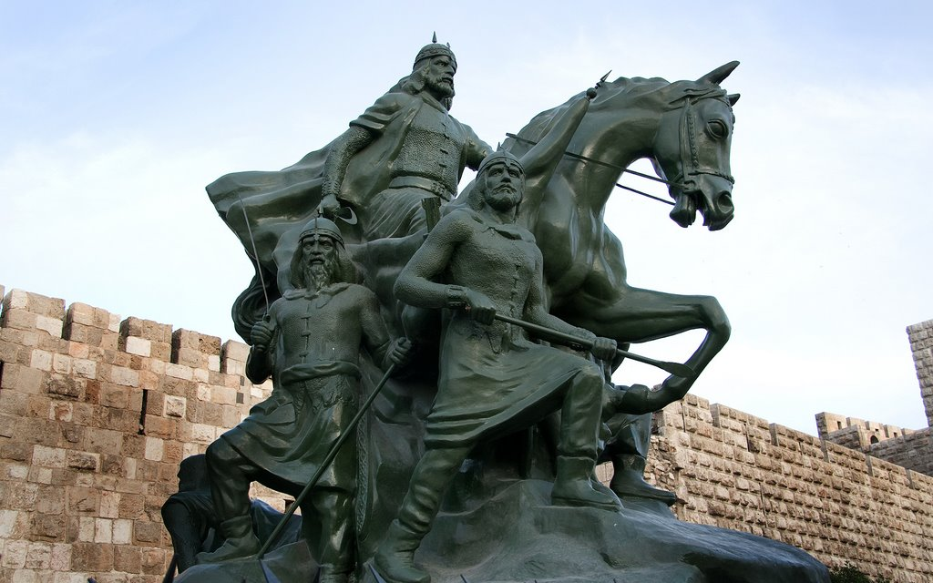
Salah al-Din Yusuf b. Ayyub (r. 1174-1193)

Slide 3
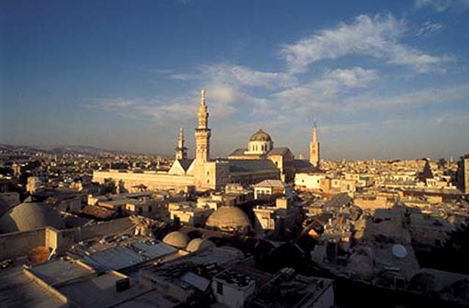
The Rise of Islam
When we say “the Rise of Islam,” what exactly are we referring to?
A religion…
A state…
A culture…
All of the above…
The Great Umayyad Mosque of Damascus

Slide 4
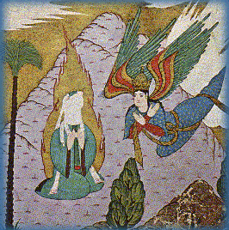
The Origins of Islam
610 CE: Muhammad receives
first revelations from
Jibrail
622 CE: Hijra and foundation
of the first Muslim
community
632 CE: Death of Muhammad
Codification of the Qur’an
Spread of Islam
Muhammad and Jibrail

Slide 5
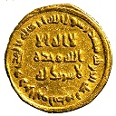
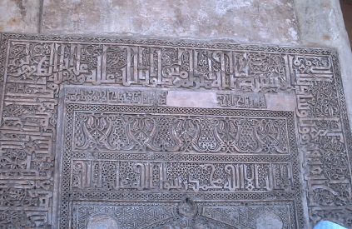
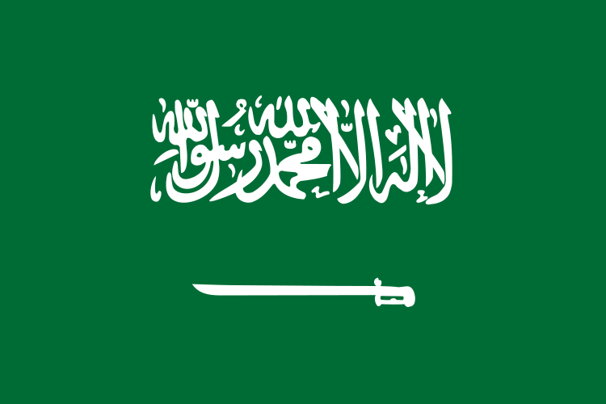
Islam, the religion
Monotheism
Shahada: lā ‘ilāha ‘illa Allāh
Abrahamic Religions
A gold dinar minted in 696 in Damascus; mihrab in Mosque of Ibn Tulun, Cairo, 1177;
flag of Saudi Arabia

Slide 6
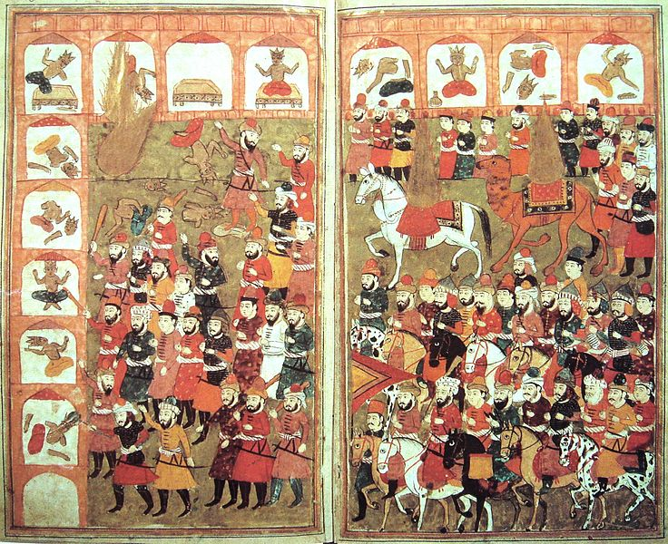
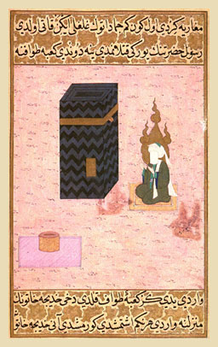
Abraham, Muhammad, and the Kaʿbah
Destruction of idols from 11th century manuscript; Muhammad at the Kaʿbah from a 14th
century Ottoman manuscript

Slide 7
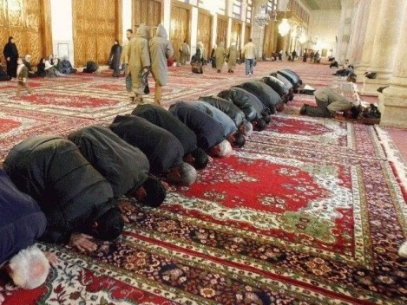
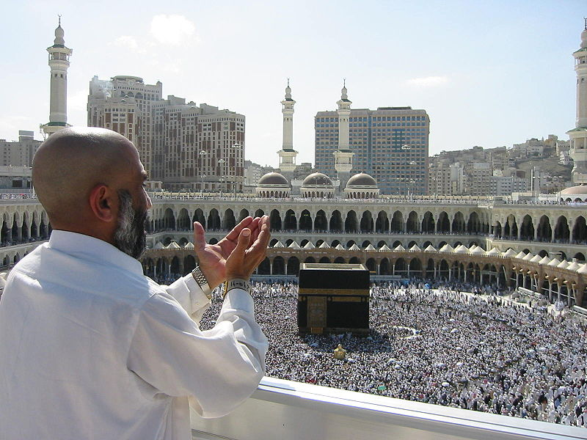
The Five Pillars of Islam
Shahada: Testimonial of faith
Salat: Prayer, five times a day
Sawm: Fasting during the month
of Ramadan
Zakat: Alms-giving (2.5%)
Hajj: Pilgrimage to Mecca once
during your lifetime

Slide 8
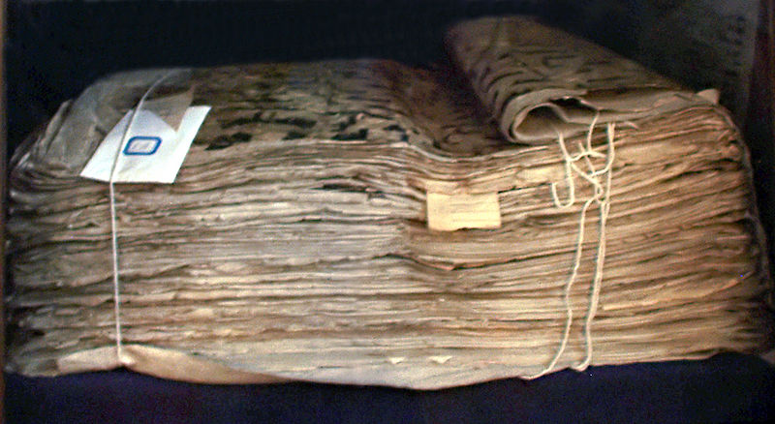
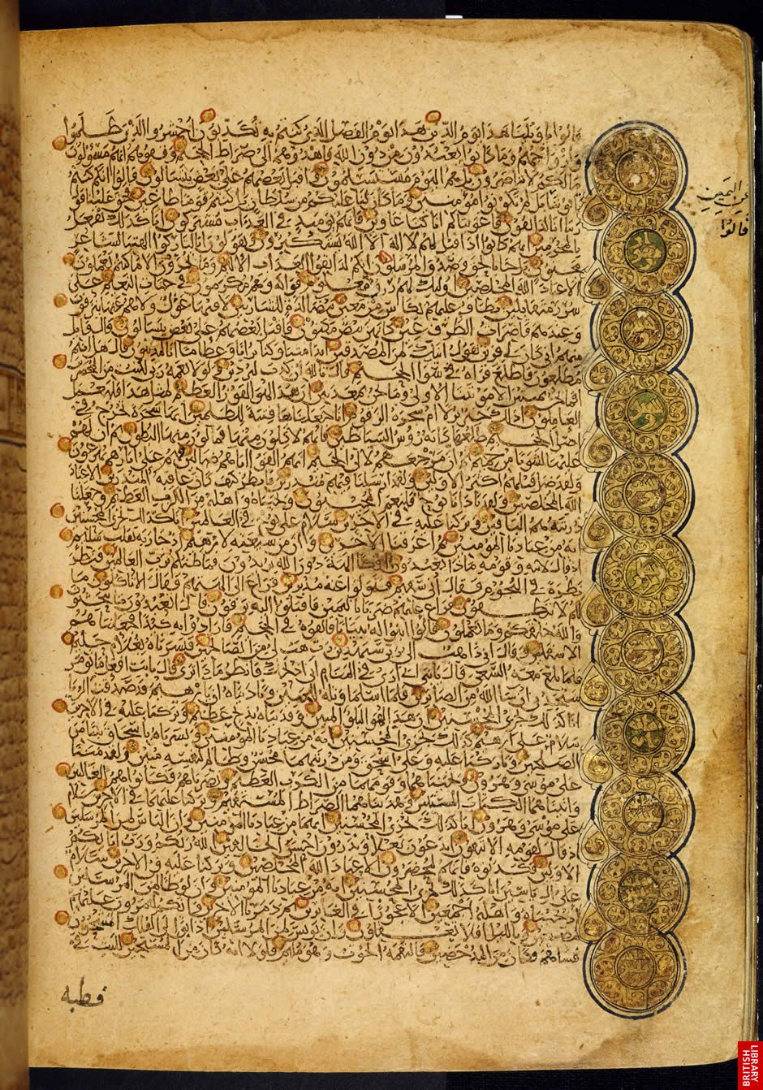
The sources of Muslim belief
The Qur’an: Codification of
revelations
Collected in the decades following
Muhammad’s death
Emphasis on oral tradition
  Qur’an vs. mushaf
  ijazah
Surah: Chapter of the Qur’an,
114 total
9th century Qur’an manuscript; page from an 11th century
Qur’an

Slide 9
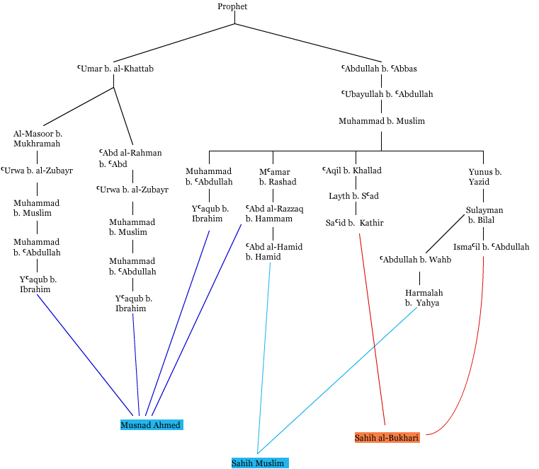
The Sources of Muslim Belief
Hadith: The Sayings and Doings of the Prophet Muhammad
What Would Muhammad Do?
Isnad and matn
Six “sound/sahih” collections
Sunna: Normative practice

Slide 10
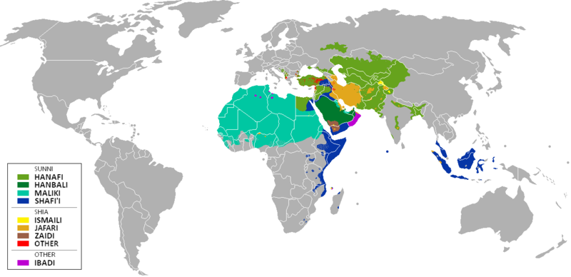
Shariah and Jurisprudence
Fiqh: Jurisprudence
Qiyas: Analogy
Ijmaʿ: Consensus
Madhhab:
School of
Islamic
jurisprudence

Slide 11
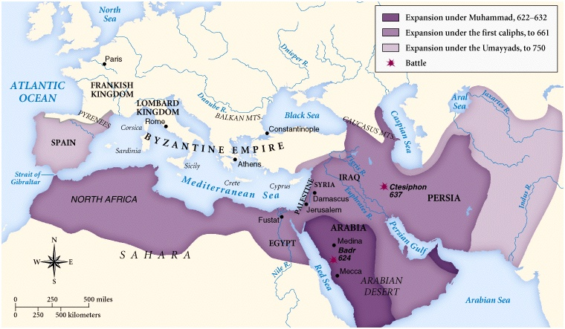
Islam as Empire

Slide 12
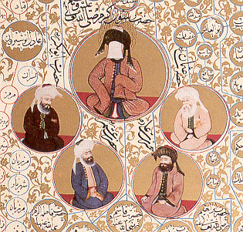
The Caliphate
Caliph: Deputy
Rashidun/Rightly Guided Caliphs (632-661CE)
  Selected from close
  companions of the Prophet
Umayyad Caliphate (661-750CE)
  First hereditary dynasty
ʿAbbasid Caliphate (750-1258CE)
Image of Muhammad and the Four Rashidun Caliphs

Slide 13
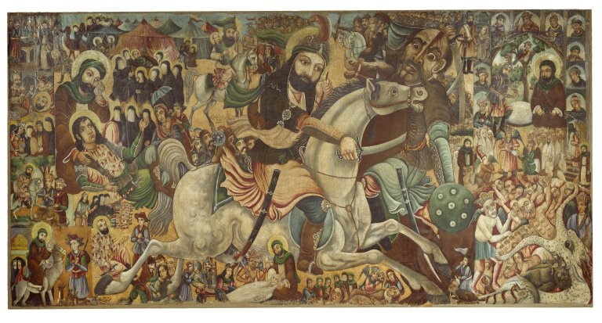
The Early Caliphate and the Sunni – Shi’ite Divide
ʿAli b. Abi Talib (r. 656-661)
Fitna: disturbance or civil war
Muawiya (r. 661-680)
Imam: leader of the
community
Husayn b. ʿAli
(626-680)
Battle of Karbala
19th century Iranian depiction of the Battle of Karbala by Abbas al-Musavi at the
Brooklyn Museum

Slide 14
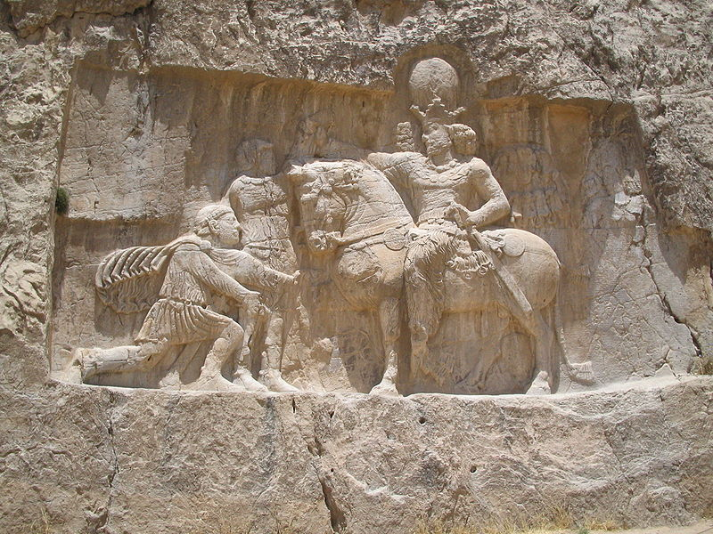
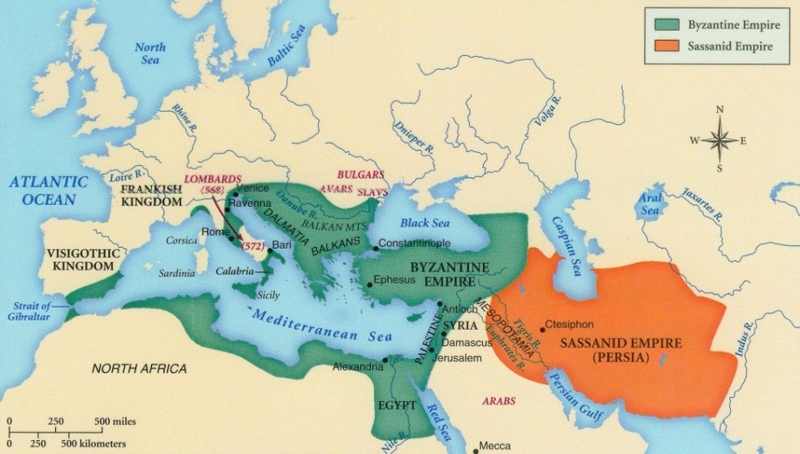
The World of Late Antiquity
Byzantine Empire (330-1453)
Sasanian Empire (224-651)
500BCE – 628CE: Competition
between Greco-Roman and
Persian empires
Byzantine-Sasanian War
(602-628)
Relief at Naqsh-i Rustam featuring Roman Emperor Valerian being captured by Sasanian
Shahanshah Shapur I in 256.

Slide 15
The Arab-Muslim Conquests

Slide 16
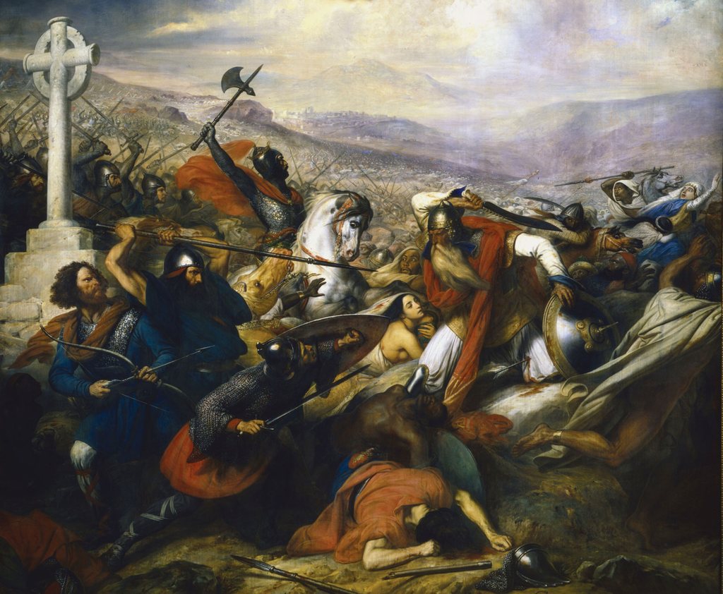
Don’t Forget: The Battle of Tours

Slide 17
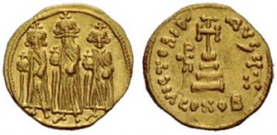
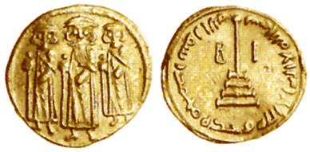
Arab Muslims and Non-Muslims
Conquering Arabs were a
minority in empire
No tradition of empire
Reliance on conquered
peoples
Islam, taxes, or the sword
Amsar: Garrison cities
Keep Arabs from allure of
Byzantine/Sasanian cities
Examples of Byzantine coin and Arab-Byzantine coin

Slide 18
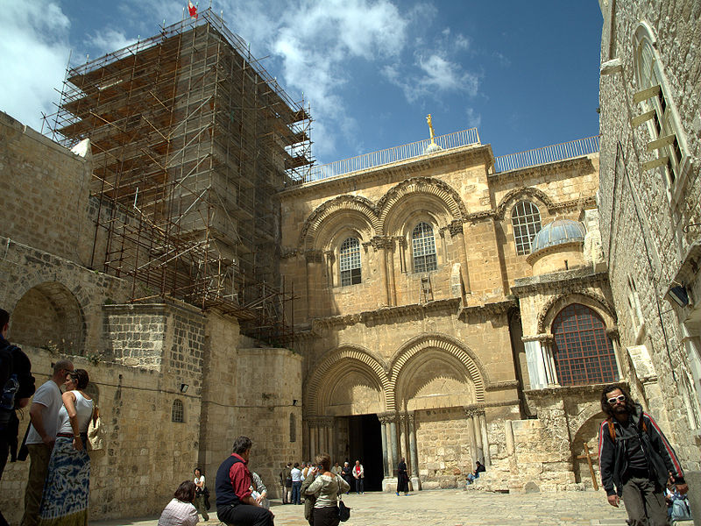
Ahl al-Kitab and Dhimma
Ahl al-Kitab: People of the Book
Dhimma: Protected minorities
Jizya: Poll tax paid by dhimmis
Mawla: Status of clientage
Incentives for both protecting
non-Muslim minorities
and discouraging
conversion.
Church of the Holy Sepulchre, Jerusalem

Slide 19
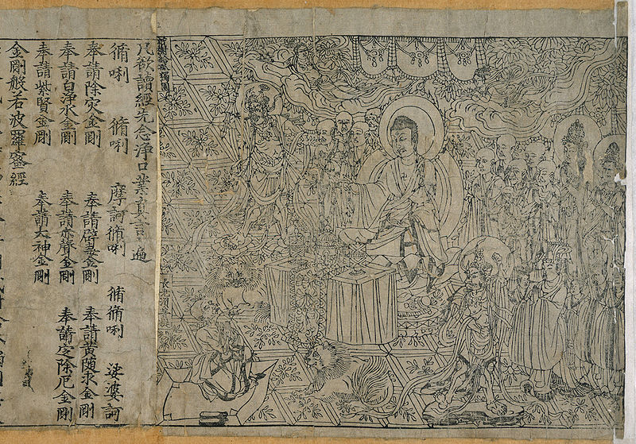
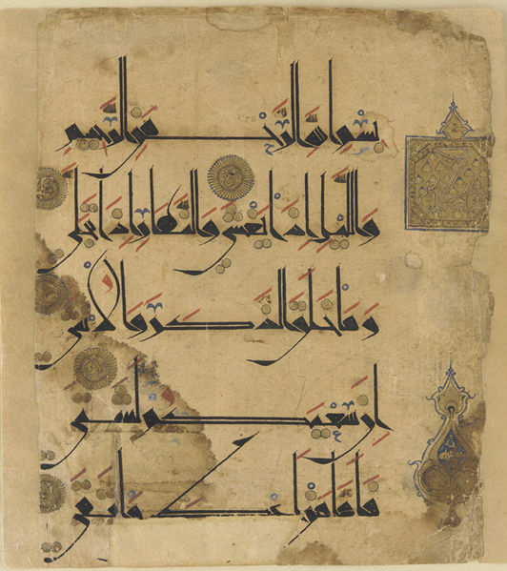
Islam as Culture
Civilization facilitated by religion and caliphate
Combine Greco-Roman and Persian civilization
Connections to China and India
People, goods, and ideas flow across empire

Slide 20
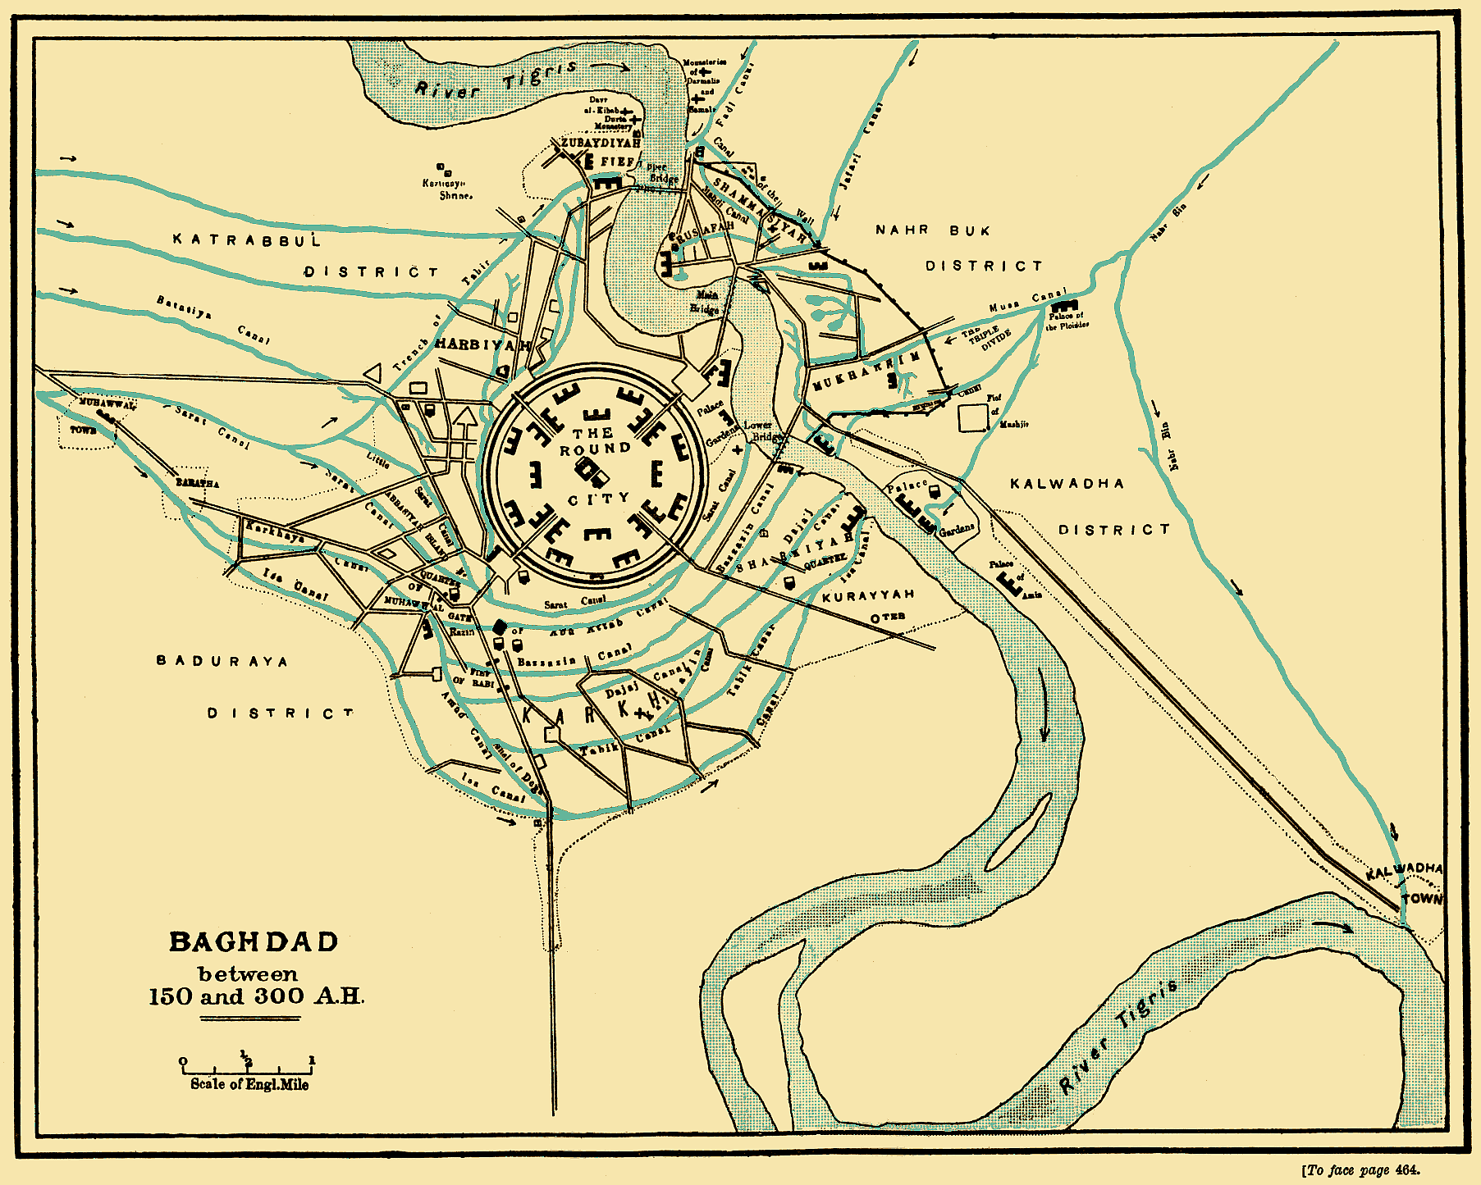
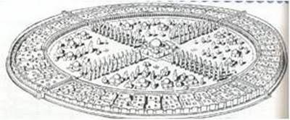
Baghdad as the Center of the World
750: `Abbasid Revolution
Baghdad – founded in 762
Cosmopolitan capital of `Abbasids
al-Yaqubi (d. 897/8)
Ibn al-Nadim (d. 998)
– al-Fihrist

Slide 21
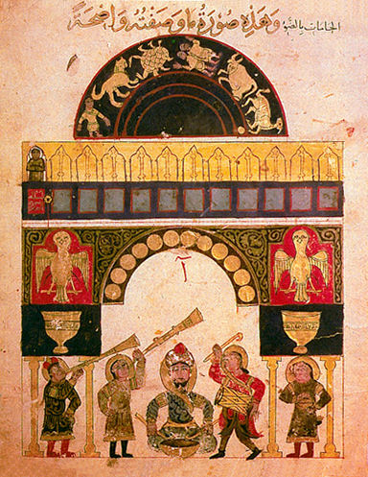
Don’t Forget: Harun al-Rashid

