Slide 1
The Holy? Roman? Empire?
HIST 1016
9/17/14

Slide 2
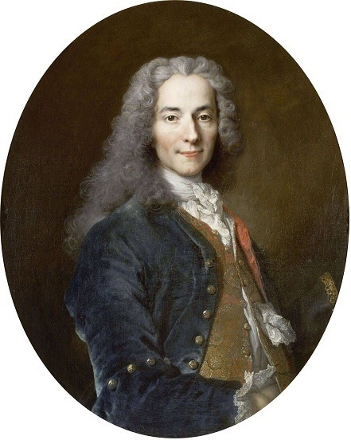
“This agglomeration which was called and which still calls itself the Holy Roman Empire was neither holy, or Roman, nor an empire.”
- Voltaire (1756)

Slide 3
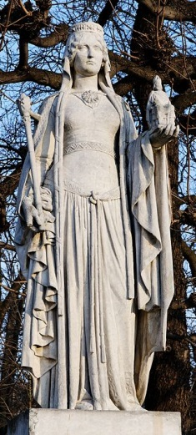
The Wives of Charlemagne and His Succession
Himiltrud: dismissed in 770
  Noble woman or concubine
  Friedelehe: “Lover Marriage”?
    Not recognized by church
    Divorce
    Children are mother’s
Bertrada and the Lombards
  Stephen III – But Charlemagne is
  married…
Statue of Bertrada in Luxembourg

Slide 4
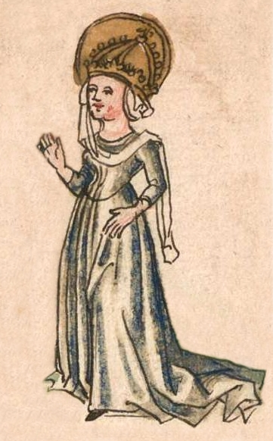
The Wives of Charlemagne and His Succession
Hildegard (d. 783):
  married in 771
  Daughter of Carloman’s noblemen
Fastrada (d. 794):
  married in 783
  Daughter of Frankish count
Liutgard (d. 800):
  married in 794
  Daughter of Almannian count
Concubines (including Saxon
nobles?)
Hildegard

Slide 5
The Sons of Charlemagne
By Himiltrud
  Pippin the Hunchback (767-811)
By Hildgard
  Charles (772-811)
  Pippin (Carloman) (ca. 773-810)
  Louis the Pious (778-840)
    Lothar: twin dies in 780
By concubines
  Drogo (801-855): Bishop of Metz
  Hugh (802-844): Archchancellor
  Richbod (805-844): Abbott of Saint-Riquier
  Theodoric (b. 807)

Slide 6
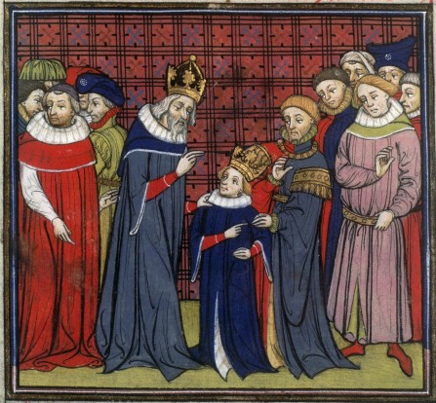
Succession
781 – Pippin (Carloman) and Louis named kings of Italy and Aquitaine
Charles the Younger intended for King of the Franks
792 – Pippin the Hunchback
revolts
  Shorn and placed in monastery
800 – Charles the Younger
crowned king by Leo III

Slide 7
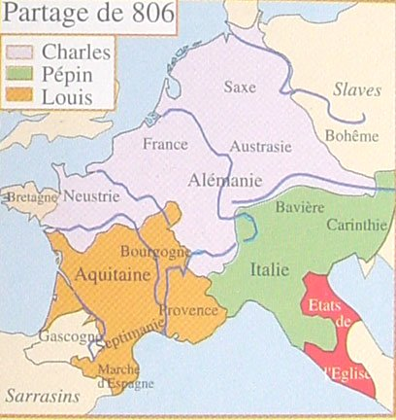

Slide 8
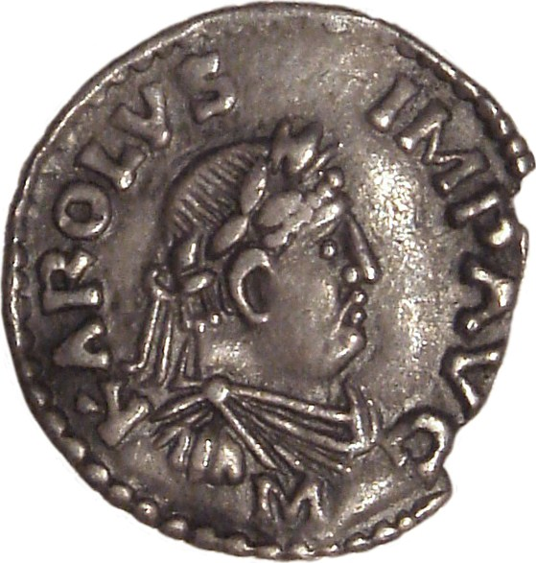
Succession
806 – Divisio regnorum
Contingency plans
Who will be emperor?
Can there be two
Roman Emperors
(Byzantine and Carolingian)?
812 – Michael I recognizes
Charlemagne as emperor
813 – Louis the Pious
named co-emperor
Coin featuring Charlemagne as emperor

Slide 9
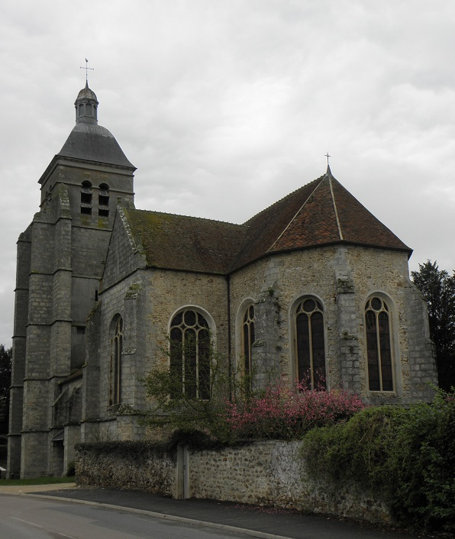
Daughters of Charlemagne
At least 9 daughters
All unmarried
Munt – parental authority
Question of status
  Exception for
  Constantine VI and Rotrud
But they weren’t single
or childless!
Collectively act as queen?
Religious offices
Abbey of Faremoutiers where Ruodhaid had been abbess

Slide 10
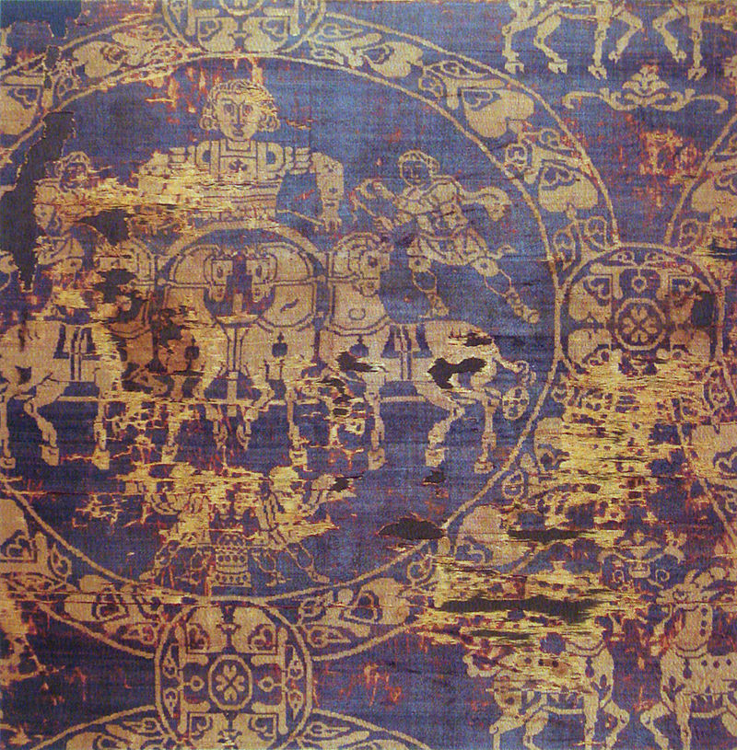
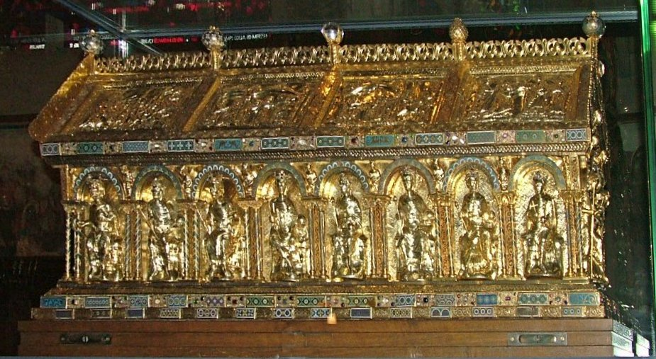
Jan. 28, 814
Original shroud and 13th century casket from
Frederick II

Slide 11
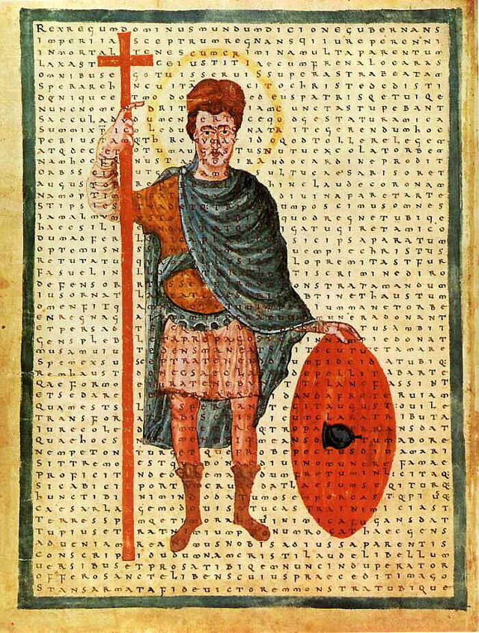
Political Legacy
Louis the Pious (r. 814-840)
Bernard of Italy (d. 818) –
son of Pippin
830s – Three civil wars
Lothair I vs. Louis II and
Charles the Bald
  Oaths of Strasbourg
  Foundations of France and
  Germany
  Treaty of Verdun, 843
Contemporary representation of Louis the Pious

Slide 12
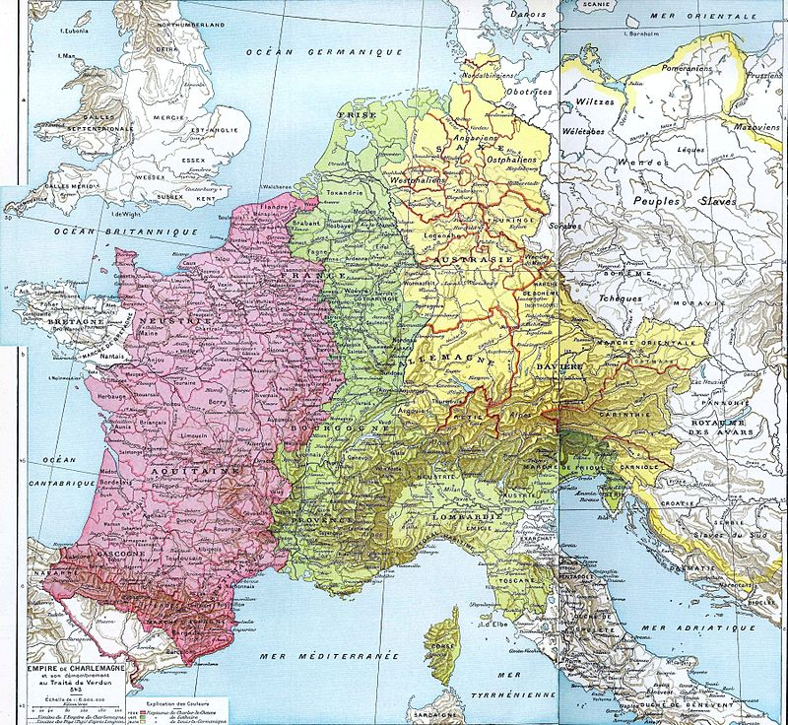

Slide 13
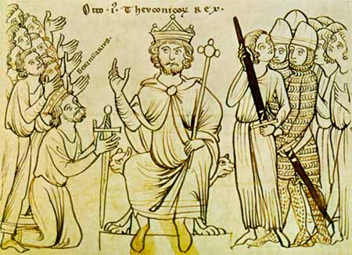
From Carolingian Empire to Holy Roman Empire
Pope and the crowning of emperor
884 – Succession struggles lead to last unification of Charlemagne’s empire
888 – revolts and Viking invasions collapse empire
962 – German King
Otto I (the Great) crowned
Emperor by Pope
Start of Holy Roman
Empire

Slide 14
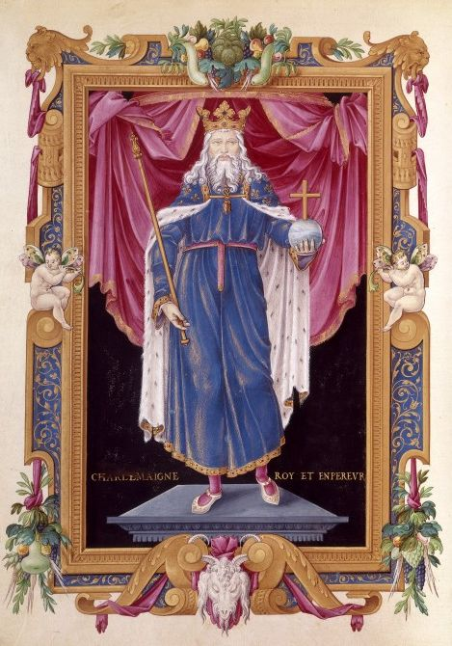
Who is Charlemagne?
What is Charlemagne’s
legacy?
Germanic warlord?
King of the Franks?
Defender of
Christendom?
Emperor of Rome?
Father of Europe?

Slide 15
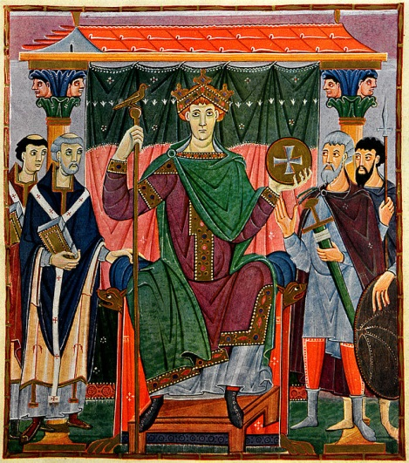
Creating a Legend
Court school creates image of Charlemagne in poetry and biographies
Einhard and Once Again my Burdened Anchor
Listed as martyr and saint (but who decides?)
Legacy for future rulers…
  Biblical David to Charlemagne
  Charles the Fat (r. 881-888)
  Otto I (r. 936-973) at Aachen
  Otto III (r. 983-1002) and the tomb
  of Charlemagne
Otto III as emperor

Slide 16
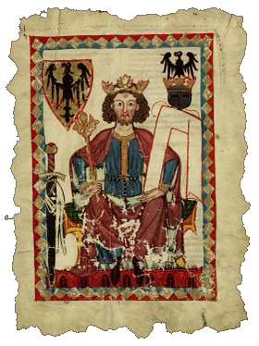
Germanic Warlord
Is military legacy most
important?
Violence – Massacre of
Verden
Frankish Law
Subjugation of Saxons,
Alemani, and Avars
Overthrow of Lombards
Establishment of vassalage

Slide 17
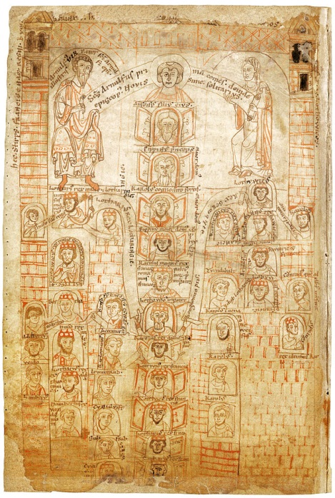
King of the Franks
Who can claim Charlemagne’s legacy?
Carolingian Empire until 887
Treaty of Verdun, 843
Kings of Franks until 987
Kings of East Franks (Germany)
until 911
Phillip II (Augustus) (r. 1180-1223):
  Claims Carolingian descent on
  both sides
  Defeats King John of England and
  Otto IV of Germany
  Reditus regni Francorum ad stirpem
  Caroli
Carolingian family tree

Slide 18
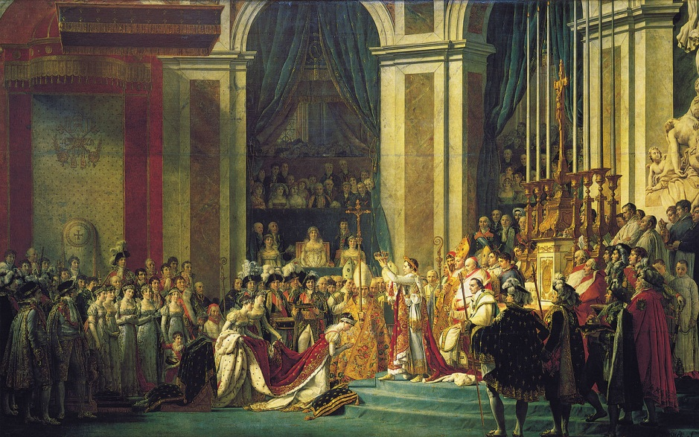
Pope Pius VII crowns Emperor Napoleon, Dec. 2, 1804

Slide 19
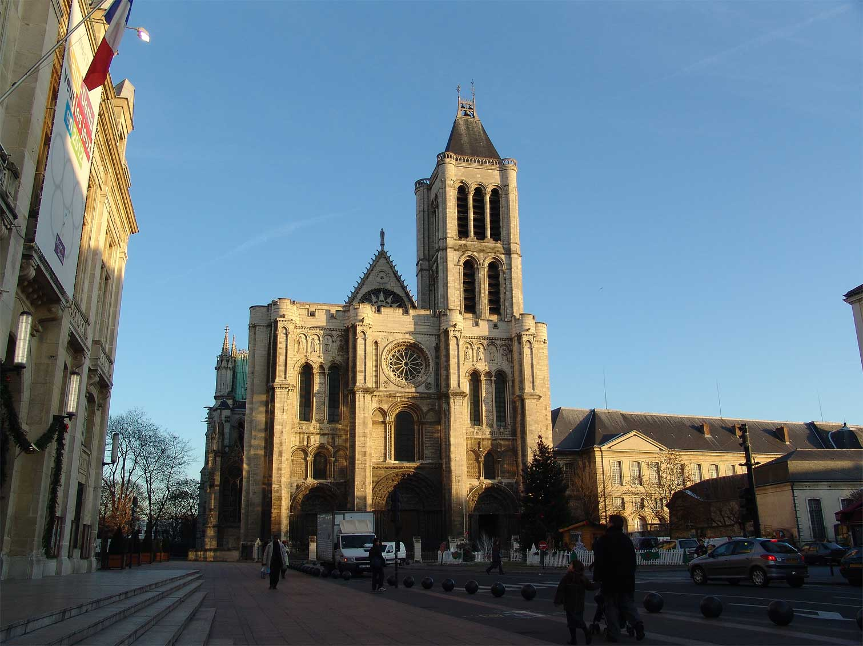
Defender of Christendom
10th century – stories of pilgrimage to Constantinople and Jerusalem
Crusades (1095-1291)
Charlemagne as Crusader
How did relics make it
to Saint-Denis?
The Song of Roland and
Reconquista
Saint-Denis Basilica

Slide 20

The Oriflamme
Sacred banner of the Abbey of
Saint-Denis
Battle standard of the King of France
First used by Louis VI in 1124
Charlemagne’s banner in the Song of
Roland
According to legend, Charlemagne
carried it on pilgrimage

Slide 21
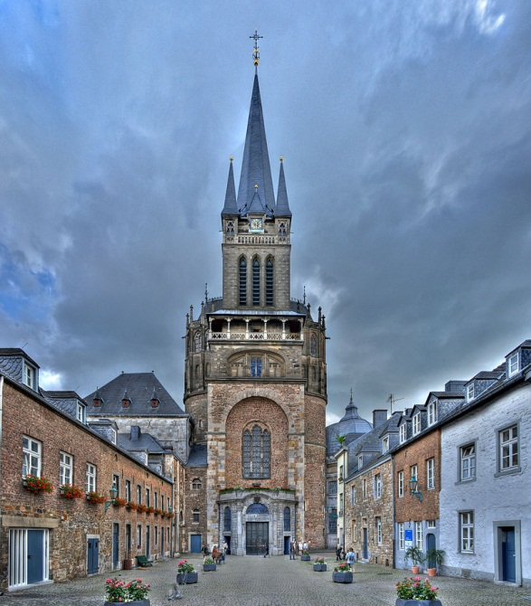
Saint Charlemagne?
1165 – Emperor Frederick Barbarossa canonizes Charlemagne
  By an anti-pope…
Frederick II (r. 1220-1250):
new gold and silver casket,
Aachen as pilgrimage site
Charles V (r. 1364-1380):
Charlemagne as patron saint of
France
Louis XI (r. 1461-1483):
Veneration of Charlemagne or
death
Is he France’s saint or Germany’s?
Aachen Cathedral

Slide 22
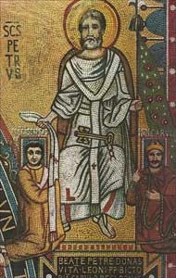
Was no saint…
1568 – no longer listed as an official Catholic saint
Did he abuse the Pope?
  Popes pray and kings rule
Ignored rules on marriage
Council of Frankfurt and idols
16th century – model for
Protestant Reformation
  Iconoclast
  Against celibacy
  Questioned judgment of papacy
St. Peter giving gifts to Leo III and Charlemagne;
Mosaic in the Papal dining hall

Slide 23
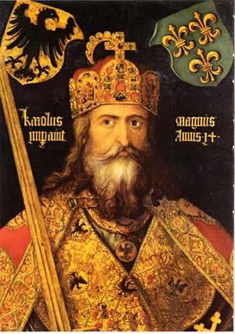
Charlemagne as Model
Can he be whoever you
want him to be?
Renewer of Rome who was
a barbarian…
Enlightened law giver who
couldn’t read…
Defender of Christendom who
was a polygamist and mass murderer…
King of France who was
Germanic…
Are modern definitions not
appropriate?
Father of Europe?

