Slide 1
Christmas Day, 800
HIST 1016
9/15/14

Slide 2
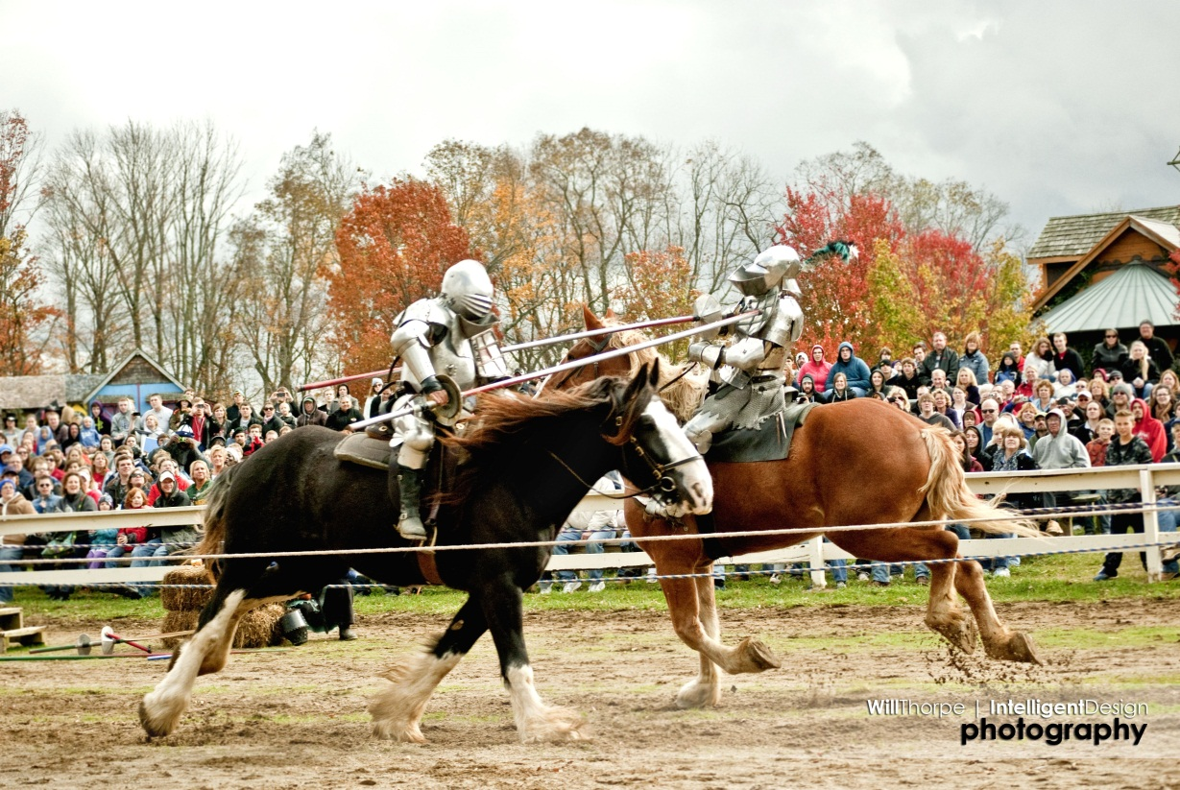
Ohio Renaissance Festival
History Club
FREE!!!
E-mail me (haugrt@ucmail.uc.edu) with preferred date
Sept. 27 or 28, Oct. 4, 5, 11, 12, 18, or 19.

Slide 3
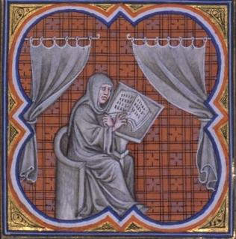
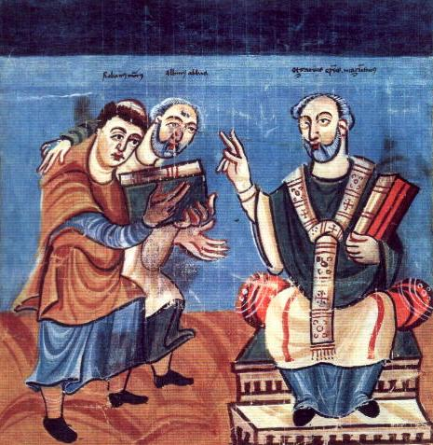
Einhard (c. 775-840)
Born into family of low status
Fulda – monastery in central
Germany
Education in Latin
791 or 792 – offered place in
Charlemagne’s court
Amassing of scholars – royal
school
Alcuin of York (d. 804)
Einhard and Alcuin of York

Slide 4
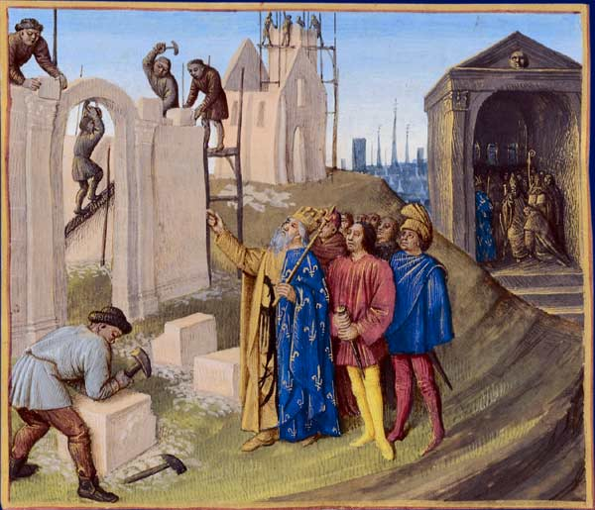
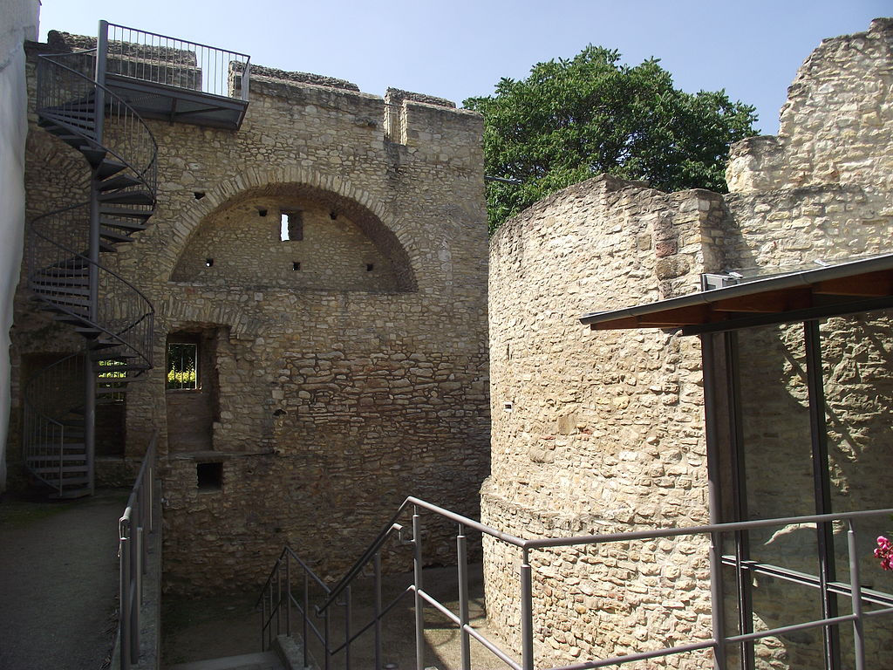
Einhard
Construction manager
Palaces of Aachen and
Ingelheim
Close with Charlemagne
Private secretary of Louis
the Pious (r. 814-840)
Vita Karoli Magni
Is it a history or a
hagiography?
Construction of Aachen and palace of Ingelheim

Slide 5
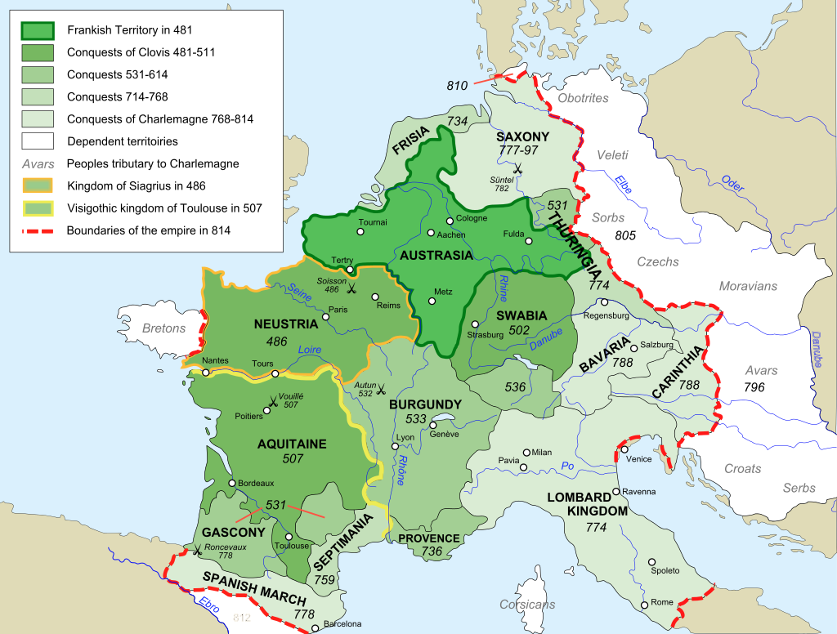
Expansion of the Frankish Kingdom

Slide 6
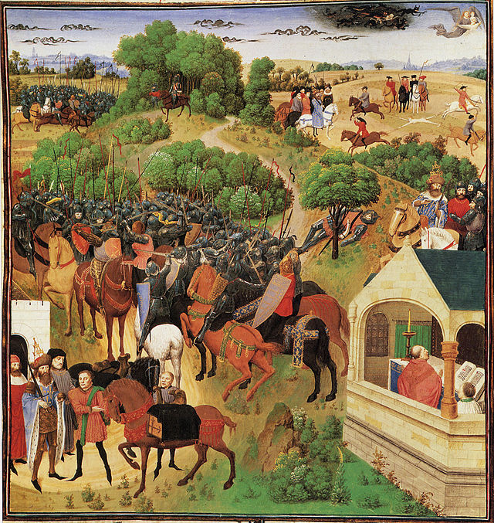
Muslim Spain
Abd al-Rahman I (r. 756-788) – Umayyads of Spain
778 - Muslim rulers of
Zaragoza, Girona, Barcelona,
and Huesca request military
aid
Extend Christendom
Forced to retreat
Basques and the Battle of
Roncevaux Pass
Roland, Warden of the
Breton March
The Song of Roland in one picture

Slide 7
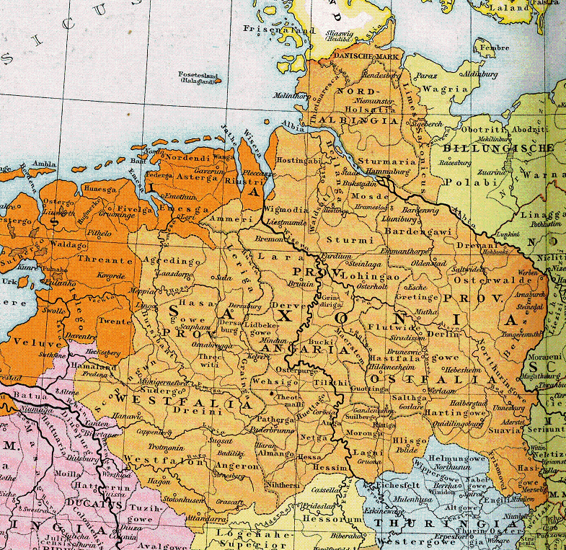
Saxon Wars (773-803)
18 campaigns against four Saxon Kingdoms
773 – destruction of Saxon pilgrimage site to fund war against Lombards
Uprisings while
campaigning elsewhere
777 – Incorporation of
Saxony into Frankish Kingdom
Mass baptisms and
conversions
Old Saxony

Slide 8
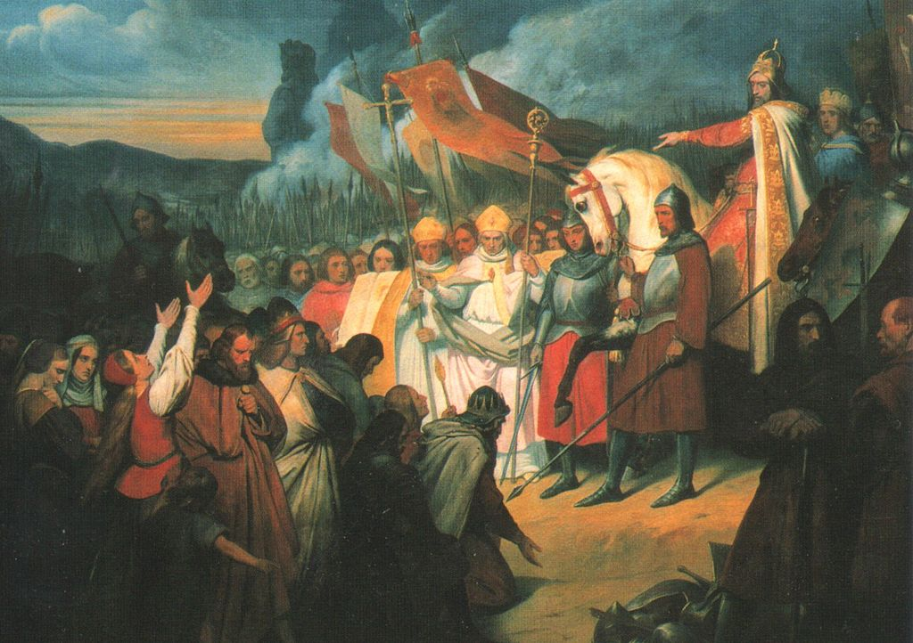
Defender of Christendom
779 – Saxony divided into missionary districts
782 – Capitulatio de partibus Savoniae “Ordinance concerning Saxony”
Law code for Saxons
Death for refusal to
convert to Christianity
Massacre of Verden –
4,500 Saxon prisoners
executed
Widukind – Saxon
leader, surrenders in 785
19th century interpretation of Widukind’s
surrender

Slide 9
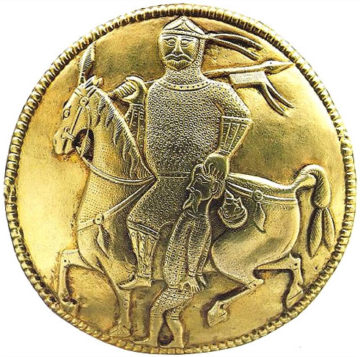
Eastern Expansion
789 – Removal of Duke Tassilo III of Bavaria
Avars – Horse nomads from Central Asia
Settled in modern Hungary
788 – Avars invade
Bavaria and Northern Italy
790 – Charlemagne sends
expedition
Avars convert and become
vassals
Remaining Avar kingdoms

Slide 10
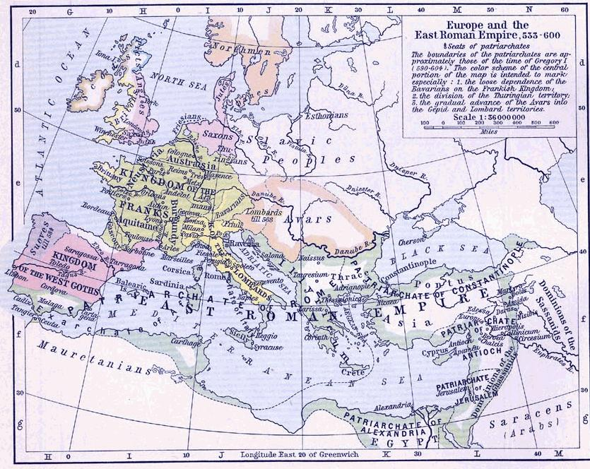

Slide 11
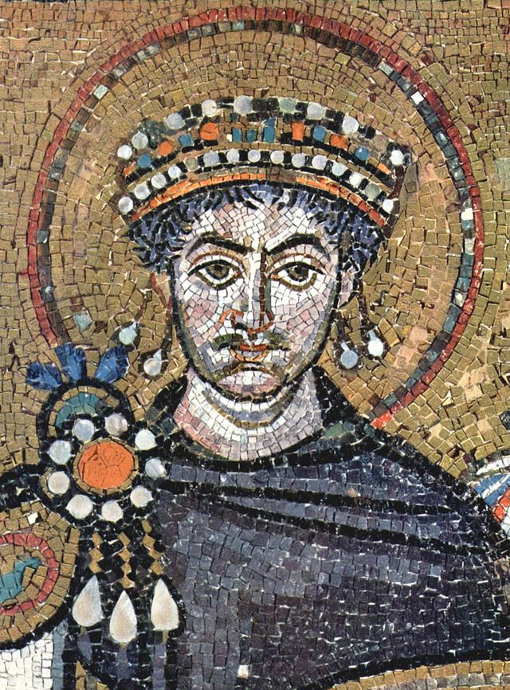
The Status of Rome
What is the Byzantine
Emperor’s role in Western Europe?
Justinian I (r. 527-565):
“restored” much of Western
Empire
Lombard Kingdom (568-774)
754: Pippin as Patricius
Romanorum in name
774: Charlemagne as Patricius
Romanorum for real
Justinian I

Slide 12
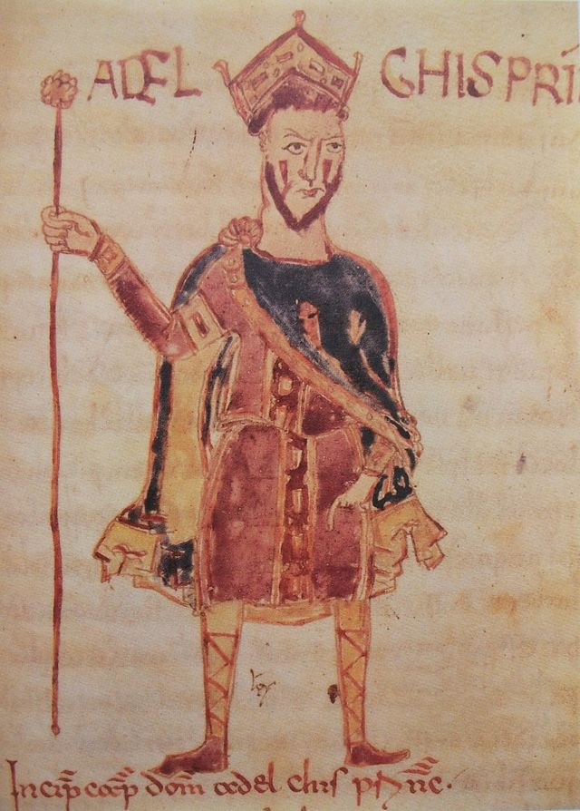
Franks and Byzantines
757 – plan to marry
Charlemagne’s sister Gisela to
Byzantine prince
774 – Do Lombard territories
belong to the Byzantines?
Adelchis – Son of Lombard king
Desiderius
  Fled to Constantinople
  Named Patricius Romanorum by
  Constantine V (r. 741-775)
Can the Byzantines retake Rome?
Support from southern Lombards

Slide 13
Franks and Byzantines
Charlemagne’s standing
Empress Irene
  Empress consort (775-780)
  Empress dowager and regent
  (780-797)
    Marriage alliance between
    Constantine VI and Charlemagne’s
    daughter Rotrude
    Canceled in 787
  Empress regnant (797-802)
    Blinds Constantine VI
Can a woman be emperor?

Slide 14
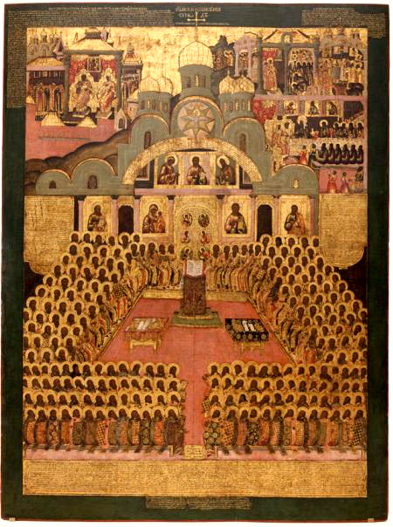
Franks and Byzantines
Iconoclasm (726-787 &
814-842)
Second Council of Nicaea (787)
Is it a council without
Frankish bishops?
Charlemagne refuses results
Relationship between Pope
Hadrian and Charlemagne
Council of Frankfurt (794) –
Called by Charlemagne
An icon of the Second Council of Nicaea

Slide 15
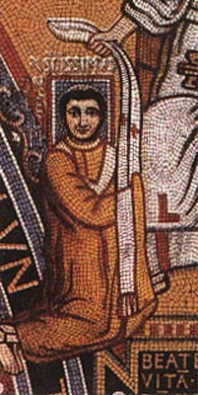
Imperator Romanorum
Pope Leo III (r. 795-816)
Victory over “scourge of
Christendom” (Avars)
Popes should pray
Charlemagne will defend the
Roman Church and Christians
799 – Leo III attacked by Roman
mob
  Attempt to remove eyes and tongue
  Request help from Charlemagne

Slide 16
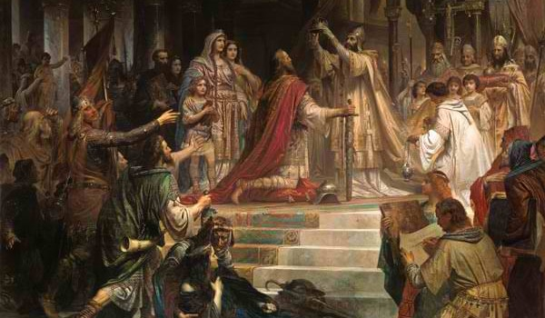
Christmas Day, 800

Slide 17
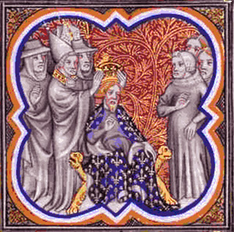
Imperator Romanorum
What does this even mean?
Invasion of Byzantium?
A Frankish barbarian
elevated to the Roman
imperial dignity?
Can Leo even do this?
Pope vs. Patriarch of
Constantinople
Donation of Constantine

Slide 18
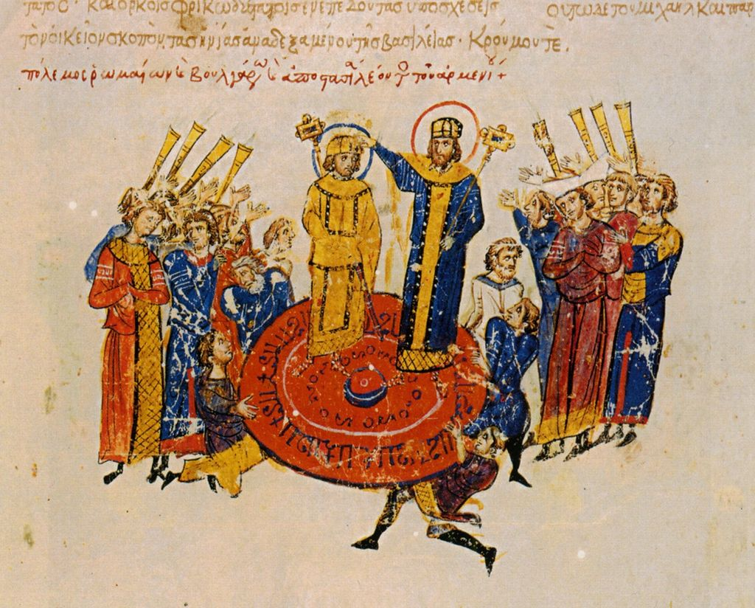
Recognition
Irene send envoys
Marriage arrangement?
802 – Irene deposed and exiled
Nikephoros (r. 802-811)
806-810: War over
Venice and Dalmatia
811 – Nikephoros killed
in war against Bulgarians
Michael I (r. 811-813):
recognizes Charlemagne as
emperor
Coronation of Michael I

Slide 19
Recognition at Home
802 – loyalty oath
  Not threaten the life of the ruler
  Not summon enemies into the kingdom
  Keep God’s commandments
  Respect the emperor’s possessions
  Acknowledge his protection over the churches and the weak
  Obey imperial commands
Being named emperor is one thing…

Slide 20
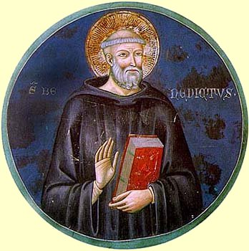
Recognition at Home
Not an emperor like the Byznatines
“Right to command and right to be obeyed”
The loyalty of counts and dukes
Codification of law codes
  Frankish Law
  Frisian, Saxon, Thuringian,
  Bavarian, and Alemanni Law
  Church Law – Benedictine
  Order
Benedict of Aniane (c. 747-821)

Slide 21
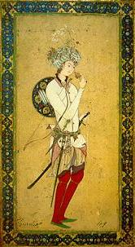
Recognition from the East
Harun al-Rashid (r. 786-809) –
`Abbasid Caliph
  Famous Caliph of the 1,001 Nights
797 – First of five embassies
Alliance against Byzantine Empire
Alliance against Umayyads of
Spain
802 – Offer Charlemagne
protectorship over the Holy
Sepulcher in Jerusalem
17th century Persian painting of Harun al-Rashid

Slide 22
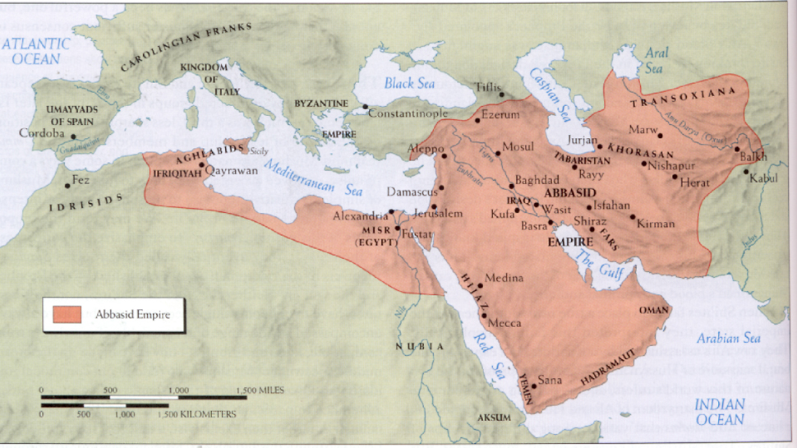
`Abbasid Caliphate (r. 750-1258)

Slide 23
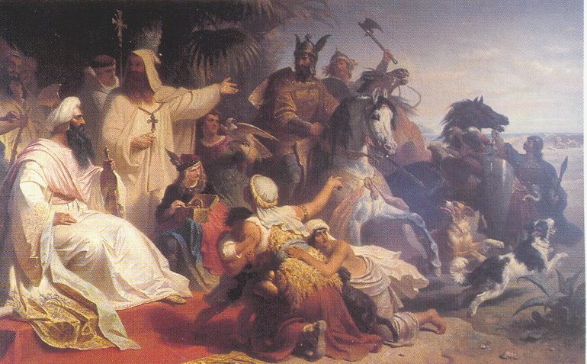
Recognition from the East
Exchange of gifts
Encouragement of opening trade
From Charlemagne
  Spanish horses
  Frisian cloaks
  Hunting dogs
19th century German representation
of Charlemagne’s embassy to
Baghdad

Slide 24
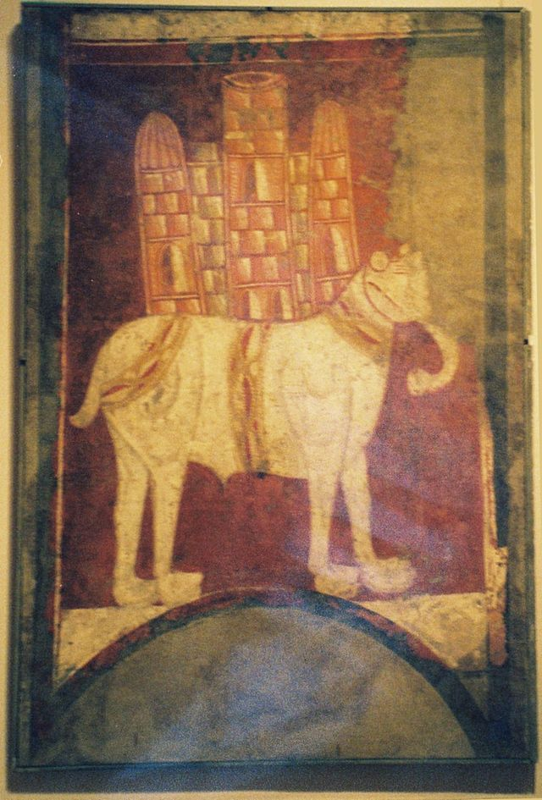
Recognition from the East
From Harun al-Rashid
  Silks
  Brass candelabra
  Perfume
  Balsam
  Ivory
  Chess set
  Tents
  An elephant
  Water clock
Abu al-`Abbas – the war elephant

Slide 25
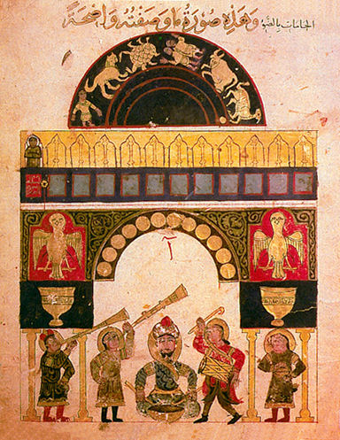
Water Clock

