Slide 1
How Central Asia Shaped the Muslim World
HIST 3035
9/12/14

Slide 2
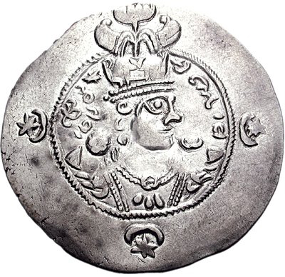
Conquest of Khurasan
651 – Yazdegerd III (last Sasanian Shahanshah) flees to Merv and is killed
Negotiated surrender
between marzbans, dihqans, and Arabs
Marv: home of Arab garrison
Local networks hold on to
most of their authority

Slide 3
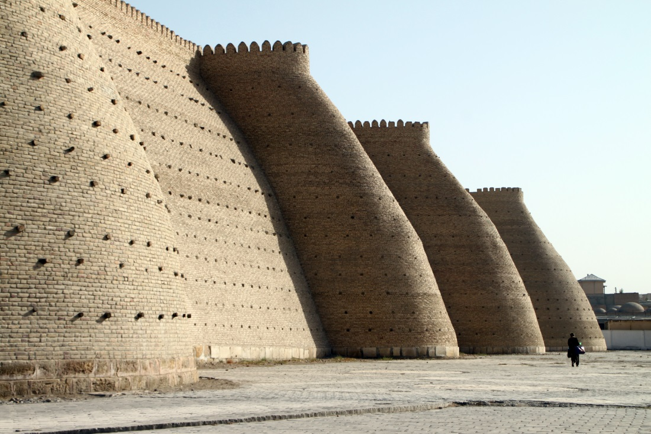
Conquest of Transoxania (662-751)
Like North Africa, slow and often interrupted
Independent city-states under Soghdian and Turkish rule
Expansion of Tang China
Conquer – revolt – reconquer
Is it conquest or raiding?
705 – 715: Qutayba
b. Muslim (d. 715) encourages
permanent Arab settlement
751: Battle of Talas –
`Abbasids defeat Tang for
control of Transoxania
Ancient walls of Bukhara, Uzbekistan

Slide 4
Islam in Central Asia
Questions about non-Muslim leadership
Can a non-Muslim collect taxes from a Muslim?
How about rent?
Shift from tribute to property tax (kharaj)
Conversion and political connections
Cotton vs. silk (and wine!)
Rivalry between Arab migrants and locals

Slide 5
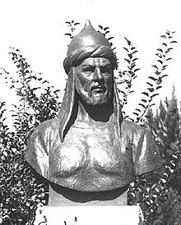
Abu Muslim (ca. 700-755)

Slide 6
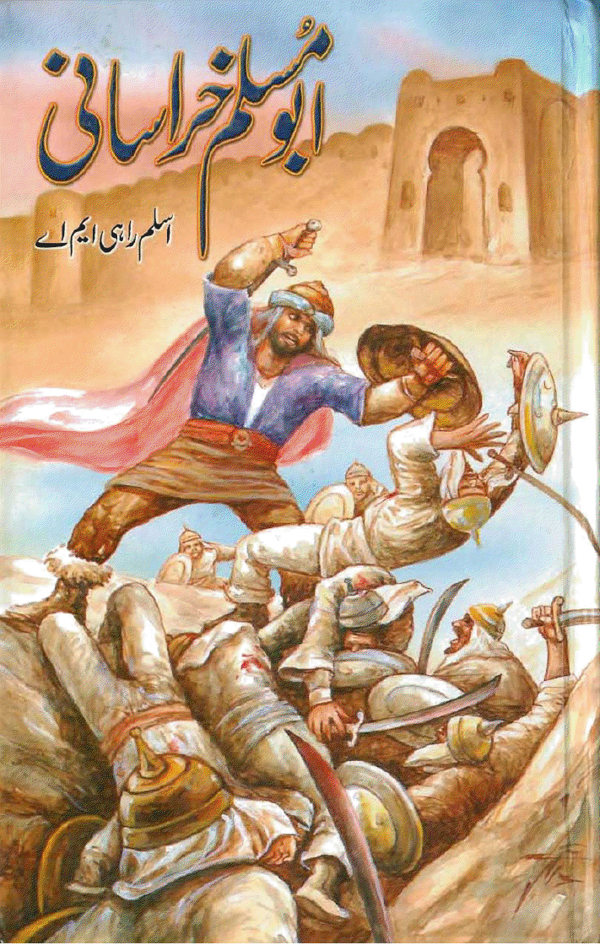
Abu Muslim

Slide 7
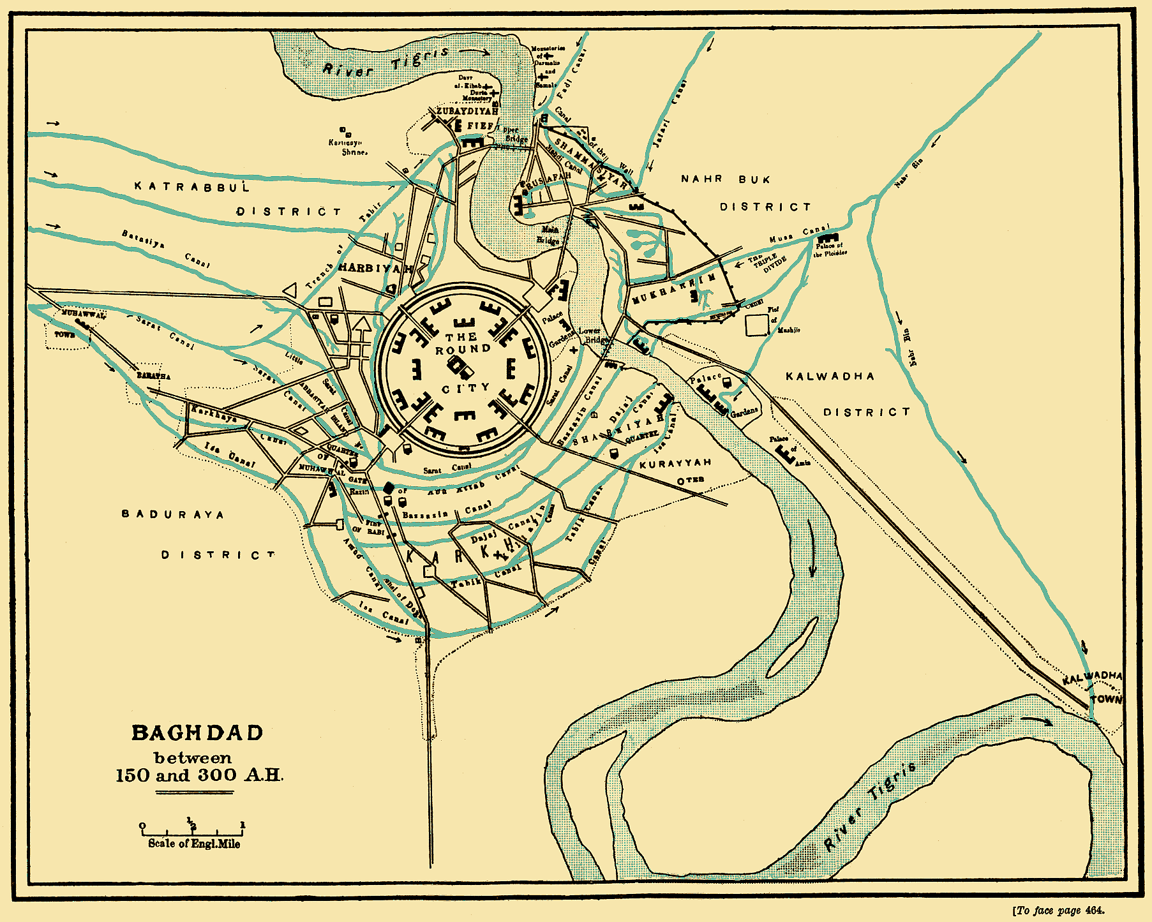

Slide 8
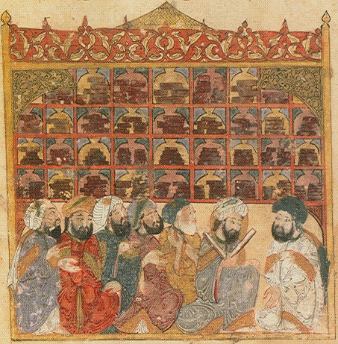
Translation Movement

Slide 9
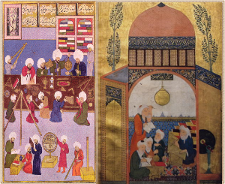
House of Wisdom

