Slide 1
The Carolingians: From Mayor of the Palace to King of the Franks
HIST 1016
9/10/14

Slide 2
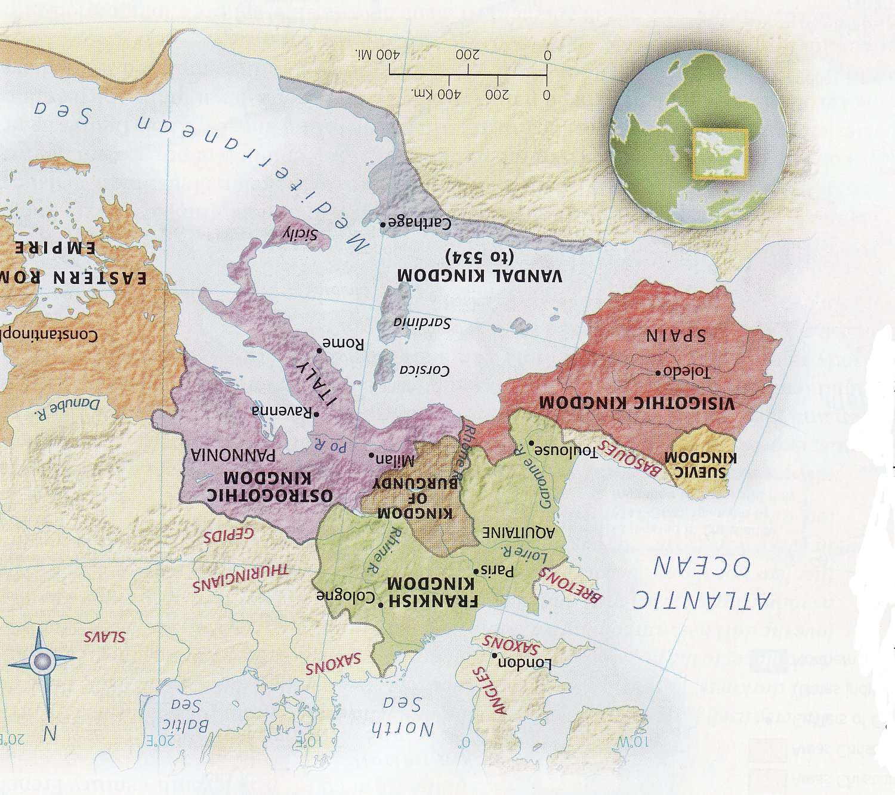
Divided Western Europe

Slide 3
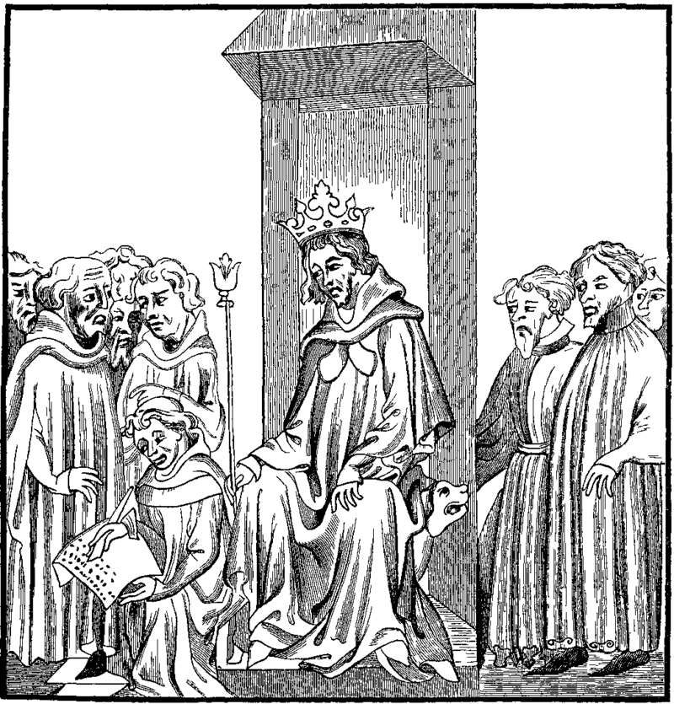
Merovingian Legitimacy
Frankish warbands – Roman military
Large military based on loyalty
Lex Salica – customary law of the Salian Franks
  Codified under Clovis I
  Extended to all Franks
  Revised as statutory law
Overlapping of Roman
and Frankish traditions
Clovis dictates the Lex Salica

Slide 4
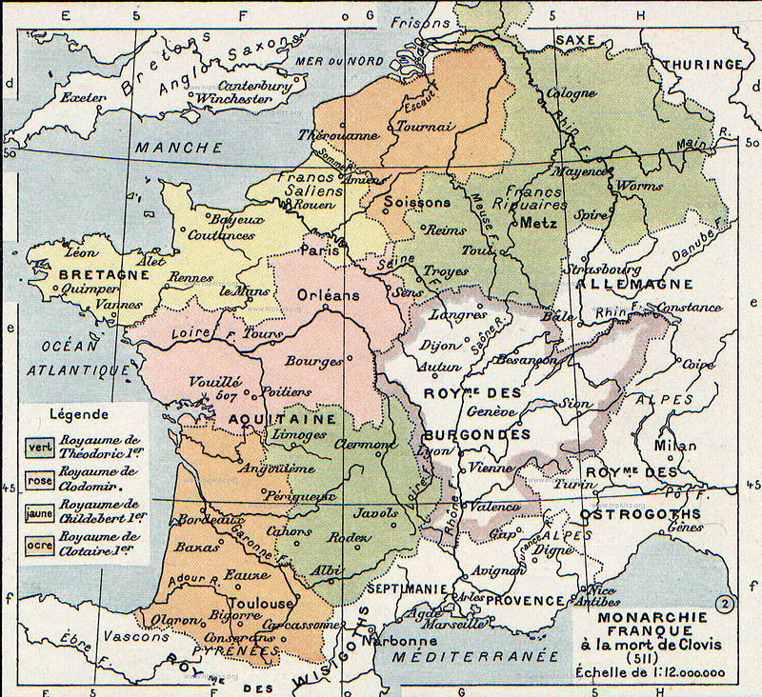
Merovingian Kingdom after Clovis I

Slide 5
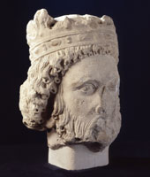
Merovingians after Clovis
Theoderic I (r. 511-533)
Chlodomer (r. 511-524)
Childebert I (r. 511-558)
Clothar I (r. 511-561)
To outsiders – united
To insiders – rivalries
and warfare
Bust of Clothar I

Slide 6
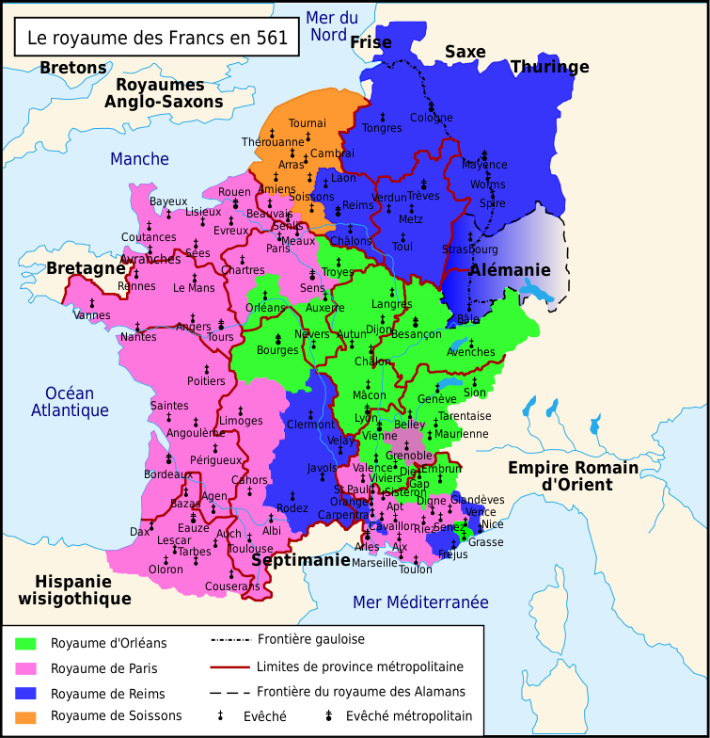
Merovingian Expansion

Slide 7
New Divisions
~558-561 – Frankish Kingdom united under Clothar I
Divided among four sons (again)
Sub-kingdoms
  Austrasia – east, capital at Rheims
  Neustria – west, capital at Paris
  Burgundy – south, capital at Orleans

Slide 8
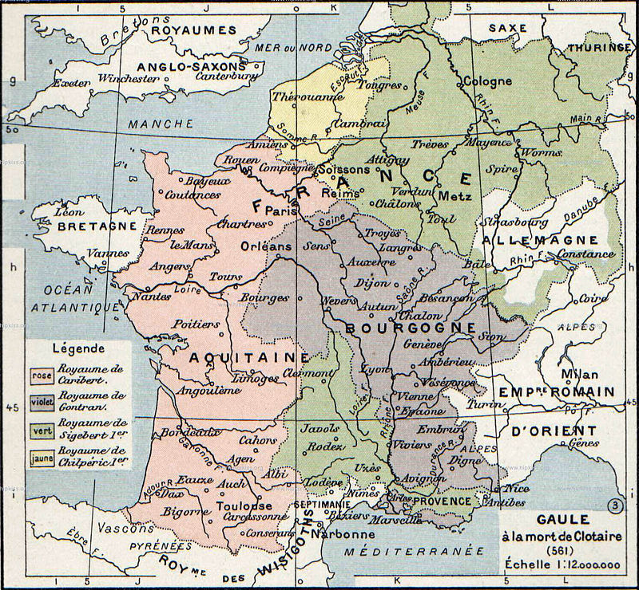
New Divisions

Slide 9
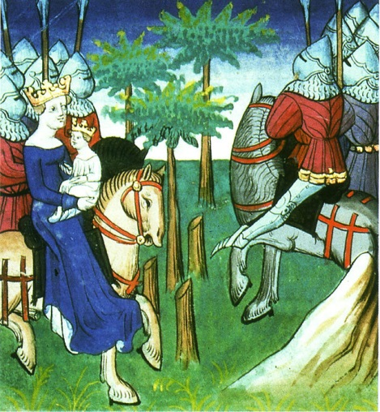
Merovingian Civil War
561-613: Series of conflicts between descendants of Clothar I
Reliance on nobility for
military support and
administration
Rise of non-Merovingian
aristocracy
Clothar II (r. 584-630):
Unites Frankish kingdom by
force
Assigning heirs to
sub-kingdoms
Clothar II and son lead troops

Slide 10
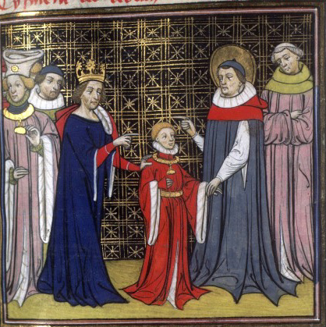
Mayor of the Palace
Aristocratic position
Manager of the palace
Increased responsibility and power
“Hand of the King”
Pippin I (the Elder) – Mayor
of Austrasia
Arnulf – Bishop of Metz
Dagobert – son of Clothar,
sub-king under the guidance of
Pippin and Arnulf in 623
Clothar sends Dagobert to Arnulf and Pippin

Slide 11
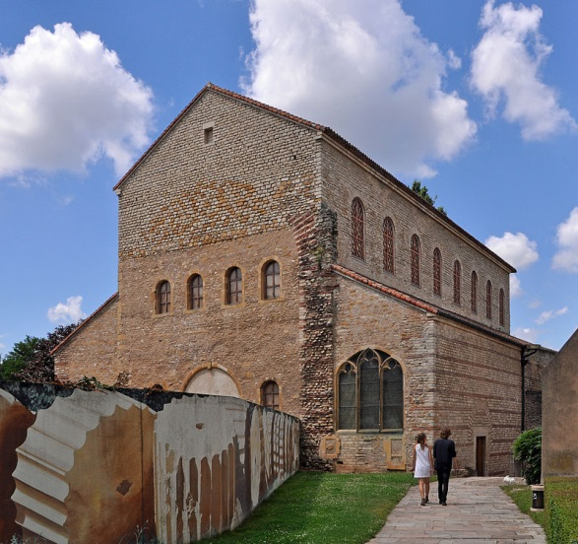
Mayor of the Palace
Series of ineffectual kings
Dukes gain virtual independence
Mayor of the Palace gains authority
Grimoald I (d. 657) –
Mayor of the Palace
Childebert the Adopted
(r. 656-661)
Instigates war between
Austrasia and Neustria
Basilica of Metz

Slide 12
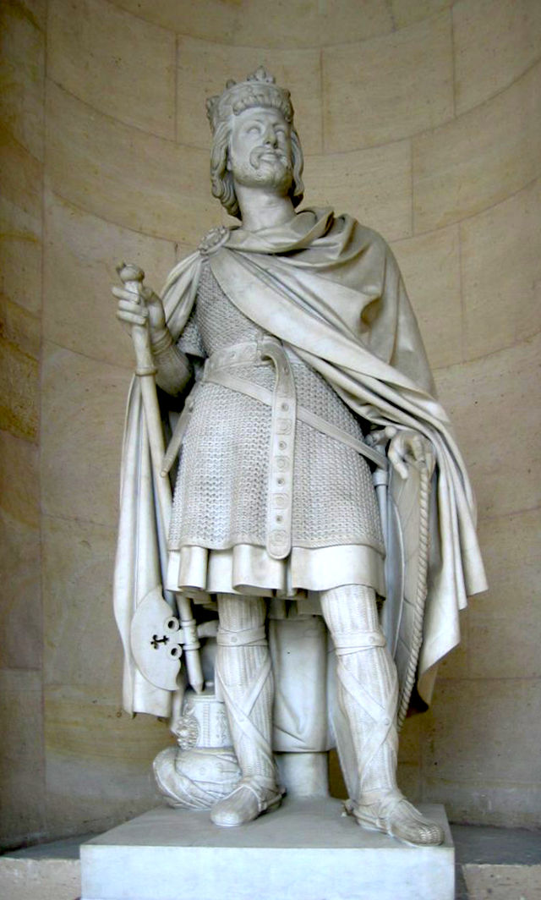
The Carolingians
Pippin II (d. 714) - Grandson
of both Arnulf of Metz and
Pippin the Elder
Duke of the Franks
Charles Martel (r. 714-741) –
Duke of the Franks, Mayor of the
Palace, and military hero
Unites Frankish Kingdom
Restarts expansion

Slide 13
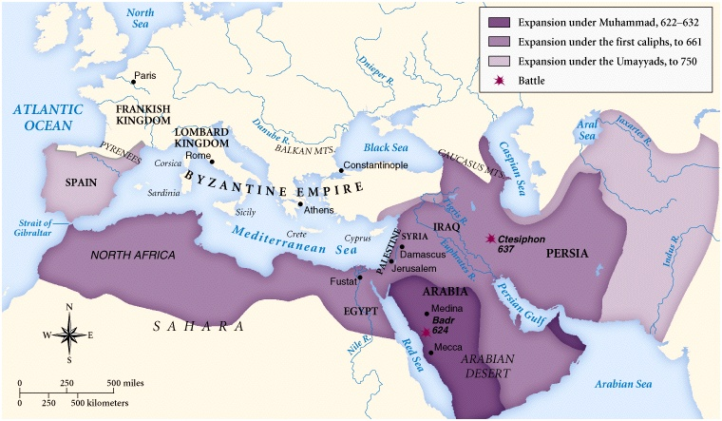
Arab-Muslim Conquests

Slide 14
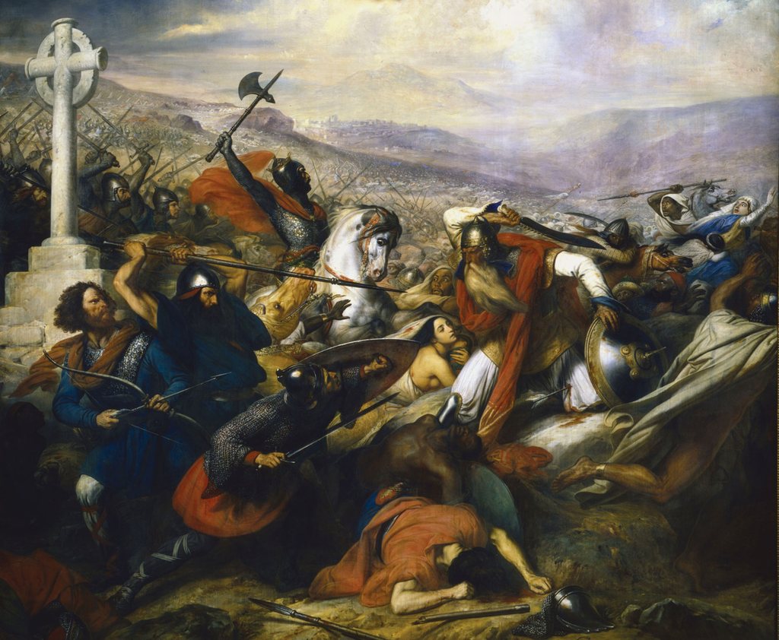
The Battle of Tours/Poitiers (732)
Tours (~150 miles to Paris)
Charles leads united Frankish force
Expansion into
Aquitaine, Burgundy,
and Provence
Stops Muslim
expansion
Wins recognition of
Pope
Charles de Steuben, Bataille de Poitiers,
1837

Slide 15
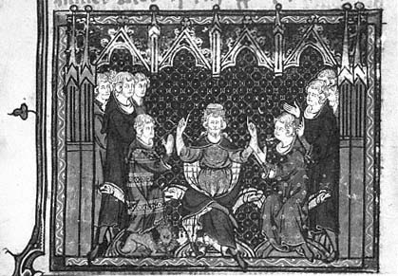
The Carolingians
737 – Theoderic IV dies, Charles names no heir
739 – Pope Gregory III offers protectorship of Rome
Prefers relations
with Lombards and
Byzantines
741 – Divides
kingdom among sons

Slide 16
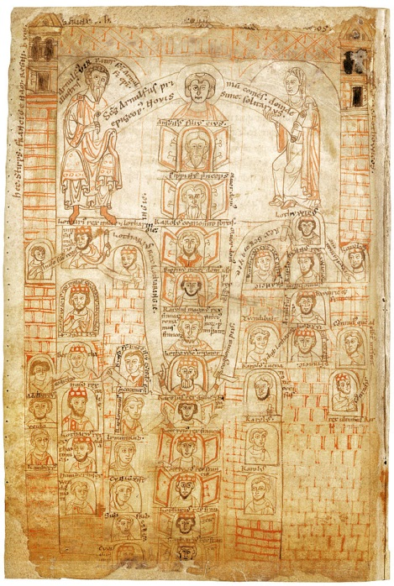
Carloman and Pippin
Joint rule
Aristocratic revolts
743 – Childerich III
Boniface – missionary
Establishment of new
bishoprics
Restoration of church
property
Tying episcopal positions to
Rome
Carolingian Family Tree, 12th century

Slide 17
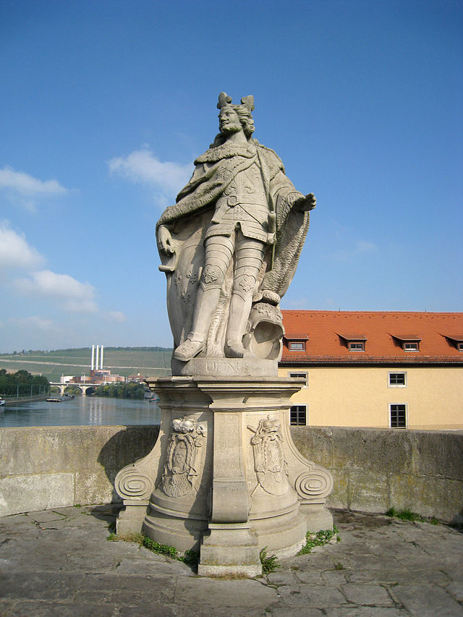
Pippin the Short (r. 751-768)
747 – Carolman abdicates,
becomes a monk
751 – Pippin asks Pope
Zacharias “whether it was a
good thing or not that kings in
the Frankish kingdom had no
royal power.”
Pippin declared king

Slide 18
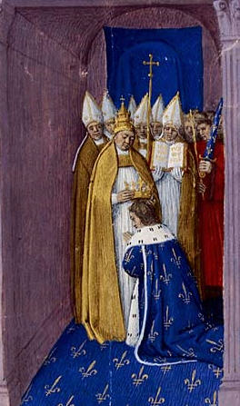
Pippin and the Pope
753 – Pope Stephen II seeks
protection from Lombards
754 – Pope in Paris
Anointing of Pippin and his
sons
Patricius Romanorum –
Protector of Rome
“Donation of Pippin”
Conquest of Italy

Slide 19
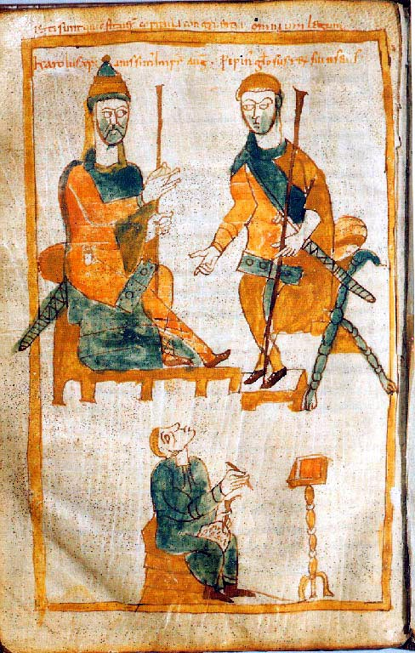
Charlemagne and Carloman
Carolus Magni – Charles the
Great
Sons of Pippin the Short
768 – Pippin dies
Kingdom divided between
Charlemagne and Carloman
Charlemagne in Neustria
Carloman in Austrasia
Bertrada – mother, arranges
diplomatic marriage with Lombards

Slide 20
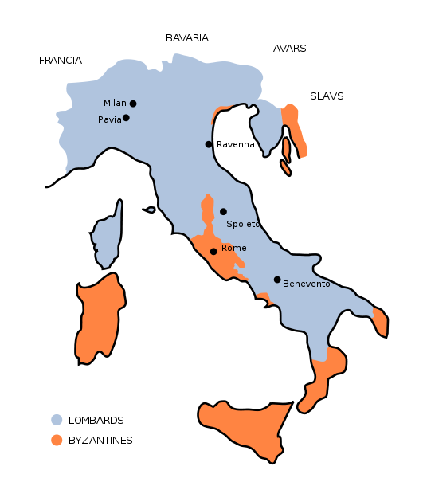
Charlemagne and Desiderius
Desiderius (r. 756-786) – King of the Lombards
Marriage alliance isolates
Carloman
Threatens Pope Stephen III
Negotiation with
Lombards on behalf of
Papacy
771 – Carloman dies,
Charlemagne as King of
Franks

Slide 21
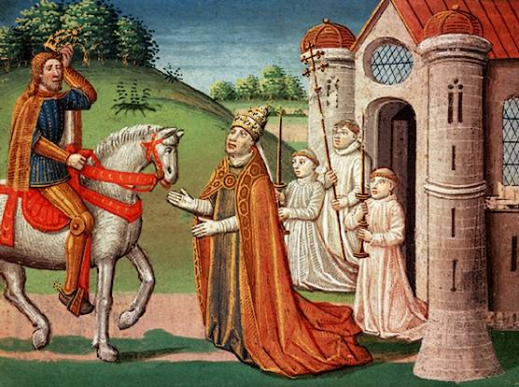
Charlemagne and Desiderius
Desiderius offers Carloman’s family asylum
Requests Pope Hadrian recognize Carloman’s sons
Maintain a divided Frankish Kingdom
Can Charlemagne rely on
Austrasian nobility?
772 – attack on Saxons
773 – Hadrian requests
support against Desiderius

Slide 22
Charlemagne in Italy
773 – Charlemagne leads troops against Lombards
Carloman’s family surrendered to Charlemagne
Easter, 774 – Charlemagne confirmed as patricius Romanorum
Renewed “Donation of Pippin”
Desiderius surrenders, sent to monastery
  Son escapes to Byzantine Empire

Slide 23
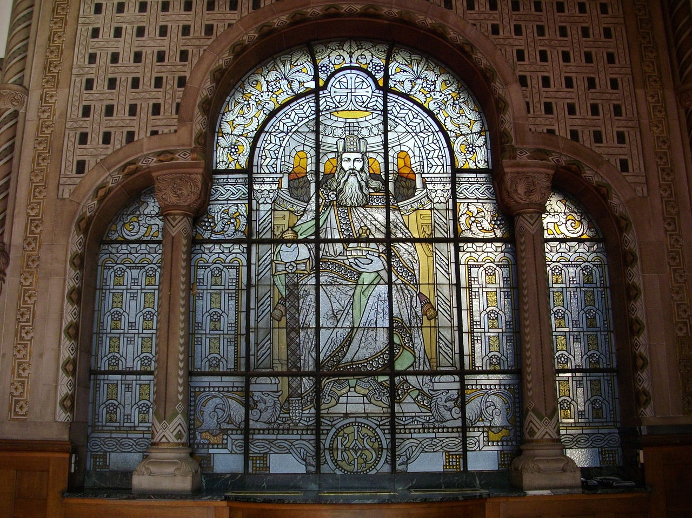
Charlemagne, King of the Lombards
Rex Francorum et Langobardorum
Incorporates upper and central Italy into Frankish Kingdom
Opportunity to
reward loyal nobles
Same for Pope

