Slide 1
Europe and the Mediterranean After Rome
HIST 1016
9/8/14

Slide 2
History Club Meeting
Fri. Sept. 12th @ 2pm
McMicken 357

Slide 3
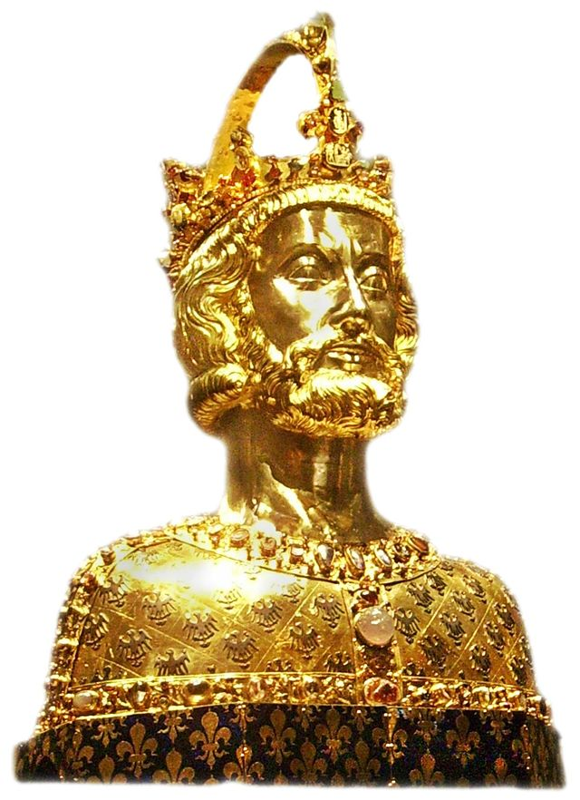
Charlemagne (r. 768-814)

Slide 4
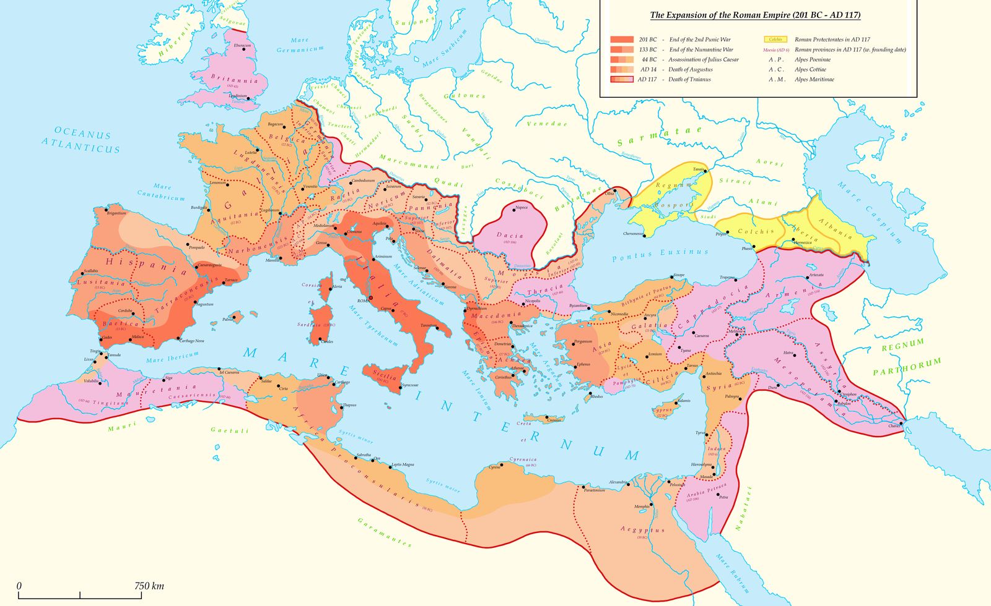
The Roman Empire (27 BCE – 476 CE)

Slide 5
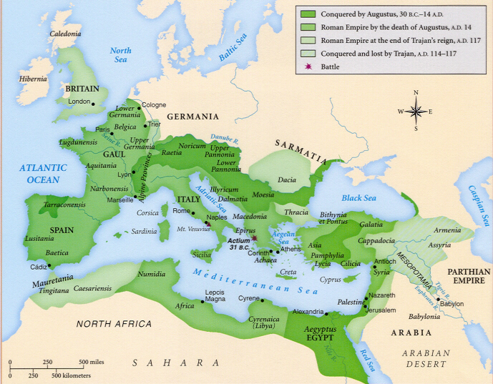
Pax Romana

Slide 6
Third Century Crisis
Frequent changes of rulers
Raids by Germanic tribesmen
Rise of regional powers
High cost of defense
Debasement of currency
Disruption of trade
Barter economy
Disappearance of urban aristocracy
Movement to rural economy

Slide 7
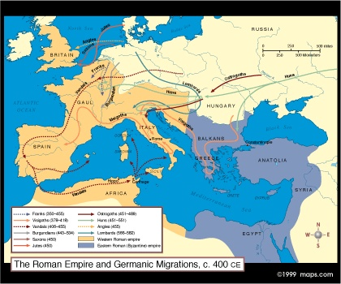
Germanic Migrations

Slide 8
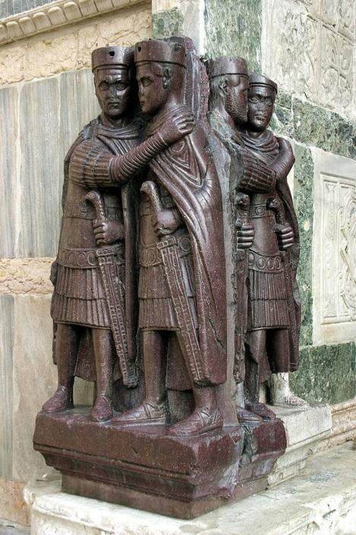
The Tetrarchy
Diocletian (r. 284-305)
Solution to 3rd century crisis
285 - Diarchy – shares
power with Maximian
293 – Tetrarchy – shares
power with Galerius and
Constantius Chlorus as well
Separate capitals / separate
responsibilities

Slide 9
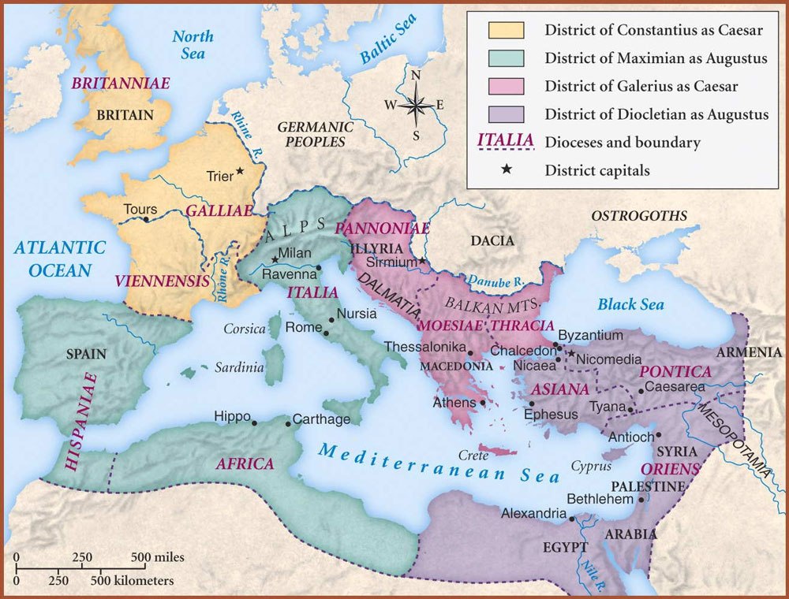
The Tetrarchy

Slide 10
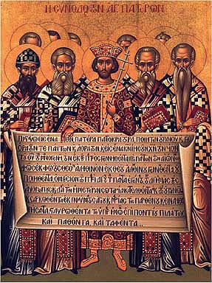
Constantine the Great (r. 306-337)
306-324 – Civil war over
complex succession
312 – Battle of Milvian
Bridge
“In this sign, you shall
conquer.”
313 – Edict of Milan ends
persecution of Christians
324 – Constantine coverts
Capital moved to
Constantinople

Slide 11
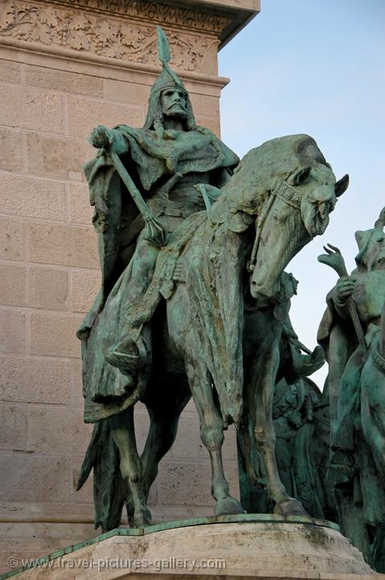
Divided Empire
Theodosius I (r. 379-392) –
splits east and west in
bequeathing empire to his sons
East less affected by 3rd
century crisis
Attila the Hun (r. 434-453)
Invasion of Gaul and Italy
ends Western Empire
Accelerates Germanic
migrations
476 – Fall of Rome

Slide 12
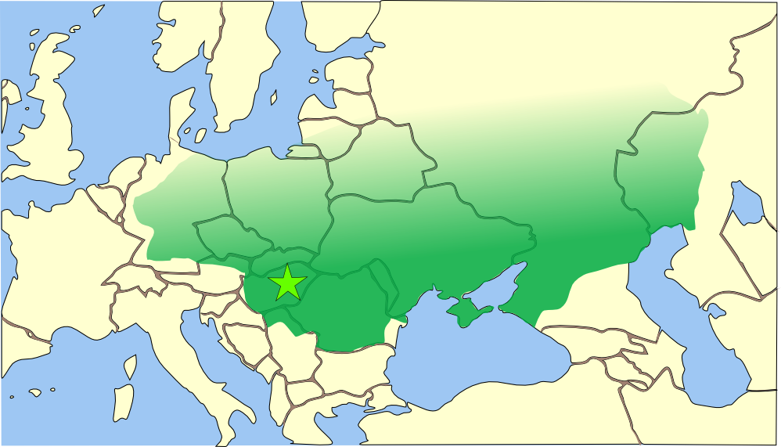
Hunnic Empire

Slide 13
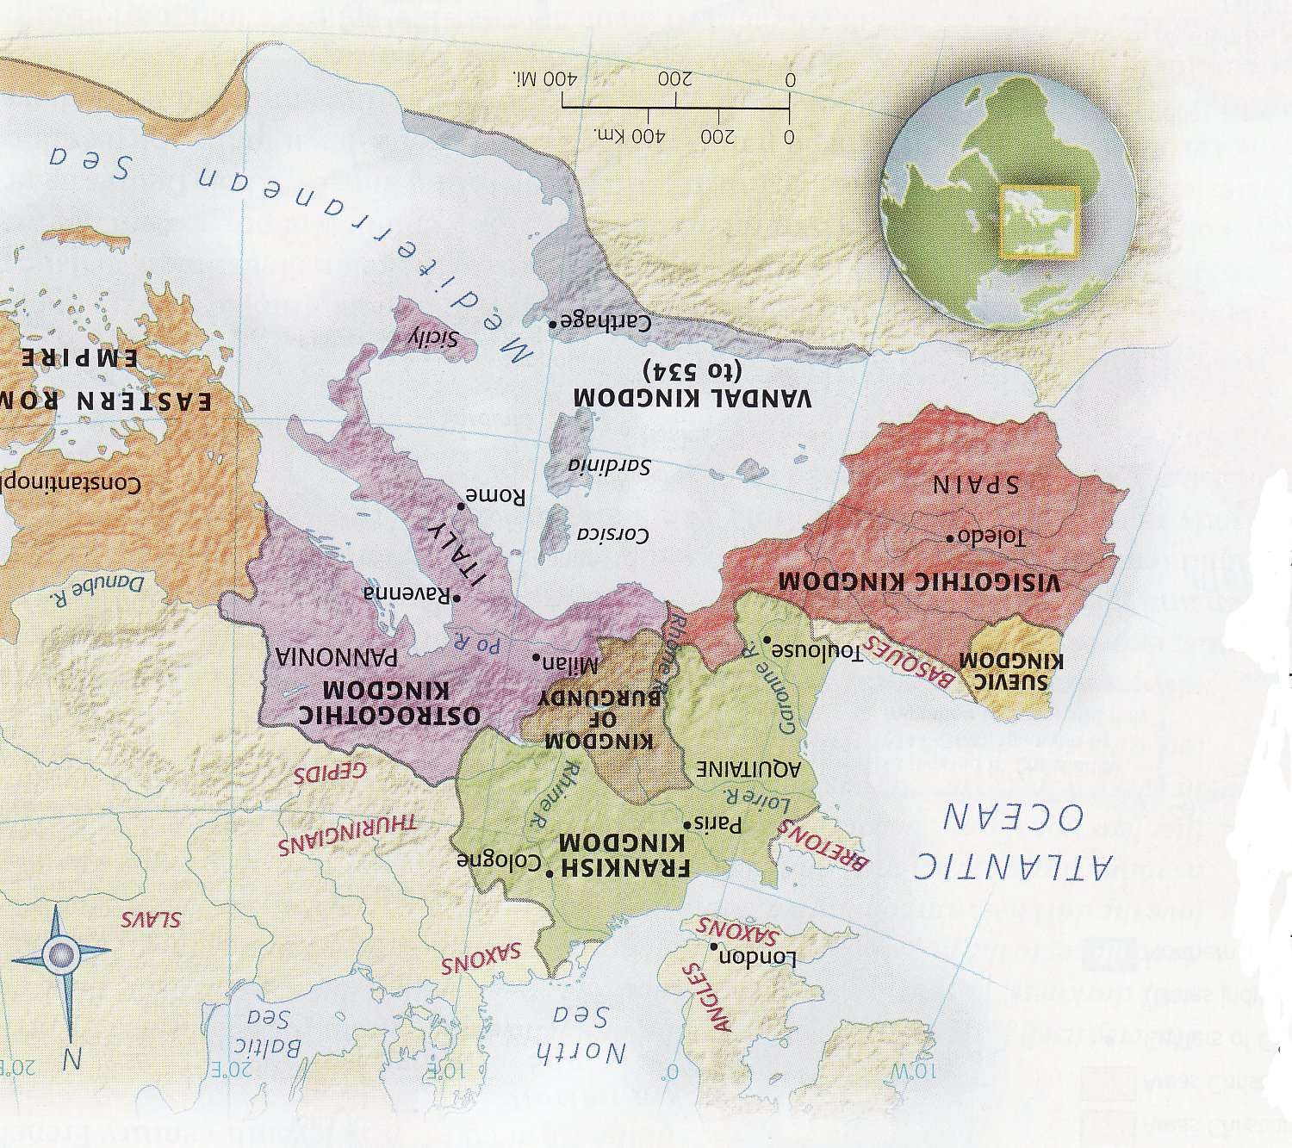
Divided Western Europe

Slide 14
Frankish Origins
Frank – Germanic people
Warbands
Laeti – foreigners given land in exchange for military service
Franks settled in northern Gaul
Mid-4th century – transformed into Roman subjects, with military obligations

Slide 15
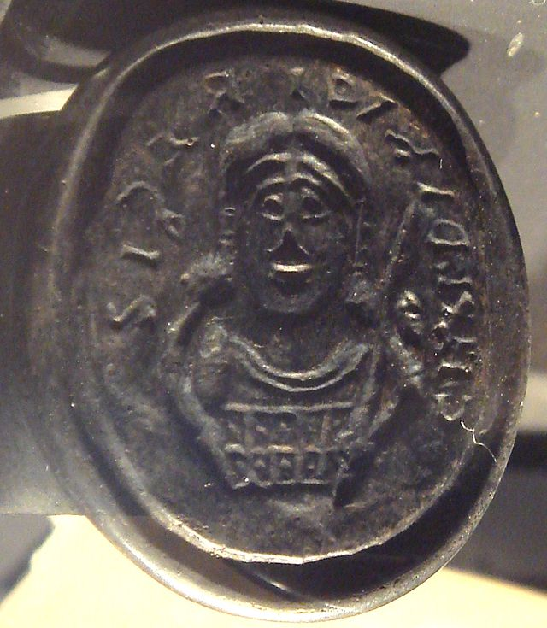
The Merovingian Kingdom
Collapse of Rome
opened vacuum
Merovech – legendary king
Membership in Roman
military
Last remains of Roman
authority
Childeric I (r. 457-481):
seizes northern Gaul from rival
Germanic warbands
Signet ring of Childeric I

Slide 16
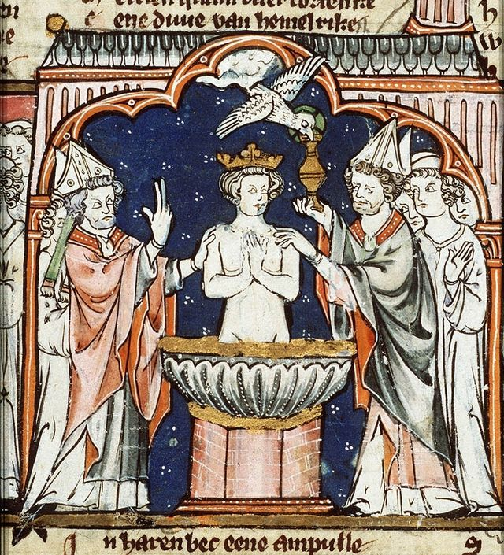
The Merovingian Kingdom
Clovis I (r. 482-511)
486 – Defeats Syagrius
– last Roman governor
498 – Adopts Nicene
Christianity
Appeal to Gallo-Romans
508 – Byzantine
Emperor Anastasius I
grants Clovis consulship

Slide 17
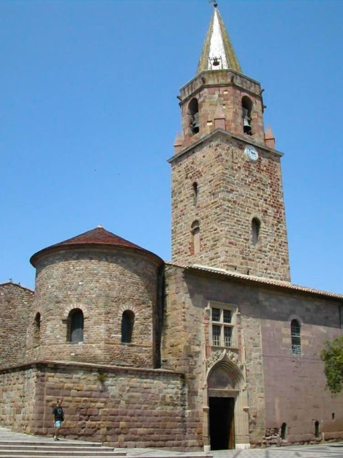
The Merovingian Kingdom
Organized on Roman system
Relied on collection of
taxes
Civitates – cities and
hinterlands
Pagi – rural districts
Comes – count, represents
king in civitates or pagi
Dux – duke, oversees
several counts
Cathedral at Frejus

Slide 18
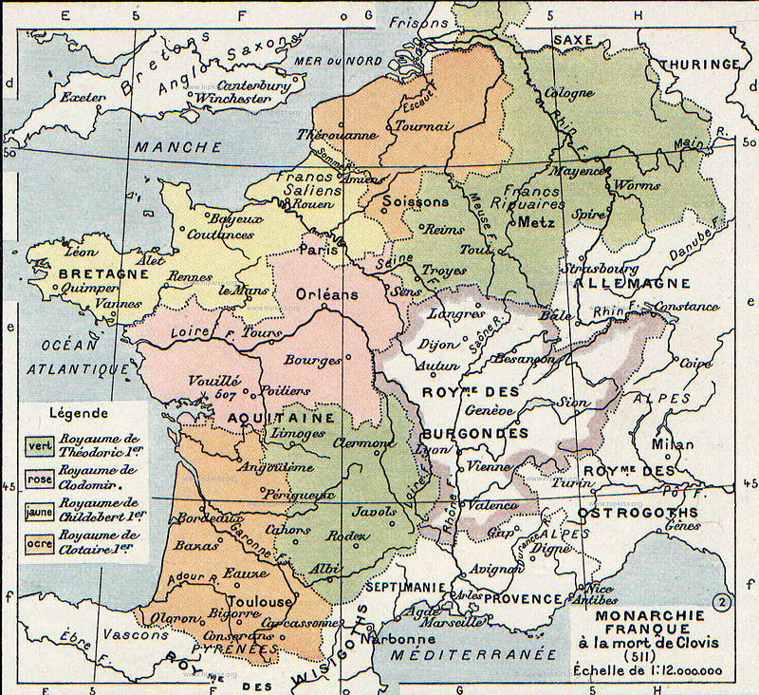
Inheritance and Division

Slide 19
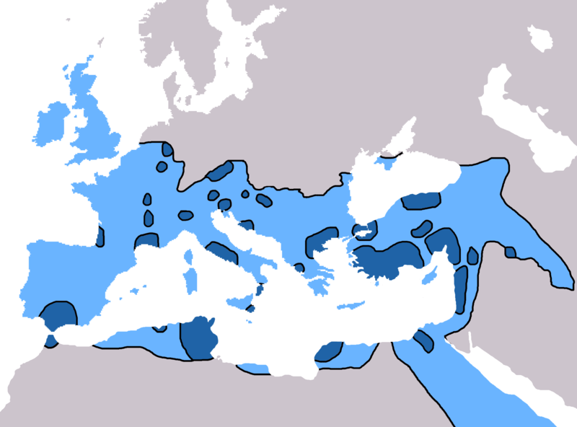
Early Christianity (before 325CE)
No centralized
leadership
Multiple sects
5 Patriarchs
Rome
Constantinople
Antioch
Jerusalem
Alexandria
Spread of Christianity: dark blue = before 325
light blue = 325-600

Slide 20
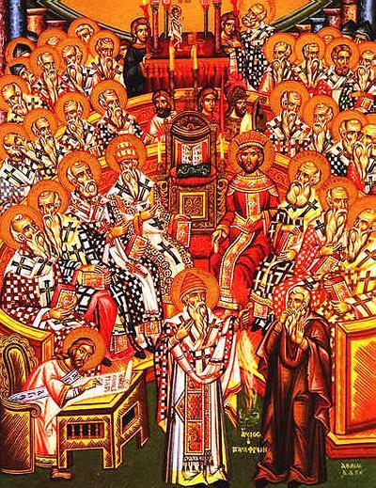
Imperial Christianity
325 – First Council of
Nicaea – Nicene Creed
380 – Edict of
Thessalonica: Nicene
Christianity becomes
state religion of Roman
Empire
451 – Council of
Chalcedon: monophysitism
vs. dyophysitism

Slide 21
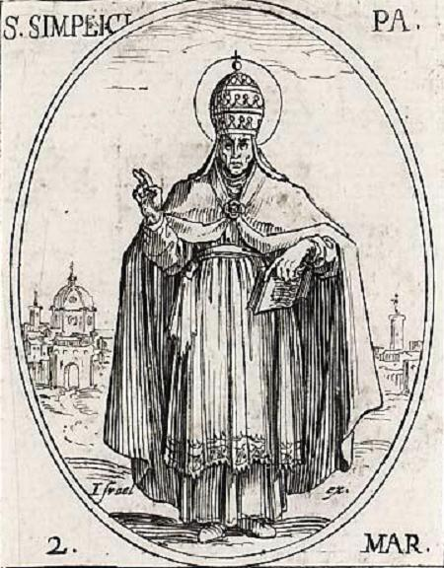
2 Empires = 2 Churches
381 – First Council of
Constantinople – Elevates
Patriarch of Constantinople
Patriarch of Constantinople
& Byzantine Emperor
Sees of Rome and
Constantinople
After 476 – Bishop of Rome
(Pope) last unifying force in
West
Pope Simplicius (r. 468-483)

Slide 22
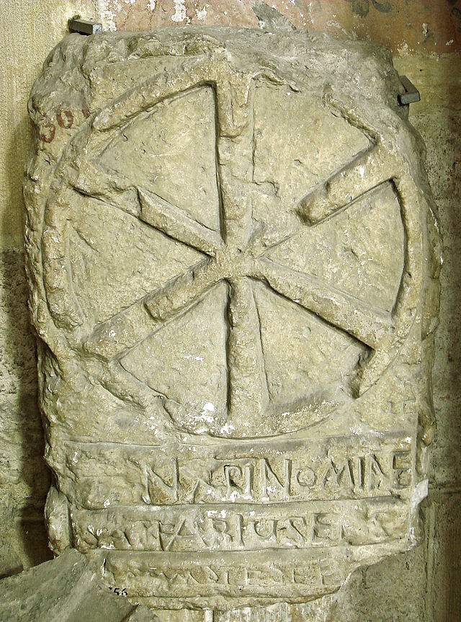
After Rome - Parallel Hierarchies
Priest and local churches
Bishop and Bishopric =
comes and civitas
Archbishop/Metropolitan
and church province
Gaul = 11 church
provinces and 128 bishoprics
“Episcopal government”
Who appoints bishops?
Merovingian sarcophagus

