Slide 1
Central Asia Before Islam
HIST 3035
9/8/14

Slide 2
Crossroads of Civilizations
Vs.
Crossroad Civilization
What’s the difference?

Slide 3
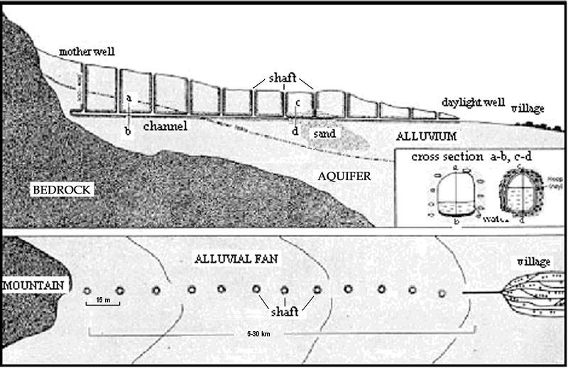
Qanat or karez

Slide 4
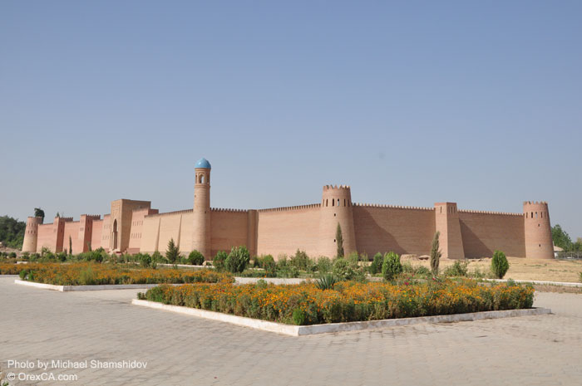
Khulbuk, Tajikistan

Slide 5
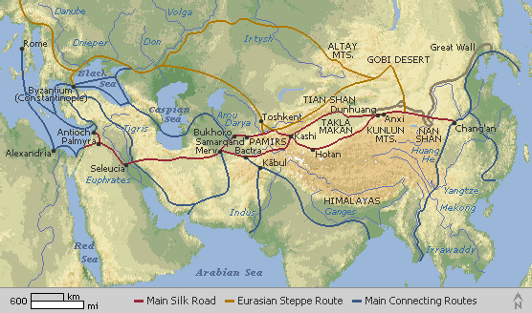

Slide 6
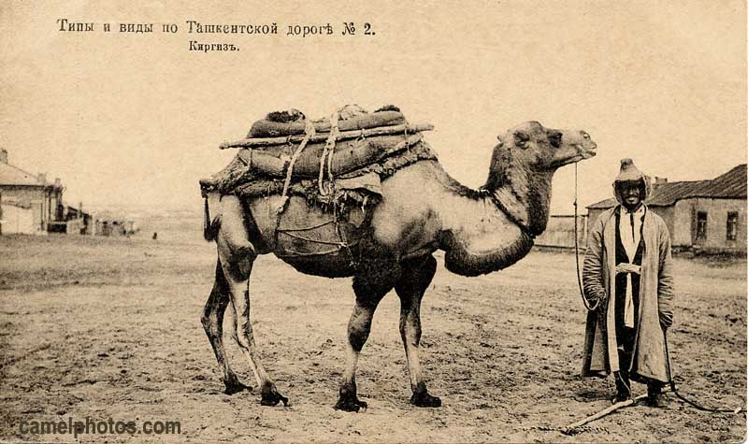
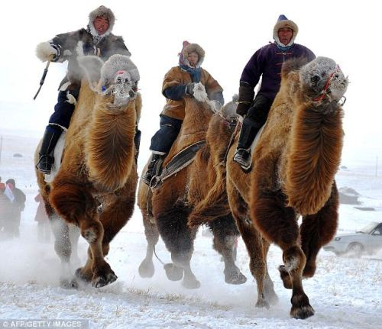
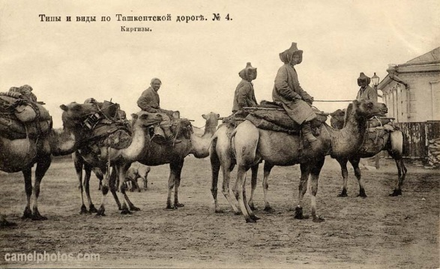
The Camel and the Wheel

Slide 7
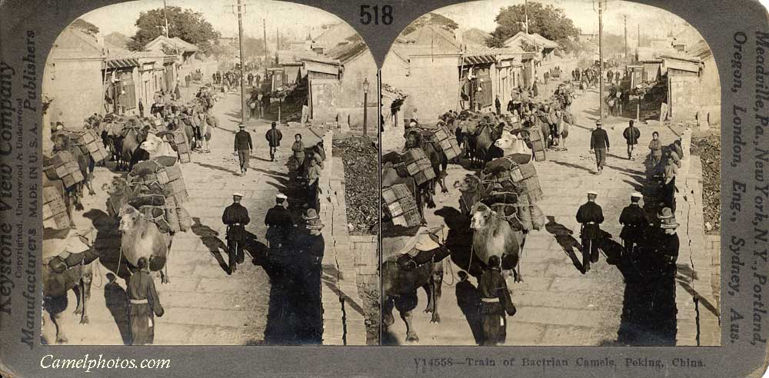
The Camel and the Wheel

Slide 8
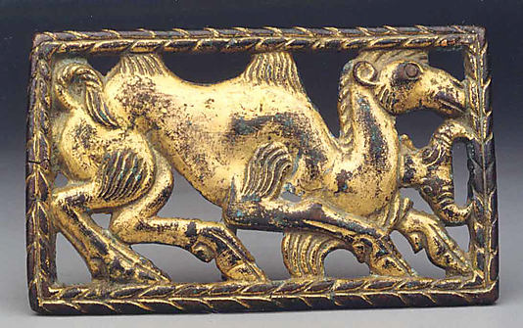
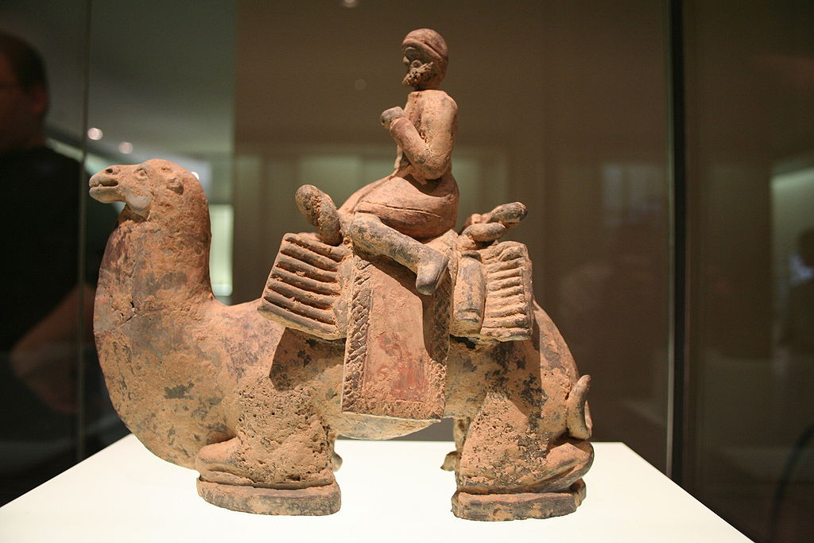
The Bactrian Camel
Bronze plaque, Northern China, 1st-2nd century BC; Westerner on a camel, Northern China,
4th-6th century;

Slide 9
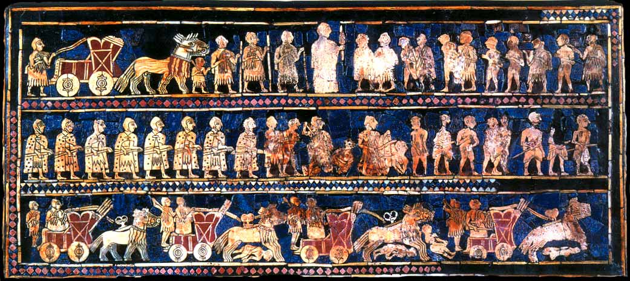
The Horse

Slide 10
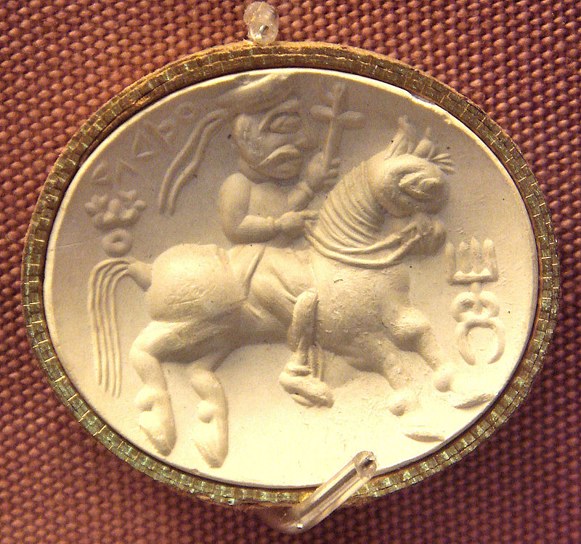
The Saddle and the Stirrup

Slide 11
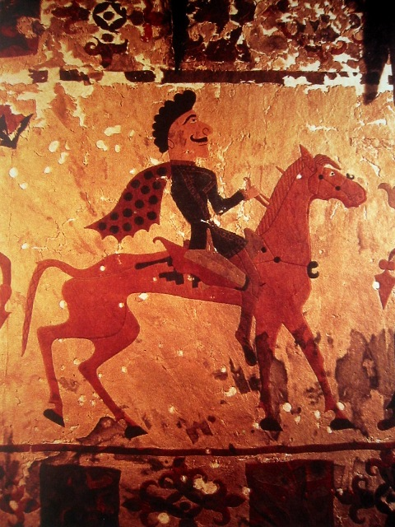
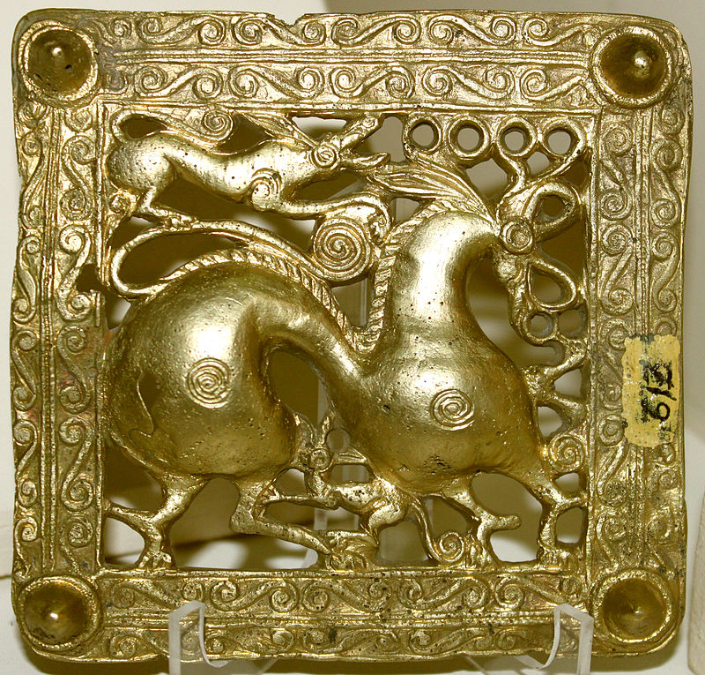
Scythians and Horse Nomads
Felt representation of Scythian, Pazyryk, southern Siberia, 4th century BC; Scythian belt,
Azerbaijan; 7th century BC

Slide 12
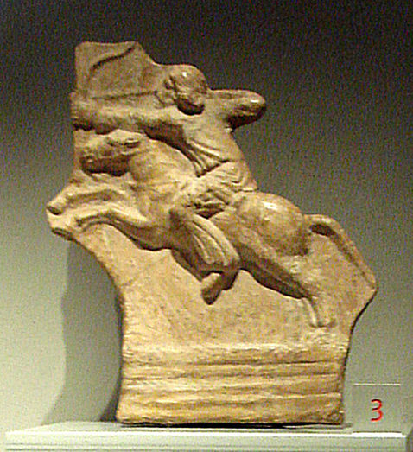
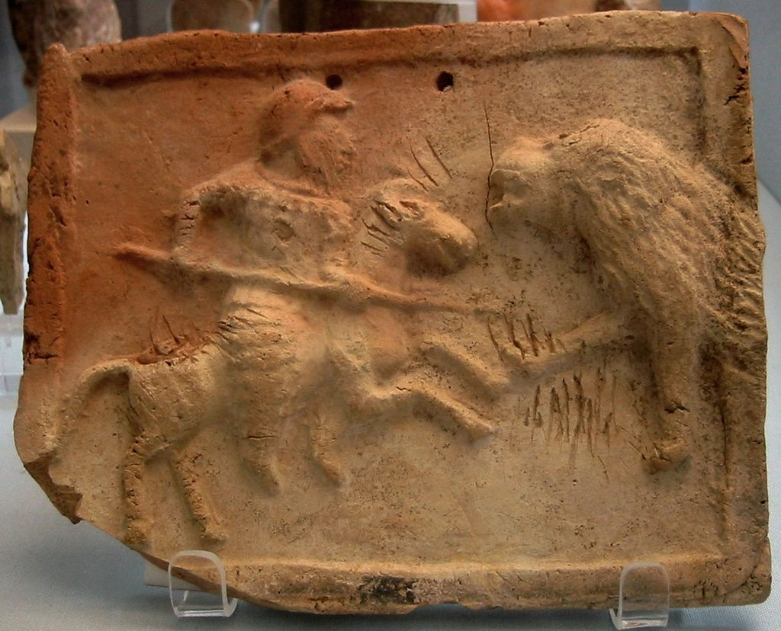
Parthian Empire (r. 247 BC – 224 CE) and Cavalry
The Parthian Shot and Cataphract

Slide 13
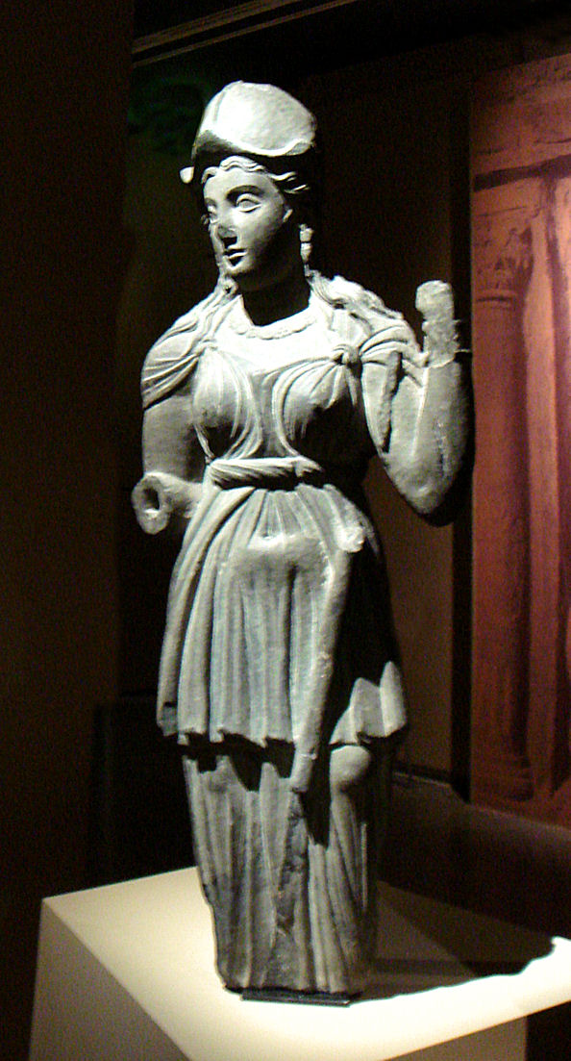
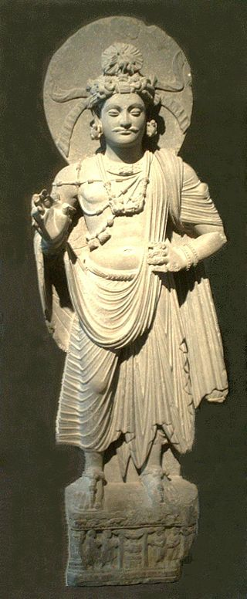
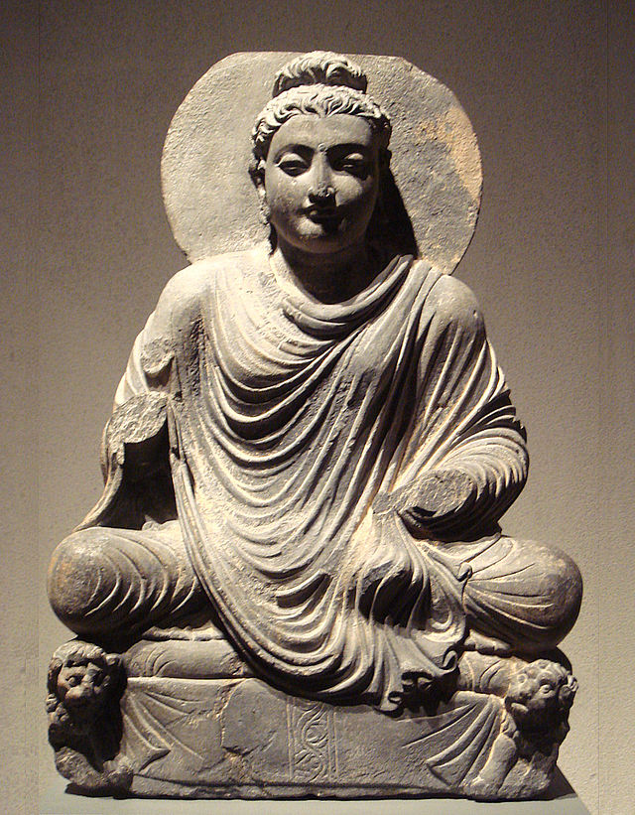
Greco-Bactrian Kingdoms (250-125BC)
Greco-Indian Kingdoms (180BC – 10CE)
Athena, Bodhisattva, and Buddha

Slide 14
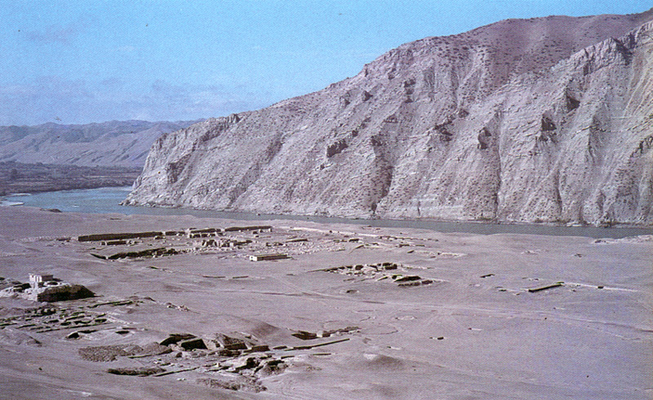
Ai Khanum (Alexandria on the Oxus)

Slide 15
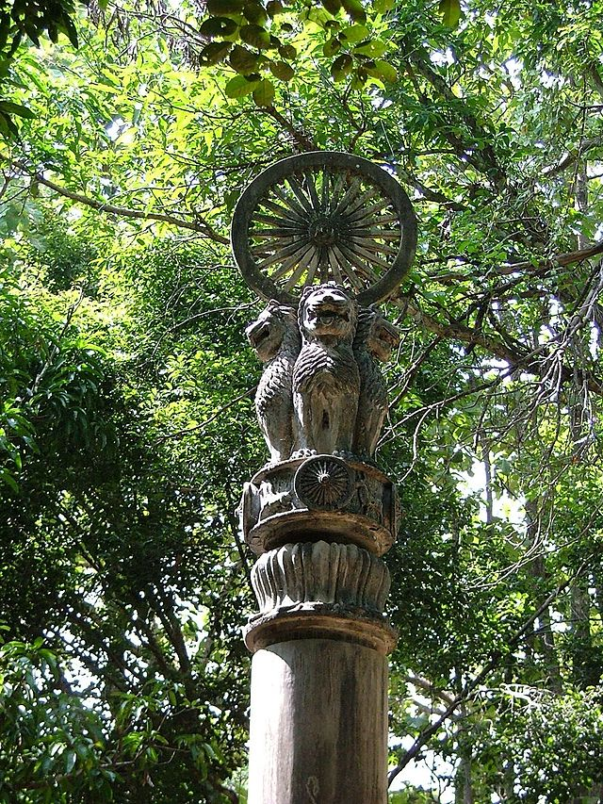
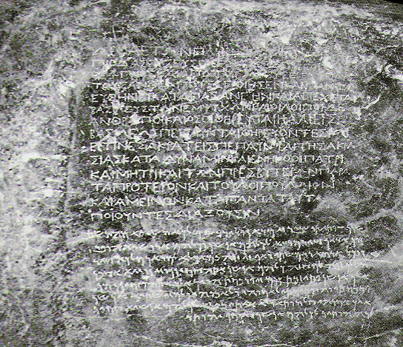
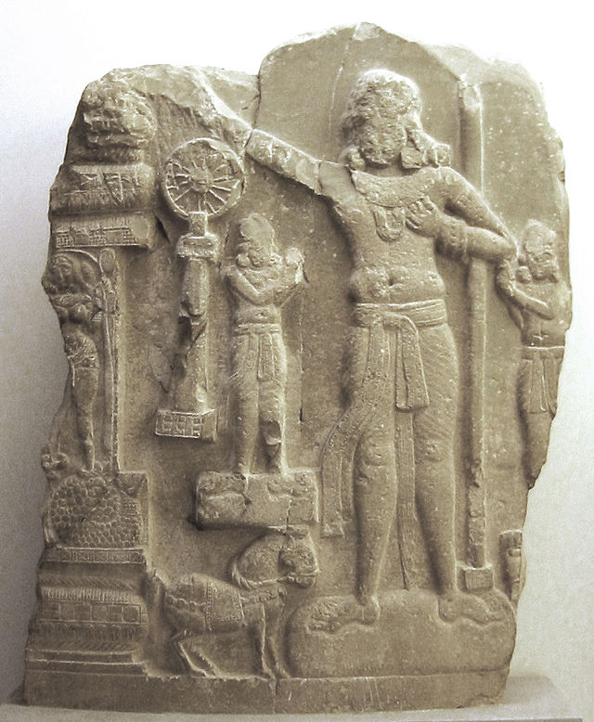
Maurya Empire (322-185 BCE)
Ashoka (r. 268-232 BCE)
Dharma Chakra on four lion capital, inscription from Ashoka
in Qandahar, and representation of a Chakravartin ruler

Slide 16
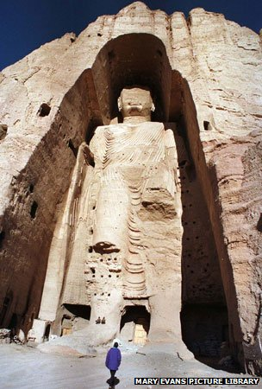
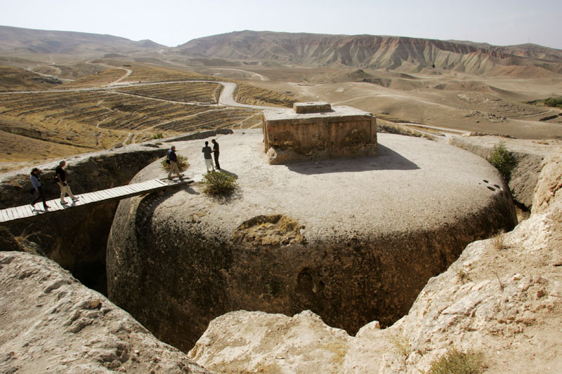
Buddhism in Central Asia
Bamiyan Buddha and Mes Aynak stupa

Slide 17
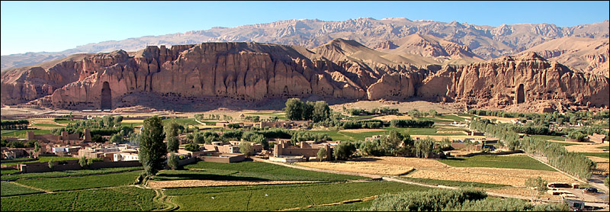
Bamiyan

Slide 18
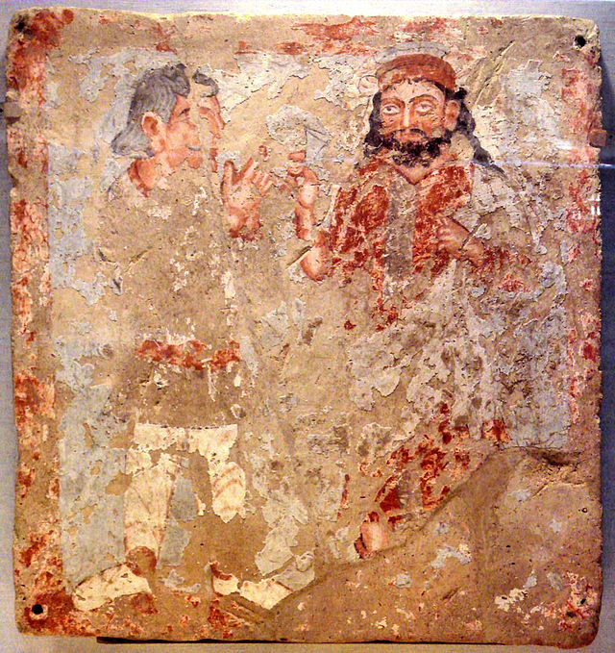
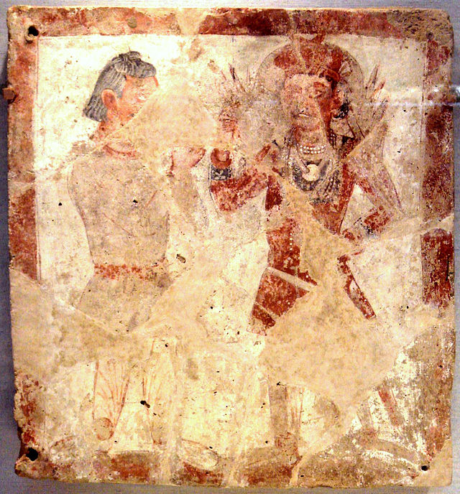
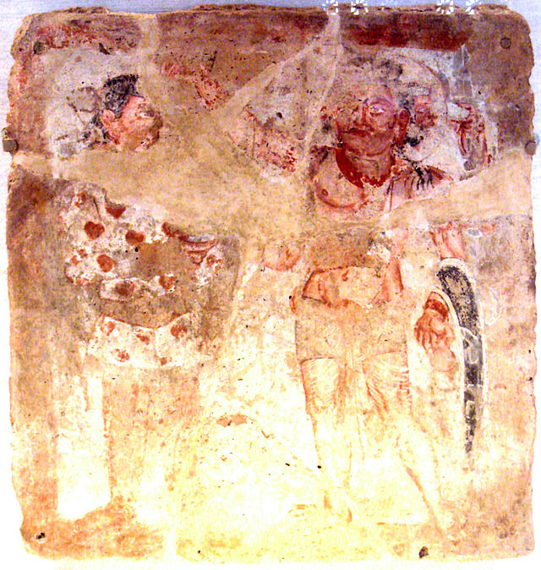
Kushan Empire (r. 30-375)
Zeus, Pharro (Zoroastrian figure), and Shiva – 3rd century Bactria

Slide 19
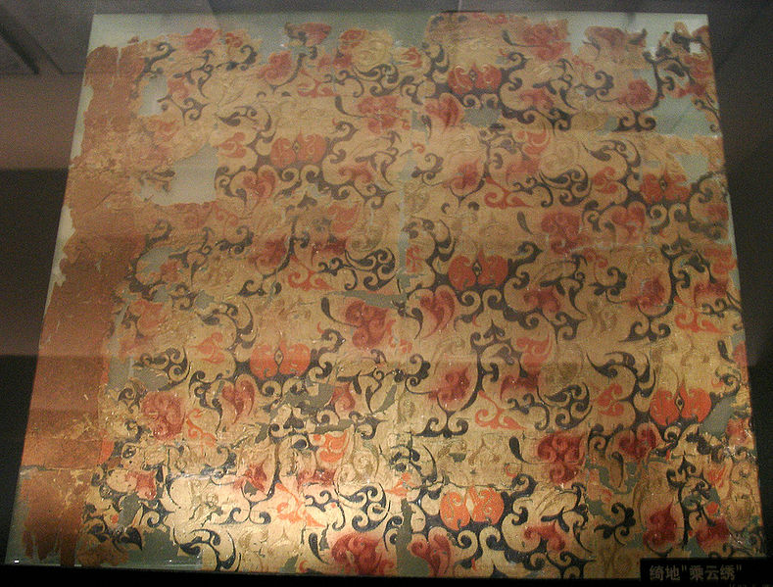
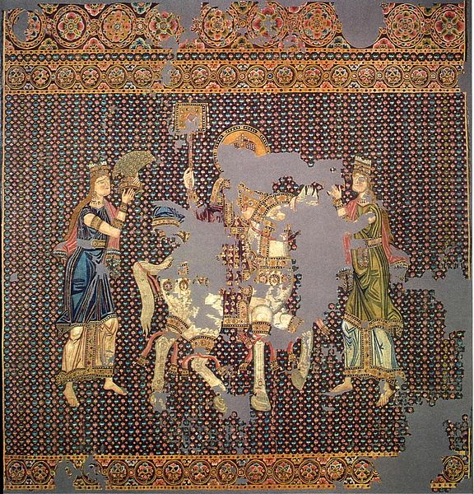
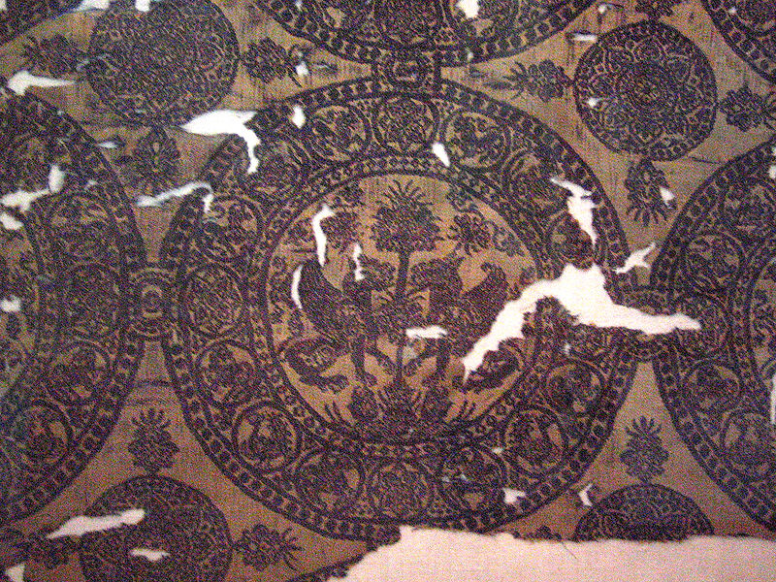
Silk Diplomacy

