Slide 1
The Origins of Kingship and Mytho-History
HIST 1016
9/3/14

Slide 2
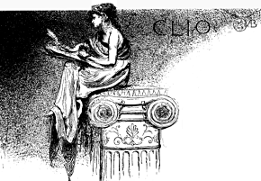
What is History?
Historia – learning through inquiry
American Historical Association – “the never-ending
process whereby people seek to understand the past
and its many meanings.”
But how do we do it?
Clio – The Muse of History

Slide 3
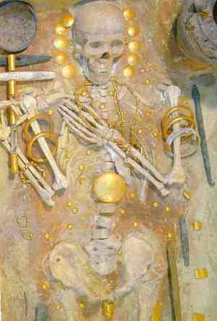
History vs. Prehistory
Sources – Historians rely on written sources.
Prehistory – The period before
written sources.
The study of prehistory relies
heavily on material culture.
What’s wrong with that?
“Elite” Burial – Varna, Bulgaria (4,500 – 4,000BCE)

Slide 4
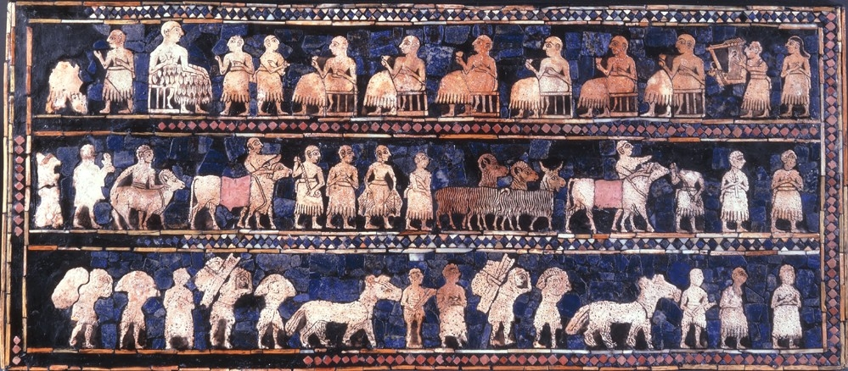
The Standard of Ur (~2600BCE)
Peace side
What can you say about the people who made this?

Slide 5
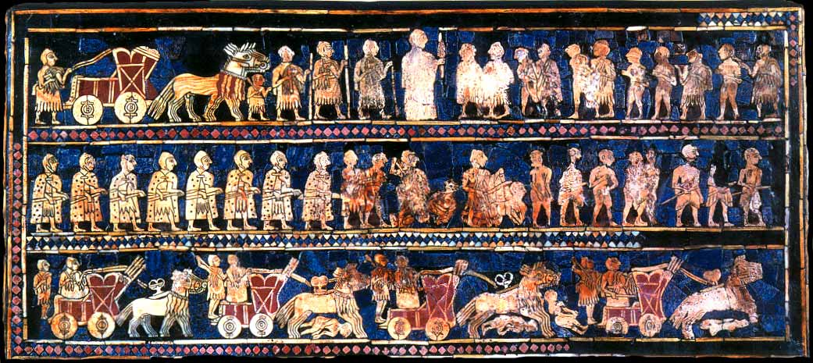
The Standard of Ur
War side
What can you say about the people who made this?

Slide 6
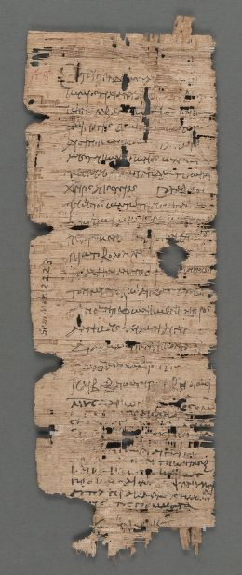
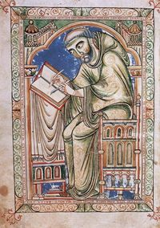
Problems of Written Sources
Authorial bias
“History is written by the victors.”
Incomplete textual record
  Destruction of documents
  Willful and accidental
Literacy and scribal
traditions
Truth = knowledge +
power
Would a scribe ever copy this bill of sale
for a donkey?

Slide 7
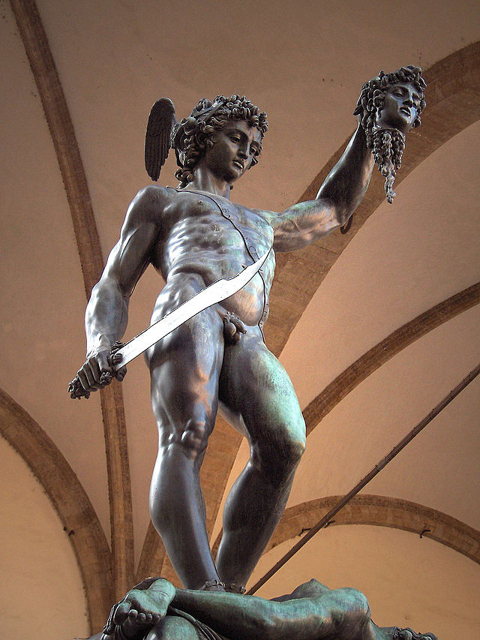
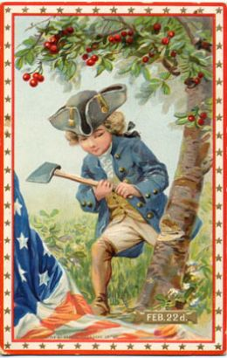
Mytho-History
Accounts that claim to be historical
Difficulty of confirming with other
sources
Used to explain traditions or
current conditions
Homer and Mycenaean Greece
Used to moralize the past
George Washington and the Cherry
Tree
Religious traditions

Slide 8
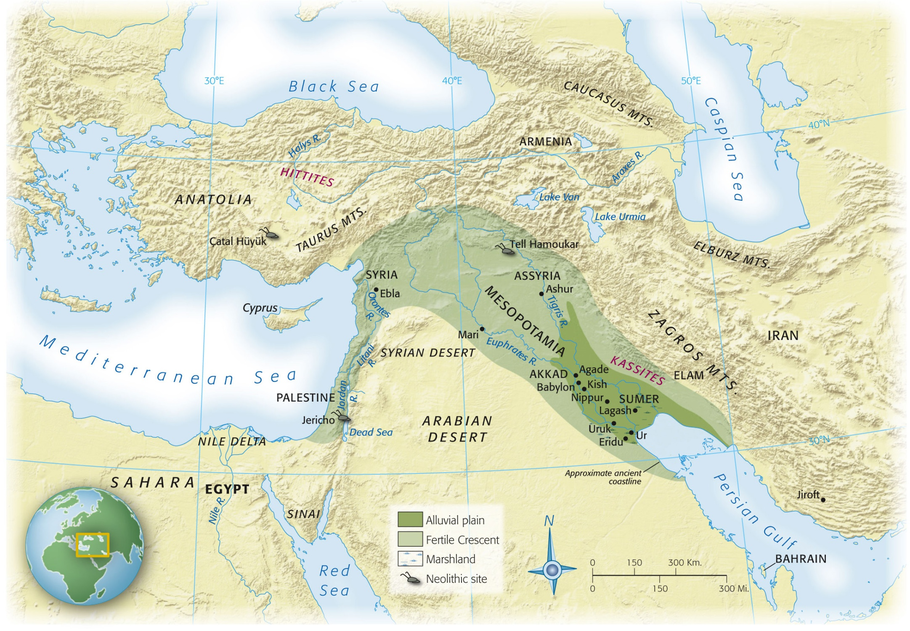
Mesopotamia

Slide 9
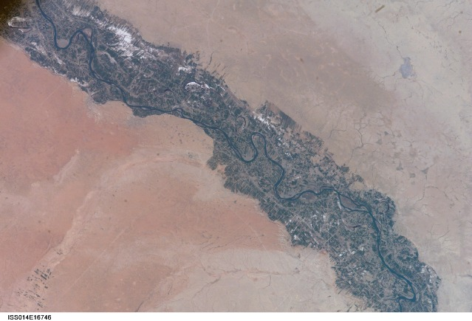
Tigris Farmland (modern)

Slide 10
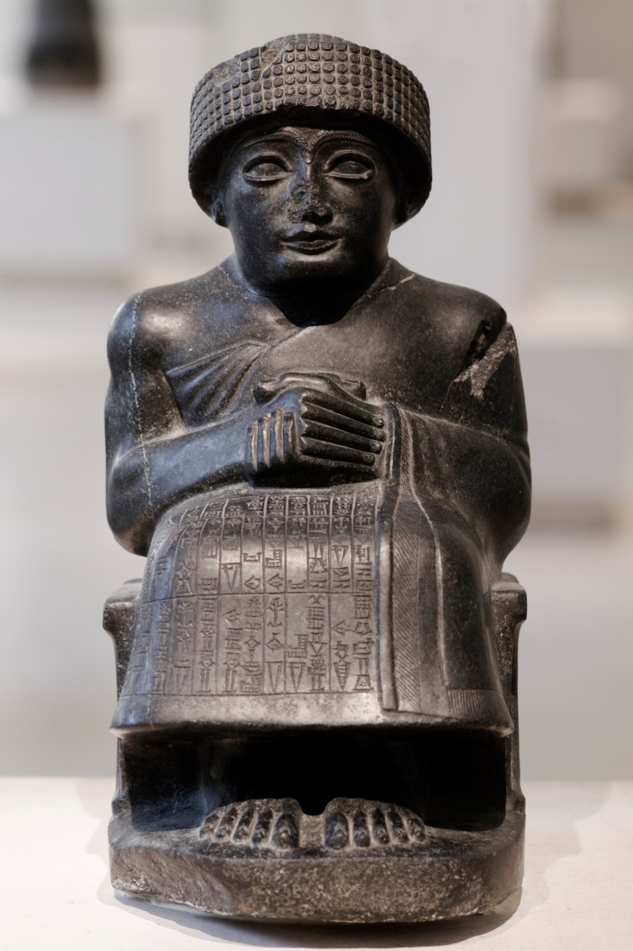
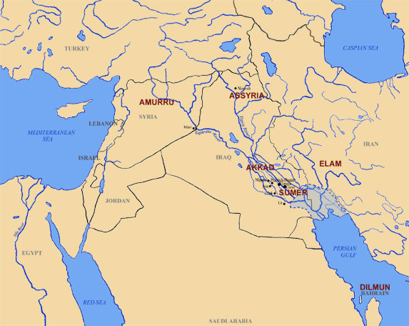
Sumer
Settled between 4500 and 4000 BCE
Network of a dozen plus
city-states
Shared language and culture

Slide 11
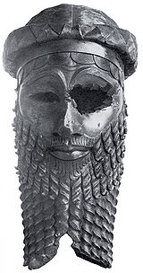
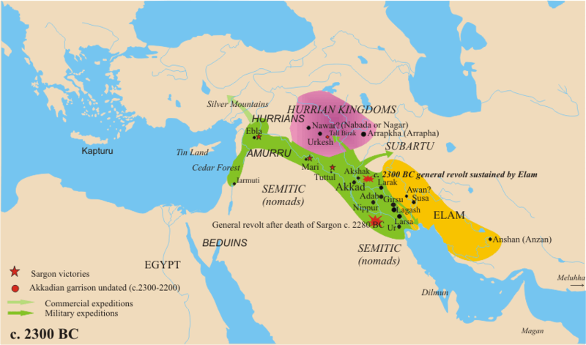
Akkadian Empire (2334-2154BCE)
Sargon of Akkad (2270-2215BCE)
The Legend of Sargon of Akkad
How does Sargon justify the
conquest of Mesopotamia?

Slide 12
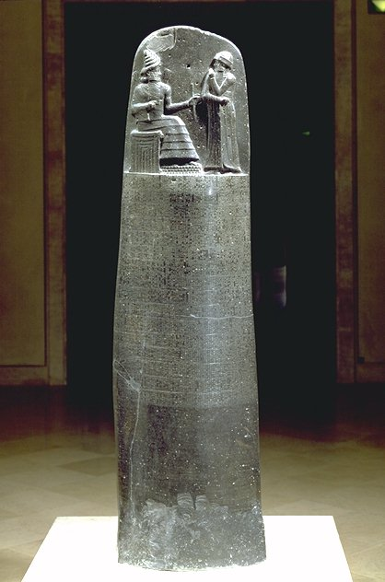
Hammurapi (r. 1792-1750 BCE)
Babylonian Empire (r. 1830-
1531 BCE)
Code of Hammurapi
282 clauses: property law,
family law, criminal justice,
commercial law, slavery,
economic issues
If… then…
Lex Talionis: “eye for an eye”
principle of equal retribution

Slide 13
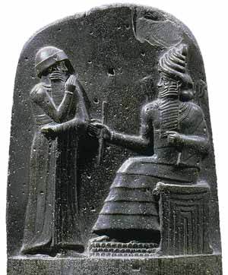
Code of Hammurabi
“Then Anu and Bel called by name me,
Hammurabi, the exalted prince, who
feared God, to bring about the
rule of righteousness in the land,
to destroy the wicked and the
evil-doers;
so that the strong should not
harm the weak; so that I should
rule over the black-headed people
like Shamash, and enlighten the
land, to further the well-being of
mankind.”

Slide 14
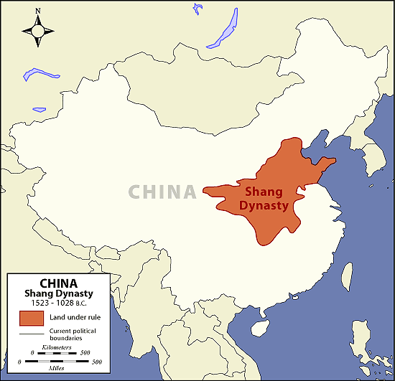
Shang Dynasty (1766-1122BCE)

Slide 15
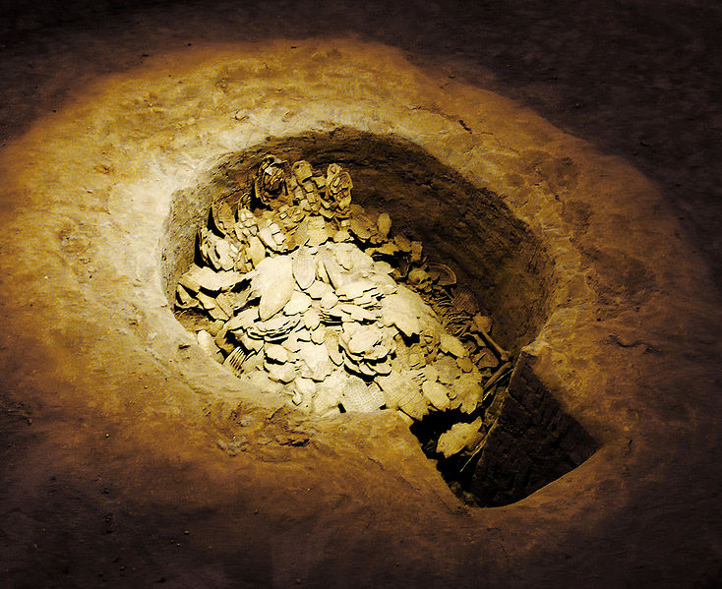
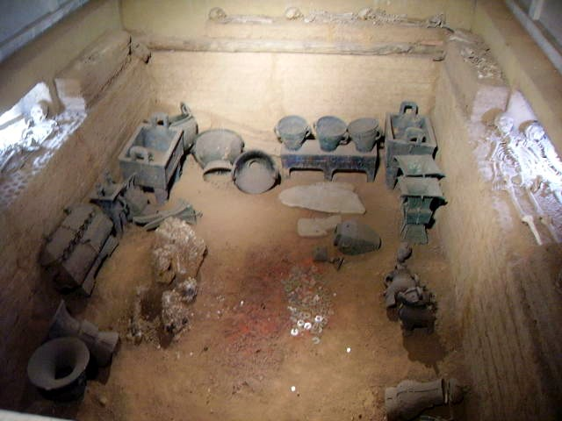
Shang Ancestor Worship
Di – supreme deity
Deceased live in realm
with Di
Heavenly Hierarchy
Ancestors of king have
closer connection to Di
Justify authoritarian rule
Oracle bones, earliest Chinese writing system
Tomb of Queen Fu Hao (d. ca. 1200 BCE)

Slide 16
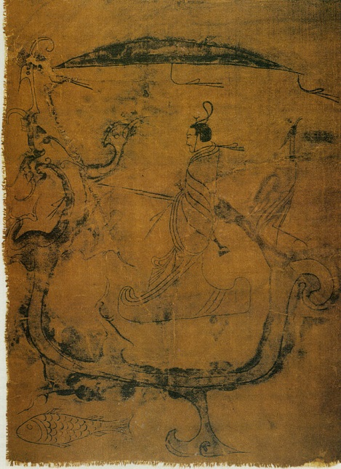
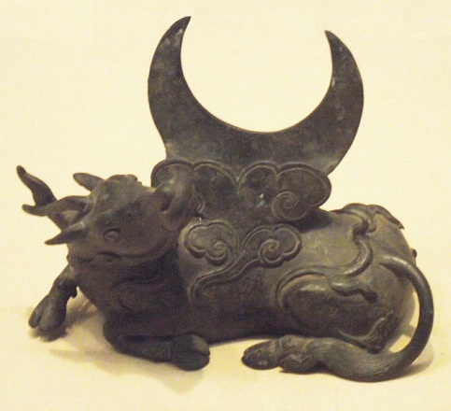
Zhou Dynasty (1122-256BCE)
Vassals of Shang in West
1045BCE - Wu overthrows Shang
Shu Jing – Book of Documents
“Mandate of Heaven”
Is this an accurate source for
the rise of the Zhou Dynasty?
Are there better sources?
Painting on silk ca. 6th century BCE
Mirror holder, ca. 1000 BCE

Slide 17
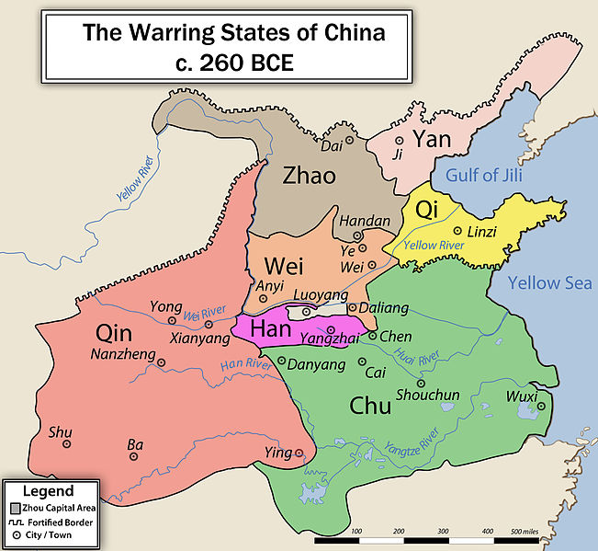
Warring States (ca. 475-221BCE)

Slide 18
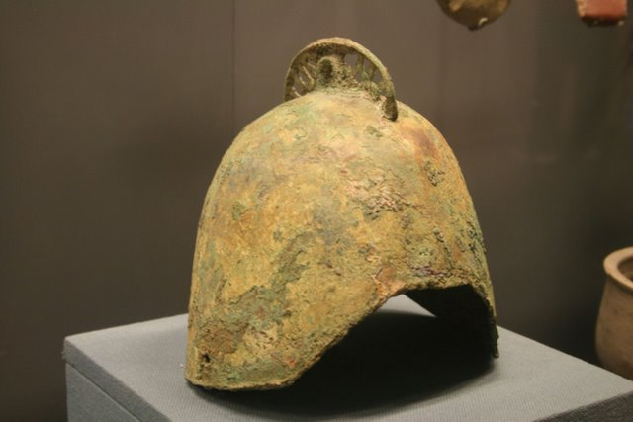
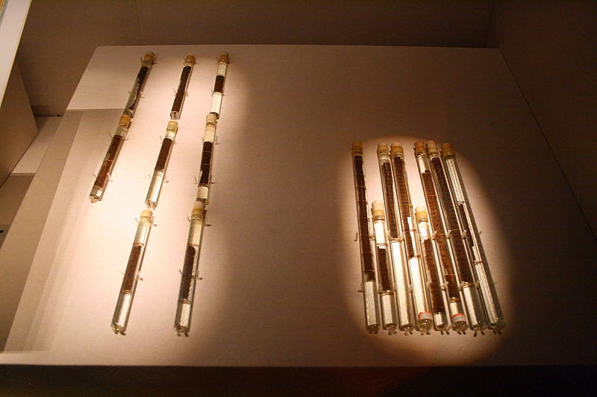
Warring States
Darkness and destruction
or golden age?
Confucianism and
Daoism
Record keeping
Iron working
Sun Tzu – The Art of War
“chivalry”

Slide 19
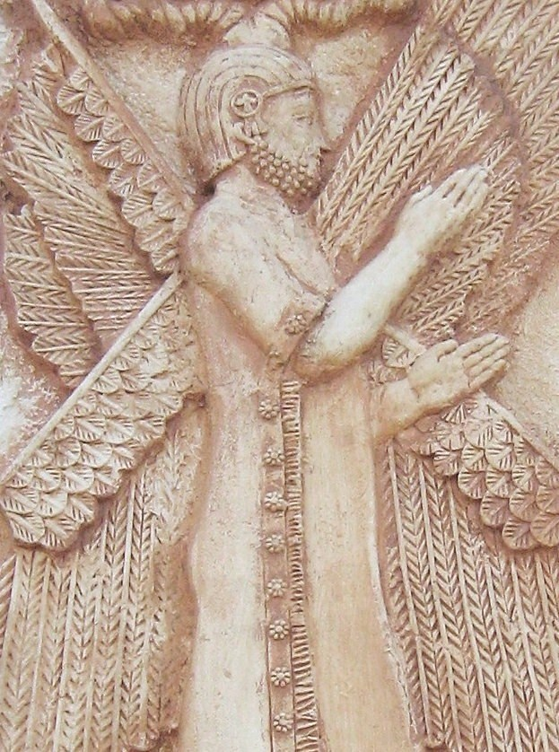
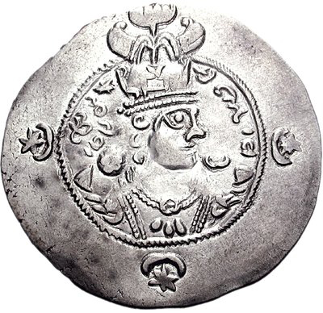
The Persian Empires
Persian Empires
  Achaemenids (r. 550-330 BCE)
  Alexander the Great and the
  Seleucids (r. 312-248 BCE)
  Parthians (r. 248 BCE – 224 CE)
  Sasanians (r. 224 – 651)
Arab-Muslim Conquest (633-651)
Cyrus the Great – founder of the Achaemenid Empire
Yazdgird III – Last Sasanian Shahanshah

Slide 20
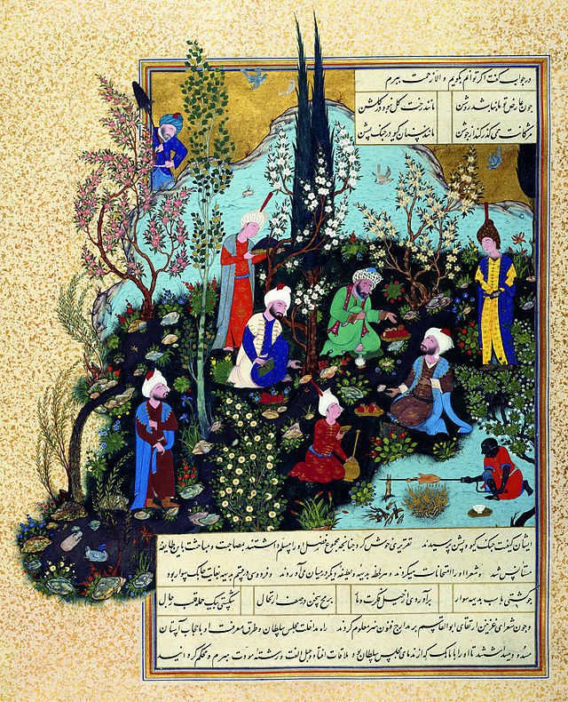
Shahnameh of Ferdowsi
“History” of pre-Islamic
Iran – “Book of Kings”
Abu ‘l-Qasim Ferdowsi
(940-1020)
50,000+ rhymed verses
Mythical Age
Heroic Age
Alexander the Great
Historical Age

Slide 21
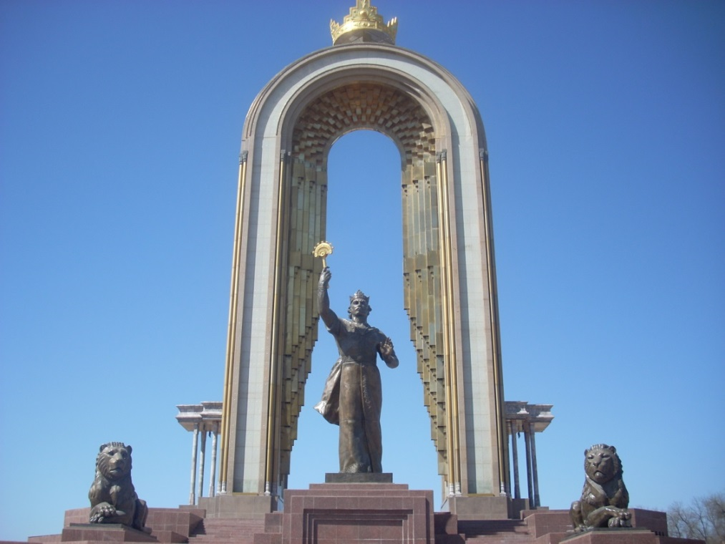
Persian-Islamic culture
Samanids (r. 819-999)
  Rulers in Central Asia
  Descendants of pre-Islamic nobility
  Independence from Iraq
  Mix Persian kingship
  with Muslim piety
New Persian – Persian
in Arabic script
Renewed interest in
Persian identity
Monument to Isma`il b. Ahmad al-Samani (r. 892-907), Tajikistan

Slide 22
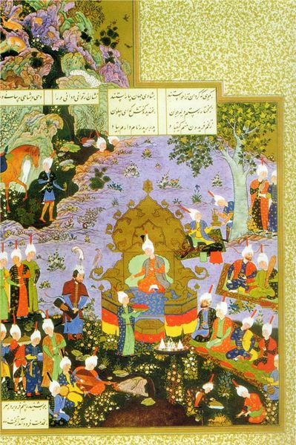
Shahnameh as Mirror for Princes
Royal farr – divine right of
kings
  All kings must have it
  Kings who misbehave can lose it
Tales of legendary kings set
the model for rulers both good
and bad
Establishes a model of Persian
kingship
Not entirely compatible with
Islam

Slide 23
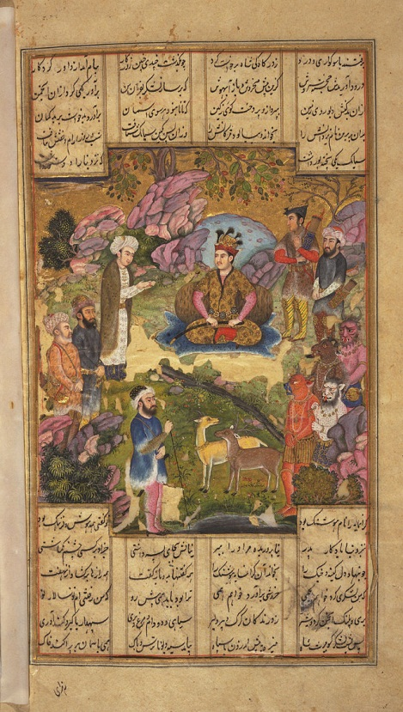
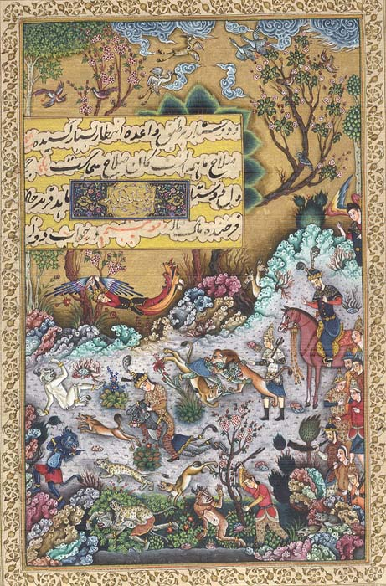
How Do We Work with the Shahnameh?

Slide 24
