Slide 1
City States and Oases:
Urbanism before Islam
HIST 3035
9/3/14

Slide 2
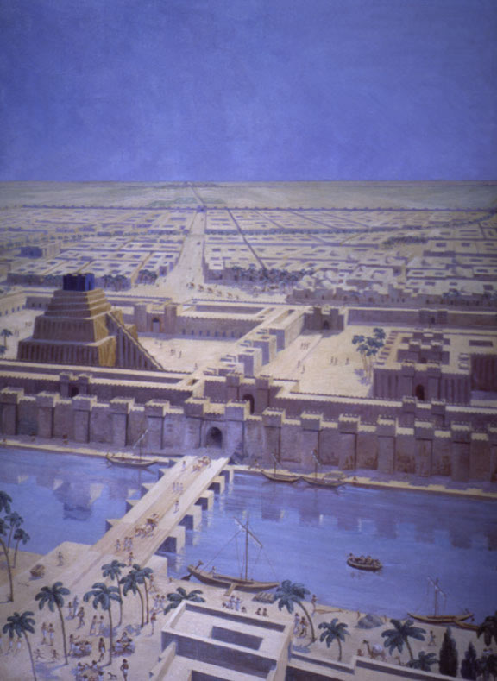
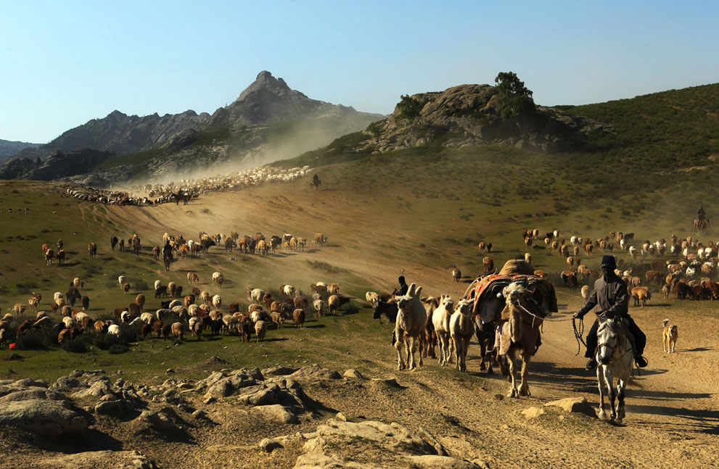
Which Came First?
Cities or Nomads?

Slide 3
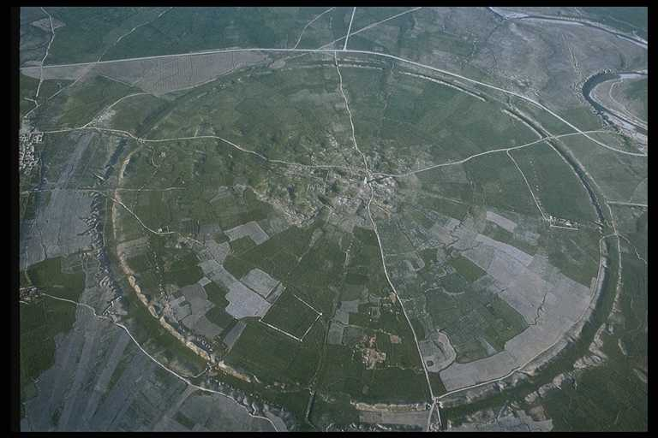
Cities and Nomads
Gur, Firuzabad, Iran

Slide 4
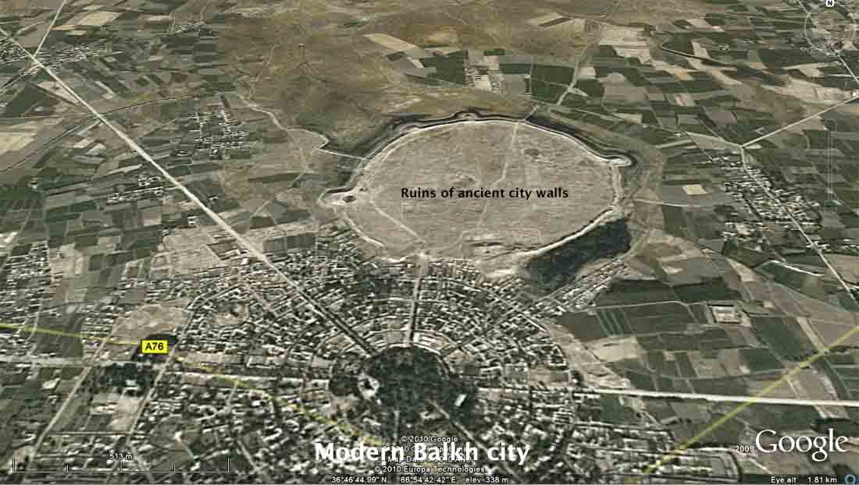
Balkh: Mother of Cities

Slide 5
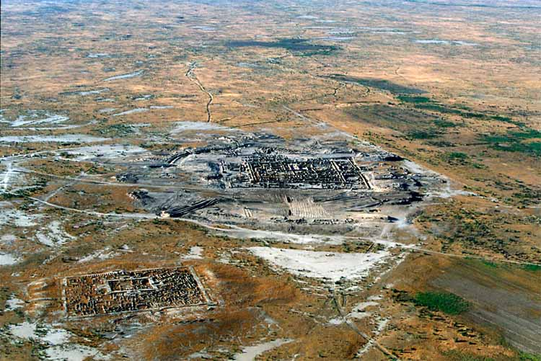
Gonurdepe and the Bactria-Margiana Civilization

Slide 6
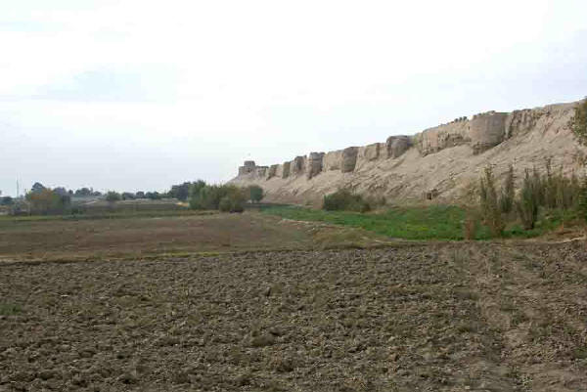
Balkh: Mother of Cities

Slide 7
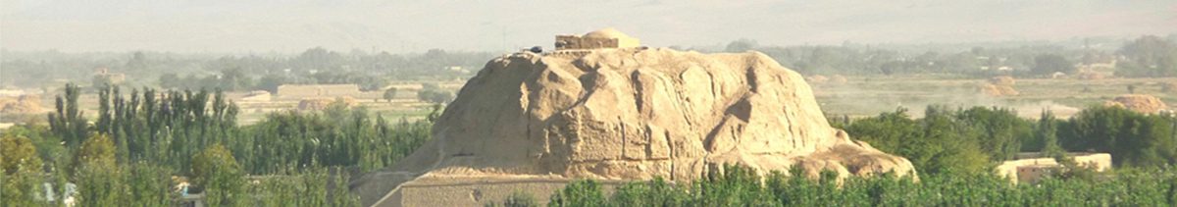
Naw Bahar

Slide 8
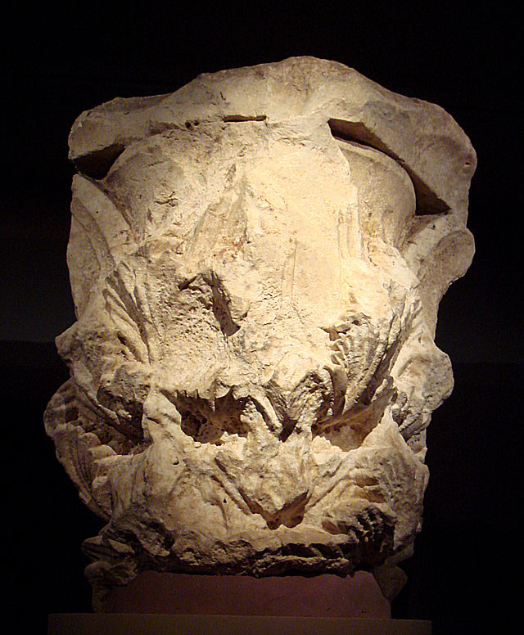
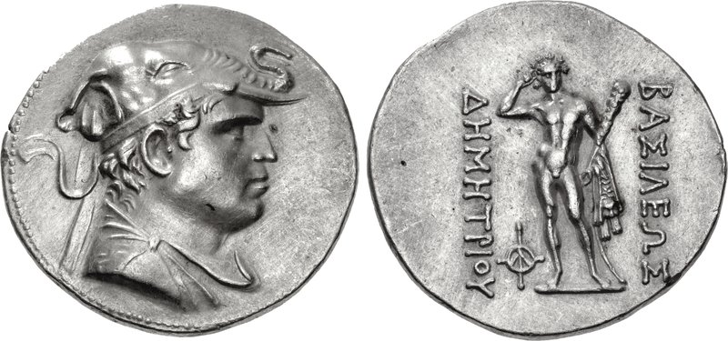
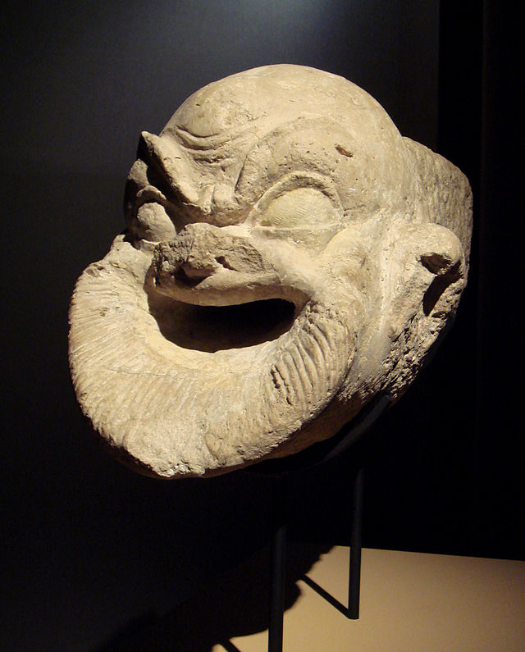
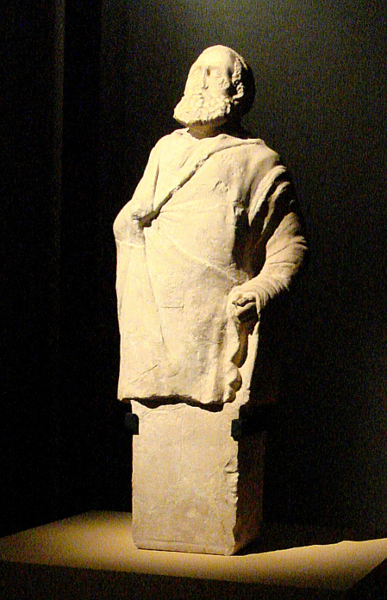
Greco-Bactrian Kingdom (r. 250-125BC)

Slide 9
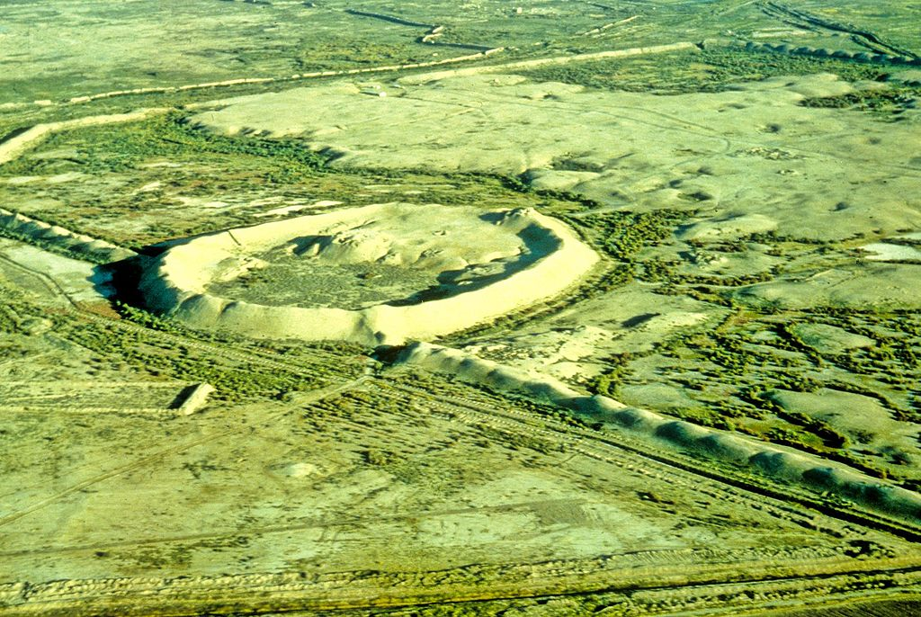
Marw (Merv), Turkmenistan

Slide 10
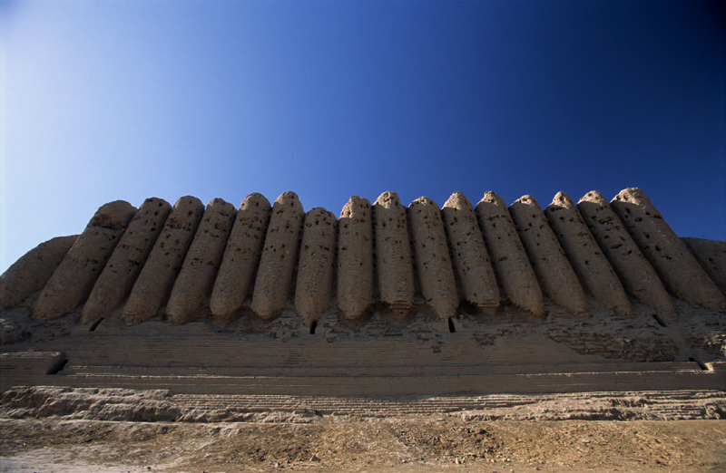
Walls of Marw

Slide 11
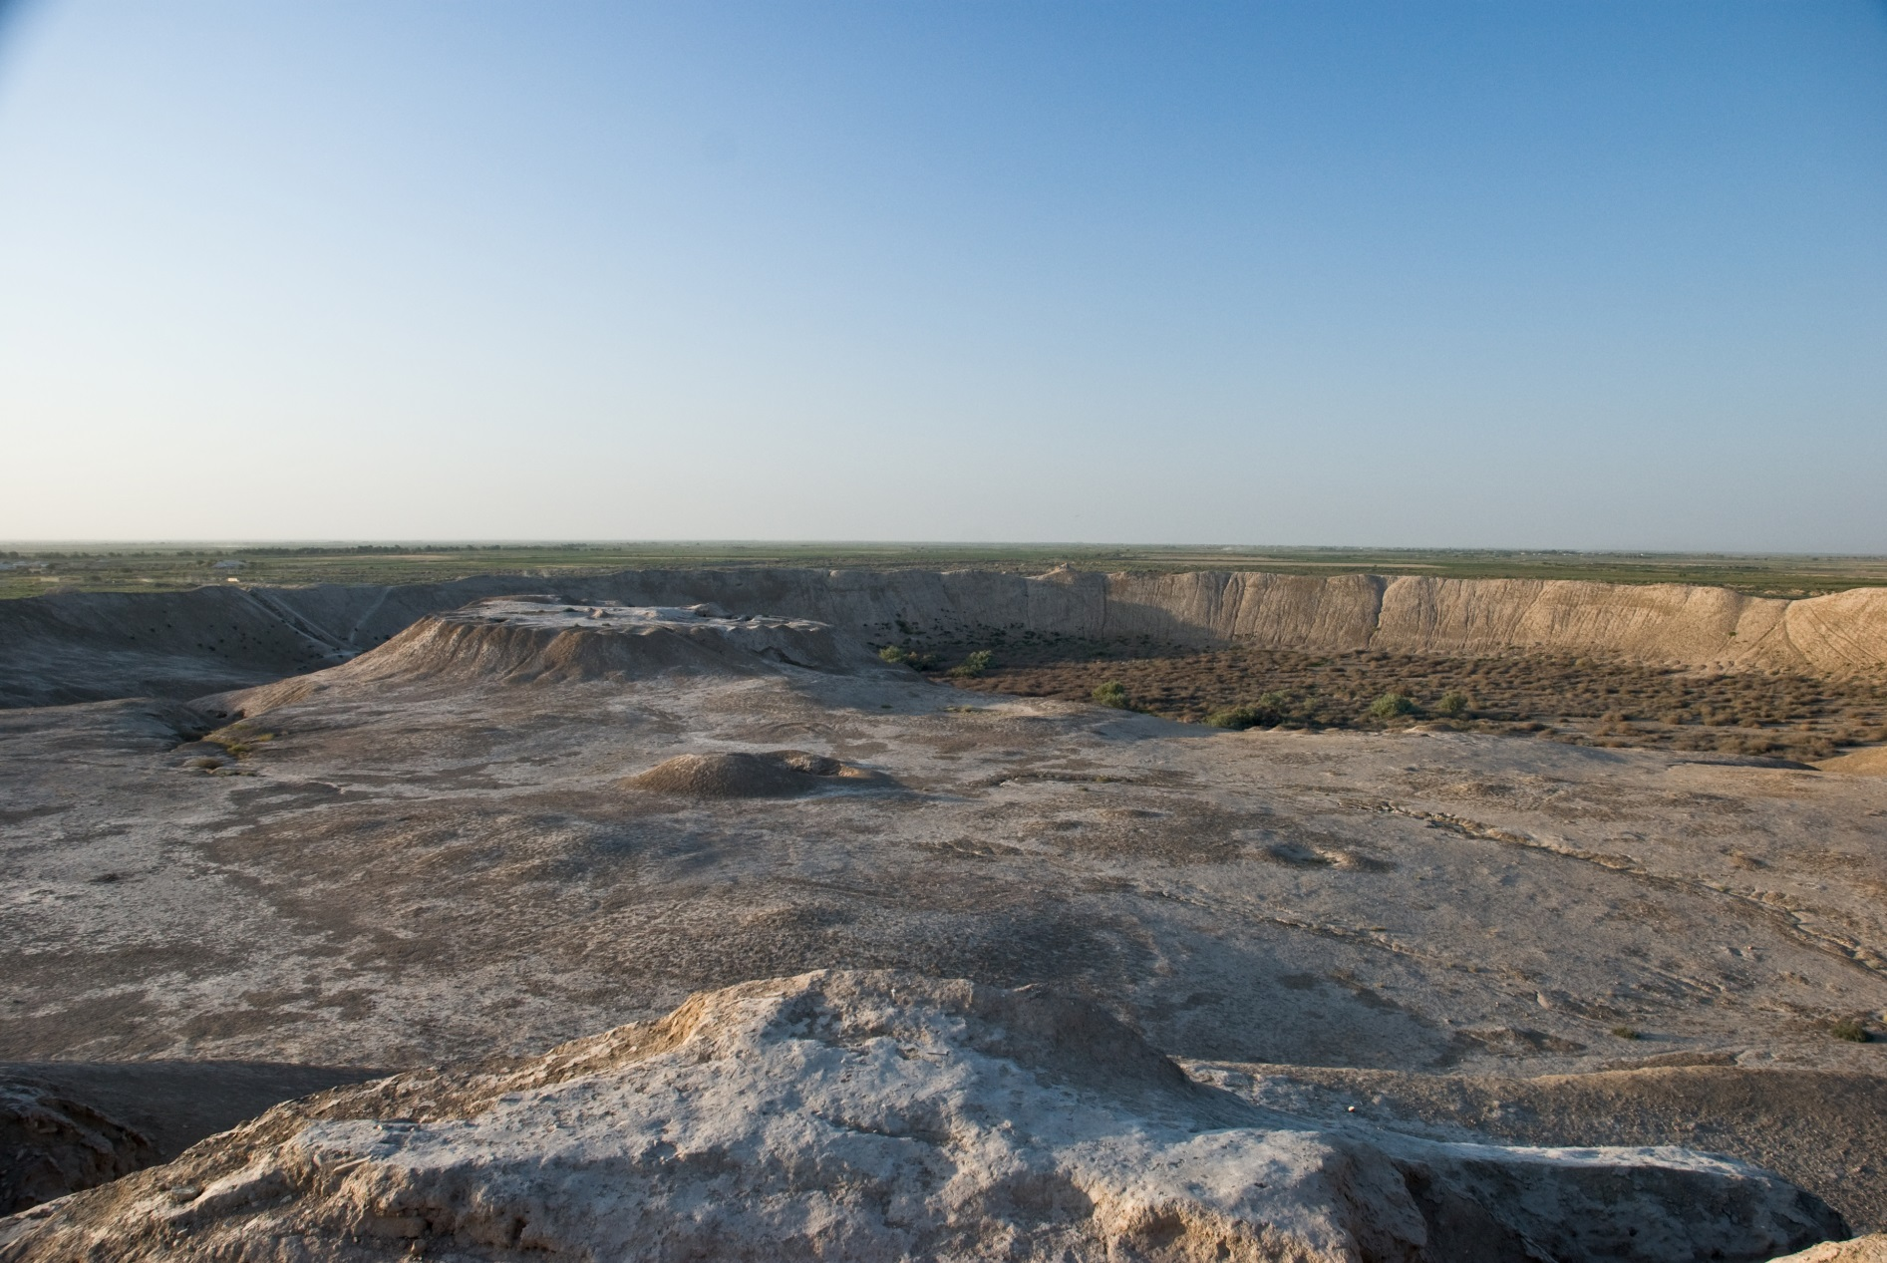
Excavating Inside Marw

Slide 12
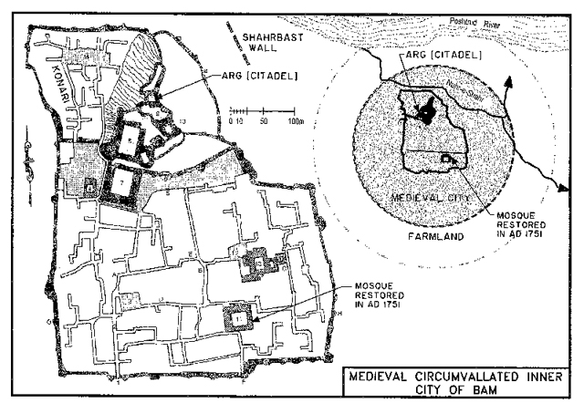
Bam and the Persian City

Slide 13
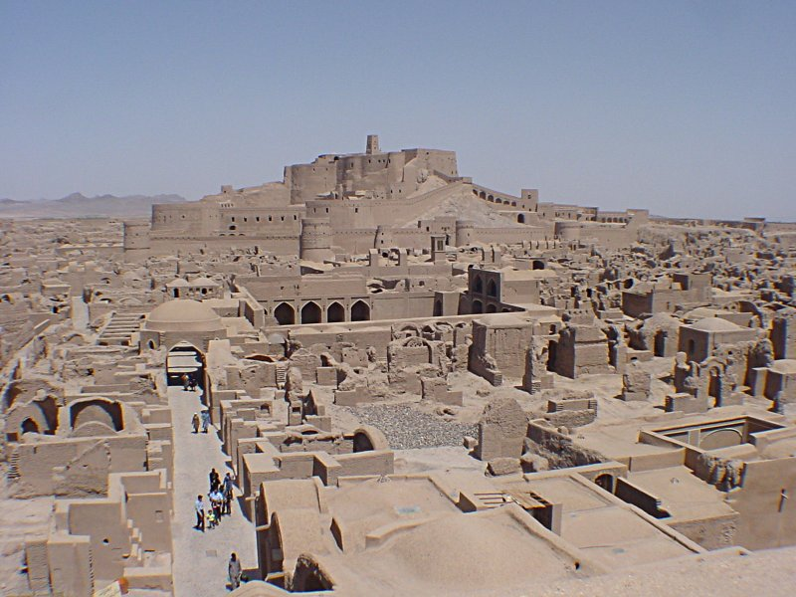
Arg-e Bam (ca. 500 BC)

Slide 14
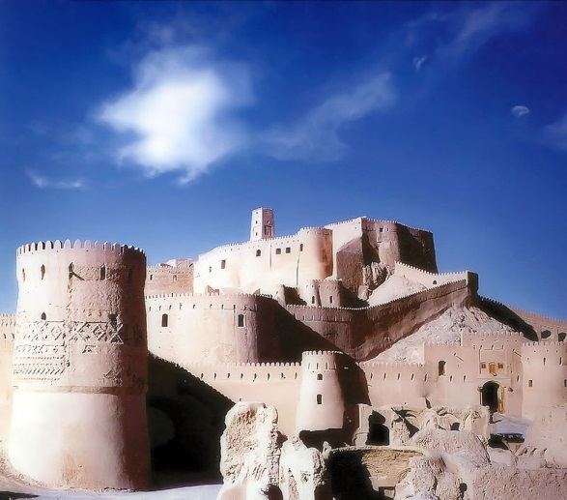
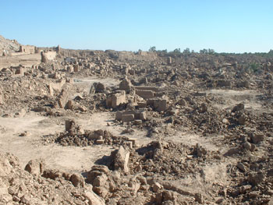
2003 Earthquake in Bam

Slide 15
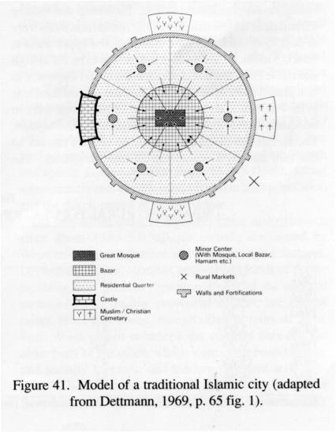
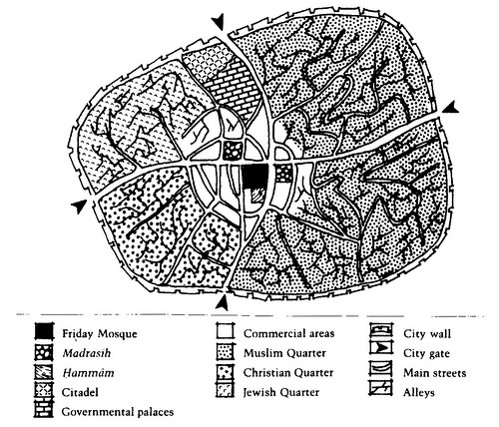

Slide 16
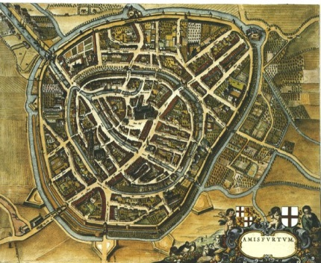

Slide 17
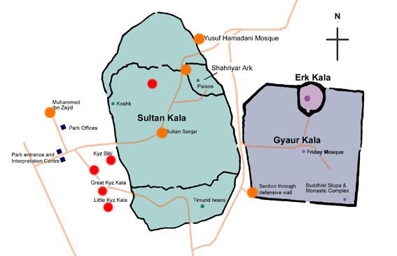
Pre-Islamic and Islamic Marw

