Slide 1
Setting the Stage:
Geography
HIST 3035
8/27/14

Slide 2
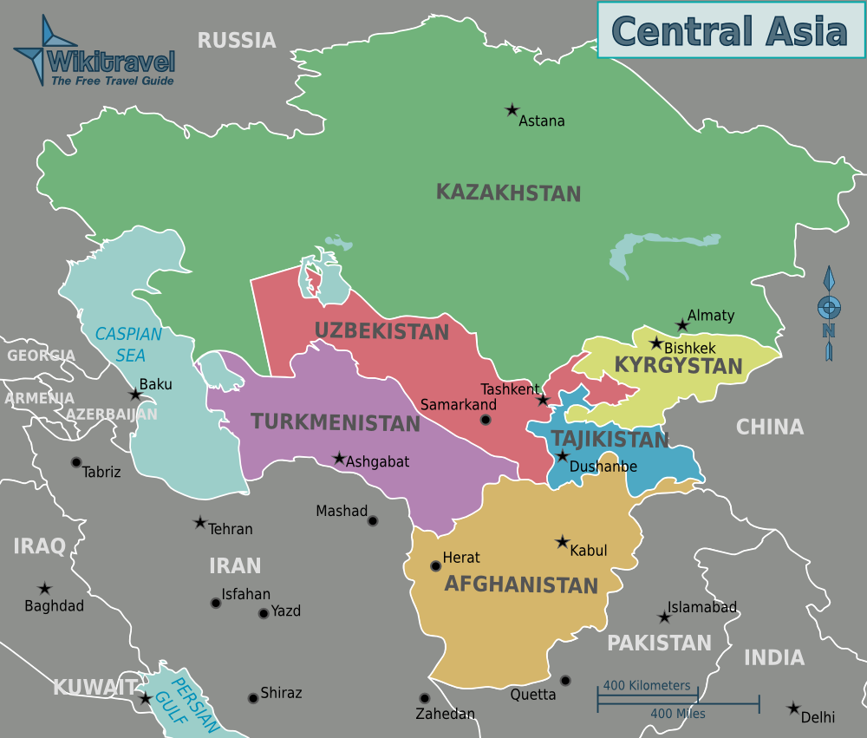

Slide 3
How Big is Central Asia?
Kazakhstan – 1,052,085 sq mi
CARS – 1,545,715 sq mi
+ Afghanistan – 1,797,487 sq mi
+ Mongolia – 2,401,396 sq mi
+ Xinjiang – 3,042,326 sq mi
India – 1,269,346 sq mi
Australia – 2,969,907 sq mi
Continental US – 3,119,885 sq mi

Slide 4
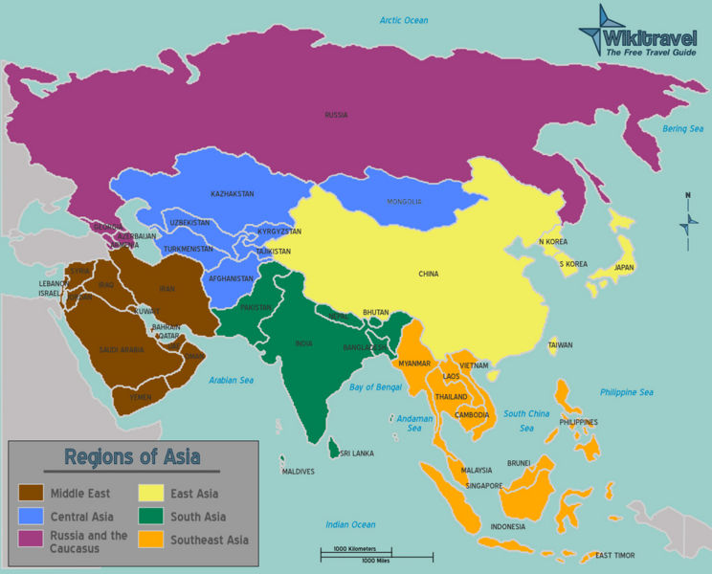

Slide 5
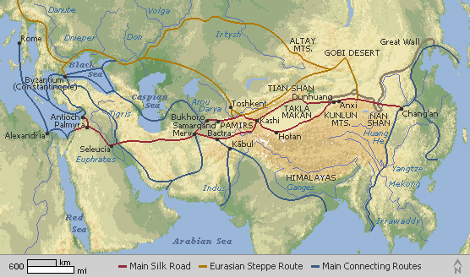

Slide 6
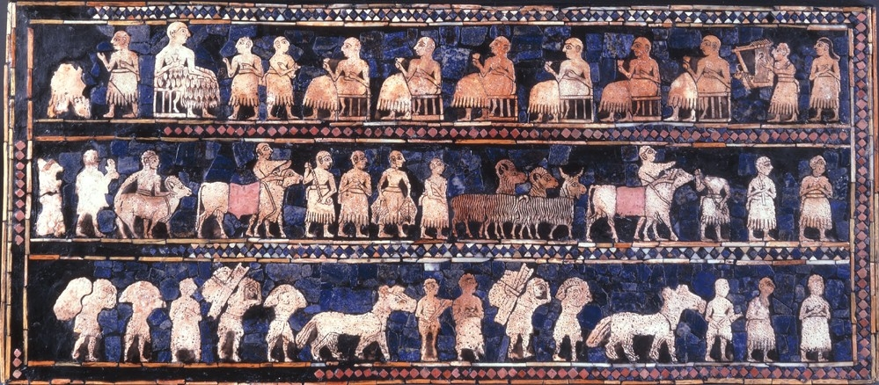
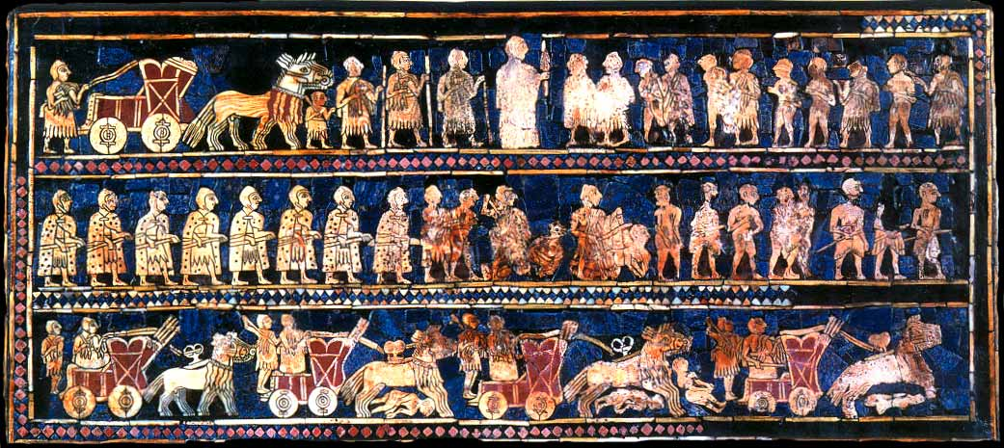

Slide 7
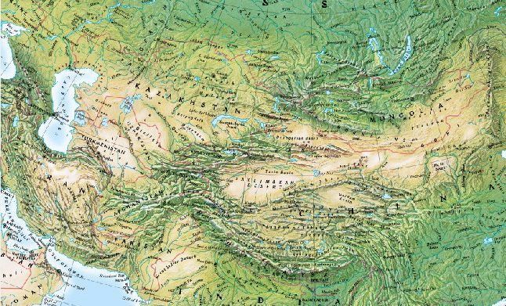

Slide 8
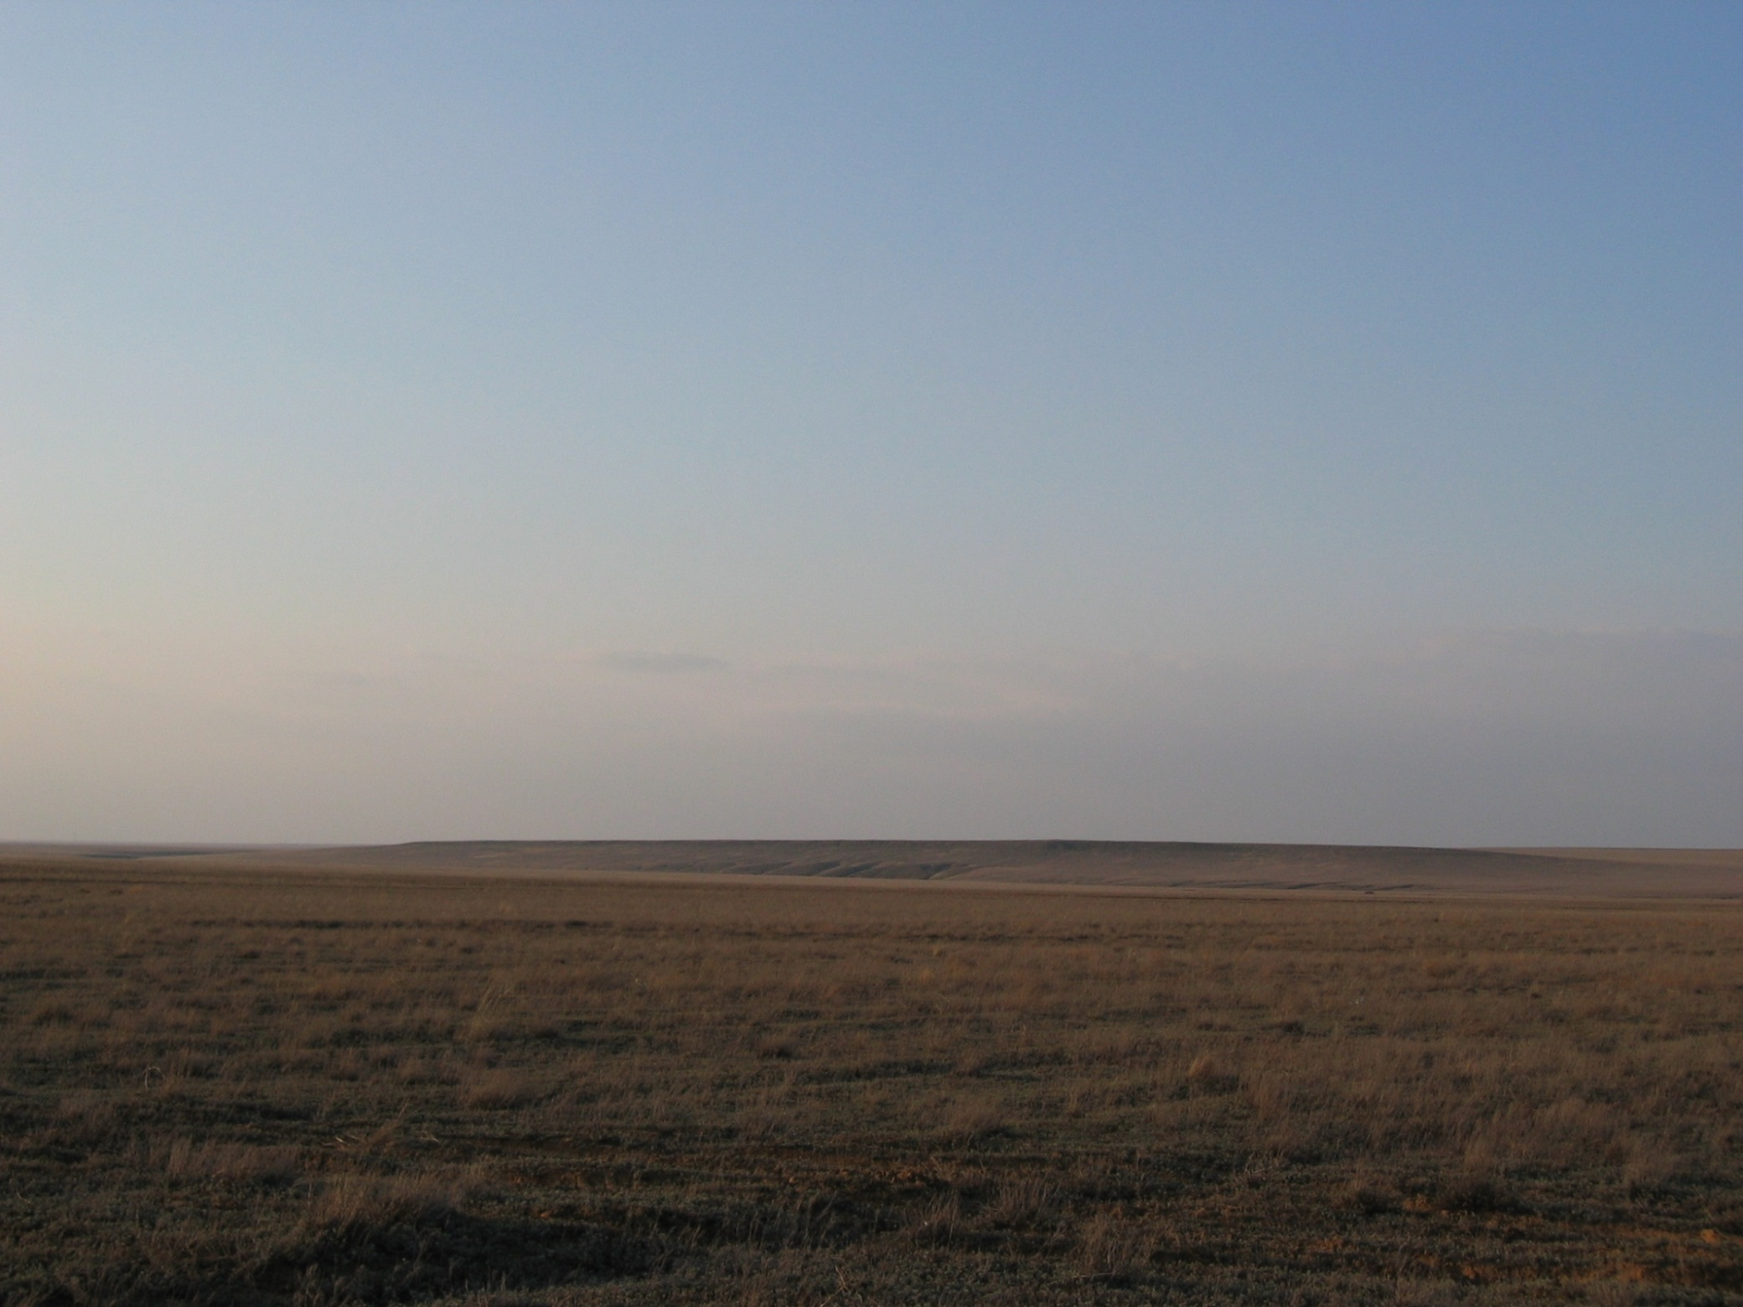
Western Kazakhstan

Slide 9
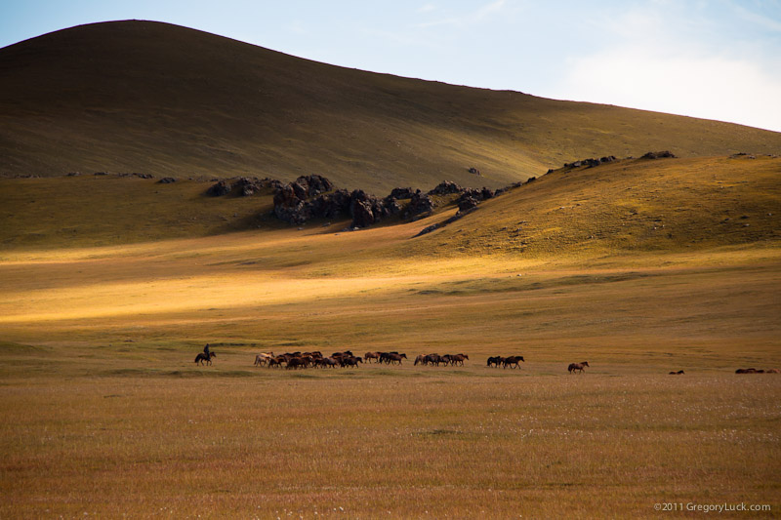
Herding in Mongolia

Slide 10
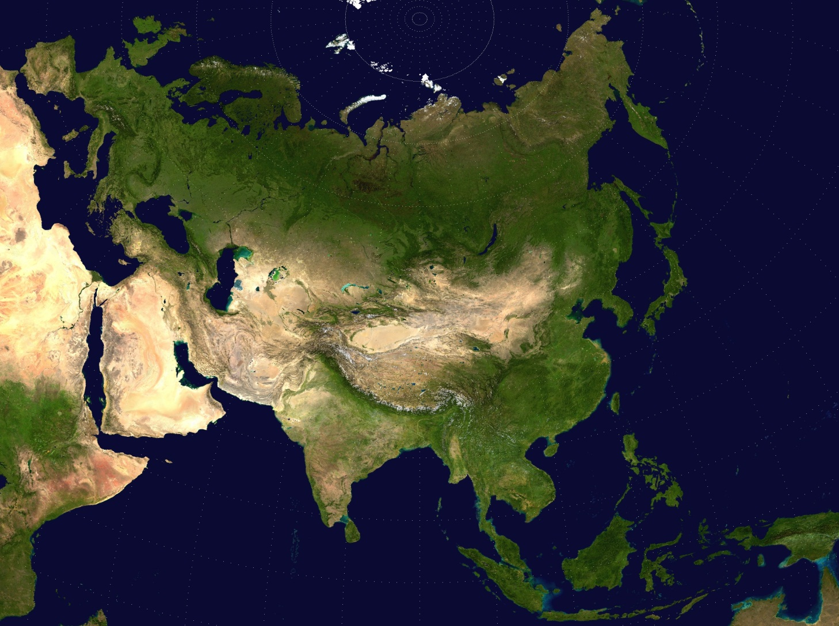

Slide 11
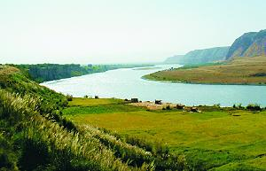
Amu Darya

Slide 12
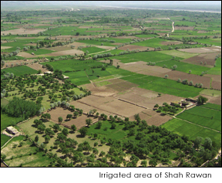

Slide 13
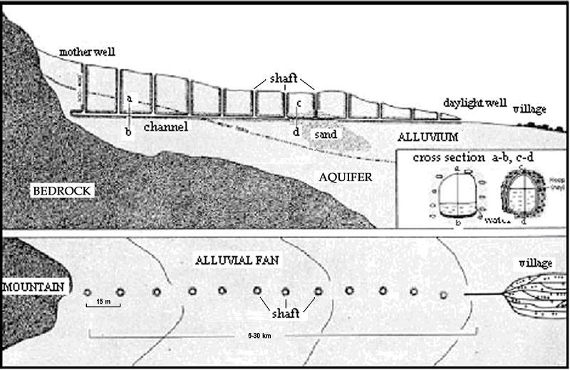
Qanat or karez

Slide 14
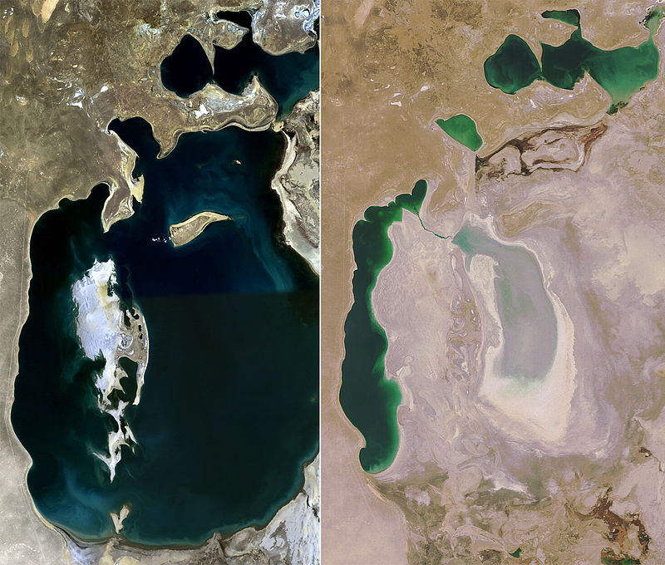
Aral Sea: 1989 vs. 2008

Slide 15
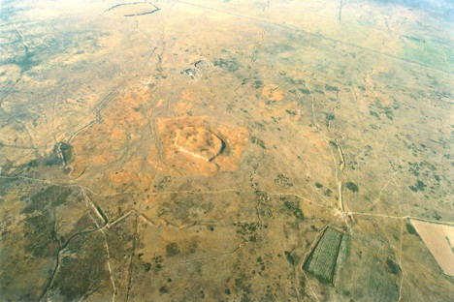
Medieval Sauran in Karatobe Kazakhstan

Slide 16
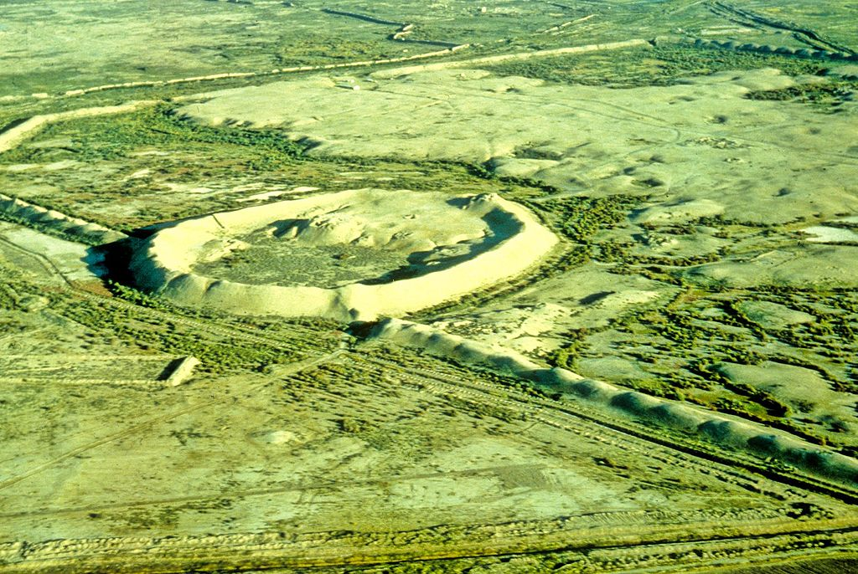
Marw, Turkmenistan

Slide 17
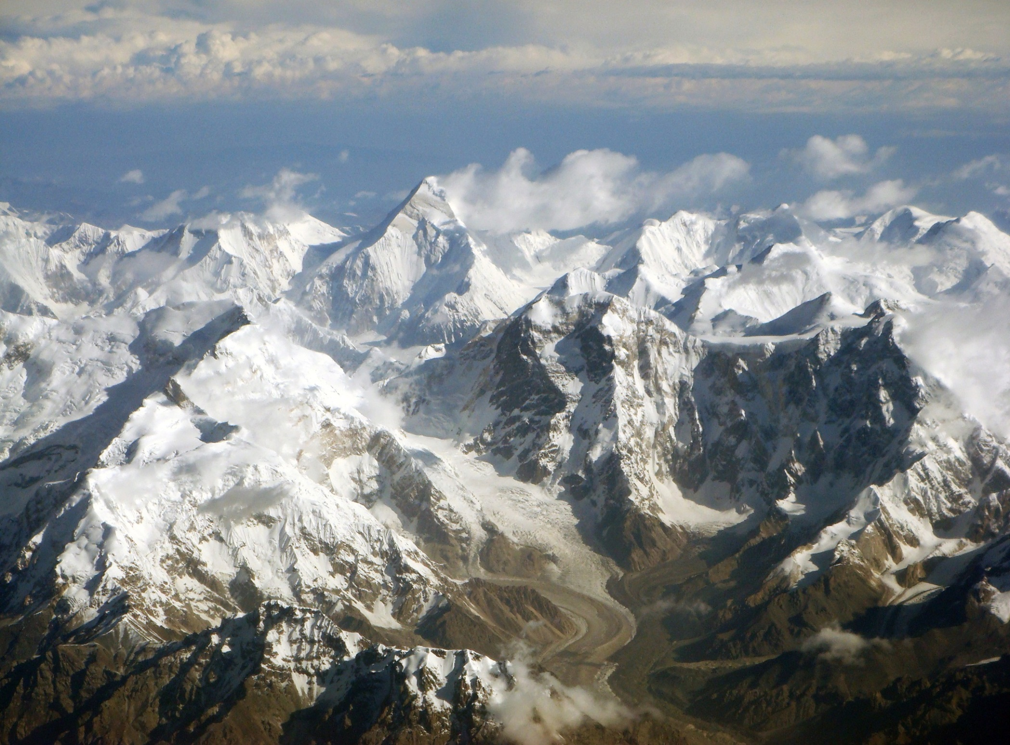
Pamir Mountains – The Roof of the World

Slide 18
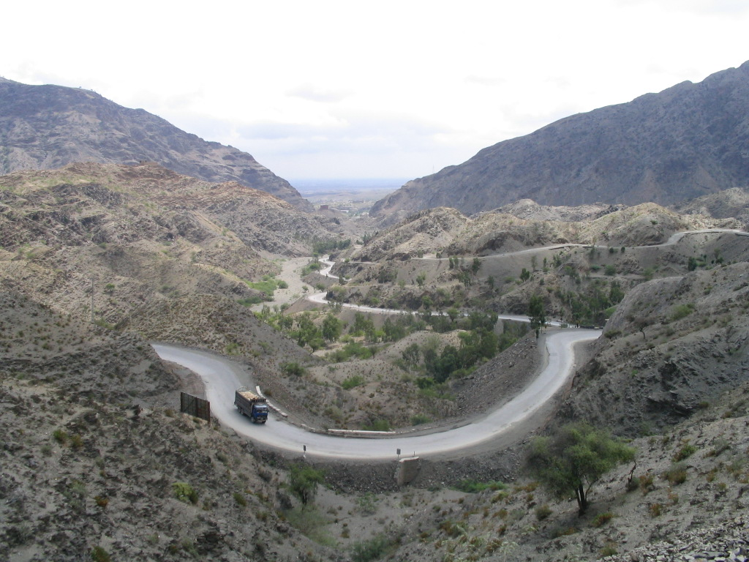
Khyber Pass

Slide 19
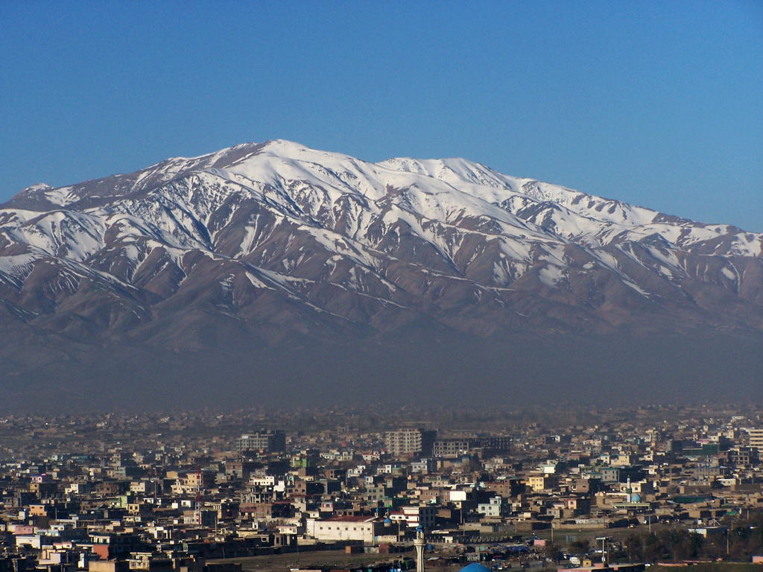
Kabul and the Hindu Kush mountains

